Slide 1
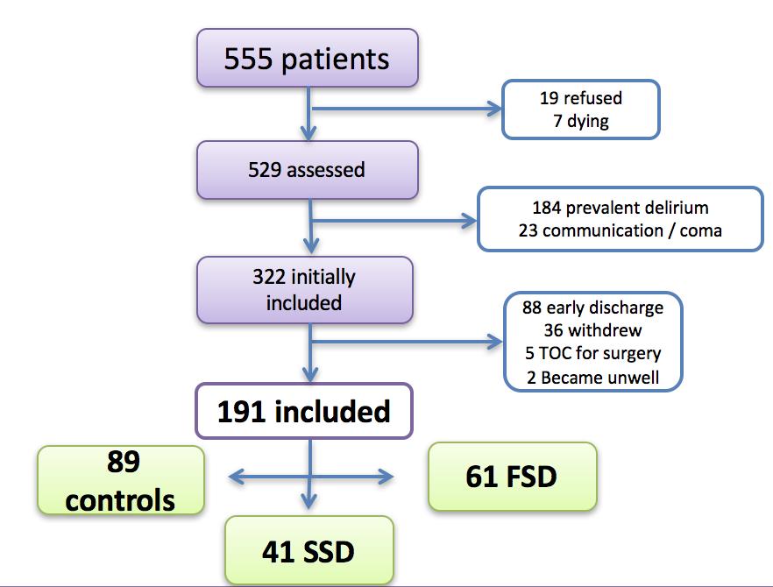
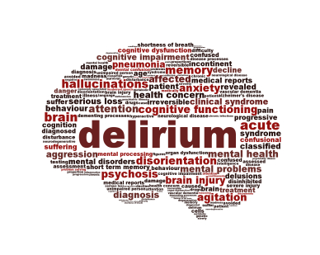
Outcomes of Delirium and Subsyndromal Delirium in Older Medical Inpatients Robert De Santis¹, James Fitzgerald, Dimitrios Adamis, DW Molloy, Suzanne Timmons, David Meagher, Niamh O’Regan¹ ¹ St. Joseph’s Healthcare, Schulich School of Medicine and Dentistry, Western University
Study Rationale
Methods: Delirium Rating Scale-Revised 98 (DRS-R98
Results
- It comprises 16 items which rate 13 severity features (from 0 to 3) and three diagnostic features (from 0 to 2 or 3) - It can distinguish delirium from other neuropsychiatric conditions, such as dementia and depression - FSD is present if severity score was ≥15 and / or if the total score was ≥18 - SSD present if the DRS-R98 total score was between 6 and 17 (inclusive), and had acute onset and evidence of inattention (This definition was based on previous work conducted by our research group^{1.})
-Delirium is a complex medical illness characterized by acute change in cognition with inattention and fluctuating symptoms
-Subsyndromal delirium (SSD is the presence of certain delirium features without fully meeting full-syndromal delirium (FSD) thresholds.
- SSD is an important disease state to recognize because:
SSD is prevalent across the acute hospital, occurring in 7-50%¹. (Variance is due to differences between different hospital settings studied and differences between the tools used for defining SSD.)
SSD is not a benign condition. Outcomes are shown to be intermediate between patients with no delirium and those with FSD^{2,3}
 | Table 1: DRS-R98 Item List
 | Severity items
1. | Sleep-wake cycle disturbance | 0-3
2. | Perceptual disturbances & hallucinations | 0-3
3. | Delusions | 0-3
4. | Lability of affect | 0-3
5. | Language | 0-3
6. | Thought process abnormalities | 0-3
7. | Motor agitation | 0-3
8. | Motor retardation | 0-3
9. | Orientation | 0-3
10. | Attention | 0-3
11. | Short-term memory | 0-3
12. | Long-term memory | 0-3
13. | Visuospatial ability | 0-3
 | Diagnostic Items
14. | Temporal onset of symptoms | 0-3
15. | Fluctuation of symptom severity | 0-2
16. | Physical disorder | 0-3
 | Table 2: Results At Discharge
 | Mortality n (%) | Admitted to Nursing Home n (%) | Composite Score n (%)
Control | 0 (0.0%) | 0 (0.0%) | 0 (0.0%)
SSD | 2 (4.9%) | 1 (2.4%) | 3 (7.3%)
FSD | 1 (1.6%) | 3 (4.9%) | 4 (6.6%)
 |  |  | p<0.001
 | Table 3: Results At 6 Month Follow-up
 | Mortality n (%) | Admitted to Nursing Home n (%) | Composite Score n (%)
Control | 4 (4.5%) | 2 (2.3%) | 6 (6.7%)
SSD | 9 (22%) | 1 (2.4%) | 10 (24.4%)
FSD | 10 (16.4%) | 5 (8.2%) | 15 (24.5%)
 |  |  | p=0.002
Purpose
To evaluate the difference in the rate of negative outcomes in older medical inpatients with incident full-syndromal delirium, subsyndromal delirium, or no delirium.
Results: Patient Inclusion
Methods
This was a prospective cohort study.
2. Inclusion criteria required study subjects to be medical inpatients that were ≥70 years old.
3. All study subjects were assessed within 36 hours of presentation to the Emergency Department
4. Patients with prevalent delirium were excluded.
5. Daily assessments for full-syndromal delirium and subsyndromal delirium were conducted by nursing staff.
6. Full-syndromal delirium and subsyndromal delirium scores were all calculated using Delirium Rating Scale-Revised 98 (DRS-R98) by author NO’R.
7. Outcome measures were mortality and admittance to nursing home. These were captured at discharge and at 6 months follow-up.
8. Statistical analysis was calculated using Fisher’s Exact test, with the alpha= 0.05
Conclusion
1. SSD was associated with poor outcomes equivalent to those with FSD.
2. Our findings add to the existing literature suggesting that delirium and SSD occur along a continuum
3. It is important to look out for all presentations of delirium (SSD and FSD) in clinical practice, as neither are benign.
.
Acknowledgements
References:
\We would like to thank:
Health Research Board, Ireland
Centre for Gerontology and Rehabilitation, School of Medicine, University College Cork
Division of Geriatric Medicine, Department of Medicine, Schulich School of Medicine and Dentistry, Western University
All the patients and care-givers who participated in this study.
1. Meagher D, O'Regan N, Ryan D, Connolly W, Boland E, O'Caoimhe R, et al. Frequency of delirium and subsyndromal delirium in an adult acute hospital population. The British journal of psychiatry : the journal of mental science. 2014;205(6):478-85. Epub 2014/11/02.
2. Marcantonio E, Ta T, Duthie E, Resnick NM. Delirium severity and sychomotor types: their relationship with outcomes after hip fracture repair. Journal of the American Geriatrics Society. 2002;50(5):850-7. Epub 2002/05/25.
3. Dosa D, Intrator O, McNicoll L, Cang Y, Teno J. Preliminary derivation of a Nursing Home Confusion Assessment Method based on data from the Minimum Data Set. Journal
4. Trzepacz PT, Mittal D, Torres R, Kanary K, Norton J, Jimerson N. Validation of the Delirium Rating Scale-revised-98: comparison with the delirium rati
ng scale and the cognitive test for delirium. The Journal of neuropsychiatry and clinical neurosciences. 2001;13(2):229-42. Epub 2001/07/13.
5. Adamis D, Treloar A, MacDonald AJ, Martin FC. Concurrent validity of two instruments (the Confusion Assessment Method and the Delirium Rating Scale) in the detection of delirium among older medical inpatients. Age and ageing. 2005;34(1):72-5. Epub 2004/12/14.

