Slide 1


Society for Co-operative Studies in Ireland
Co-operatives for Sustainability Second level programme Teachers slides
UNIT 6
CO-OPERATIVES AND SDG 13: CLIMATE ACTION, REGULATING AND REDUCING EMISSIONS, AND PROMOTING RENEWABLE ENERGY.

Slide 2

Quiz

Slide 3
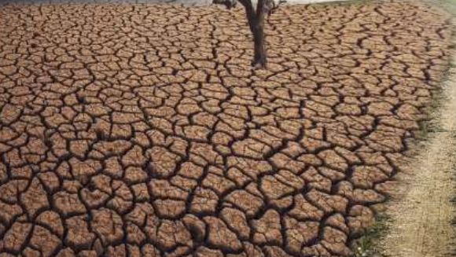
True or False
Those living in poverty are the hardest hit by climate change despite being the least responsible for the crisis.

Slide 4
True or False
Those living in poverty are the hardest hit by climate change despite being the least responsible for the crisis.
True

Slide 5
….Climate change is forcing people from their homes, bringing poverty on top of poverty and increasing hunger.
According to Oxfam, people in poorer countries are at least four times more likely to be displaced by extreme weather than people in rich countries. And 2020 research estimates that climate change will drive as much as 132 million into poverty by 2030.
Source: https://blogs.worldbank.org/climatechange/covid-climate-change-and-poverty-avoiding-worst-impacts
Climate change is a particularly acute threat for countries in Sub-Saharan Africa and South Asia — the regions where most of the global poor are concentrated. In a number of countries, a large share of the poor live in areas that are both affected by conflict and facing high exposure to floods — for example, Nepal, Cameroon, Liberia, and the Central African Republic.

Slide 6
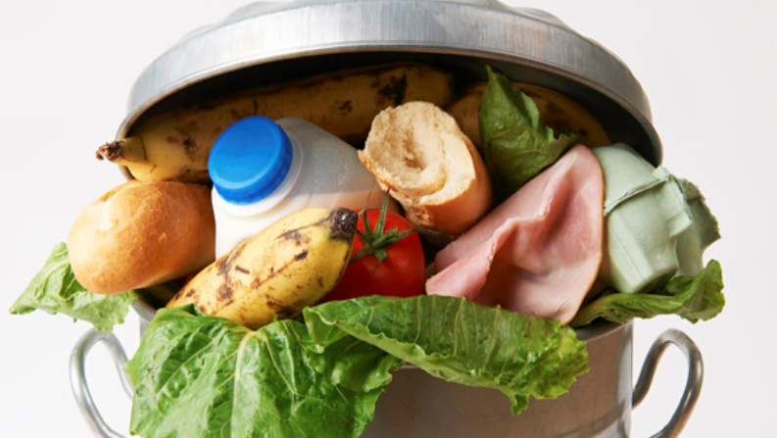
True or False
An estimated 931 million tonnes of food – 17% of all food available to consumers, or the equivalent of about 23 million fully loaded 40-tonne trucks – went into trash bins in 2019.

Slide 7
True or False
An estimated 931 million tonnes of food – 17% of all food available to consumers, or the equivalent of about 23 million fully loaded 40-tonne trucks – went into trash bins in 2019. True
Source: Food Waste Index Report, published by the United Nations Environment Programme (UNEP), March 2021

Slide 8
…..As wasted food rots, it emits methane, a powerful greenhouse gas which, according to the UN, has a 100-year global warming potential 25 times that of CO2.
Source: Food Waste Index Report, published by the United Nations Environment Programme (UNEP), March 2021

Slide 9
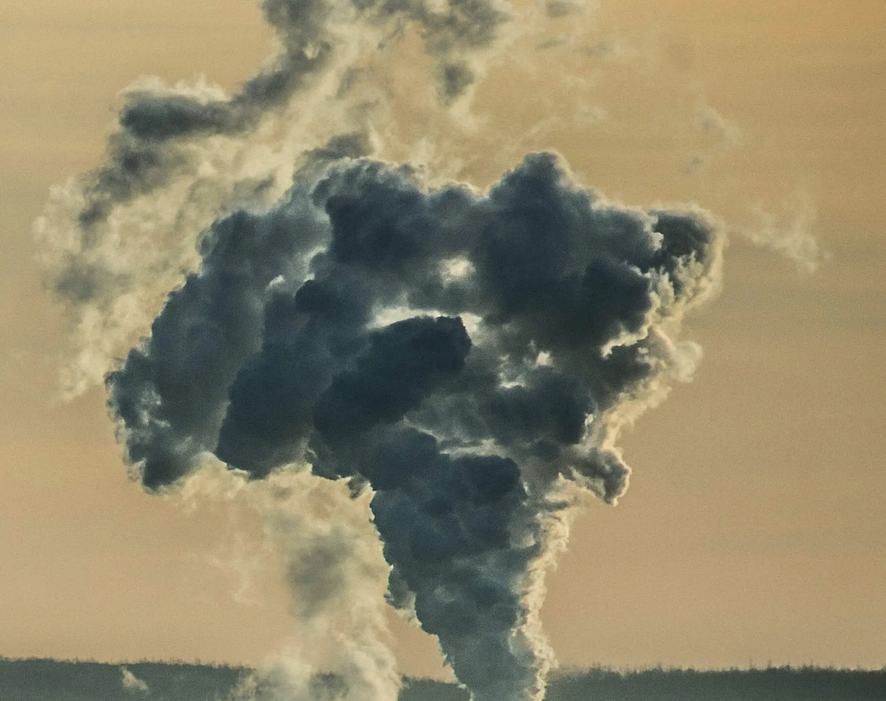
True or False
Buying just one white cotton shirt produces the same amount of emissions as driving 40 kilometres in a car

Slide 10
True or False
Buying just one white cotton shirt produces the same amount of emissions as driving 40 kilometres in a car
False

Slide 11
…..Buying one white shirt produces the same amount of emissions as driving 56 km in a car, so even more than the above.
Source: Oxfam. Based on statistical analysis of WRAP (2016) Valuing Our Clothes: The Cost of UK Fashion

Slide 12
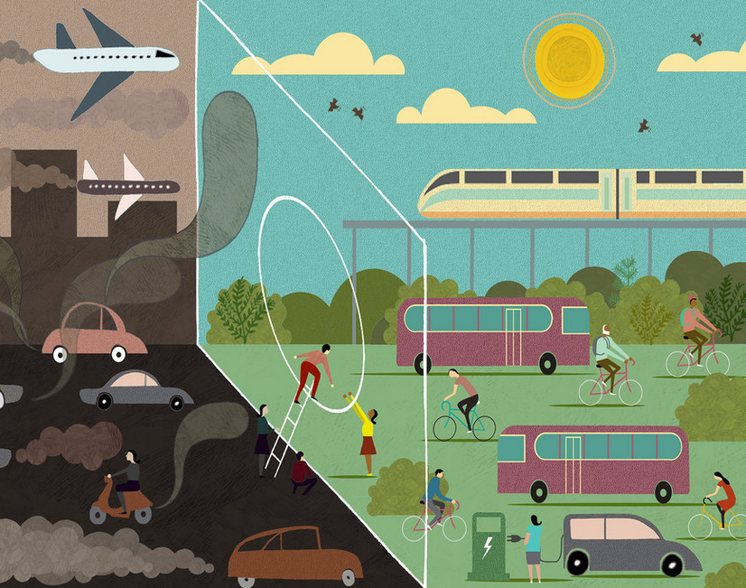
True or False
We need to cut CO2 emissions almost in half (43%) by 2030

Slide 13
True or False
We need to cut CO2 emissions almost in half (43%) by 2030
True
Source: IPCC (2022) ‘Mitigation of Climate Change’ Sixth Assessment report

Slide 14
…Limiting the use of fossil fuels such as oil, carbon and natural gas and replacing them with renewable and cleaner sources of energy is one way of doing this.

Slide 15
https://www.youtube.com/watch?v=hIcJCwvTFfg Video: Climate action targets. Produced by the World Meterological Organization. Duration: 1 min, 48 sec.

Slide 16
DUBLIN FOOD CO-OPERATIVE
As you watch the video, note three ways in which the Dublin Food Co-op supports climate action through its focus on sustainability.
‘How Can Co-operatives Work in Your Community’ Produced by the SCSI. Duration 3 mins, 41 secs LINK REQUIRED

Slide 17

Community co-operatives and renewable energy
True or False
In 2016, more money was invested by the world’s 20 largest economies in renewable sources of energy (e.g. wind, water) than in fossil fuels (e.g. coal, petroleum, natural gas)?

Slide 18
Community co-operatives and renewable energy
True or False
In 2016, more money was invested by the world’s 20 largest economies in renewable sources of energy (e.g. wind, water) than in fossil fuels (e.g. coal, petroleum, natural gas)?
FALSE

Slide 19
…..almost four times more money was invested in fossil fuels, which increase greenhouse emissions.
Source: Carringdon, D (2017) ‘G20 public finance for fossil fuels 'is four times more than renewables’ The Guardian, 5 July 2017

Slide 20

True or False
One third of all European Union (EU) citizens could be producing their own electricity by 2050, and meeting 25% of the EU’s electricity demand

Slide 21
True or False
One third of all European Union (EU) citizens could be producing their own electricity by 2050, and meeting 25% of the EU’s electricity demand
FALSE

Slide 22
……The actual estimates are that half of all EU citizens could produce their own electricity by 2050, meeting 45% of the EU’s electricity demand, according to research undertaken by Greenpeace, the European Renewable Energy Federation (EREF), Friends of the Earth Europe and REScoop.eu in 2016.
It is estimated that co-operatives and collectives could generate 37% of this energy.
Source: RESCOOP (2020) Mobilising European citizens to Invest in Sustainable Energy Clean Energy for all Europeans Final results oriented report Of the RESCOOP MECISE horizon 2020 project

Slide 23
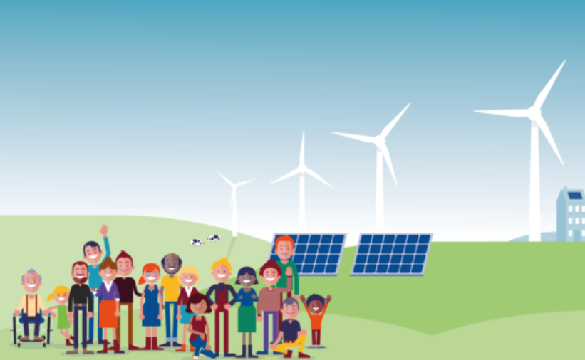
Multiple choice How many renewable energy co-operatives are there in Ireland in 2019?
2
5
90

Slide 24
Multiple choice How many renewable energy co-operatives are there in Ireland in 2019?
2
5
90

Slide 25
Multiple choice How many renewable energy co-operatives are there in Ireland in 2019?
2
5
90
In contrast there are about 2,500 European renewable energy co-operatives, located mainly in western Europe

Slide 26
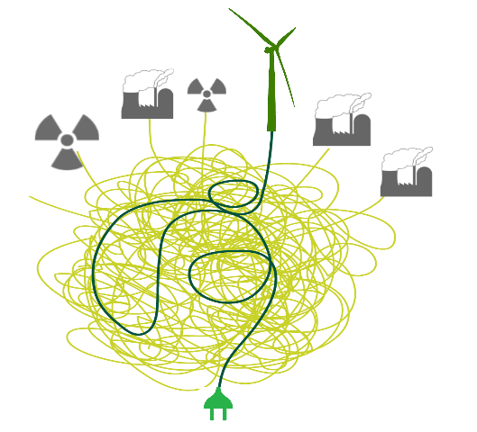
How much of Ireland’s energy did it import in 2019? Was it
14?
55?
69%

Slide 27
How much of Ireland’s energy did it import in 2019? Was it
14?
55?
69%
Source: SEAI (2020) Energy in Ireland 2020 Report

Slide 28

Video: Drumlin Energy Co-operative. Duration: 2 mins, 11 secs. https://youtu.be/FXsMJWWIUlE

Slide 29
Video: RESCoop: the energy transition to energy democracy. Produced by RESCoop. Duration: 3 mins, 29 secs. https://www.youtube.com/watch?v=ZTmeNmWEupg

Slide 30
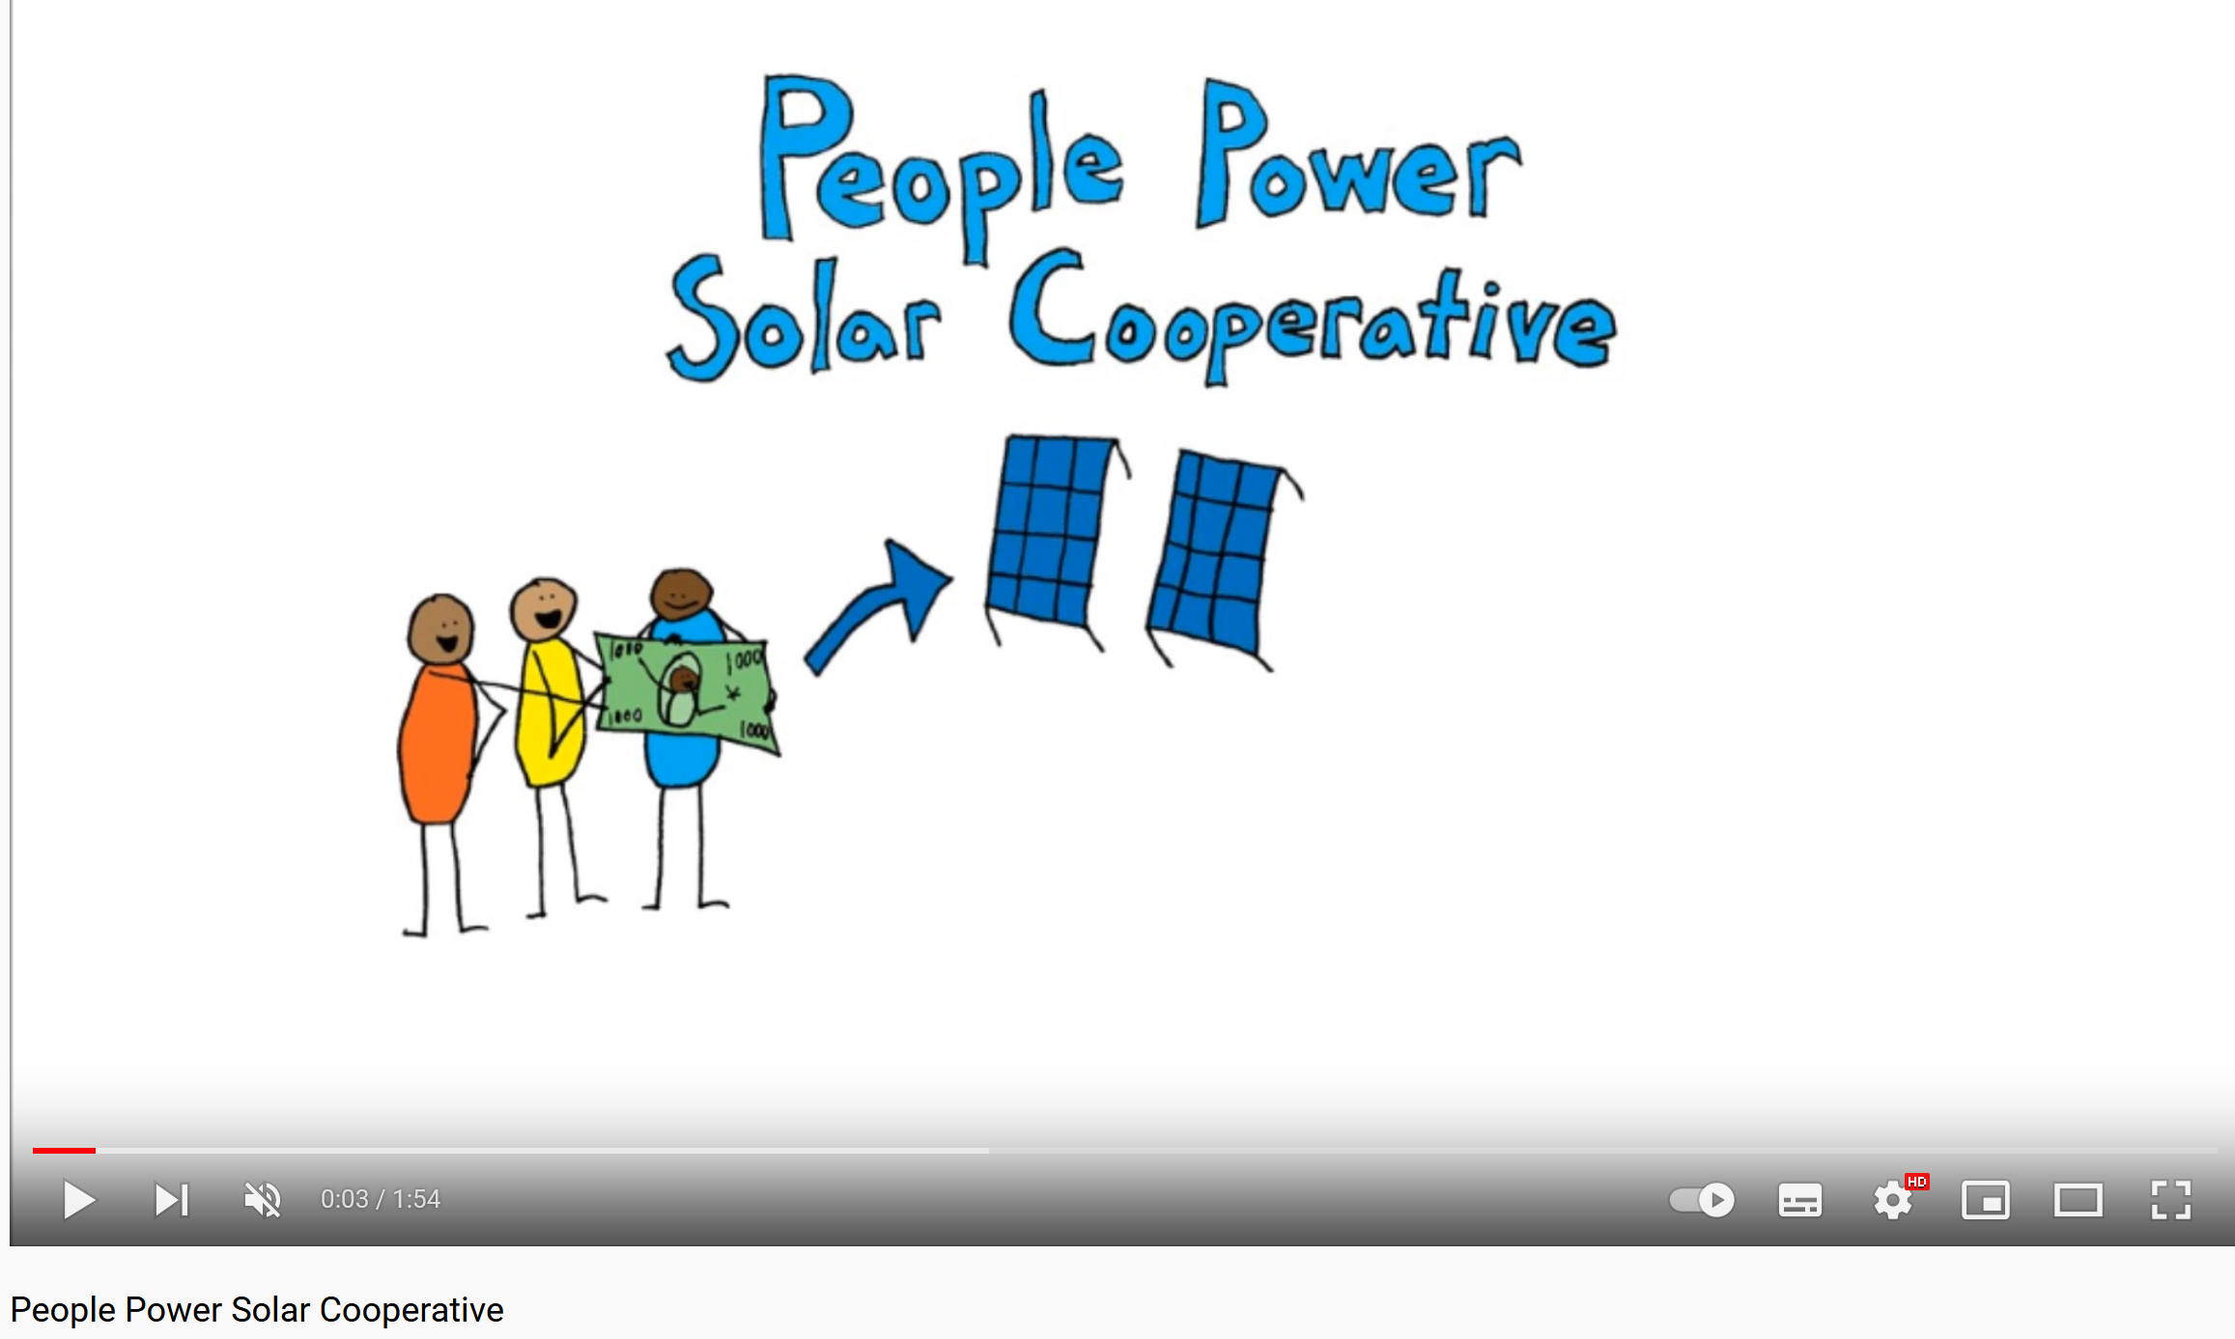
Video: People Power Solar Co-operative. Produced by Sustainable Economies Law Centre. Duration: 1 min, 54 secs. https://www.youtube.com/watch?v=6TkWRVawlXs

Slide 31
Video: Bristol Energy Co-op. Produced by Bristol Energy Co-op. Duration: 1 min, 25 secs. https://www.youtube.com/channel/UCojVboGhwWw4FZSnOY8wvwQ

