Slide 1
Society for Co-operative Studies in Ireland
Co-operatives for Sustainability Second level programme Teachers slides
UNIT 4 CO-OPERATIVES AND SDG 8: DECENT WORK AND ECONOMIC GROWTH

Slide 2
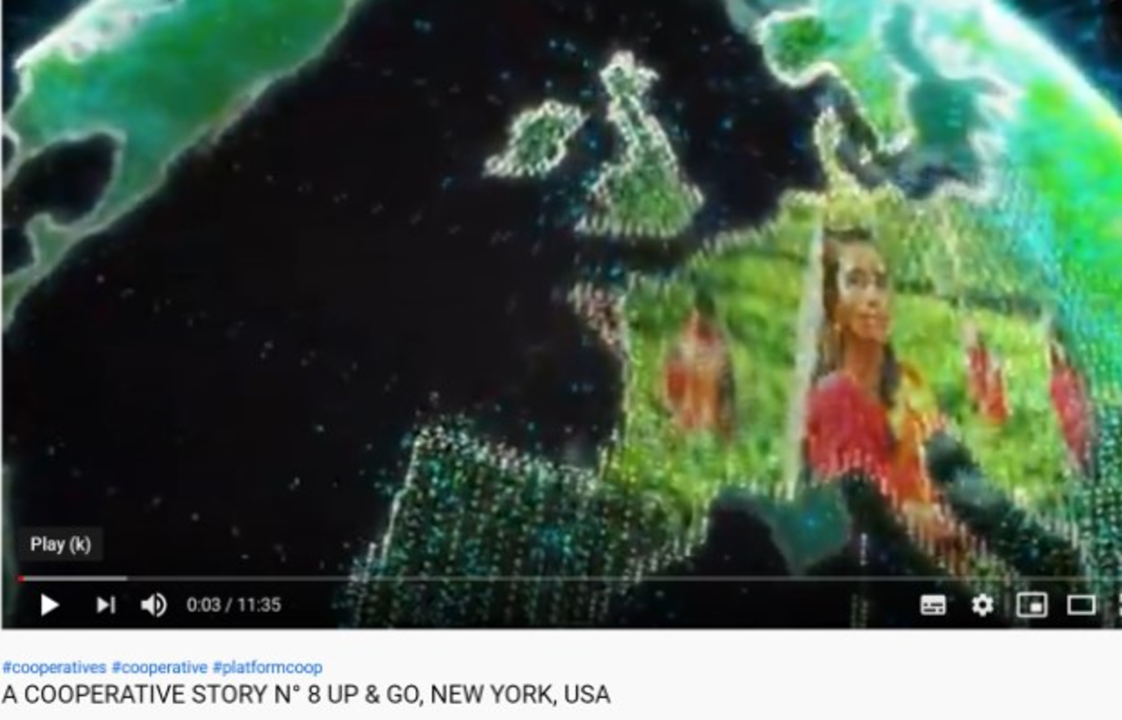
Video: A Co-operative story No. 8 Up and Go. Produced by Aroundtheworld.coop Duration: 11 mins 35 secs. https://www.youtube.com/watch?v=7QnB_jwcl3E

