Slide 1
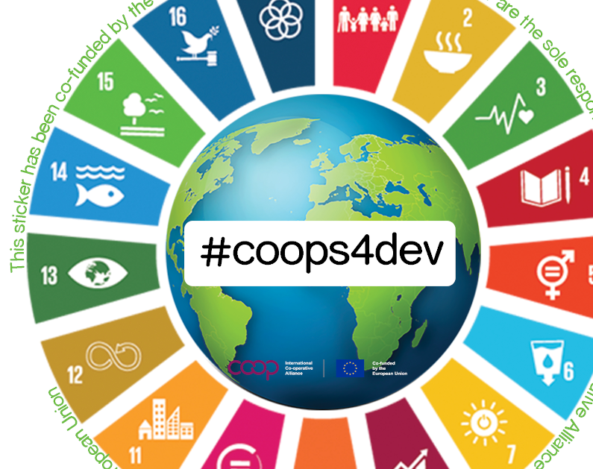
Society for Co-operative Studies in Ireland
Co-operatives for Sustainability Second level programme Teachers slides
UNIT 3 CO-OPERATIVES AND THE SUSTAINABLE DEVELOPMENT GOALS

Slide 2
Sustainable
Sustainable development

Slide 3
What do we mean by sustainability
Sustainability means meeting our own needs without compromising the ability of future generations to meet their own needs.

Slide 4
A set of solutions for the biggest problems the world faces.
The SDGs set out a vision for countries to end all forms of poverty, fight inequalities and tackle climate change, while ensuring that no one is left behind.
There are 17 SDGs which were agreed at a meeting of the United Nations in 2015.
What are they?

Slide 5
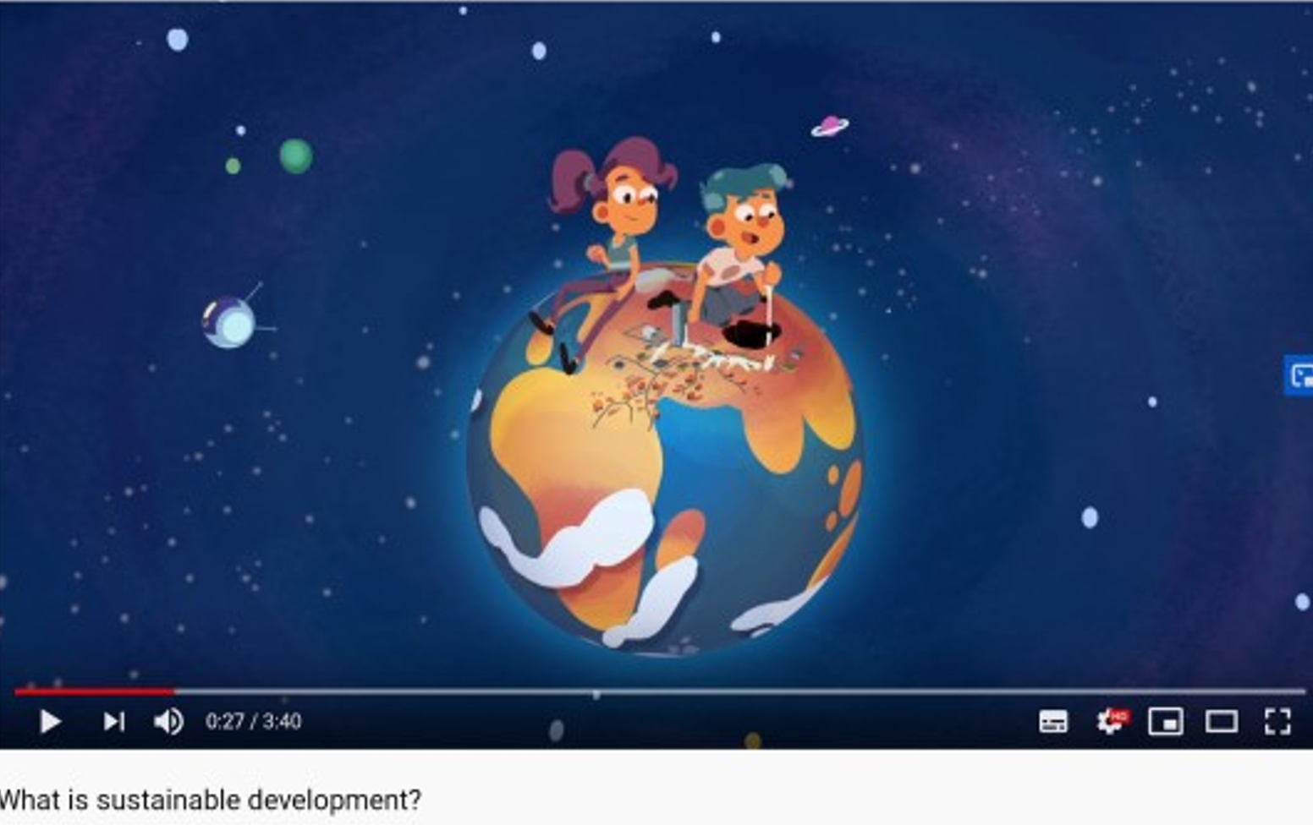
Video: What is sustainable development? Produced by Animaskin on behalf of UN Association of Norway and UNICEF Norway, Duration: 3.40 minutes. https://www.youtube.com/watch?v=7V8oFI4GYMY

Slide 6
