Slide 1


Society for Co-operative Studies in Ireland
Co-operatives for Sustainability Second level programme Teachers slides
UNIT 2
THE PIONEERS AND ORIGINS OF CO-OPERATIVES.

Slide 2

Teachers’ note
This unit is flexible – the unit allows one of the following case examples to be used:
The origins of the modern co-operative movement in the UK, or
The origin of the credit union movement in Ireland
Depending on which one the teacher chooses to use for the class session, there is required reading for students who should read these prior to the class.
Of course, if time permits, both examples can be used – this would require two classes

Slide 3
Option 1
The origins of the modern co-operative movement in the UK
Class role play or presentation
In groups of two or three, students could:
Undertake short two or three minute role play exercises in class using characters (developed as part of the homework). These role plays should reveal the experience and situation of people living in urban England.
Students will tell the class who they are and invite questions about their lives and their situation from the teacher and the class.
OR
3) Students could prepare a short presentation for the class, based on their characters about their lives.
After the presentations, some of the class could ask questions about the characters.
See homework and reading in the manual accompanying this programme (pages 21-24). The materials will need to be read by students prior to the class.

Slide 4
What was what life in England at this time like?
Robert Owen and Victorian Britain
The following video can be used which outlines what life was like and about Robert Owen.
‘Robert Owen and Victorian Britain’ Video produced by BBC Scotland as part of the Victorian Scotland series. Length: 2.06 minutes https://youtu.be/LM0SDjR6H8c

Slide 5
Group exercise and class discussion
How are the social, political, and economic conditions in Rochdale similar to life today (in Ireland, or other parts of the world)?
What do you believe were the biggest concerns facing these communities?
Do you think that a co-operative could emerge in a community such as Rochdale or similar communities?
What type of needs might it address?
What barriers or risks might it face?
Why might a co-operative form? What sort of economic activity might it undertake?
Why do you think these were significant and how might a co-operative contribute to addressing these issues?

Slide 6
Follow up homework:
WHO WERE THE ROCHDALE PIONEERS?
VIDEO: THE BEGINNINGS OF THE MODERN CO-OPERATIVE MOVEMENT
Right click on the image below (or click on the hyperlink below it).
See homework and reading in the manual accompanying this programme (pages 27-28). The materials will need to be read by students prior to the class, but some class time can be allocated to reviewing it.
The new pioneers Length: 4:50 minutes https://www.youtube.com/watch?v=KYPe5xJAm5w

Slide 7

Discussion points
What is your reaction to the Rochdale pioneers and what they did?
What do you think the impact of a co-operative shop would be in a community, compared with a privately owned shop? Give reasons for your answer?
What kind of skills did the Rochdale pioneers have?
What sort of skills and characteristics do you think that the pioneers needed?
Why do you think the business succeeded?
Did it matter that they did not have experience in running a shop? How typical do you think this limited experience is of co-operatives?
What approaches did the co-operative take in addressing the barriers?

Slide 8
Option 2
The origins of the modern co-operative movement in the Ireland
Class role play or presentation
In groups of two or three, students could:
Undertake short two or three minute role play exercises in class using characters (developed as part of the homework). These role plays should reveal the experience and situation of people living in urban England.
Students will tell the class who they are and invite questions about their lives and their situation from the teacher and the class.
OR
3) Students could prepare a short presentation for the class, based on their characters about their lives.
After the presentations, some of the class could ask questions about the characters.
See homework and reading in the manual accompanying this programme (pages 31-32). The materials will need to be read by students prior to the class.

Slide 9
Discussion point What was what life in Ireland at this time like?
Social conditions
Political conditions
Economic conditions

Slide 10
Discussion point What was what life in Ireland at this time like?
Population decline
Compulsory education only to 14 years – most not progressing to second level
Women’s labour market participation as low – having to leave the civil service when married
The late 1940s experienced tuberculosis in Ireland
Protests around unemployment
Strong role and influence of the Catholic church in Ireland
The early 1950s was marked by controversies such as the Mother and Baby scheme
Very high level of unemployment and poverty
Low pay for those in employment
Little economic opportunity
High rates of emigration
Moneylenders
Social conditions
Political conditions
Economic conditions

Slide 11
Group exercise and class discussion
How are the social, political and economic conditions similar to life today in Ireland)?
What do you believe were the biggest concerns facing these communities?
How might a co-operative emerge in these circumstances, and what type of needs might it address?
What barriers or risks might it face?
Why might a co-operative form? What sort of economic activity might it undertake?
Why do you think these were significant and how might a co-operative contribute to addressing these issues?

Slide 12
Follow up homework:
WHO WERE THE PIONEERS OF THE CREDIT UNION MOVEMENT IN IRELAND ?
Discussion points
What do you think the impact of credit unions were in a community?
Do you think if a similar organisation was forming now, that they would succeed?
In what way do you see the principles of co-operation emerging in the case study above?
What kind of skills did the pioneers have, and what sort of skills and characteristics do you think that they needed?
Did it matter that they did not have experience in running a credit union? How typical do you think this limited experience is of co-operatives?
What do you think that John Hume meant by ‘community development.’
Do you think that the credit union was about community empowerment?
What was the importance of the international credit union movement do you think?
See homework and reading in the manual accompanying this programme (pages 35-36). The materials will need to be read by students prior to the class, but some class time can be allocated to reviewing it.

Slide 13

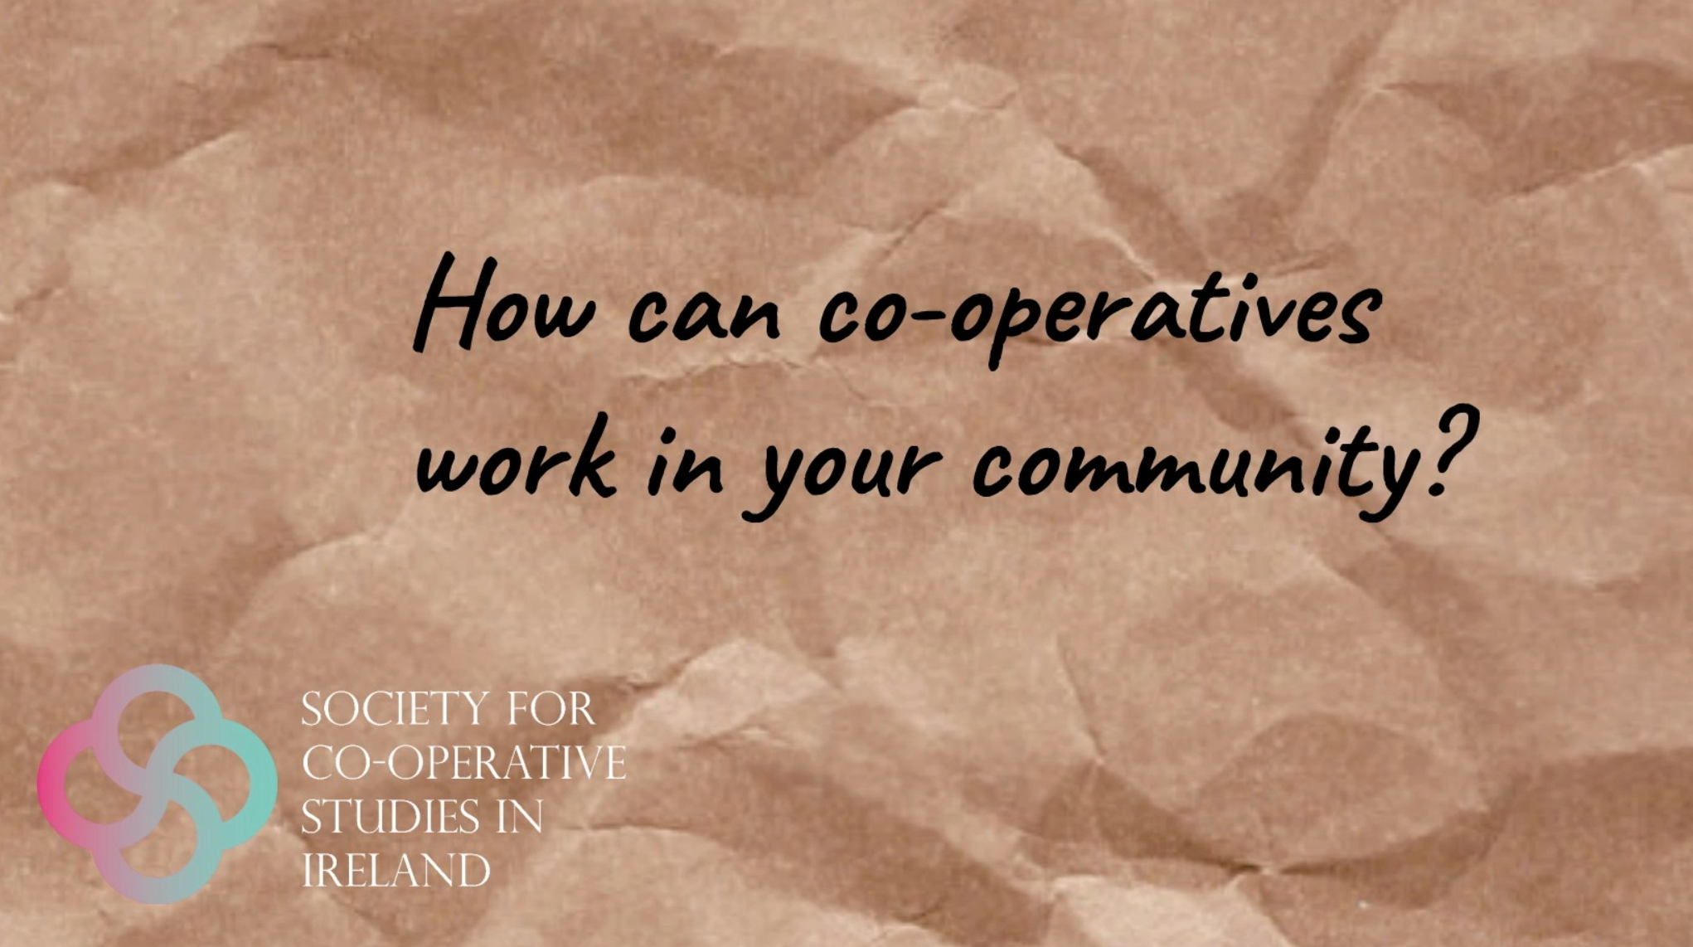
‘Dundalk Credit Union’. Produced by SCSI (2022). Length: XXX LINK REQUIRED

