Slide 1


Society for Co-operative Studies in Ireland
Co-operatives for Sustainability
Second level programme
Teachers slides
UNIT 1 WHAT IS A CO-OPERATIVE?

Slide 2



Which is the odd one out?
Manchester United
Barcelona FC
Kerrygold butter
Your local credit union

Slide 3
Which is the odd one out
Manchester United – all the others are co-operatives
Barcelona FC
Kerrygold butter
Your local credit union

Slide 4

How many co-operative members are there are in Ireland?
Less than 10,000
Between 10,000 and three million
More than three million

Slide 5
How many co-operative members are there are in Ireland?
Less than 10,000
Between 10,000 and three million
More than three million – Ireland has one of the highest rate of co-op membership in the world

Slide 6

What was the turnover or Ireland’s largest co-op in 2020?
20 million euros
200 million euros
2.3 billion euros

Slide 7
What was the turnover or Ireland’s largest co-op in 2020?
20 million euros
200 million euros
2.3 billion euros - Ornua, is the largest Irish co-op, in the agriculture and food production sector, with over 2,000 employees

Slide 8

What percentage of workers (worldwide) work in a co-op?
1%
4%
10%

Slide 9
What percentage of workers (worldwide) work in a co-op?
1%
4%
10% - according to the International Co-operative Alliance (ICA)

Slide 10

Are you surprised by the answers?
Are any of you members of a co-op? For example, your local credit union?

Slide 11
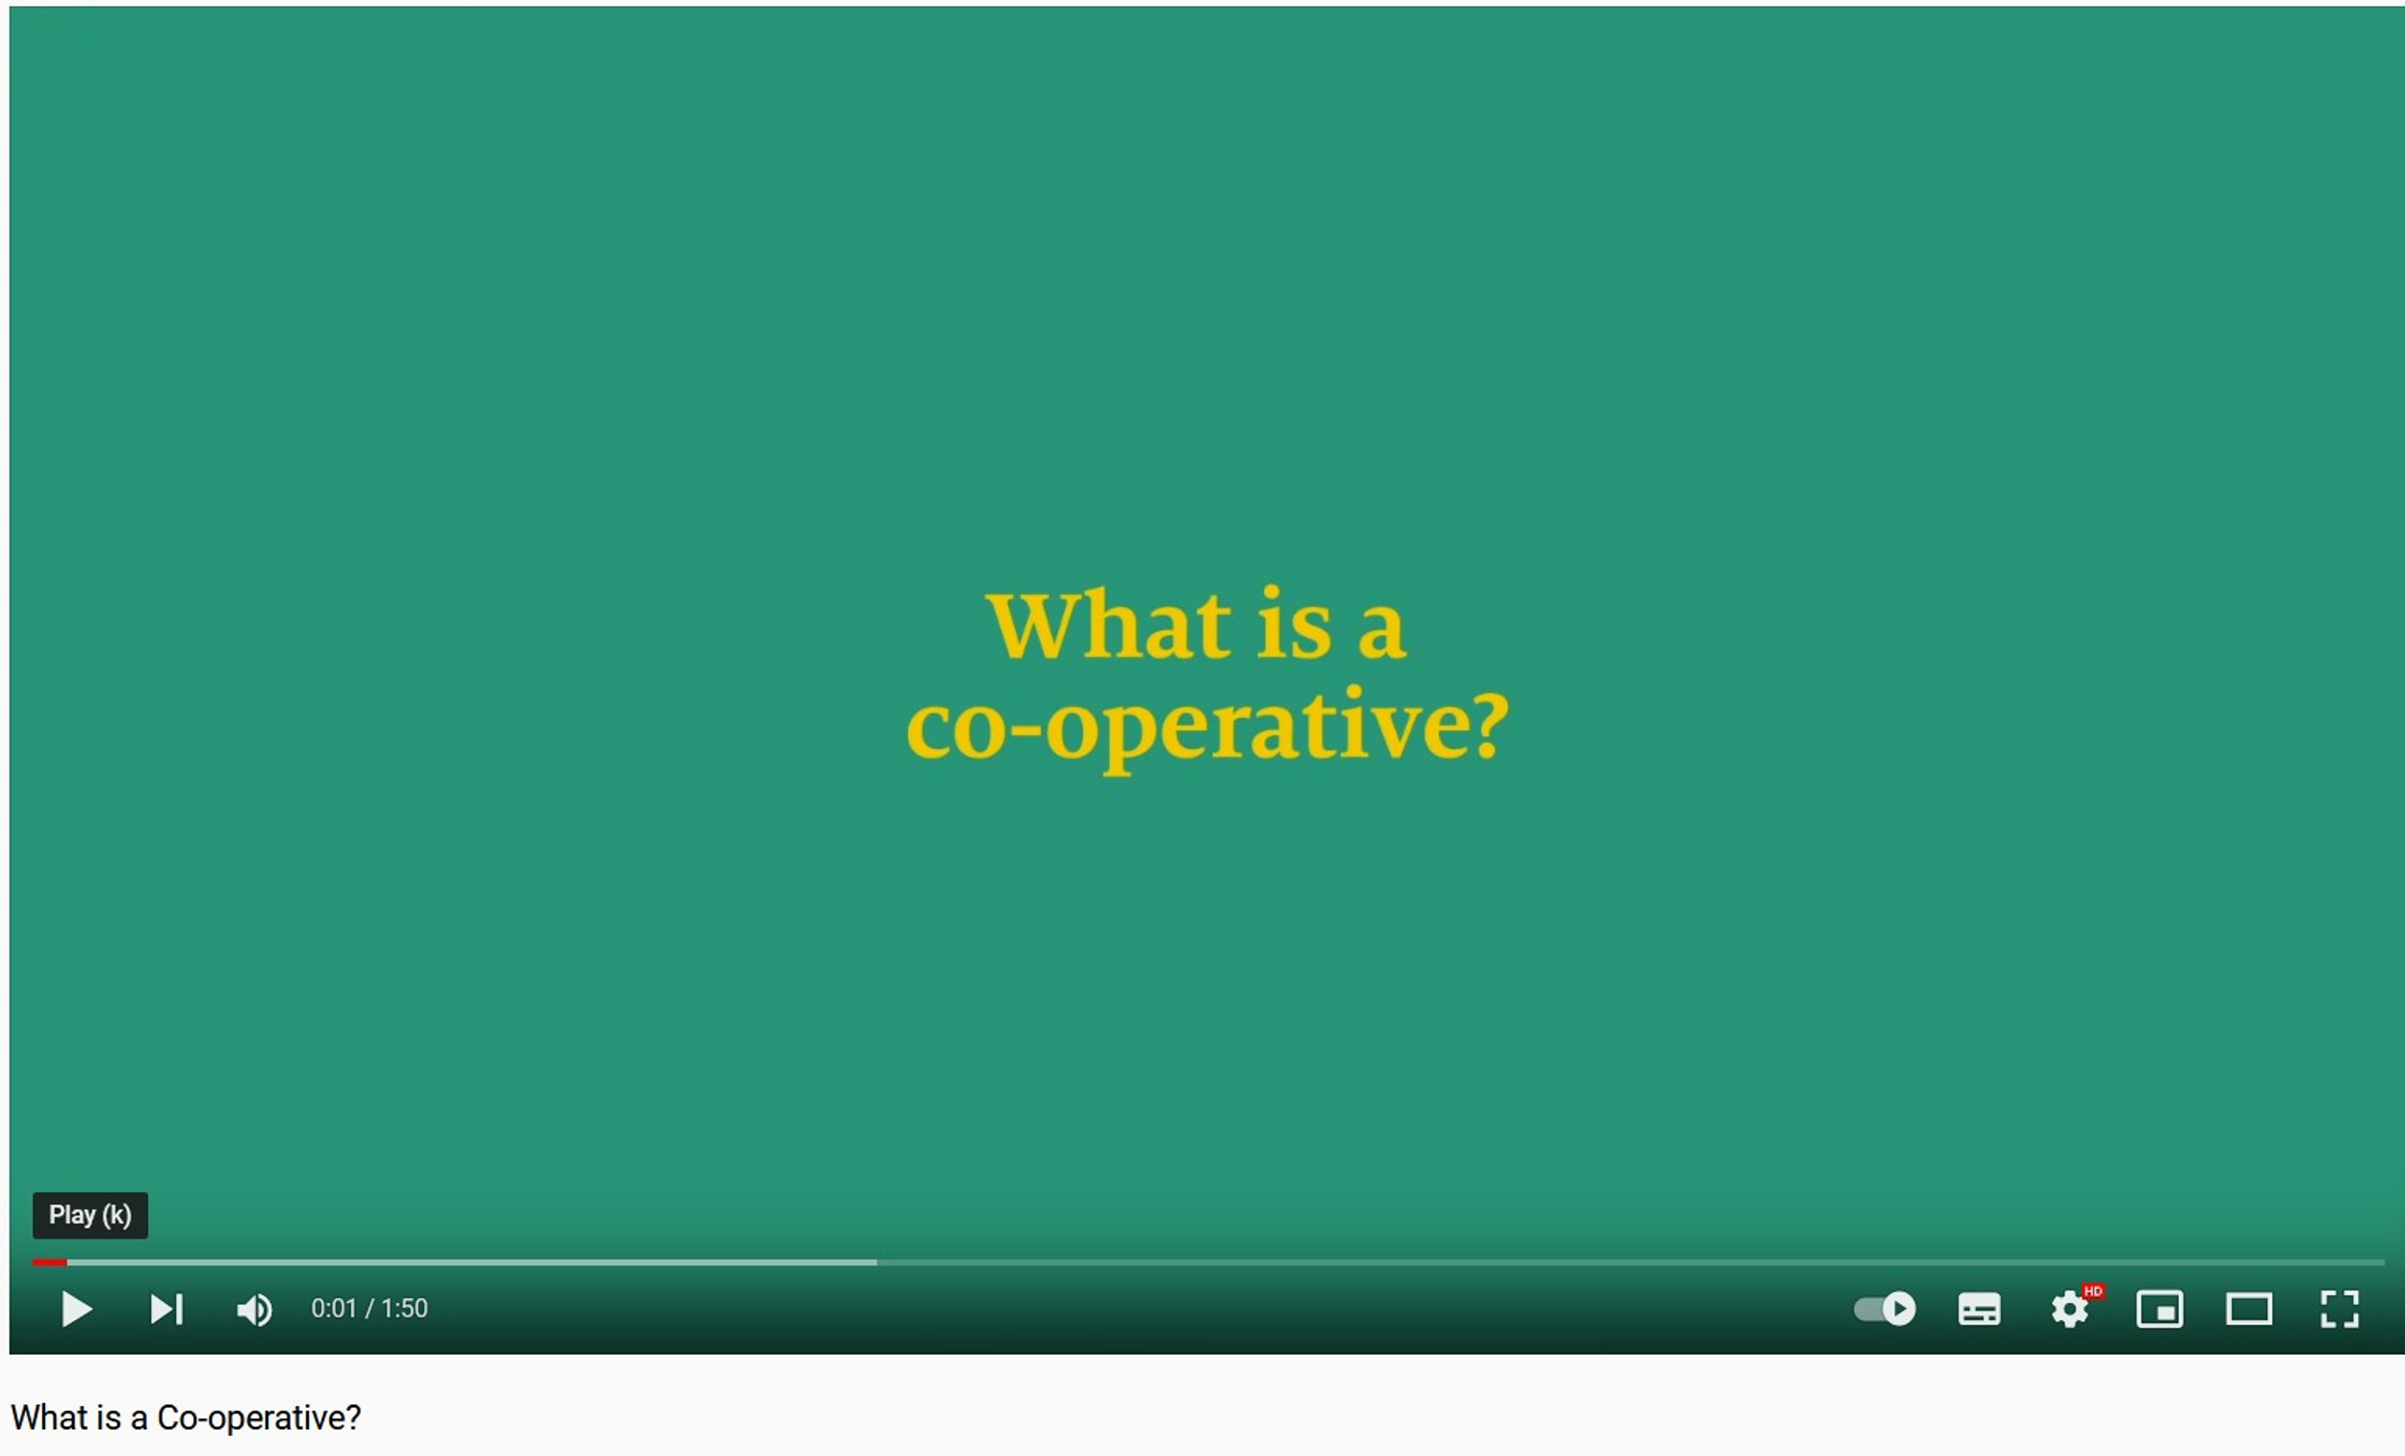
Video: What is a Co-operative? Produced by Co-operatives UK. Duration: 2 mins https://www.youtube.com/watch?v=90FL_bBE4mw

Slide 12
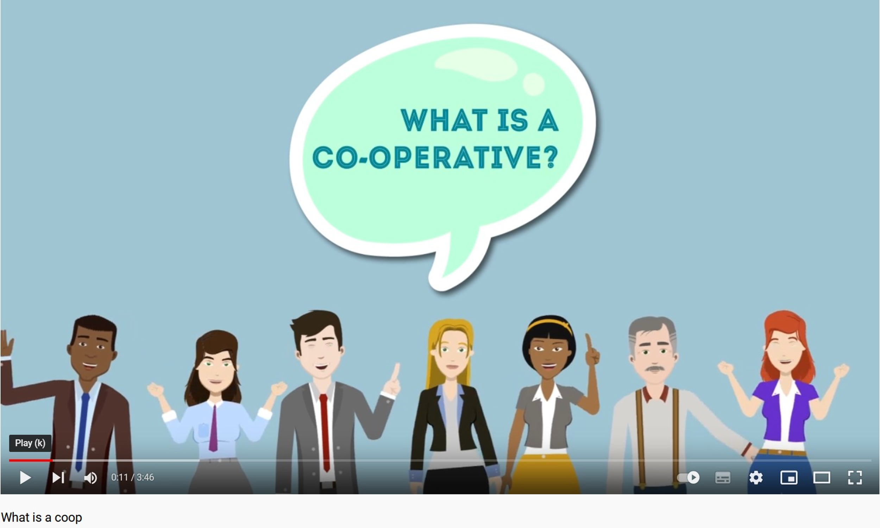

Video: What is a co-operative? Produced by The Irish Co-operative Learning Academy, and initiative of the Irish Co-operative Organisation Society (ICOS) Duration: 4:05 minutes.
Available at: https://www.youtube.com/watch?v=N50Mysg3Iuw

Slide 14
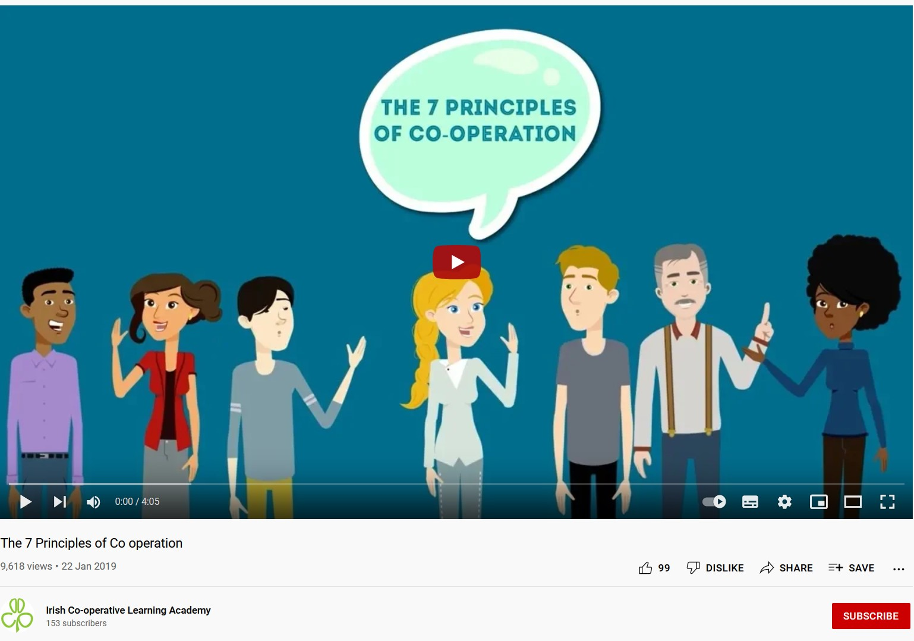
Video: The principles of co-operation. Produced by The Irish Co-operative Learning Academy, and initiative of ICOS, (4.05 minutes).
Available at: https://www.youtube.com/watch?v=KJTf4PuTy64

Slide 15
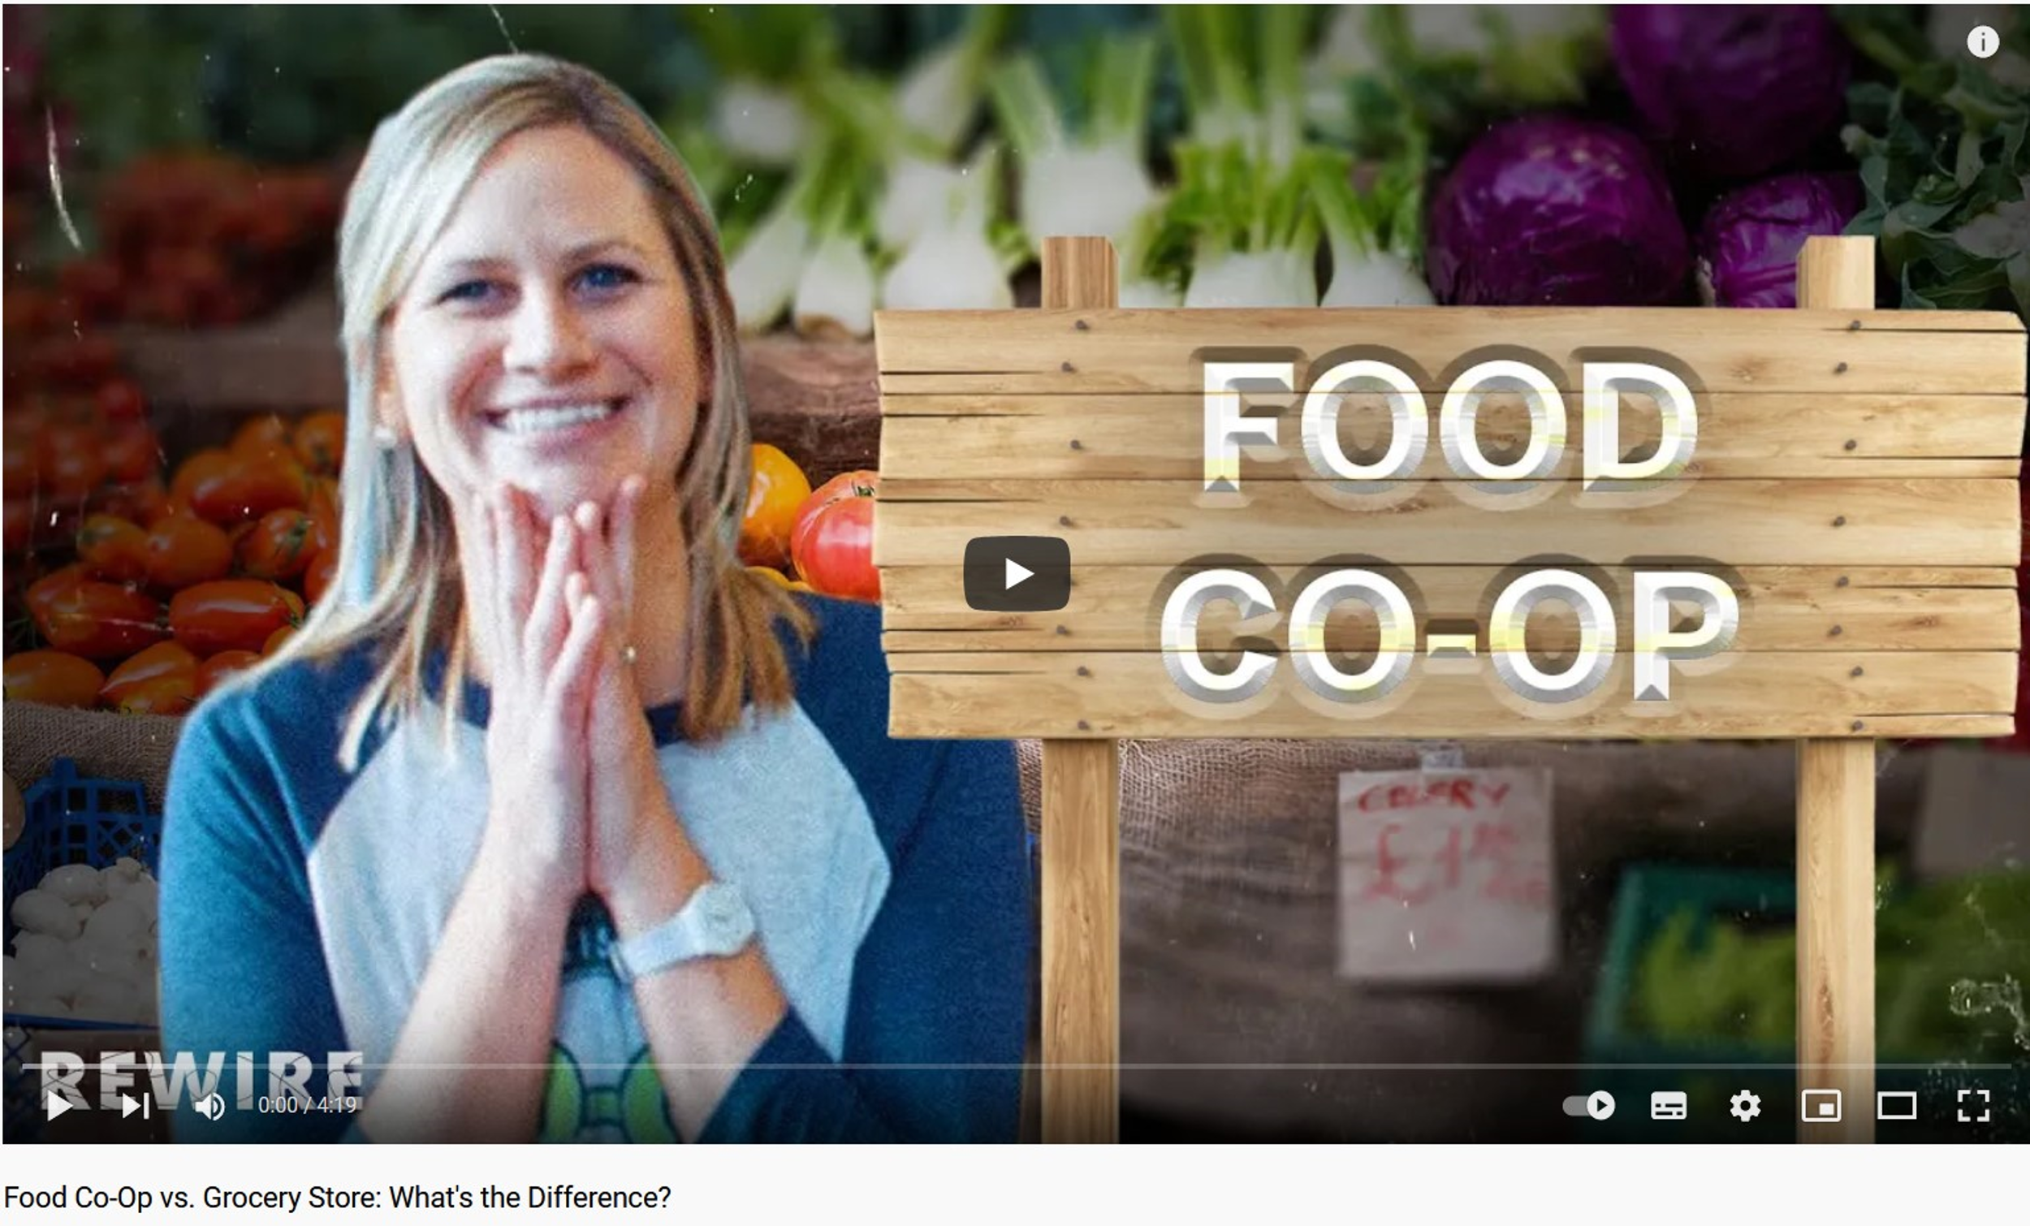
Video: Food Co-Op vs. Grocery Store: What's the Difference? The Mississippi Market. Produced by Rewire. Duration: 4 mins 20 secs. https://www.youtube.com/watch?v=ryQE5_aNy2I

Slide 16

Video: How can co-operatives work in your community? Three co-operative examples. Produced by SCSI (2021). Duration: 4 mins 35 secs. LINK REQUIRED

