Slide 1

Co-Learning, Co-Research and people with intellectual disability
Dr Nicola Maxwell, Ms Gráinne Mulcahy, Ms Claire McCarthy

Slide 2
Background
2009–2020
Certificate in Contemporary Living (CCL) 2009 - 2020 (Segregated Model)
2022–2024
id+ Project 2022 – 2024 (Hybrid model funded by HEA Impact Case Study)
2023–2026
Id+ Futures Project 2023 – 2026 (Hybrid model funded by HEA Path 4, Phase 2 funding)
Programmes: Certificate in Social Citizenship (CSC), Certificate in Disability Inclusive Practice (CDIP)

Slide 3
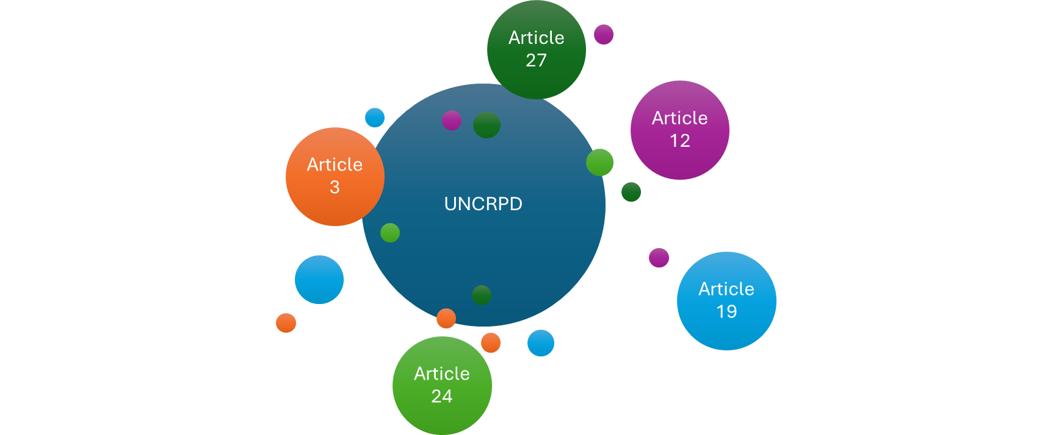
Values and Philosophy
The id+ Project, informed by the CRPD, has embraced inclusive and co-learning practices and methods where students with ID learn in shared lectures and classes with students registered on degree and post-graduate programmes.

Slide 4
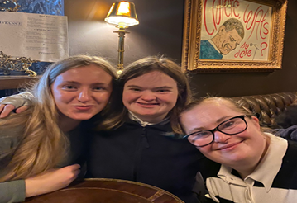
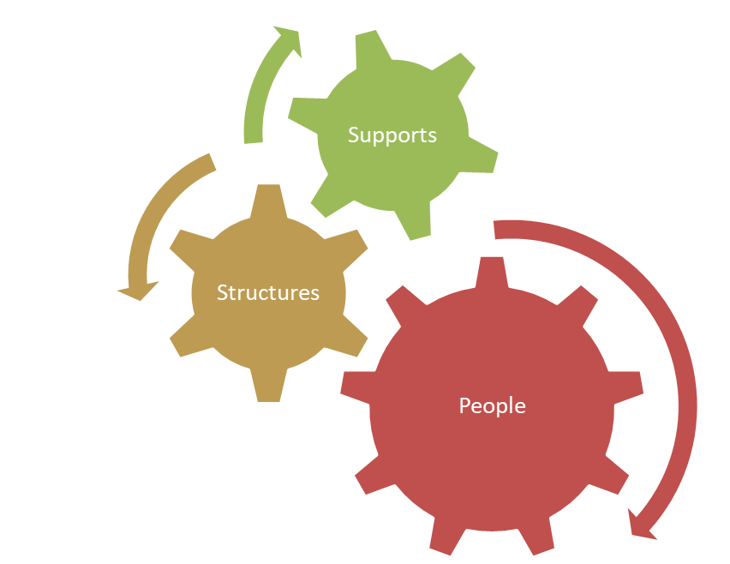
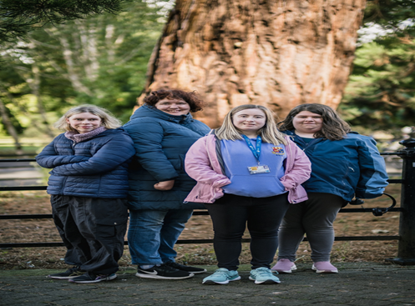
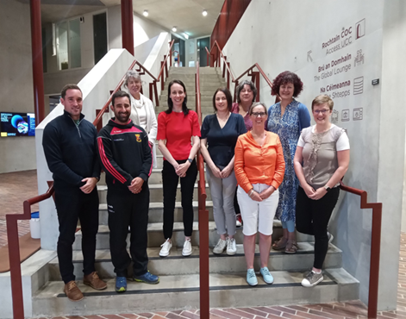
Inclusive Education AND Inclusive University Experience

Slide 5
Co-Learning in 4 Colleges in UCC
CACSS: Applied Social Studies, Psychology, Archaeology, Music, Theatre, Geography, Education
COMH: Public Health, Occupational Therapy, Nursng and Midwifery
COBL: Law, Economics
SEFS: Engineering, Environmental Science, Plant Science, Food and Nutrition
Notes:
Talk about informed decision-making Human rights are about discovery, capacity, and control over one’s life. It involves having options and making informed choices.

Slide 6
Researching Co-Learning: Inclusive Practices
Who?
Graduates with expertise, skills and lived experience.
Facilitators
What?
Designing, facilitating modifying and adapting training with people with lived experience of co-learning as an id+ project student to undertake co-research.
4 Phase Training and Research Plan
Making Decision Making Explicit and CRPD Proofed (April 2025)
Reflecting on telling the story of co-learning (May 2025)
Research Project and Research Training (May – July 2025)
Simultaneous Reiteration of Training and Data Collection and Analysis (Sept – Dec 2025)
Dissemination of Findings (Jan to March 2026)
Notes:
Evaluation key

Slide 7
Research Skills Training
Gráinne Mulcahy

Slide 8
Facilitation and Decision-Making
Supporting the graduates (from the Certificate in Social Citizenship (CSC) and Certificate in Disability Inclusive Practice (CDIP) courses) towards becoming competent co-researchers.
Guiding graduate's decisions on the central research questions and giving them the tools and confidence to decide on the most appropriate methodology for analysing co-learning experiences during the id+ Project.
Choice
Autonomy
Self-determination
Support

Slide 9
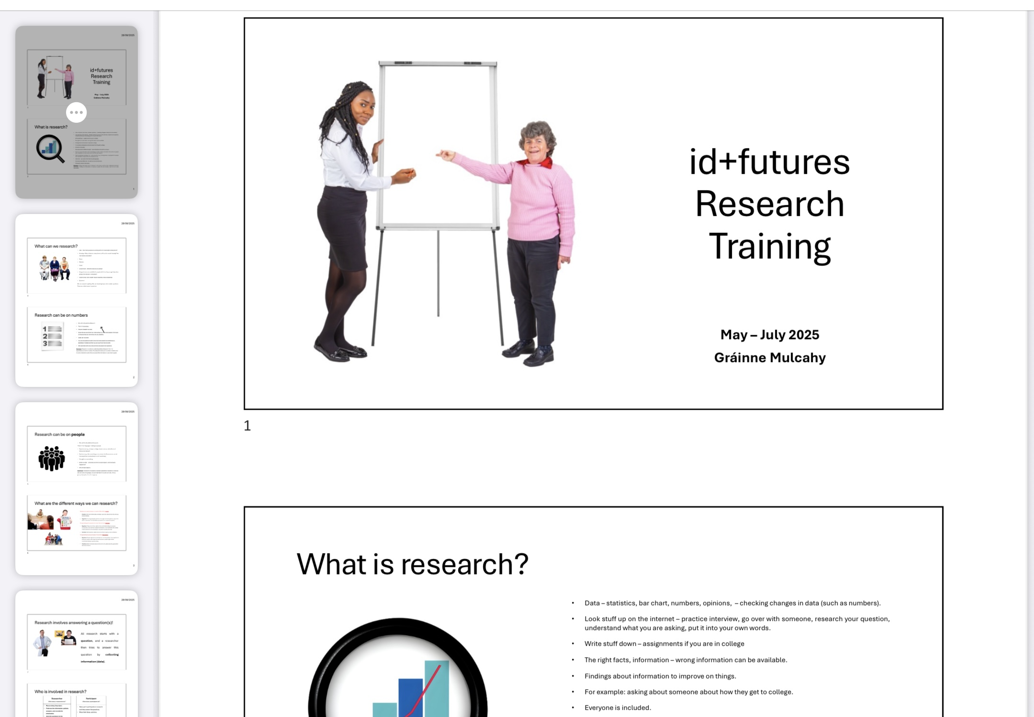
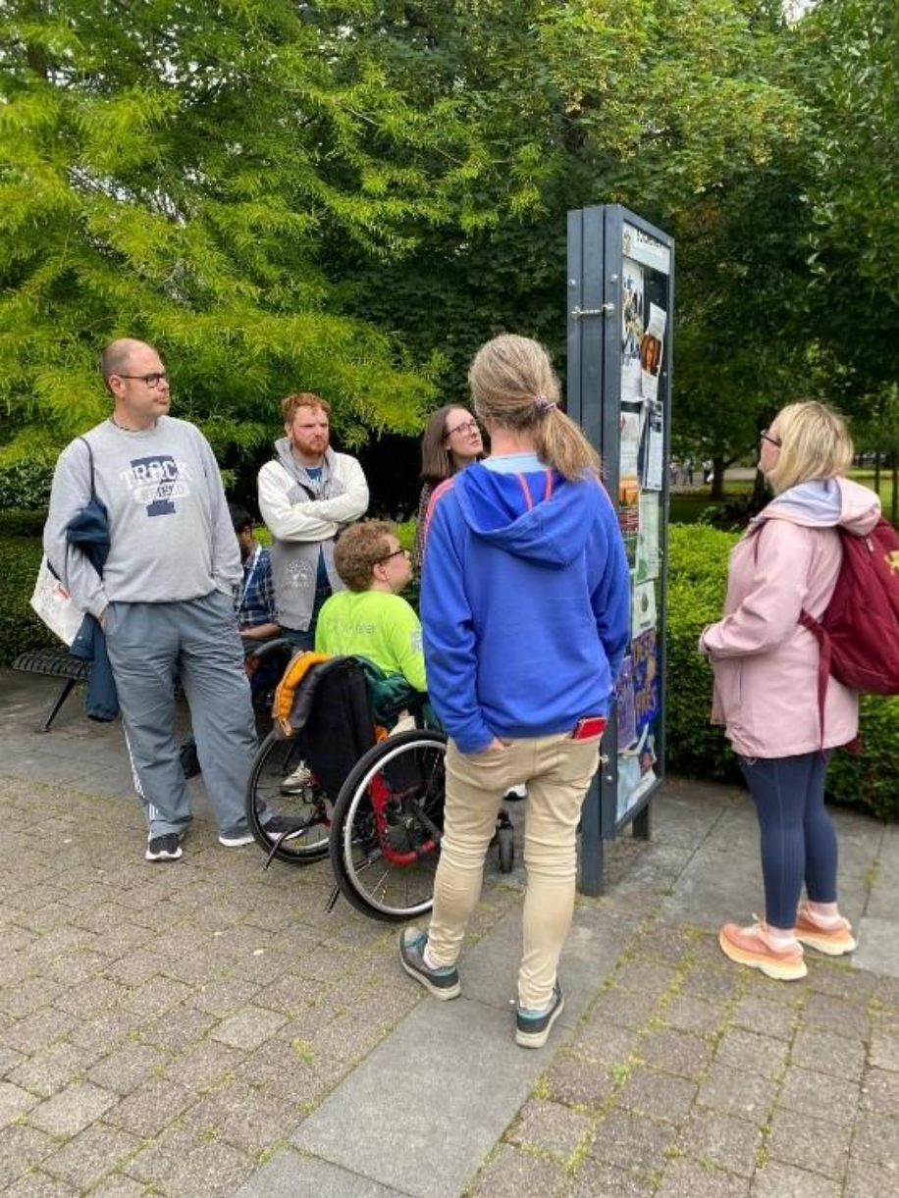
Co-creating: Learning Outcomes
Breaking down often complex research concepts and terminology into simplified (jargon free) language.
Co-creating a comprehensible roadmap to understanding the research process.
Facilitating opportunities for experiential learning, active participation and experimentation through practical / interactive activities.

Slide 10
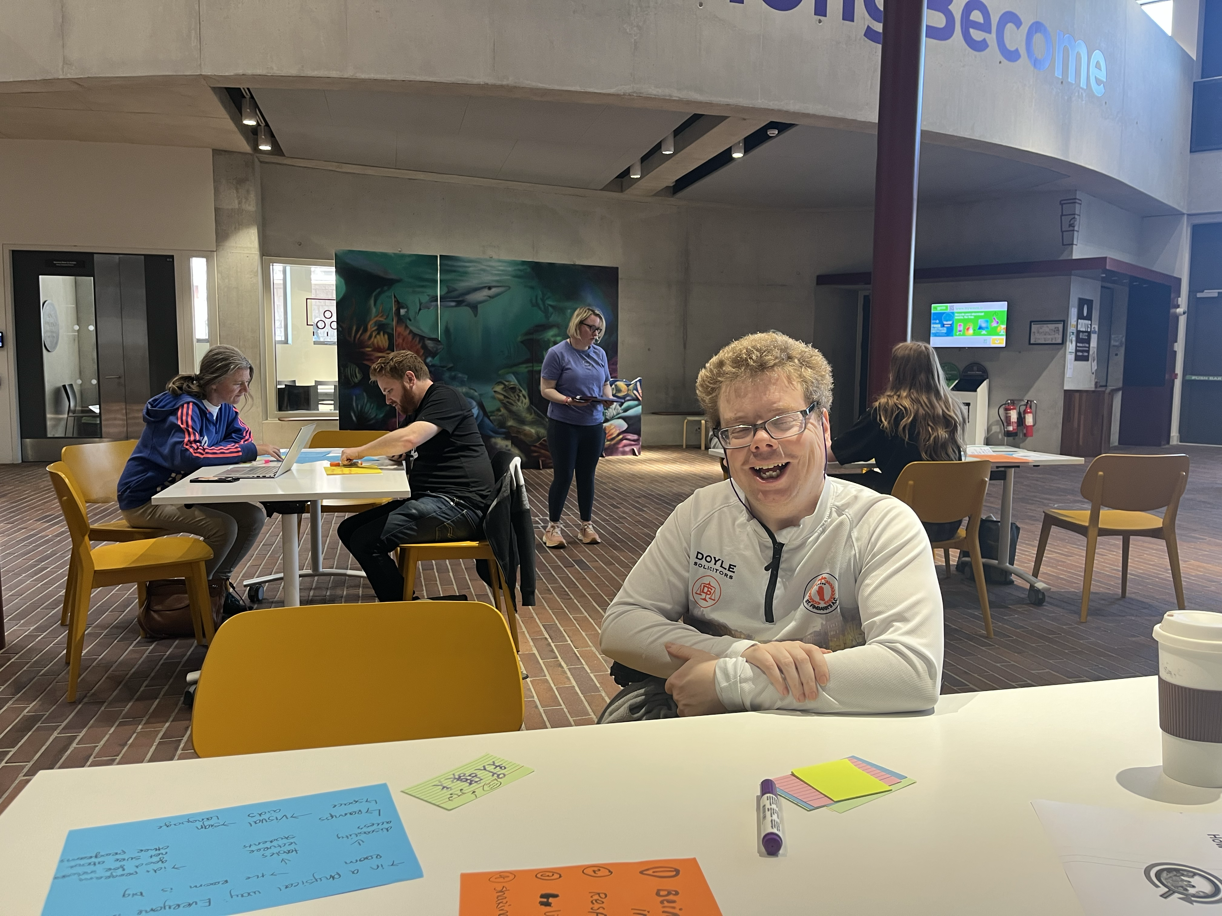
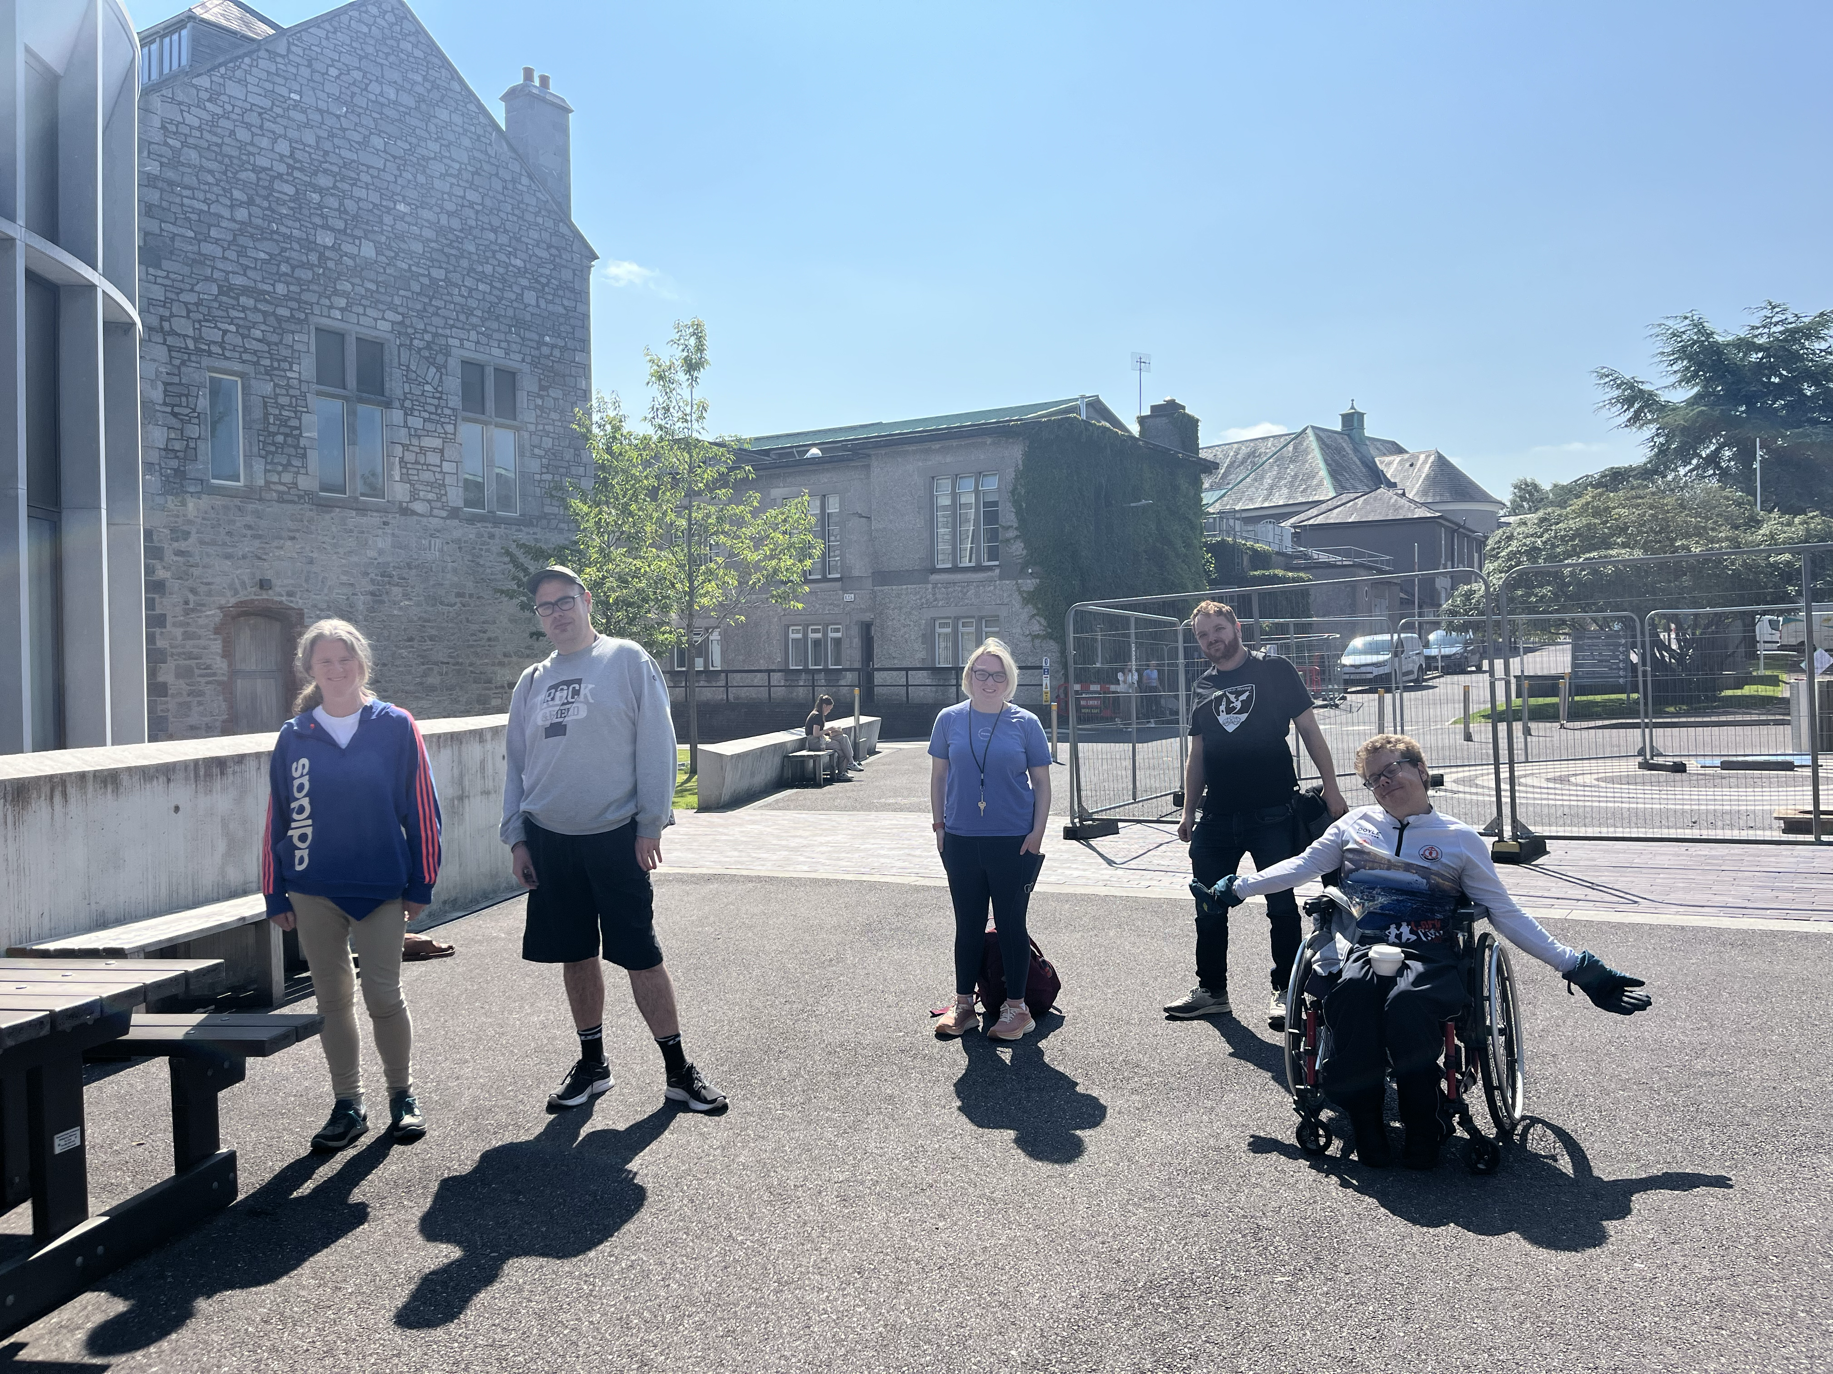
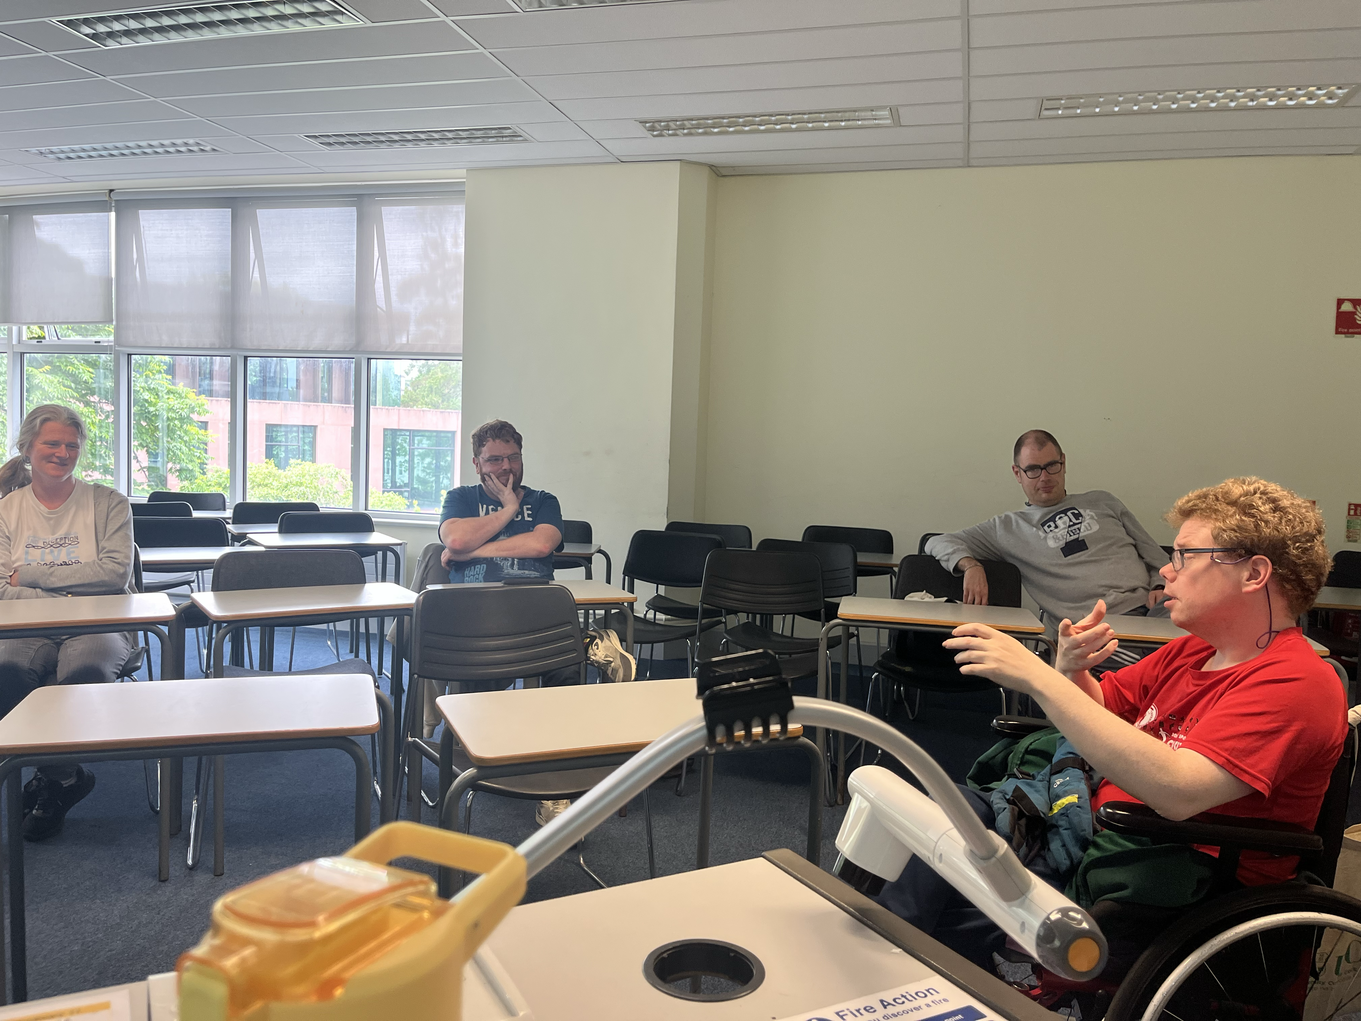
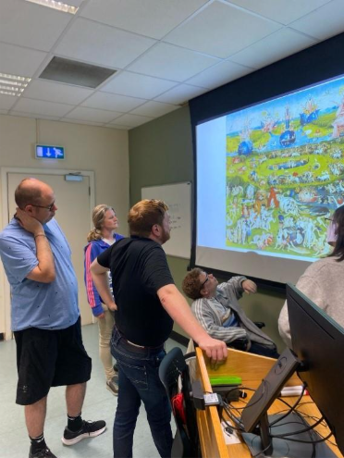
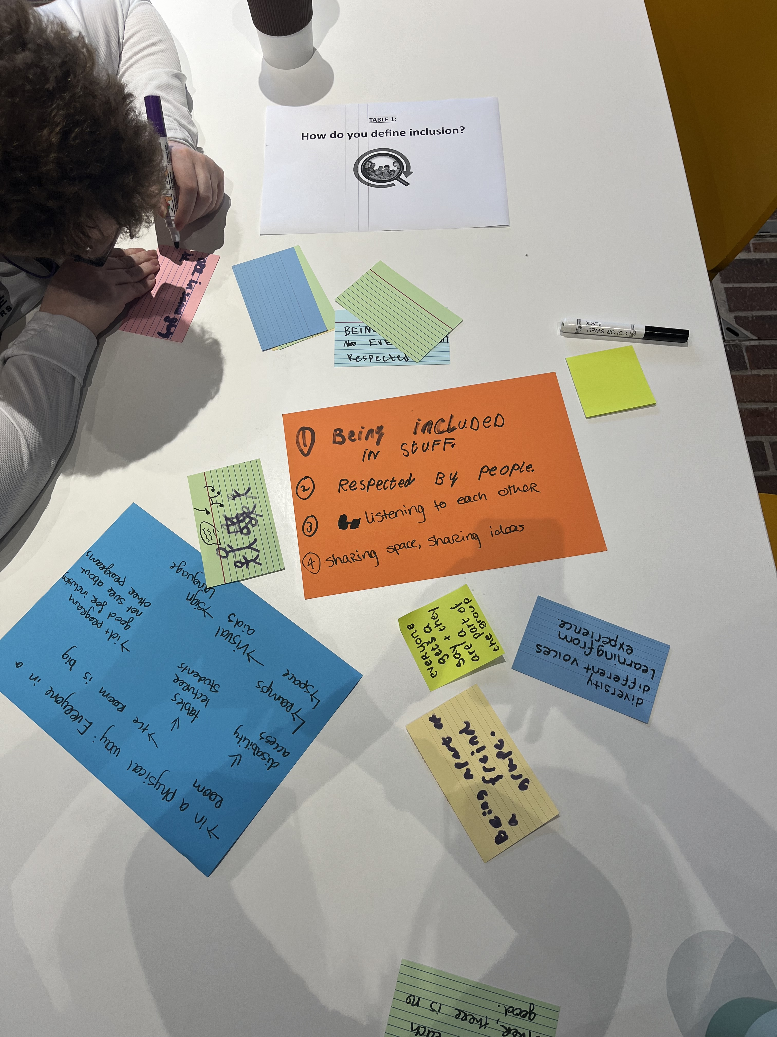
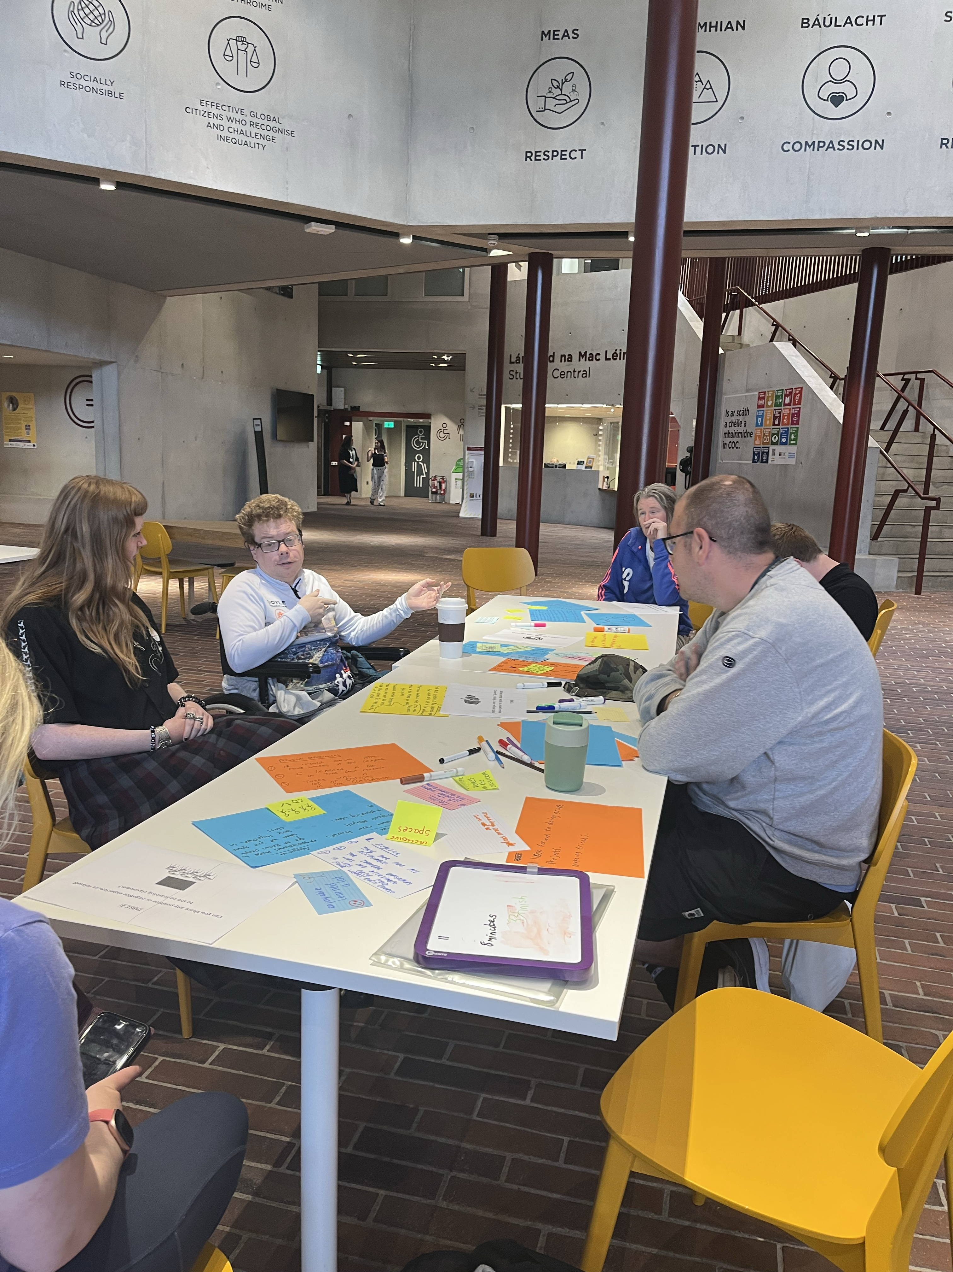
Co-creating: Seeing what works best for all of us
Walking / Wheeling Interviews
Focus Groups
World café Workshop
Photovoice

Slide 11
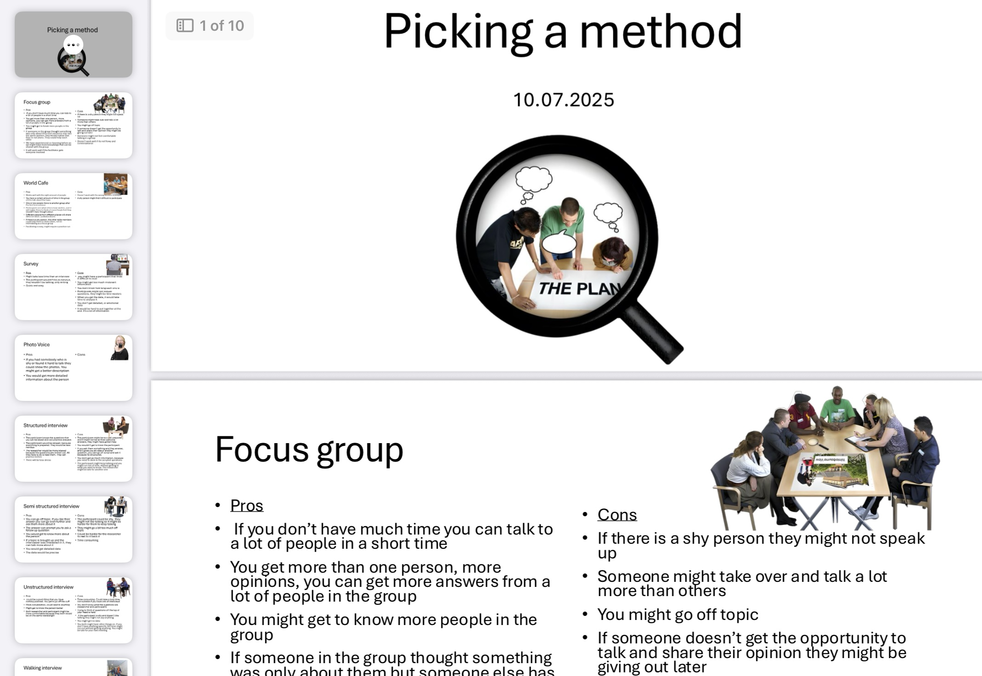
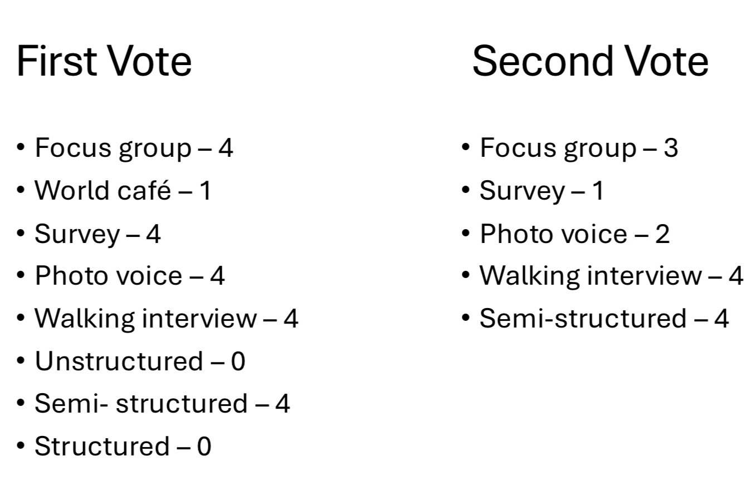
Decision-making: Research methodology & methods
A considered and democratic decision-making process was facilitated to enable the graduates to confidently choose which methodology they felt worked best for them as co-researchers analysing co-learning experiences.

Slide 12
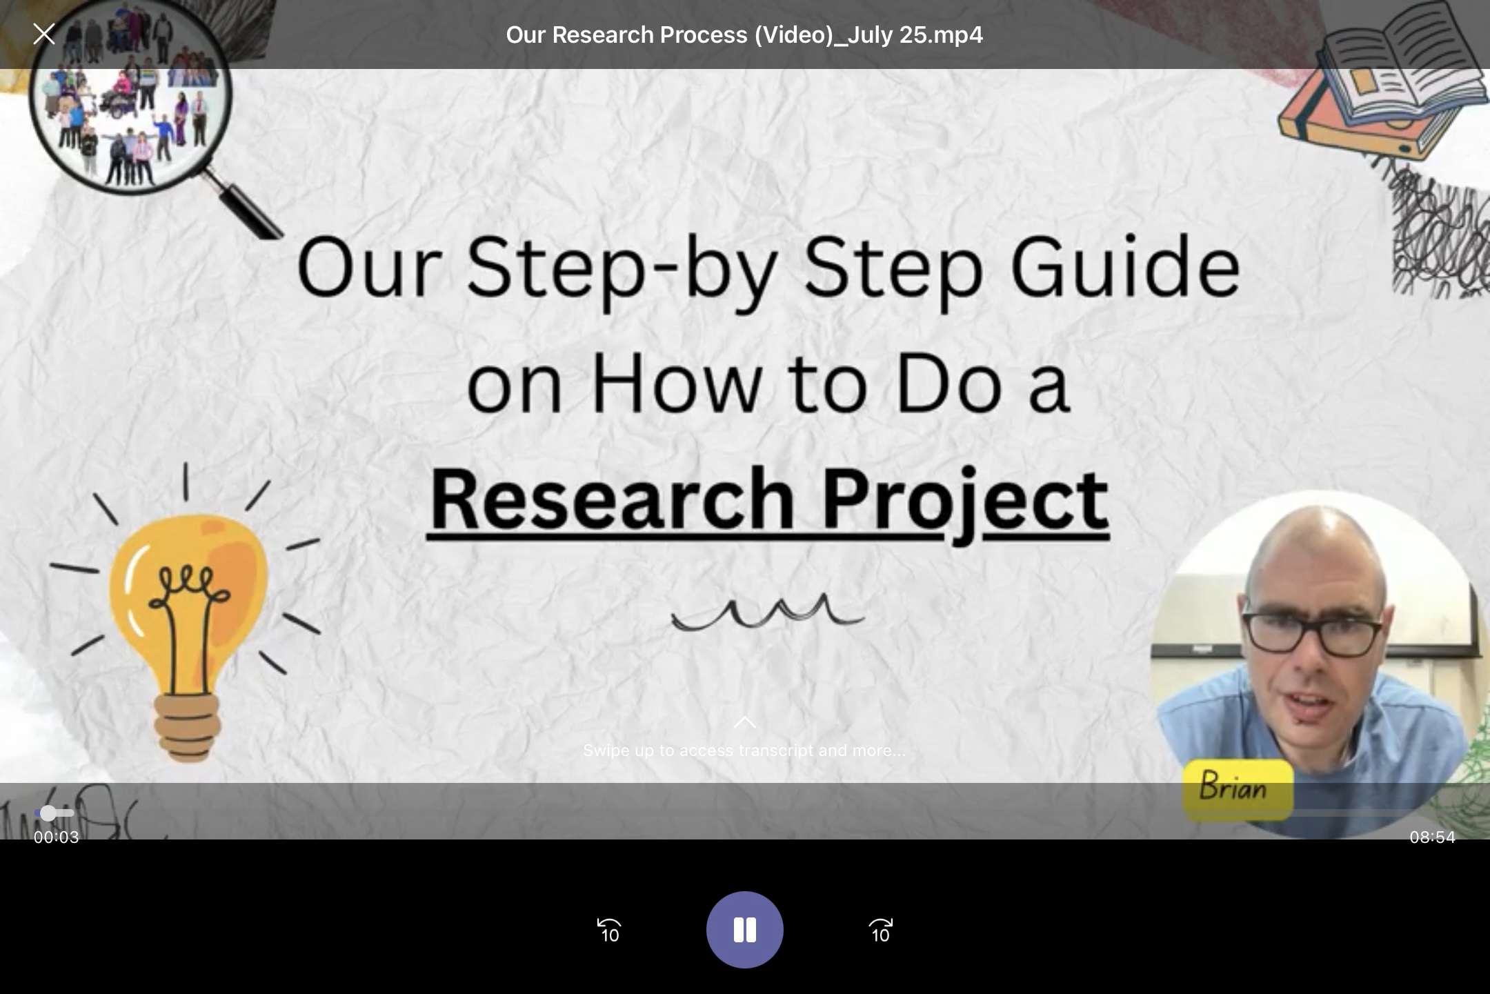
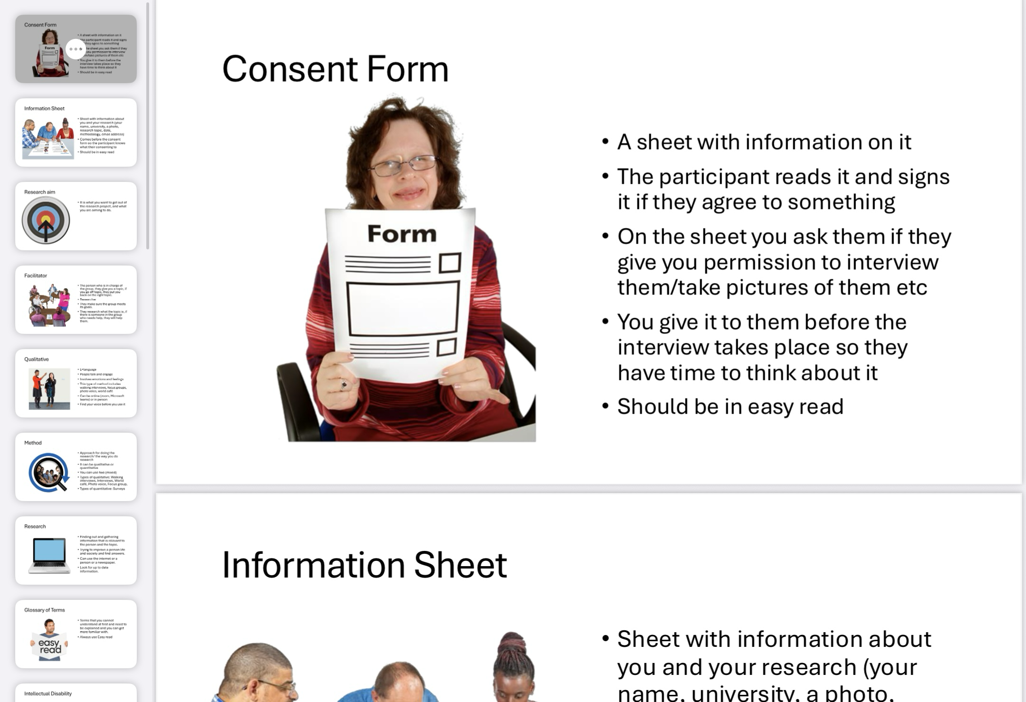
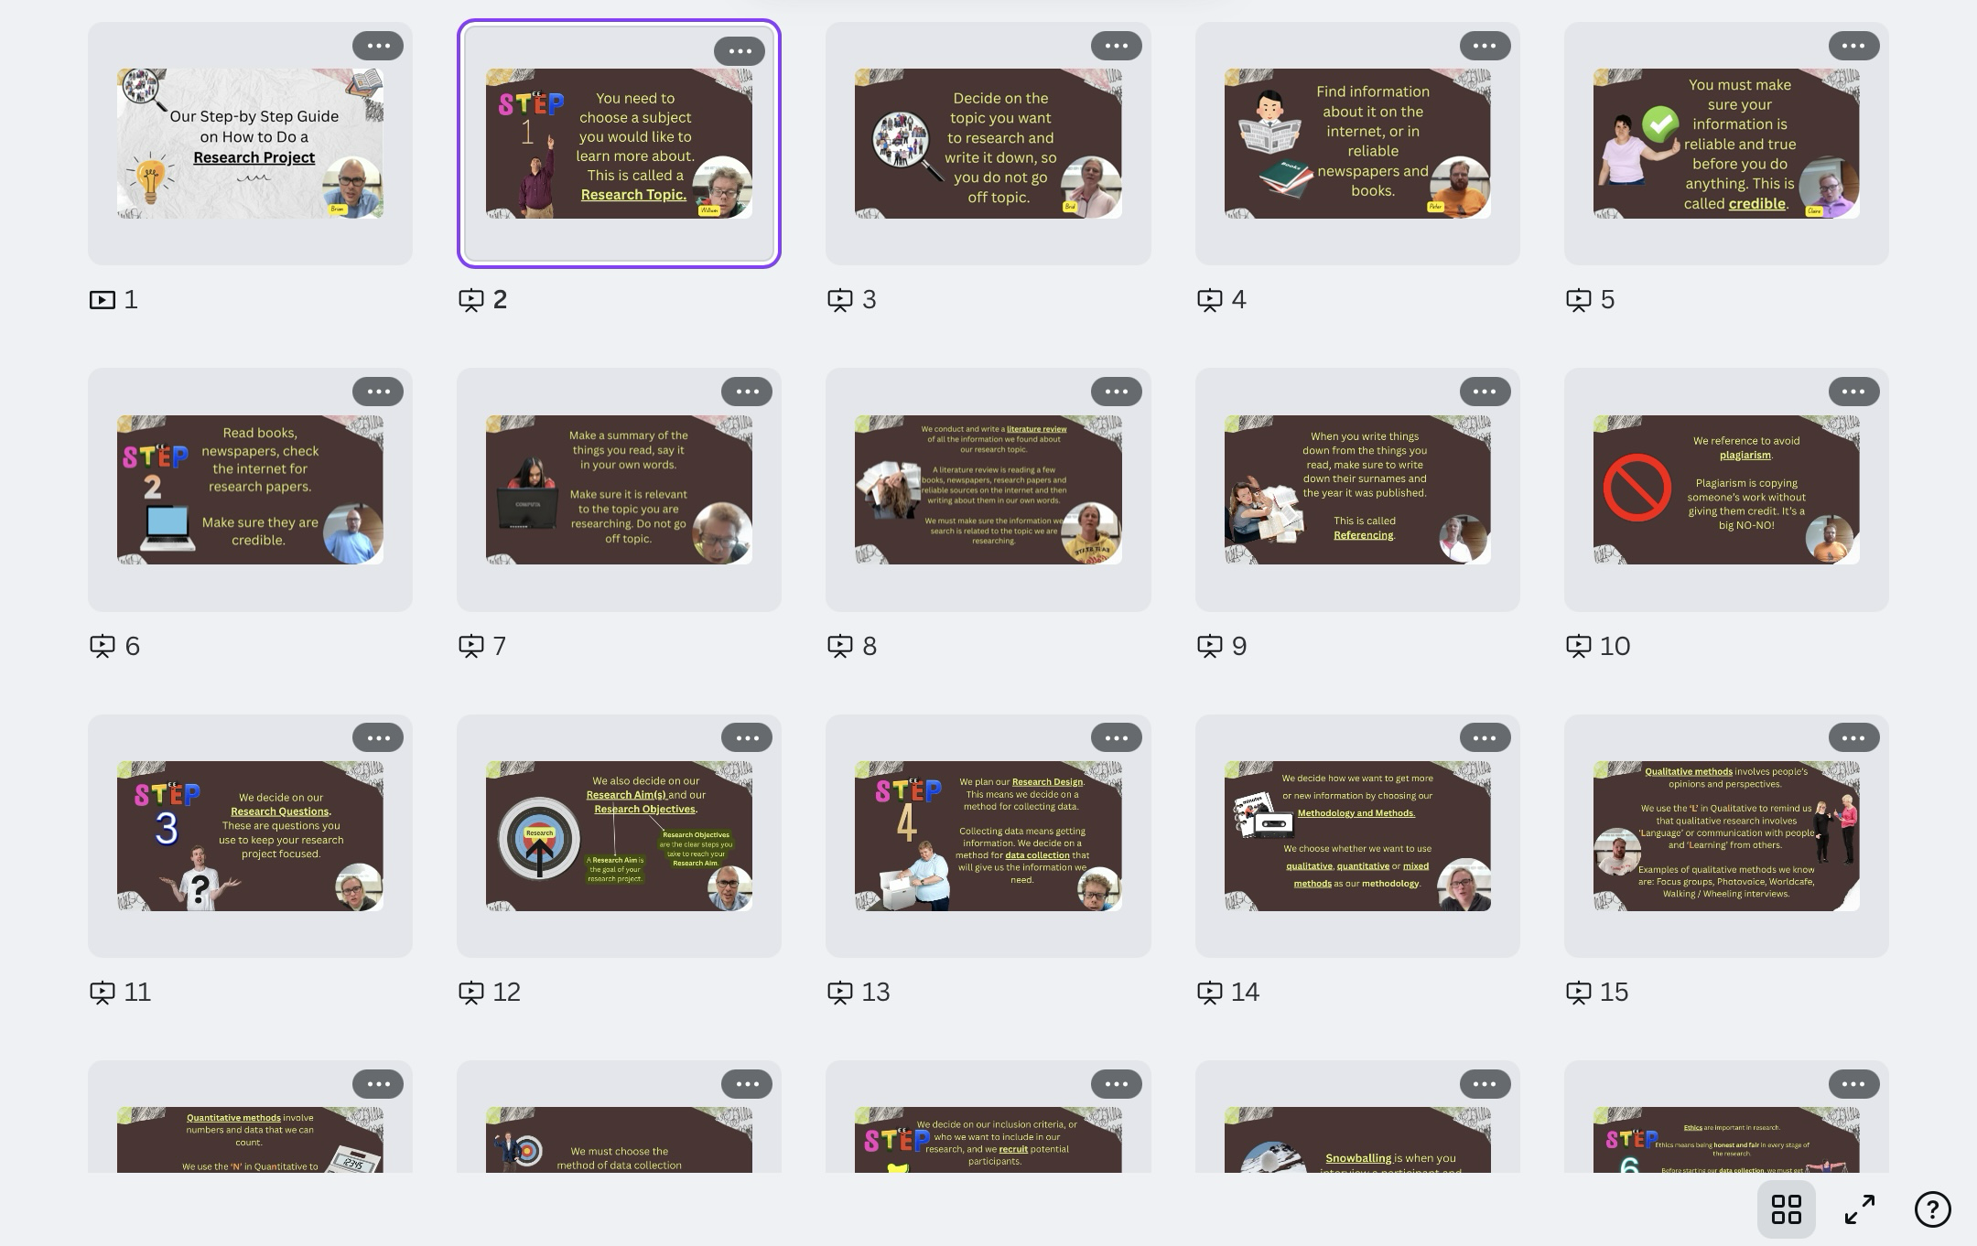
Co-producing: Resources / Deliverables
Easy-read Glossary of Terms
Learning Materials / Tools
Step-by-Step Guide (PowerPoint with Easy-Read Visuals and Commentary)
Notes:
https://www.whocanuse.com/

Slide 13
Key Takeaways.
What did I learn throughout the research skills training / co-production process?

Slide 14
Training For Research
Claire McCarthy

Slide 15
4 Points
Why co-learning is important
Why WE should do research about co-learning
What we did in the Research Skills Training
Why people with intellectual disabilities should be co-researchers

Slide 16
Special thanks!
Our graduates Bríd, Brian, Claire, Peter and William.
Ruby Walsh and Iesa Mortell.

Slide 17
Contact
Claire McCarthy, CSC and CDIP Graduate.
Email: 122146788@umail.ucc.ie
Gráinne Mulcahy, BSocSc., Ph.D. Candidate in the School of Applied Social Studies, University College Cork.
Email: grainnemulcahy@ucc.ie
Nicola Maxwell, Academic and Research Co-Director, id+ Futures Project.
Email: n.maxwell@ucc.ie

