Slide 1

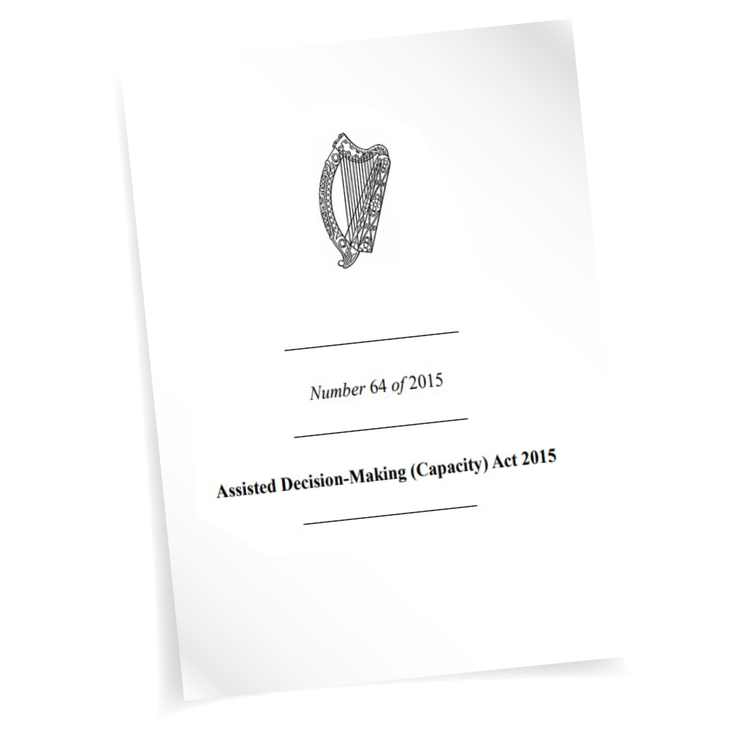

Capacity Applications and Wardship Discharge Applications A Practitioner’s Perspective
CCJHR Mental Health and Capacity Law Conference UCC
5th September 2025
Dr Joanna Ralston BL
joanna.ralston@lawlibrary.ie

Slide 2


Assisted Decision-Making (Capacity) Act 2015 General Principles
No intervention unless necessary
Minimise restriction on RP’s rights and freedom of action
Have due regard to RP’s rights to dignity, bodily integrity, privacy, autonomy and control over his/her financial affairs and property
Proportionate to the significance and urgency of the matter
Limited in duration insofar as is practicable
Permit/encourage participation by RP
Give effect, insofar as practicable, to RP’s past and present will and preferences
Take account of RP’s values and beliefs
Consider views of anyone named by RP/any supporter under the Act (unless not appropriate/practicable)
Act at all times in good faith and for the benefit of RP

Slide 3

Who Can Make a Capacity Application?
Includes the following persons:
the relevant person
the Decision Support Service
the person's spouse, civil partner or cohabitant
the person's adult child
an existing decision supporter for the person
Any other adult with a genuine interest in the welfare of the person can make an application to court, but they must get the permission of the court first.

Slide 4

Leave of the Court
Anyone not included in the list of persons set out in s.36(4) (b) to (i) must make an ex parte application seeking the leave of the court. Must complete the following:
Form 55G (Consent Application Notice of Motion)
Grounding Affidavit: This must include details of any existing decision support arrangements and provide information as to why the application cannot be made by one of the persons who do not need the consent of the court to make an application.
The grounding affidavit must exhibit the draft Capacity Application (Form 55A) and Statement of Particulars (Form 55B) intended to be filed if consent is given.
You do not need to notify anyone that you are making the ex parte application.
Court tends to give directions at the point as to independent legal aid, advocacy, service, notice parties.

Slide 5

Capacity Applications Under Part V 2015 Act
Jurisdiction: where RP resides or carries on a business or has resided at any time within the 3 years prior to the application
Stage 1: Declaration (s. 37) [Power of court to make declarations as to capacity]
Person lacks capacity unless Co-Decision Maker appointed
Person lacks capacity even if CDM appointed
Stage 2: (s. 38) [Power of court to appoint Decision-Making Representative]
Court Decision
Appointment of Decision-Making Representative

Slide 6

Decisions Not covered by the ADMCA
All decisions except:
Marriage/ Civil partnership
Judicial separation/Divorce/dissolution of civil partnership
Placing of child for adopting/making of adoption order
Decisions in respect of Guardianship
Consent to sexual relations
Serving as a member of jury
Making a will

Slide 7

The Functional Approach to Capacity
RP ability to understand at time decision being made
The nature and consequences of decision within context of available choices
Lacks capacity if:
To use or weigh that info as part of decision process
Retain the info long enough to make a decision
Unable to understand the information
Or to communicate their decision

Slide 8

Statement of Particulars – Form 55B
The Statement of Particulars includes information about:
Who is making the application and their connection to the relevant person
The reason for the application
The benefit to the relevant person in making the application
An explanation as to why less intrusive options (for example a lower tier of support) cannot be taken
Details of any relevant support agreements, instrument or court orders affecting the relevant person
Details of the relevant persons past and present will and preference in relation to the decisions concerned
Details of any particular needs the relevant person may have in relation to the decisions concerned
Where the decision concerned relates to the relevant persons property and affairs – details of their assets, liabilities, income and expenditure.
Details of any proposed co-decision-maker or decision-making representative
[information from courts.ie]

Slide 9

Personal Welfare Decisions
Decisions about a person’s interests, health and wellbeing. These types of decisions can include:
Accommodation
Employment
Education and training
Social activities
Social services
Healthcare
Participation by the Relevant Person in healthcare research and social care research
Other matters about a person’s wellbeing

Slide 10

Property & Affairs
Decisions about property, business and money matters. These types of decision can include:
Managing property, including purchasing good and services
Selling, mortgaging or disposing of property
Buying property
Business decisions
Ending a partnership
Carrying out a contract
Managing debts and taxes
Exercising the powers of a tenant for life
Providing for the needs of other people
Court proceedings
Applying for social services

Slide 11

Suitability of Proposed Decision-Making Representative
Criteria set out in the 2015 that the Court shall have regard to as follows:
(a) the known will and preferences of the relevant person;
(b) the desirability of preserving existing relationships within the family of the relevant person;
(c) the relationship (if any) between the relevant person and the proposed representative;
(d) the compatibility of the proposed representative and the relevant person;
(e) whether the proposed representative will be able to perform the functions to be vested in him or her;
(f) any conflict of interest.

Slide 12

Decisions which DMR cannot make
May not dispose of property by way of a gift unless specific provision has been made for this by the court in the DMR order
May not prevent a person having contact with the RP
May not refuse consent to the carrying on or continuation of life-sustaining treatment or consent to the withdrawal of life-sustaining treatment

Slide 13

Decision-Making Representative Applications Some Further Considerations
The relevant person central to the process
Necessity and Benefit to RP
Specific Orders – limited in scope and time
Capacity Assessment Report; A social worker, an OT, a GP, a psychiatrist or other medical professional such as a geriatrician – Does the report support the application – Format of Capacity Assessment
Independent Legal Aid Referral/ Independent Advocate –Will and Preferences
Costs
Appointment of Independent DSS Panel Members

Slide 14

Wardship No More
Wardship still exists for those under 18 years
Existing Wards of Court discharge application to the High Court within 3 years, supported by a functional capacity assessment carried out by a court appointed psychiatrist.
June 2025 High Court Practice Direction HC133 – functional capacity assessment now acceptable by a registered medical practitioner
Who can make a discharge application:
The ward of court (the relevant person)
The committee of the ward
A relative or friend of the ward in a position of trust with the relevant person
Such other person as appears to have sufficient interest or expertise in the welfare of the ward (require the consent of the Court)

Slide 15
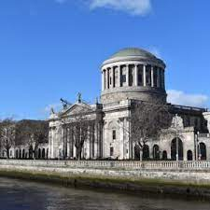
Wardship Discharge – Process
Notice of Motion for Discharge Lodged with Wards of Court Office which triggers the medical visitor to carry out the functional capacity assessment
Receipt of Functional Capacity Assessment – recommends the required tier of support
Relevant documentation including a schedule of assets and liquidity issued by WOC
Submission of Grounding Affidavit with exhibits and other documentation
Hearing date is set
A judge of the High Court will either discharge the person to look after their own affairs or will approve an arrangement with the relevant support services
High Court will make one or more than one of the following orders:
that the relevant person lacks capacity, unless the assistance of a suitable person as a co-decision-maker is made available to assist in making one or more decisions
that the relevant person lacks capacity, even if the assistance of a suitable person as a co-decision-maker were made available (a decision-making representative is required)

Slide 16


Discharge Hearing Process
The discharge hearing can be held remotely or in person (in Dublin).
Kept as informal as possible
The relevant person/former ward may choose to attend and speak to the Judge during the hearing.
The Judge will consider the Functional Capacity Assessment Report, along with other relevant information, to determine the level of support (if any)required for the ward in the context of Personal Welfare and/or Property & Affairs
If a Co-Decision Maker/Decision-Making Representative is required, the Court will direct a review by the Circuit Court within 1–3 years.
If funds are held by the Court for the ward, payment arrangements are addressed during the hearing.

Slide 17

Professional Bio Details
Joanna Ralston is a practising Barrister-at-Law with 23 years post qualification experience. She is based in Cork and has a broad general practice on the Cork Circuit and Dublin.
In particular Joanna has developed her practice specialising in child and family law. Joanna has particular interest and expertise in mental health law, capacity law and the law surrounding vulnerable persons.
Joanna holds a Bachelor of Commerce Degree, a BCL and an LLM (Child and Family Law), First-Class Honours from University College. Joanna also completed a PhD in the area of mental health law and children’s rights at University College Cork in December 2022.
From 2015 to 2022 Joanna was an Assistant Law Lecturer at the Law School at University College Cork.
Since September 2023 to May 2024 Joanna was a Lecturer in law at the Law School at University College Cork
In April 2025 Joanna was appointed as a Member of the Board of the Mental Health Commission by the Minister of State for Mental Health
See https://www.lawlibrary.ie/members/joanna-ralston-kelleher-bl/
Email joanna.ralston@lawlibrary.ie

