Slide 1

The Assisted Decision-Making (Capacity) Act 2015 and Decision Support Service: Overview and Update UCC Mental Health and Capacity Law Conference 5 September 2025
Áine Flynn
Director of the Decision Support Service

Slide 2
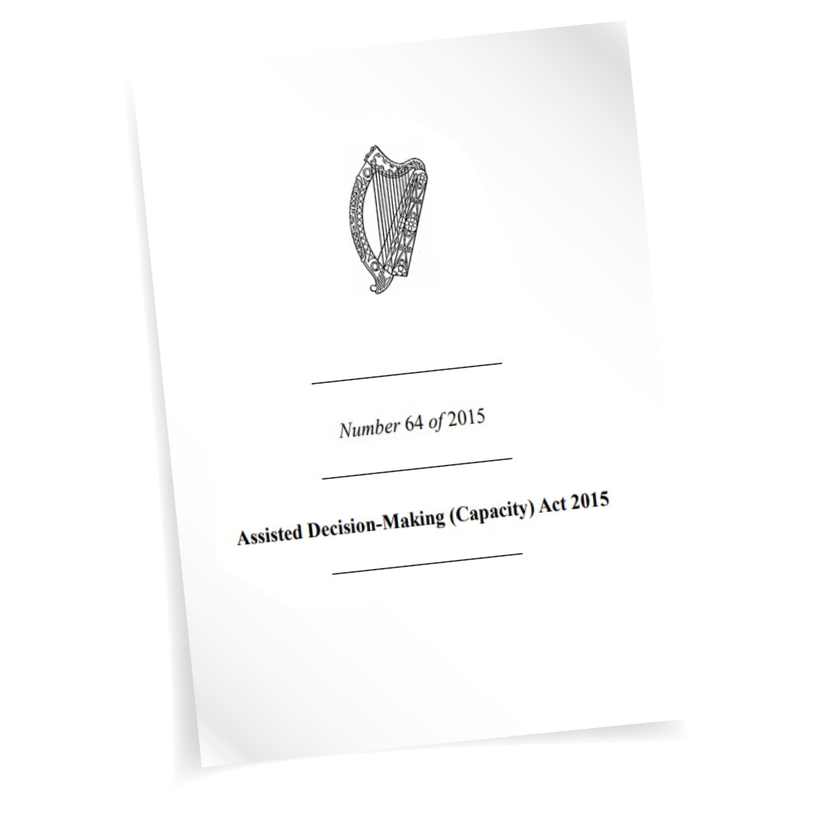

Assisted Decision-Making (Capacity) Act 2015
An Act to provide for the reform of the law relating to persons who require or may require assistance in exercising their decision-making capacity, whether immediately or in the future.
Signed into law 30 December 2015
Assisted Decision-Making (Capacity)(Amendment)Act 2022
Act (as amended) commenced 26 April 2023

Slide 3
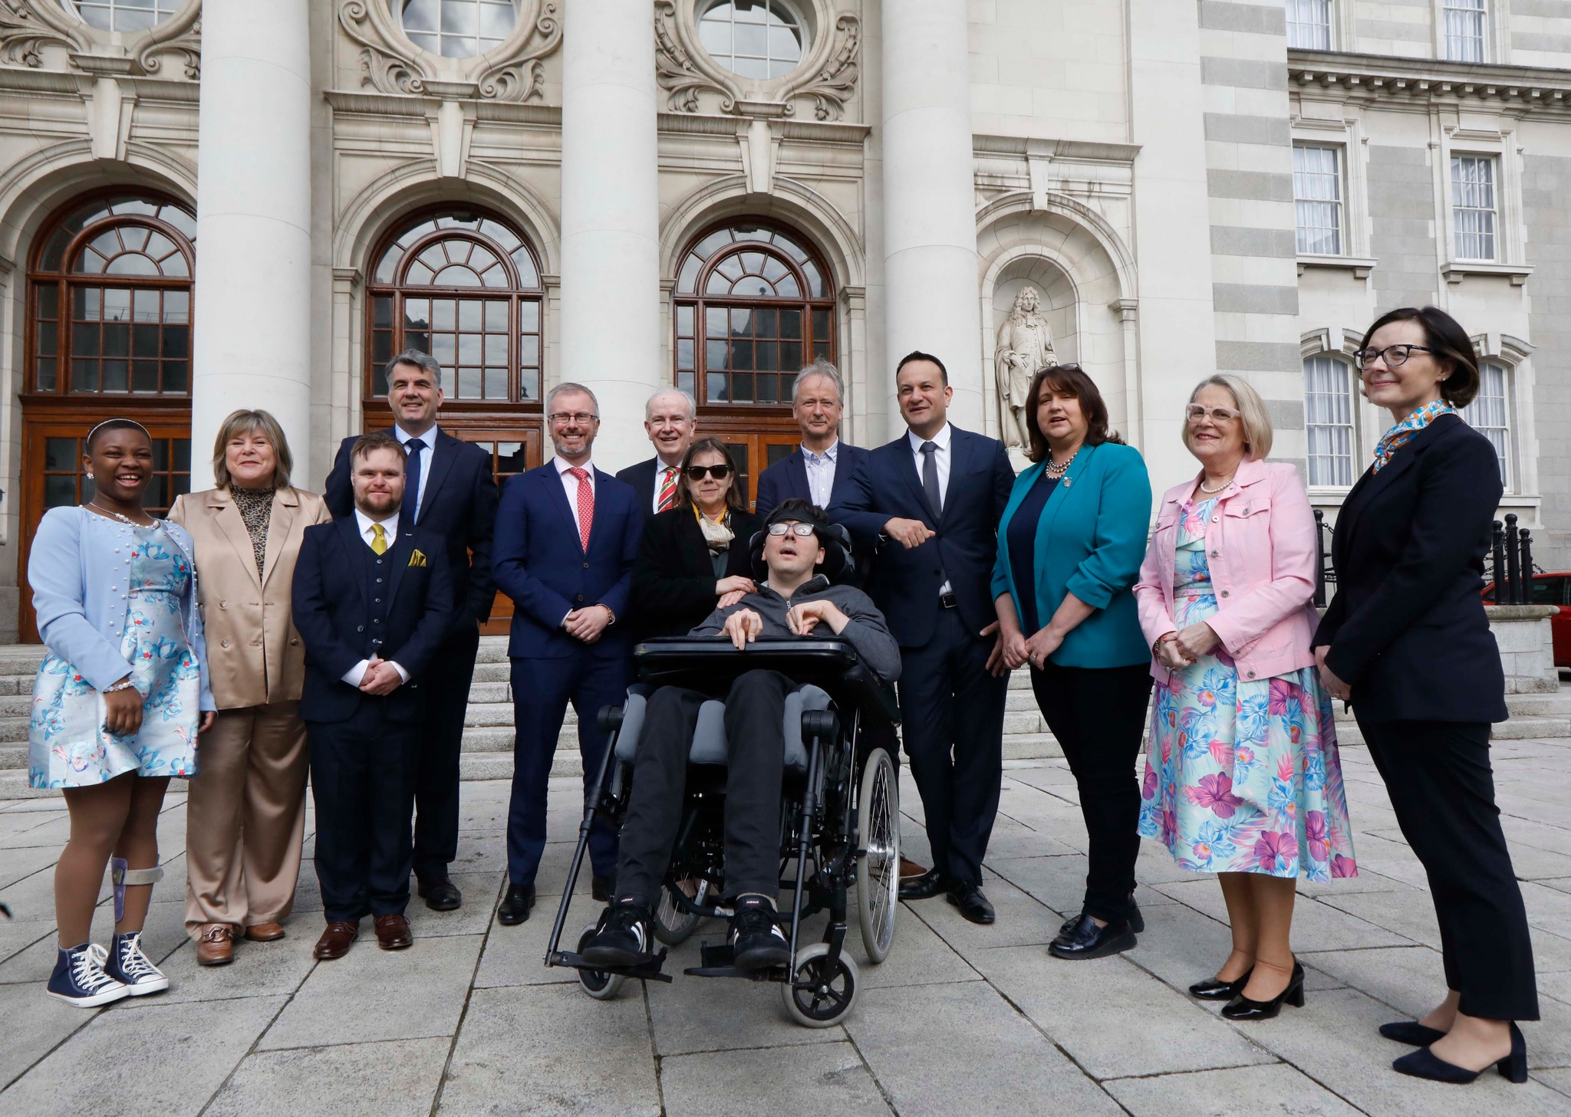
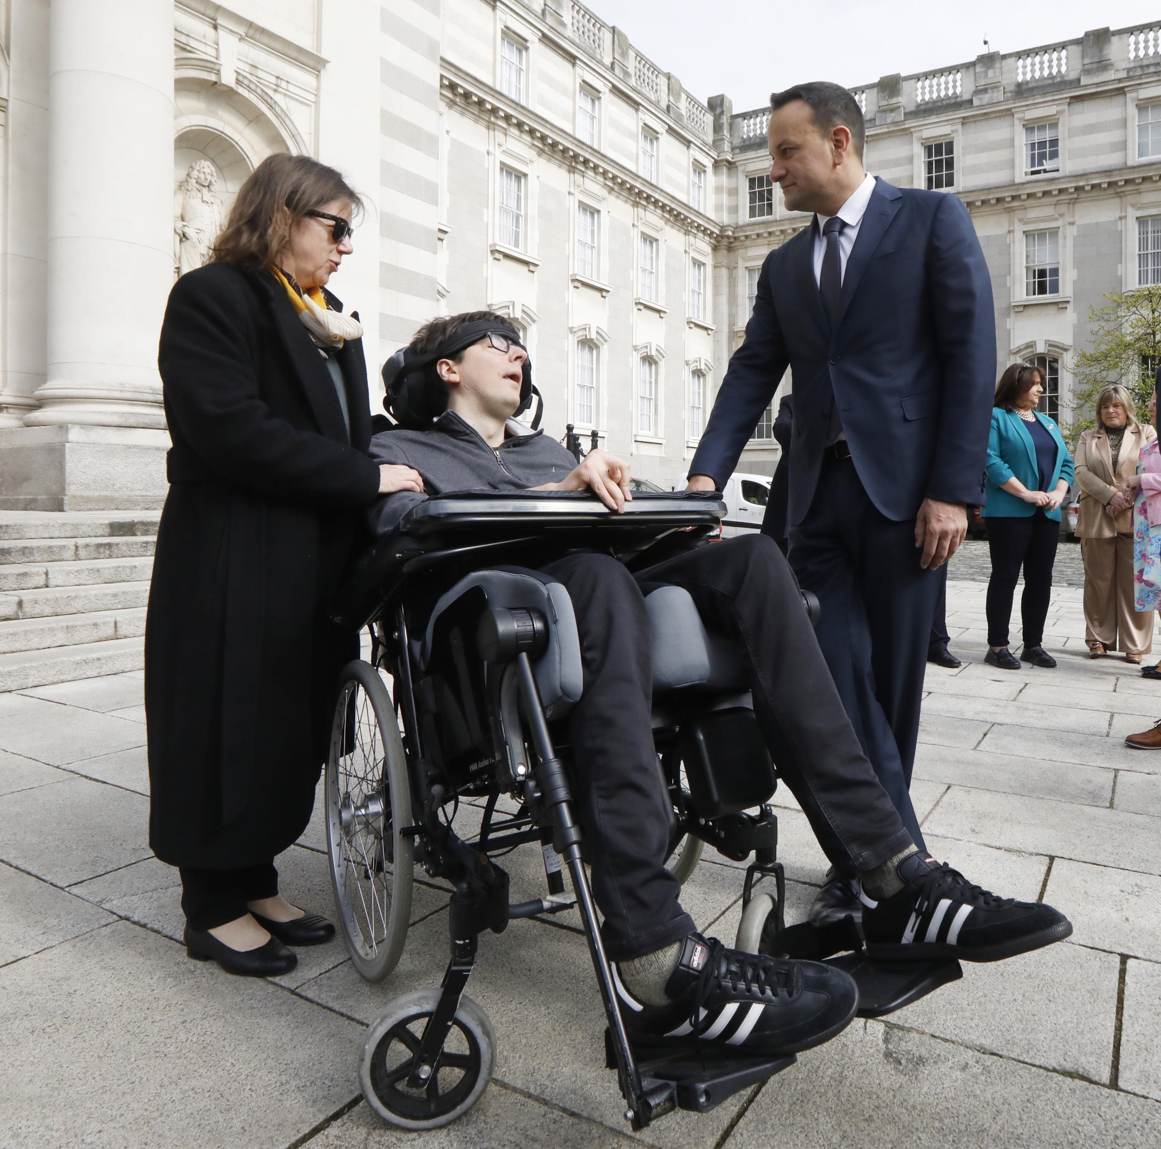
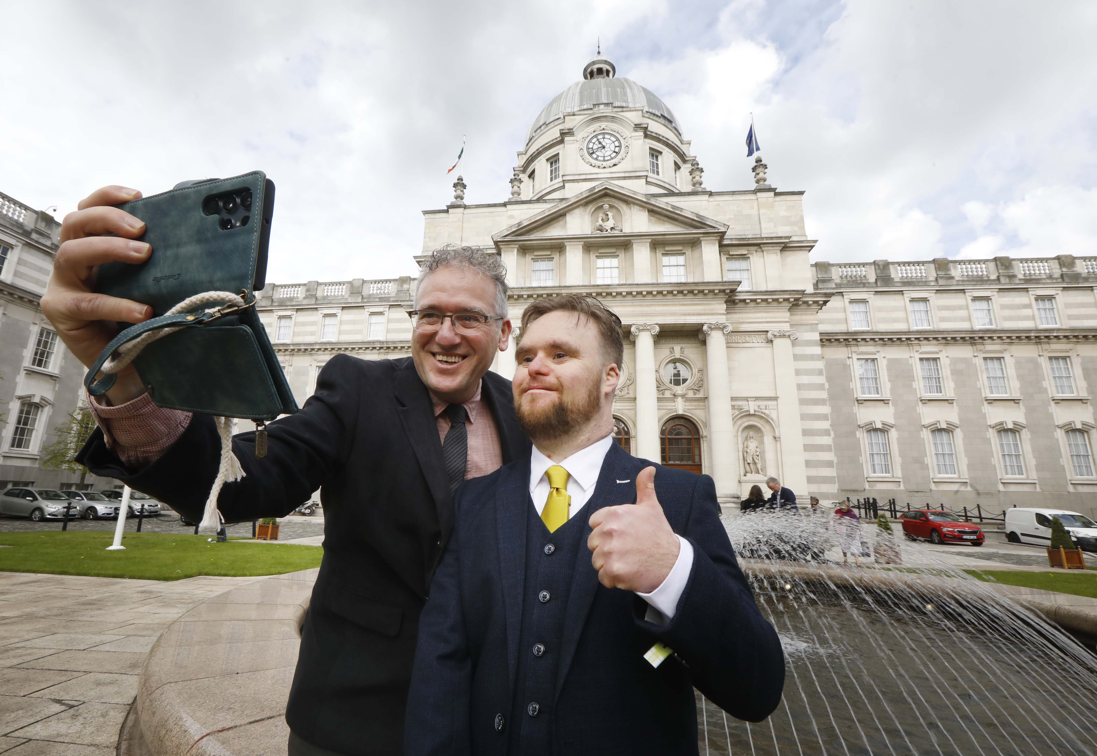
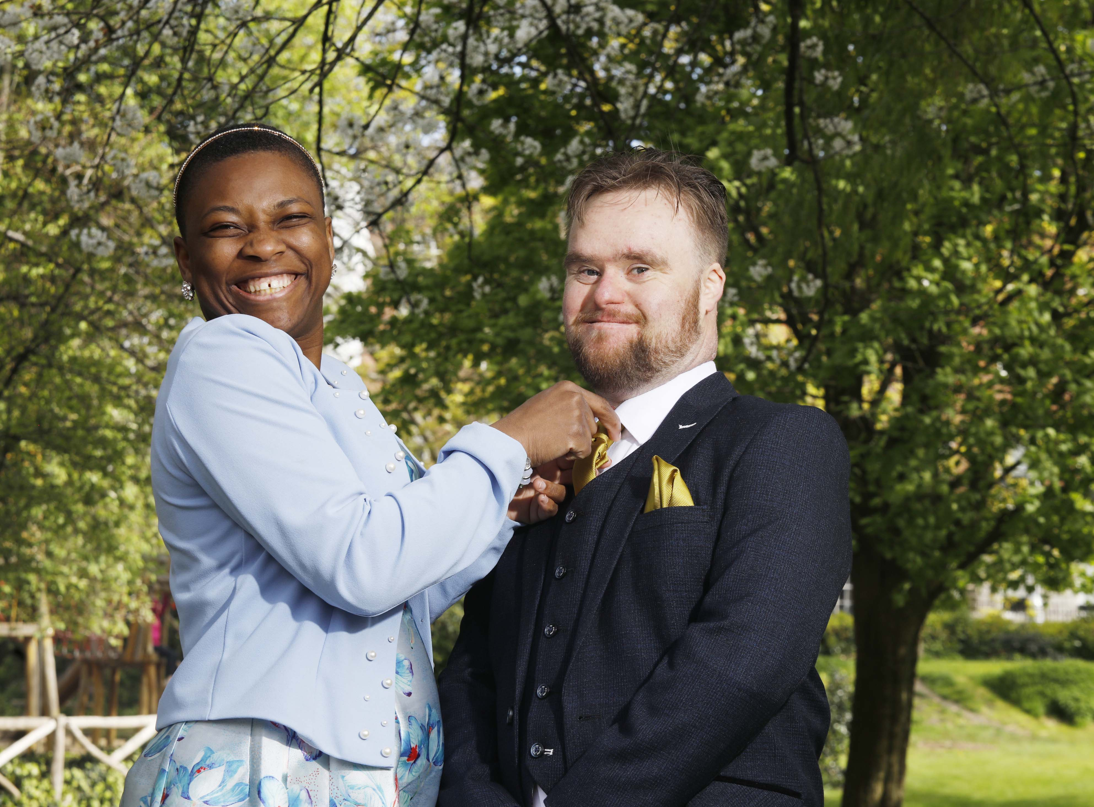

April 2023

Slide 4
Decision Support Service (DSS)
Director of the DSS is appointed by the Mental Health Commission to carry out functions conferred on the Director by the 2015 Act
- Funded by Department of Children, Disability and Equality since 2020
Functions include:
Publish codes of practice to provide guidance
Central Authority for Hague Convention on International Protection of Adults
Effective1st September 2024
Promote awareness & confidence
Provide information to relevant persons & decision supporters
Provide information & guidance to bodies on interactions with relevant persons & decision supporters
Recommend organisational change to promote the exercise of capacity
Maintain registers & supervise arrangements under the Act
Investigate complaints about decision support arrangements
Maintain panels of persons to carry out certain roles under the Act
Report and make recommend-ations to government
Updated registration statistics are published monthly on DSS website
Notes:
Stakeholder engagement/ stakeholder forum
As of 29 Aug 5287 registrations
Register searches legitimate interest – membership of bodies and classes of person
Panels- 2nd recruitment to DMR panel
Hague- not ratified by near neighbours
EU Draft Regulation for Protection of Adults

Slide 5
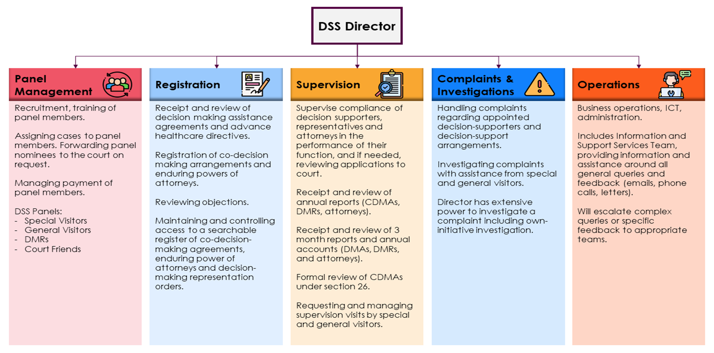
DSS Director
DSS Panels
Recruitment, training of panel members.
Assigning cases to panel members. Forwarding panel nominees to the court on request.
Managing payment of panel members.
DSS Panels:
Special Visitor
General Visitor
Decision-making Representatives
Supporting the creation of decision support arrangements
Receipt of notified decision- making assistance agreements.
Review (including consideration of objections) and registration/ acceptance of notification of co-decision-making agreements and enduring powers of attorneys.
Registration of decision-making representation orders received from court.
Maintaining and controlling access to a searchable register
Supervising compliance by decision supporters in the performance of their functions
Engagement to promote understanding of supporters’ roles and functions
Receipt and review of initial reports and annual accounts (CDMAs, DMRs, and attorneys).
Formal review of CDMAs under section 26.
Requesting and managing supervision visits by special and general visitors.
Referrals to court where required.
Managing complaints about decision supporters and decision support arrangements.
Investigating complaints with assistance from special and general visitors as required.
Exercise powers of investigation, including own-initiative investigations: summon witnesses and take up information
Apply for Temporary Prohibition Order if necessary
Escalation of complaints to court for determination
Business operations and administration
ICT: running of the digital systems
Information and Support Services Team: providing information and assistance around all general queries and feedback (emails, phone calls, letters).
Enduring power of attorney helpdesk
Escalation of complex queries or specific feedback to appropriate teams.
Notes:
IS 600-700 calls per week

Slide 6

Make decisions for people
Regulate professionals or services /
Deliver training
Directly appoint decision supporters
DSS
does not
Provide legal advice
Manage money and property

Slide 7

Statutory functional assessment of capacity
“A person’s capacity shall be assessed on the basis of ability to understand at the time that a decision is to be made, the nature and consequences of the decision in the context of available choices"
Not ‘a person of unsound mind’
Capacity is time-specific and issue- specific
No diagnostic criteria or threshold; no reference to ‘mental capacity’
A person lacks capacity if unable to:
understand;
retain;
weigh up information;
communicate a decision, with appropriate assistance if necessary
Notes:
Old habits…
Training –refer to this later

Slide 8


Guiding principles
These include:
presumption of capacity for adults
persons must be supported to make own decisions as far as possible
minimal restriction of rights and freedom of action
dignity, bodily integrity, privacy, autonomy, right to control over own financial affairs and property
An unwise decision is not conclusive of lack of capacity to decide
give effect to as far as practicable to past and present will and preferences
act in good faith and for the benefit of the person
no reference to ‘best interests’
United Nations Convention on Rights of Persons with Disabilities
Article 12: persons with disabilities enjoy legal capacity on an equal basis with others in all aspects of life
Optional Protocol ratified and came into effect 30 November 2024
Notes:
Unwise decision.. Not right to be unwise .. Not inimical to safeguarding..
Misapplication of will and pref- HSE National Consent Policy ‘Will’ carries a stronger sense of determination or planning. It incorporates a person’s values, personal beliefs and ultimate goals. ‘Preference’ means a greater liking for one alternative over another).
UNCRPD –IHREC first report to UNCRPD on all aspects of State compliance- 2015 Act mentioned a bit.

Slide 9





What decisions may be supported?
Property and affairs, including:
Personal Welfare, including
Accommodation
Education and training
Social services
Healthcare
Participation in healthcare/social care research, not including clinical trials
“…other matters relating to the relevant person’s wellbeing”
Buying and selling property
Applying for benefits
Carrying on a business
Paying debt and liabilities
Providing for other persons
Court proceedings
Section 138: Limited exceptions apply where existing law on capacity and consent is unchanged.
DSS has published Information Note
Notes:
May not must- problem solving tools
Section 138 : some clear examples- getting married- status changing decisions – can’t decide with or for, but ancillary decisions in scope – Information Note on website

Slide 10
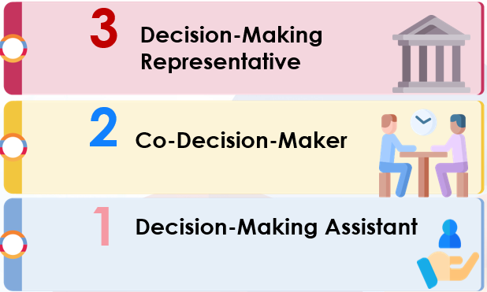

Statutory Decision Support Arrangements
3-tier framework
Instruments for Advance Planning
Enduring Power of Attorney
Advance Healthcare Directive
All ‘decision supporters’ apply the guiding principles
Eligibility criteria apply
Notes:
So it’s not a question of fitting a person into the framework – only as required
Rem you don’t rush to assess and you support as far as possible

Slide 11

Decision-making assistant (DMA)
1
‘Appointer’ is a person who considers that his or her capacity is or may shortly be in question
Relevant decisions are set out in a decision-making assistance agreement
Functions of decision-making assistant:
assist to obtain and explain relevant information
ascertain and help appointer to communicate will and preferences
assist appointer to make and express decisions
help to ensure that decisions implemented
The appointer still makes the decision
No capacity assessment required
Notified to but not formally registered with the Decision Support Service
Process is provided for by regulation (S.I. No. 205/2023)
Notes:
Stats as of 29 Aug: DMAA: 154
Some misunderstanding as to scope. The fact that these exist doesn’t mean you need one
Stats

Slide 12

Co-decision-maker (CDM)
‘Appointer’ is a person who considers that his or her capacity is or may shortly be in question
Co-decision-maker is a relative or friend in a pre-existing relationship of trust
Functions of co-decision-maker:
assist the appointer to obtain relevant information
advise the appointer, explain relevant information ascertain and help
to communicate will and preferences
make a relevant decision jointly
make reasonable efforts to ensure that decision is implemented
to acquiesce unless serious harm is foreseeable
Co-decision-making agreement takes effect when registered with the DSS
includes capacity statement by medical/other healthcare professional
Relevant decisions taken otherwise than jointly are null and void
Co-decision-maker reports to and is supervised by the DSS
Section 26: DSS conducts separate periodic reviews
2
Notes:
Stats CDMA: 133
Can take a bit of time,.
This isn’t just a confidante, collaborator- don’t have one if you don’t need one
Banks coming to terms… new ideas
Section 26 – GV reviews

Slide 13

Decision-making representative (DMR)
3
Court appointment-
Part 5 Circuit Court: application by any person with a bona fide interest in the welfare of the relevant person or
Part 6 wardship court on review and discharge of a former ward
DSS is not a party to court applications
Court Rules set out the process;
Courts Service: information about applications to court
The court may make a declaration about the person’s capacity:
relevant person lacks capacity unless assisted by a co-decision-maker
relevant person lacks capacity even if a co-decision-maker were made available
this declaration is kept under review by Circuit Court every 12 or 36 months
Court may make a decision-making representation order, appointing a DMR
Notes:
Every CCt –some busier than others
Not uniform but moving to use of template – increasingly fine-tuned- balance between not having to keep returning and not making it too broad- not wardship
CDMA challenges
Section 49

Slide 14

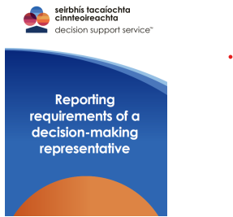
Decision-making representation order (DMRO)
Court has regard to matters including:
will and preferences of the relevant person
desirability of preserving family relationships
any conflict of interest
complexity of decisions and expertise available to DMR
‘Joan Doe’ v. HSE Dublin Circuit Court, 8 December 2023
Where no suitable, willing DMR, court shall seek nominations from the DSS panel
Court may include limitations and conditions in DMRO as appropriate
In the Matter of AB Dublin Circuit Court, 9 October 2024
Court may appoint more than one DMR
Provisions for re-entry, variation and discharge
DMRO representation order is sent to the Decision Support Service for registration and supervision of reporting duties.
Notes:
Themes of applications
DSS Panel – 2 nd phase or recruitment- not self dealing
AB concerned transfer of property in lifetime of RP – Ct ruled DMR did not toi do that and oblig to provide meaningful representation even if you can’t take instructions
We have developed guidance

Slide 15

Functions of DMR
Make decisions on behalf of & act as agent for the relevant person
DMR keeps accounts and submits reports to the DSS
Authority is based on court order; restrictions apply
Ascertain and assist with communication of will and preferences
DMR may not make decisions about refusal or discontinuation of life-sustaining treatment
May not prohibit contact by another person
A DMRO may not authorise restraint or detention
Section 43: specific provision must be made for gifts
Notes:
You haven’t; become the carer, decision-maker in all day to day matters
Support the supporter

Slide 16
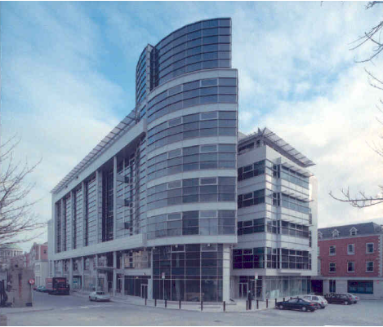
Part 6 review and discharge of current wards of court by the wardship court
All adult wards must be discharged from wardship within 3 years of commencement by 26 April 2026
Minor wards must be discharged from wardship within 6 months of 18th birthday
Office of Wards of Court manages applications:
Discharge Process
DSS has collaborated on information and events for wards, committees and families
Wardship court may make declarations and orders similar to the court under Part 5
An order of the wardship court detaining a person in an approved centre or other institution on commencement of the Act shall be reviewed by the wardship court as soon as possible.
High Court has ruled against new detention orders in wardship: if the ward was not detained at the time of commencement, the court wardship court may not now detain (In the Matter of KK, 7 June 2023 and Court of Appeal, 11 October 2024)
Part 10 review of detention orders in wardship
Notes:
133 registered WOC cases
118 currently active (8 closed due to replacement DMR / 7 RIP)
83 panel members appointed on 81 active cases (69% of cases)
7 cases where panel member is appointed alongside family member
30% of cases where family member is appointed more than one DMR is appointed

Slide 17
Enduring Power of Attorney: new 2-stage process
Stage 1: Registration
Stage 2: Notification
Attorney(s) notify DSS when donor loses capacity for one or more decisions that are included in the EPA
Evidence needed that donor has lost capacity for the decisions
DSS reviews notification application
DSS reviews for compliance, considers any objections and registers EPA if appropriate
Supporting documents include a capacity statement
If notification is accepted, then EPA comes into effect
Donor executes the EPA and submits to the DSS
Notes:
The enduring power of attorney process under the 2015 Act is a two-step process.
Both steps require the completion and submission of supporting documents to the DSS to accompany the application and these are reviewed by the DSS as part of that process.
EPAs have been available since 1996- no first stage- advantage of opportunity to scrutinise while the donor is still in a position to engage

Slide 18

DSS ‘digital first’ approach
Director may certify an electronic copy as a true copy
An applicant can open secure authenticated portal MyDSS account to complete forms unique to the applicant, access supporting documents, upload and submit for registration
‘Digital first but not digital only’; alternatives are provided to facilitate accessibility issues
DSS Accessibility Policy (July 2024): to focus supports where needed
Dedicated EPA helpdesk in place since September 2024
Notes:
EPA: 3,692 EPA (registration application): 2,397
EPAs (notified): 116

Slide 19

EPA: New supervision and reporting requirements
After second stage acceptance of notification, attorney must :
Submit- within 12 months and annually- a report to the DSS on performance of functions to include details of expenses and remuneration
Additionally, if authorised in respect of property and affairs:
submit within 3 months a schedule of assets and liabilities, and projections of income and expenditure
keep accounts and financial records and make these available for inspection by the DSS
If reporting is incomplete, Director may determine that the attorney should no longer act and remove from the register
determination may be appealed to the Circuit Court
Notes:
Haven’t had to apply yet for removal

Slide 20


EPA Helpdesk In–Person Event
Galway, November 2024
Notes:
Cork, Portlaoise, Dublin next

Slide 21

Advance healthcare directive (AHD)
Treatment in relation to a person means:
an intervention that is or may be done for a therapeutic, preventative, diagnostic, palliative or other purpose,
related to the physical or mental health of the person
and includes life-sustaining treatment
Treatment may be refused by an adult with capacity for any reason even though refusal:
appears unwise
not based on sound medical principles
may result in death
Purpose of an advance healthcare directive:
to enable person to be treated according to will and preferences
to provide healthcare professionals with information about treatment choices
Notes:
% of people who have an AHD Recent survey suggest as low as 4%. We don’t see them.
Advanced planning will be the focus of our next public info campaign

Slide 22
Advance healthcare directive
Refusal of treatment in an AHD is as effective as if made contemporaneously
Directive-maker may appoint a designated healthcare representative:
AHD :
may extend to life sustaining treatment; must be explicit
may not include refusal of basic care
does not require registration to be valid
Minister for Health may make regulations to provide for a DSS register; none at present
Minister for Health has approved a template AHD for guidance; now published on the DSS website
Process applies where there is doubt about validity and applicability; court may determine
Protections from civil and criminal liability for healthcare professionals
Existing criminal law (murder, manslaughter, assisted suicide) is unchanged
Treatment decisions may not be included in an EPA
Notes:
AHDs and detention under the Mental Health Act

Slide 23
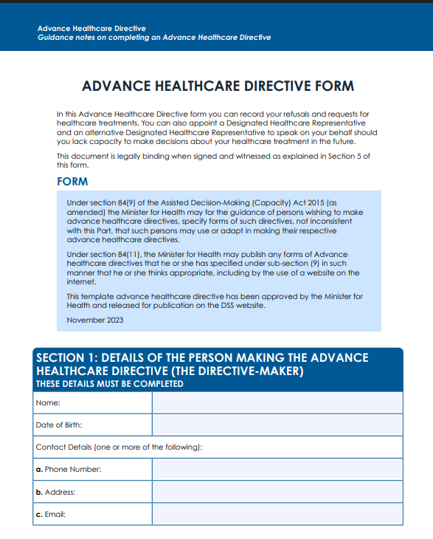
Approved template advance healthcare directive available on DSS website

Slide 24



Advance Planning Campaign

Slide 25


Investigations of Complaints
Grounds of complaint
Director powers
Acting outside scope
Unsuitability
Arrangement not in accordance with will and preferences
Fraud, coercion, undue influence
Capacity issues
Breach of function or a breach of Act, including guiding principles
A complaint may be made to the DSS against an attorney under the Powers of Attorney Act 1996
Commission a special or general visitor
Summon witnesses
Take up evidence
Escalate to court
Temporarily suspend pending investigation
Escalate for criminal investigation, if necessary
Conduct own initiative investigations
Resolve informally
Complaint may be raised by any person
Notes:
PF’s data: Complaints received 110 since commencement- over half that , 57 already this year. 23 open investigations; a little over 50% concern an EPA under the old Act.
Gist of complaints; only one application to court- effort to resolve informally

Slide 26
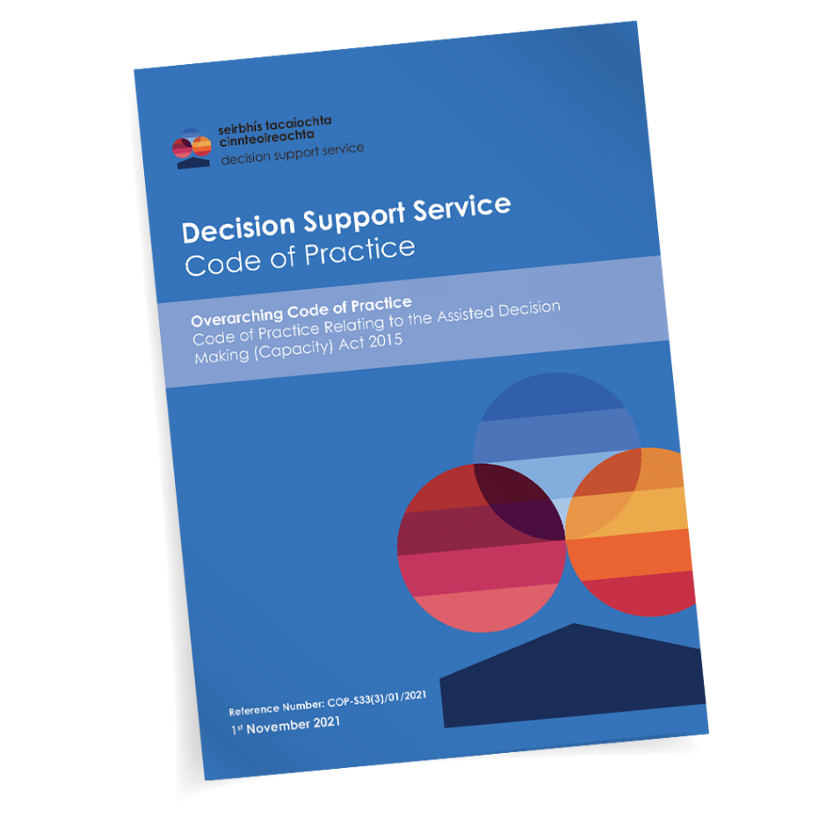
Codes of Practice
general guidance code on supporting decision-making and assessing capacity
guidance for professionals
codes published with Ministerial consent
A person concerned shall have regard to a code of practice when performing any function under the Act in respect of which the code provides guidance
codes are available on the DSS website with other materials and resources
Notes:
Quoted a bit in judgments…

Slide 27

Matters arising?
Applications in Inherent Jurisdiction
Protection of Liberty Safeguards- being developed by the Department of Health
Mental Health Bill 2024/ alignment with 2015 Act
Alignment of other legislation and policy with 2015 Act
Statutory review of operation and effectiveness of the 2015 Act/
potential amendments?
Implementation of 2015 Act in diverse sectors
Challenges of promoting public and professional confidence and awareness
Evolving caselaw
Notes:
Act did not amend everything- NHSS Act, Union Act
Mother and Baby Home Redress… Consumer Protection Code- references 2015 Act
Key thing is the roll out in other sectors and embedding it in public conscientiousness.. Challenge of next of kin myth

Slide 28
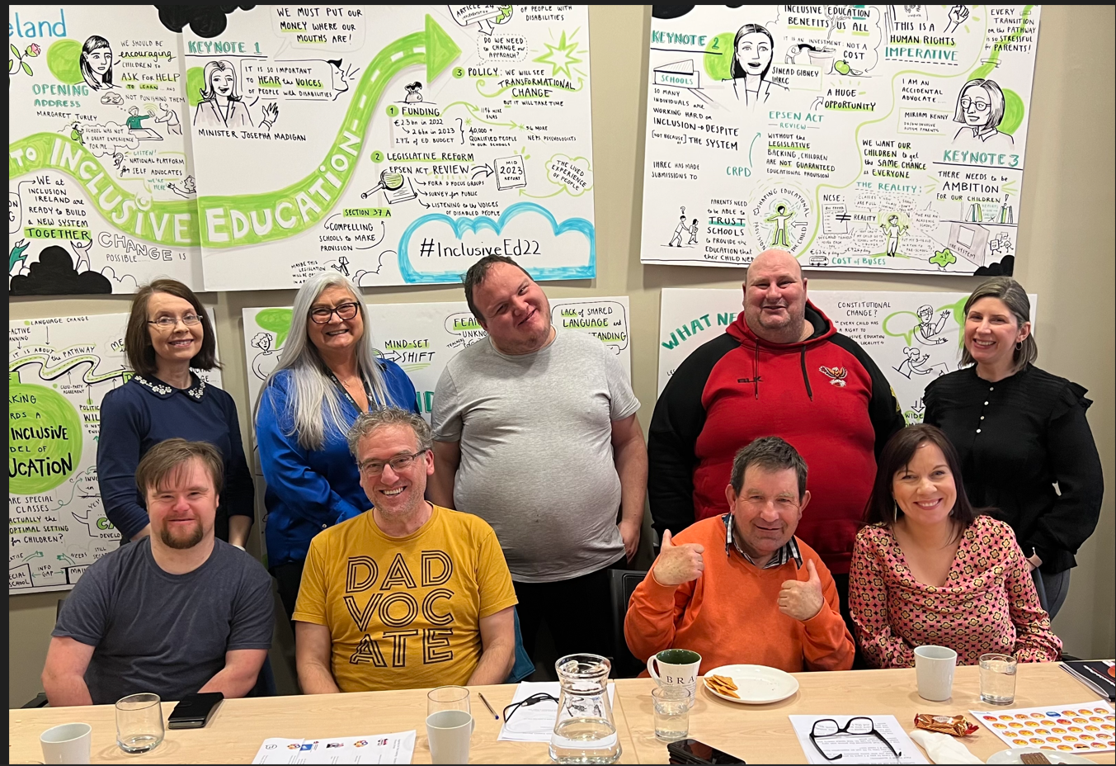

Slide 29


Thank You
www.decisionsupportservice.ie/
Email: queries@decisionsupportservice.ie
Telephone: 01 2119750
This presentation is intended as an overview of aspects of the Assisted Decision-Making (Capacity) Act 2015 and related matters and should not be relied on as legal advice or opinion

