Slide 1
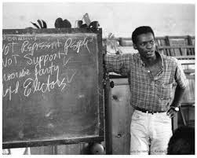
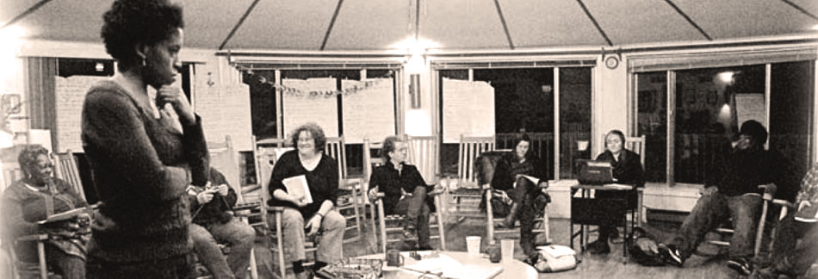
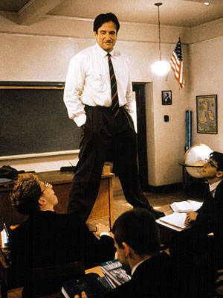
Pedagogies of Hope:
Engaged Teaching, Social Justice & the Future of Education

Slide 2
Agenda
1. teaching in general [exercise #1]
2. context for the rise of engagement
3. History and Theory
4. definitions and landscape
5. 101—best practices
6. Course mapping [exercise #2]
7. Break
8. Defining Social Justice [exercise #3]
9. Social Justice and Service Learning
10. Mapping a Case Study
11. Critical Community Engagement
12. The Three R’s

Slide 3
Exercise #1
Please take a few minutes to write down—to the best of your memory and ability—why you became a teacher/professor/scholar?

Slide 4
Exercise #1a
Next, pair off with someone and explain what you wrote and why you wrote what you did

Slide 5
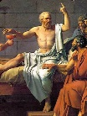
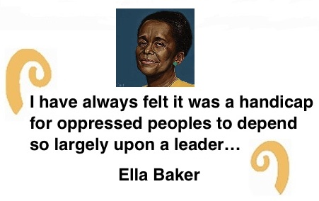
Part One: The Politics of Teaching
Teaching is not an objective practice. Like good Doctors who want to help their patients and engineers who want to build things that work, teachers embrace rigorous research, empirical observation and evidence, textual analyses, theoretical inquiry and experiential reflection to BEST educate their students. The analytical process may engage and even pursue objectivity to a degree, but the pedagogical enterprise is driven by the subjective desire to teach effectively, not transfer information transactionally but create knowledge transformationally, to make the world a better place.

Slide 6
Why We Can’t Teach
“You cannot teach a man anything, you can only help him find it within himself.” ― Galileo Galilei
“I never teach my pupils, I only attempt to provide the conditions in which they can learn” --Albert Einstein
“[Kids] don't remember what you try to teach them. They remember what you are.” ― Jim Henson

Slide 7
Why We Shouldn’t Teach
“It would seem that you have no useful skill or talent whatsoever," he said. "Have you thought of going into teaching?” ― Terry Pratchett
Everybody who is incapable of learning has taken to teaching.” ― Oscar Wilde
He who can, does; he who cannot, teaches.” George Bernard Shaw

Slide 8
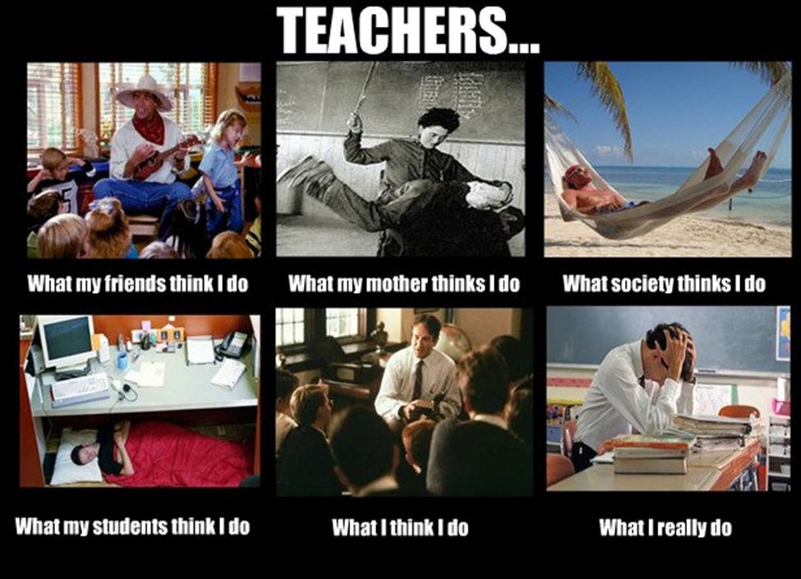

Slide 9
Why We Teach?
1. Personal Fulfillment
2. Altruism
3. Idealistic or Moral Vision of Social Change
4. Autonomy and Creativity

Slide 10
Why Young People are Becoming Scholars and Teachers in Higher Education
I. DECIDING TO BE A PUBLIC SCHOLAR
Establish “public good” focus area for teaching, scholarship, creative work
II. BUILDING A KNOWLEDGE FOR PUBLIC SCHOLARSHIP
Identify civic, public, community issues in your field and know who is working on them
Map campus (people, programs, pathways) and Map community (people, programs, issues)
III. DEVELOP SKILLS: PRIORITIZE AND START TO ACQUIRE THEM
Teaching, networking, presentation, writing and speaking accessibly
Ethnography and oral history
IV. MENTORING PUBLIC SCHOLARS
Get mentoring , Peer mentoring, Give mentoring
V. DOING PUBLIC SCHOLARSHIP
Participate in Preparing Future Faculty program

Slide 11
Education at the Crossroads
The corporate, commodity driven institutional and economic utilitarian paradigm
                OR
                The Generative and Democratically Driven Paradigm including social responsibility and citizenship

Slide 12
Bell Hooks and the Spirit of Engagement
To educate as the practice of freedom is a way of teaching that anyone can learn. That learning process comes easiest to us who teach who also believe that there is an aspect of our vocation that is sacred; who believe that our work is not merely to share information but to share in the intellectual and spiritual growth of our students. To teach in a manner that respects and cares for the souls of our students is essential if we are to provide the necessary conditions where learning can most deeply and intimately begin.
http://www.stonehill.edu/faculty/faculty-focus-2015/

Slide 13
History of Engaged Learning- U.S.
Cambridge Handbook
Table of Contents
2 - Religion and Civic Engagement pp 42-50
By Darby Ray
3 - Jane Addams, Feminist Pragmatism, and Service Learning pp 51-63
By Mary Jo Deegan
4 - Historically Black Colleges and Universities pp 64-70
By Kisha Daniels, Kianda S. Hicks, Miya T. Plummer
5 - Recovering a Forgotten Lineage of Democratic Engagement pp 71-80
By Scott J. Peters
6 - Labor Education and Workers’ Colleges pp 81-92
By Corey Dolgon, Reuben Roth
7 - Connecting Civil Rights and Community Engagement pp 93-98
By Matthew Countryman, Timothy K. Eatman
8 - Ernest Boyer and the Rediscovery of Integration pp 99-111
By Thomas G. McGowan
9 - A Brief History of the Civic Engagement Movement in American Higher Education* pp 112-124
By John Saltmarsh, Matthew Hartley

Slide 14

Experiential and Engaged Pedagogy
* John Dewey and Guided Reflection
* Jane Addams--community based learning and research
Educated young people are seeking an outlet for that sentiment of universal brotherhood, which the best spirit of our times is forcing from an emotion into a motive.” They feel a fatal want of harmony between their theory and their lives, a lack of coordination between thought and action… These young men and women, longing to socialize their democracy, are animated by certain hopes which may be thus loosely formulated; that if in a democratic country nothing can be permanently achieved save through the masses of the people, it will be impossible to establish a higher political life than the people themselves crave; that it is difficult to see how the notion of a higher civic life can be fostered save through common intercourse; that the blessings which we associate with a life of refinement and cultivation can be made universal and must be made universal if they are to be permanent; that the good we secure for ourselves is precarious and uncertain, is floating in mid-air, until it is secured for all of us and incorporated into our common life.

Slide 15
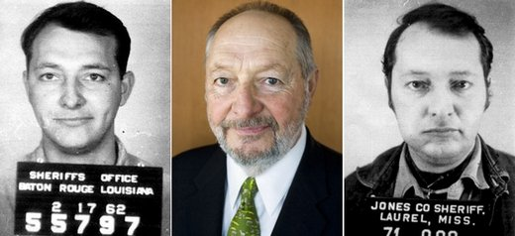

Developing competence in ethical and moral reasoning and action: integrating personal and social responsibilities, applying in learning and in life.
Thought and Action
Values in Practice
The Individual and Society
The Purpose of Education
“The sit-ins have given us an opportunity for “the word to become flesh. They have inspired us to build a new image of ourselves in our own minds.”
http://www.youtube.com/watch?v=zS-nG7WByqY

Slide 16
The World of Service Learning and Community Engagement
What, Why, and How?

Slide 17
Definitions
Civic Engagement
Community Service
Experiential Education
Service-Learning
Community Engaged or Community Based Learning
Community-Based Research
Internships

Slide 18
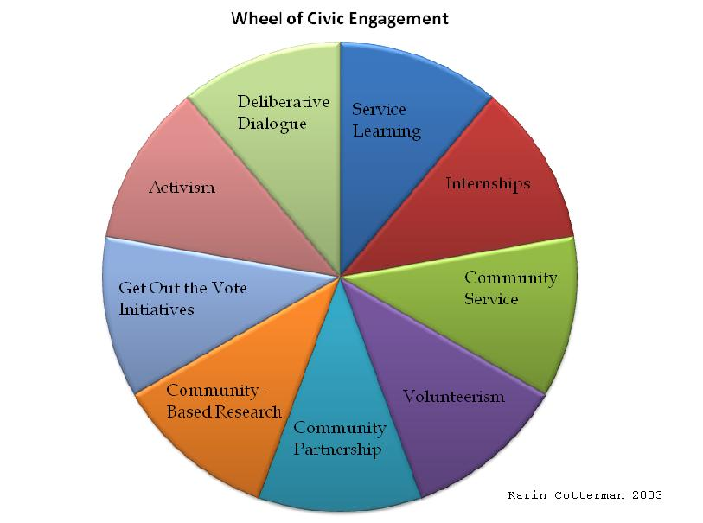
Trajectory

Slide 19
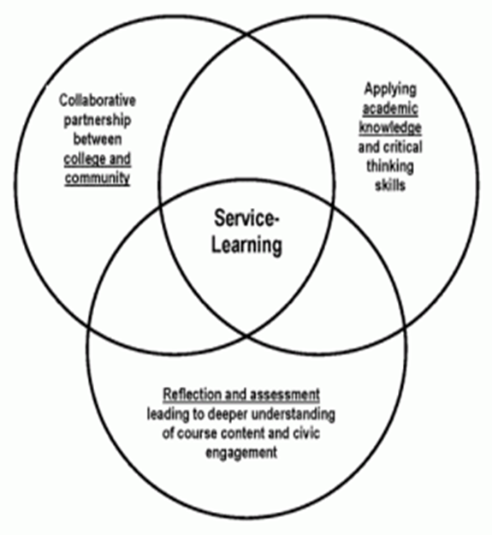
Integration Model

Slide 20
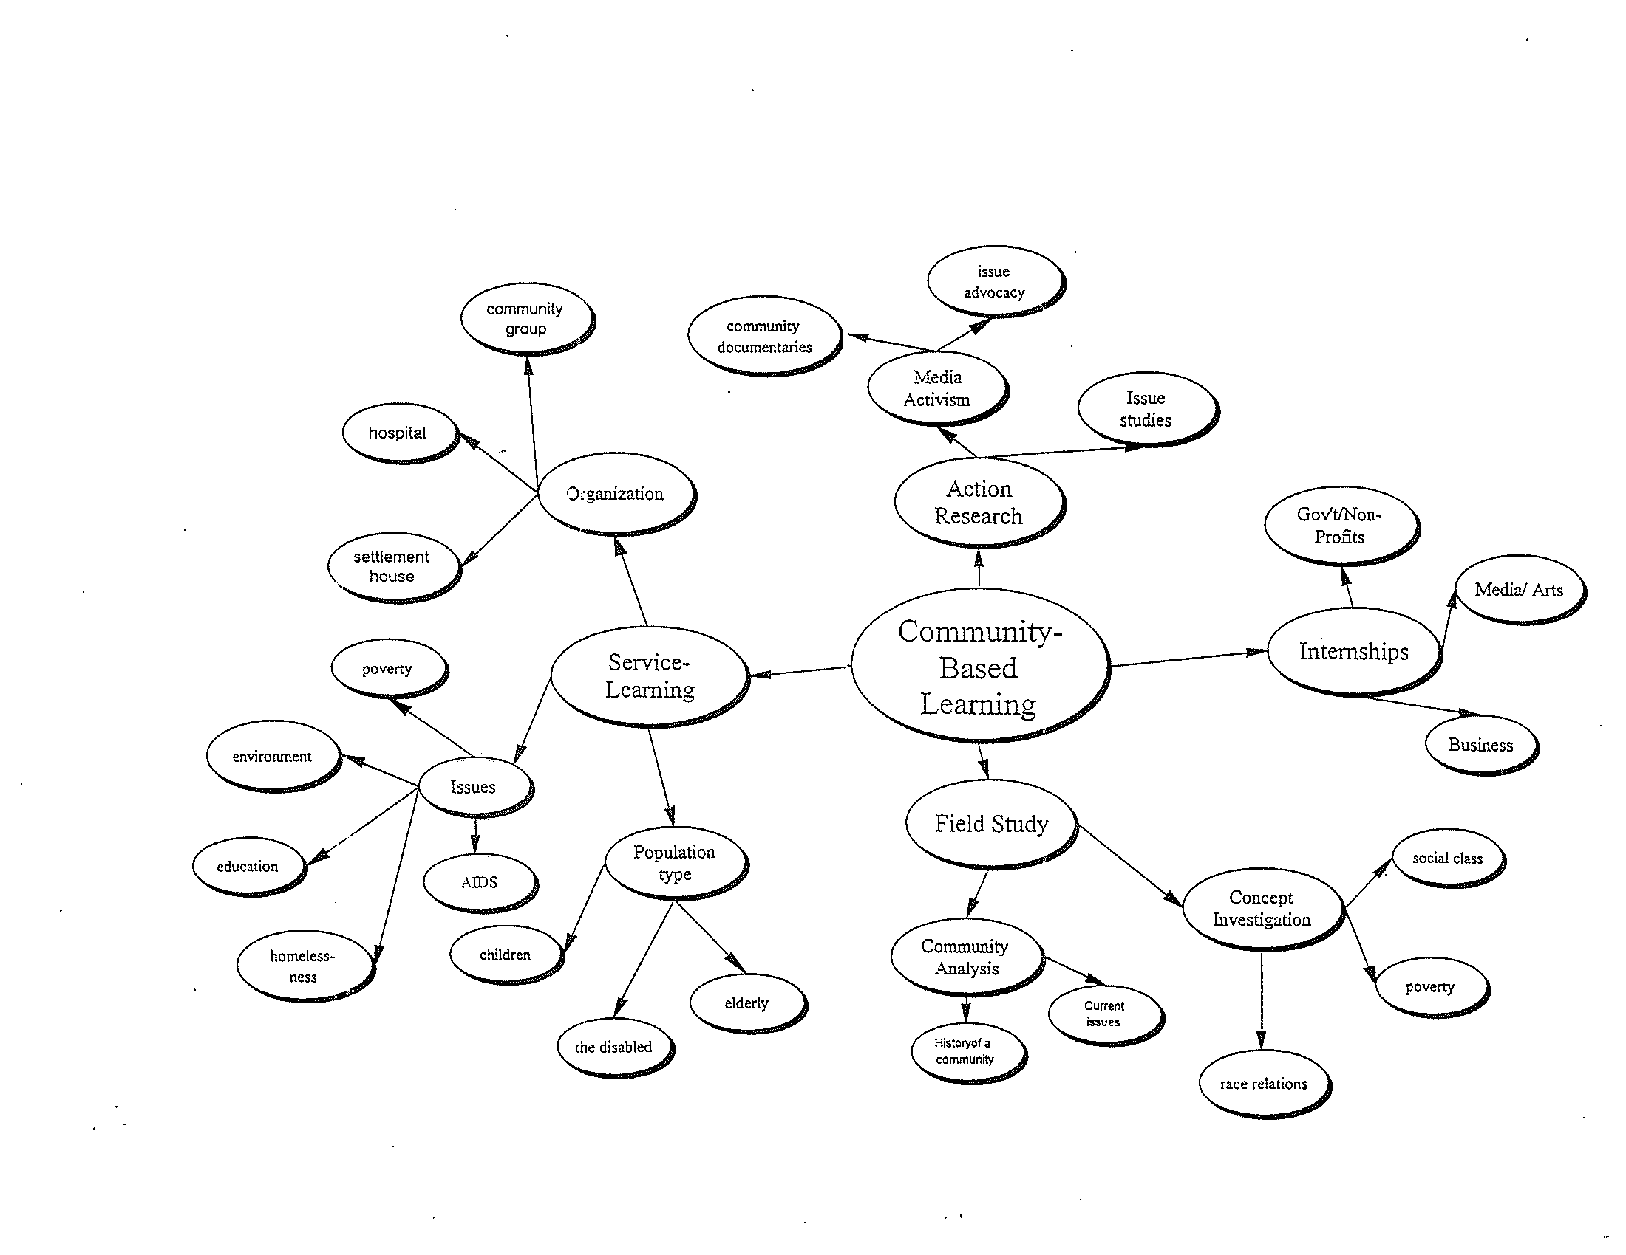
Theory 2: Range of Experiential Pedagogy

Slide 21
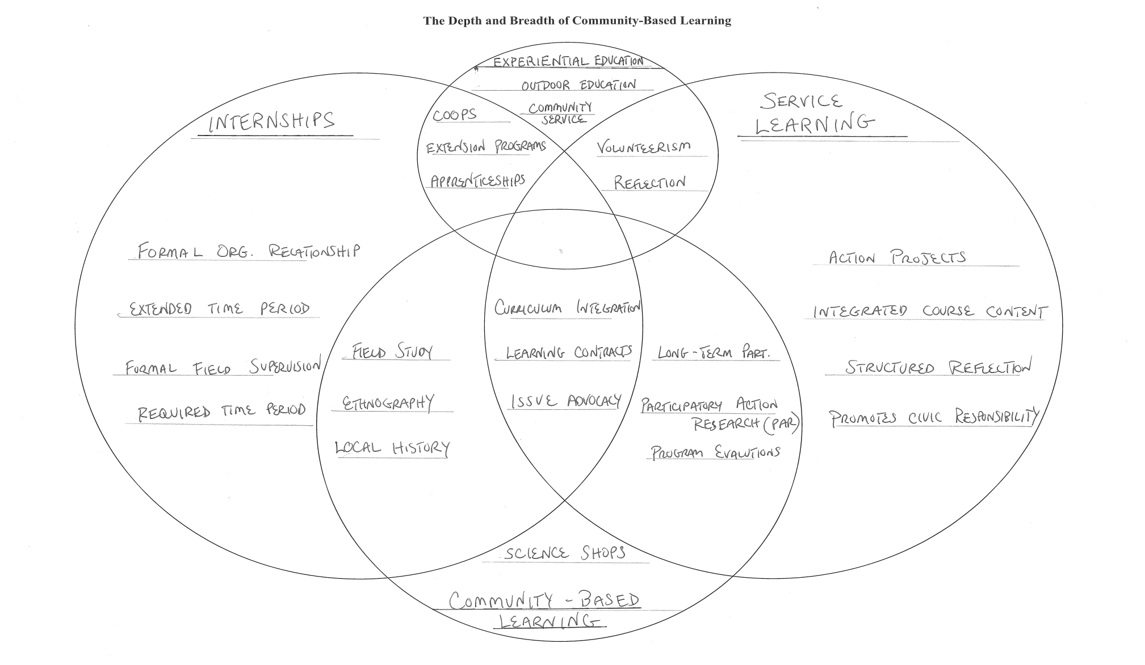
Theory 3: The Depth and Breadth of Community Based Learning

Slide 22
Principles and Practices
Bob Sigmon’s 3 principles of service learning
1. Those being served control the service(s) provided
2. Those being served become better able to serve and be served
3. Those who serve also are learners and have control over what is expected to be learned
John Reiff’s Five Steps to Best Practices
*Preparation—faculty need to identify goals (learning outcomes and community needs),
but students should learn about the community they enter and the work they will need to do.
*Action—Is there reciprocity for community and is their voice included in designing service?
*Reflection—Faculty and students should understand action and reflection as an ongoing
conversation of discussing both learning outcomes and community impact.
*Evaluation—Assess outcomes and impact, understanding that with evaluation new goals and
new outcomes should emerge for students, faculty and possibly community as well.
*Celebration and Acknowledgement—All projects , all participants recognize growth and accomplishments.

Slide 23
Academic credit is for learning, not for service
In traditional courses academic credit and grades are assigned based on students' demonstration of academic learning as measured by the instructor.
It is no different in service-learning courses.
In service-learning courses we evaluate students' learning from traditional resources, from the community service, and from the blending of the two.

Slide 24
Do not compromise academic rigor
Widespread perception in academic circles that community service is a "soft" learning resource, temptation is to compromise academic rigor in service-learning courses.
But s-l students must not only master academic material, but also learn how to learn from unstructured and ill-structured community experiences, merging experiential learning with other course resources.
Furthermore, while in traditional courses students must satisfy only academic learning objectives, in s-l courses students must satisfy both academic and civic learning objectives.

Slide 25
Prepare students for learning from the community
Most students lack experience with both extracting and making meaning from experience, and in merging it with other academic and civic course learning strategies; and they rarely know much about the history and diversity of the communities they engage. Therefore, even an exemplary reflection journal assignment will yield, without sufficient support, uneven responses.
Faculty can provide:
Learning supports such as opportunities to acquire skills for learning from the service context ( e.g., participant-observer skills);
Examples of how to successfully complete assignments (e.g., past exemplary student papers and reflection journals, etc.;
Give students history tours, lectures, materials as well as diversity training and recognition of structural inequality.

Slide 26
Community Based Learning 101
Learning Outcomes— how will pedagogy of engaged learning enhance traditional learning outcomes; what new learning outcomes are encouraged and how might they be assessed?
Community Partnerships—site for service or research; what would students do and what role should faculty and partner play?
Preparation—What local knowledge do students need and specific training for service, etc.? What training will facilitate engagement, reflection, learning, etc.? [community Build and the Story of change at stonehill college].
Action—Logistics, logistics, logistics, but don’t have the learning get lost in the logistics and as much as possible fold logistical challenges into the learning.
Reflections—Make sure there are ongoing opportunities for students to reflect on their engagement, the impact of their work, the partner’s work, and how integrating course content and knowledge informs their analysis.
Celebration—debrief and processing as well as honoring both student effort and community participation

Slide 27
Partnerships: CCPH’s 10 principles
1. Partnerships form to serve a specific purpose, may take on new goals over time
2. Agreed upon mission, values, goals, & measurable outcomes for partnership.
3. Relationship has mutual trust, respect, genuineness, & commitment.
4. Builds on identified strengths & assets, but addresses areas for improvement.
5. Balances power among partners & enables resources to be shared.
6. There is clear, open communication—listening, common language, terms validated & clarified
7. Roles, norms, & processes for the partnership established collaboratively by the partners.
8. Feedback to, among, & from stakeholders to improve partnership & outcome.
9. Partners share the credit for the partnership's accomplishments.
10. Partnerships take time to develop and evolve over time.

Slide 28


Hugh Sockett’s 4 Stages of Partnerships
Service
Exchange
Cooperative
Systemic/Transformative
---------------------------------------------------------------
Hollander & Dolgon 3 Levels of Partnerships
Immediate or Transactional Projects
Sustainable Relationship
Transformative Strategies

Slide 29
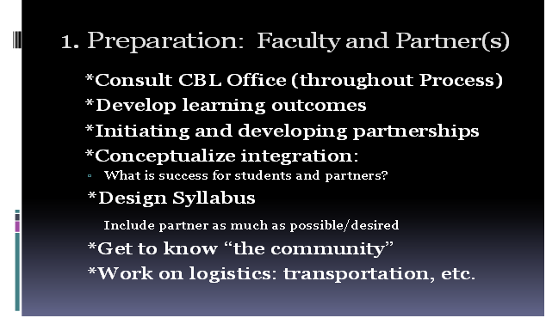

Slide 30
Preparation for Students
1. Explanation of CBL Component
2. Diversity and Community Training
3. Research or Methods Training (interviews, obs., etc.)
4. Journaling
5. “Tips” sheet from appropriate support offices
6. Risks or liability (community engagement office?)

Slide 31
Action
1. Initial Class Meeting with Partners
2. Bringing Students into the Field
3. Conducting Research and/or Service
4. Documentations, Reflection and Analysis (journals, etc.)
4. Encourage Conversations
  A) partners
  B) residents
  C) clients
  D) among themselves

Slide 32


Reflection
*Begin Process of Reflection in Class
*Discuss Reflection and Action as
ongoing process and the dynamic of Praxis
*Consider ways to integrate partner
into reflective process
*Early Data on Learning Outcomes suggests more often and more substantive reflection the stronger the outcomes

Slide 33
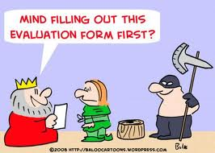
Evaluation
Learning Outcomes & Community Impact
  Standard Measures—qualitative & quantitative
  New means for measuring local impact
  Unheard Voices and unethical data
  All Players should be heard who have stake in the projects and the assessment—returning to original principles of Bob Sigmon.

Slide 34
Course examples
Humanities—History and Public Arts: Stonehill College and Brockton’s Cape Verdean Association
Social Sciences—Research Methods: Stonehill College and The Community Connections of Brockton
Natural Sciences—Plant Biology: Stonehill College and Community Gardens; neuropsychology—HOPe House
Professional Division—Marketing: Stonehill College and Burrito Wraps

Slide 35
Critical Engagement Map
Community Organization
Community Goals Higher Ed. Goals
Campus Partnership

Slide 36

Community Organization
Strategies for Change Services/Research
Community Goals Higher Ed. Goals
Curriculum Project (Theory & Method)
Campus Partnership

Slide 37
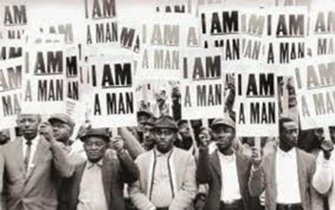


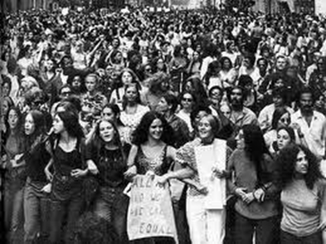
What is Social Justice?
Take just a minute or two and write down your definition or description of what social responsibility and social justice are or should be. Make sure to distinguish between the two if you think it is important to distinguish. Report back

Slide 38
Social Justice
1. The goal of social justice education is full and equal participation of all groups in a society that is mutually shaped to meet their needs. Social justice includes a vision of society that is equitable and all members are physically and psychologically safe and secure." Teaching for Diversity and Social Justice: A Sourcebook.
Edited by Maurianne Adams, Lee Anne Bell, and Pat Griffin.
2. “Concepts of “fairness” and “equality” as the key components… respondents focused on the distribution of resources and fairness in the way society treats people. The concept of equality was referred to almost as much as fairness and often in conjunction with it. Most common were references to equality of opportunity and equality of outcomes.
    Inquiry into the Future of Civil Society in the UK and Ireland, www.futuresforcivilsociety.org
3. Social Justice is a set of principles and a process that govern humans’ behavior to one another and the natural world. Social justice is based on the premises that society is characterized by inequalities in resources and influence, and that individual and collective actions can and will transform society. Social justice promotes awareness of inequalities, action to redress inequalities, and ongoing habits of mind and actions that continue to redress inequalities. Social justice seeks transformation of society at global and local levels and the liberation of creation from every oppressive situation.
    Saint Mary’s College Bonner Foundation
    https://www.youtube.com/watch?v=rtBvQj2k6xo

Slide 39
Civic Engagement, Social Responsibility and Social Justice
The Story of the River

Slide 40
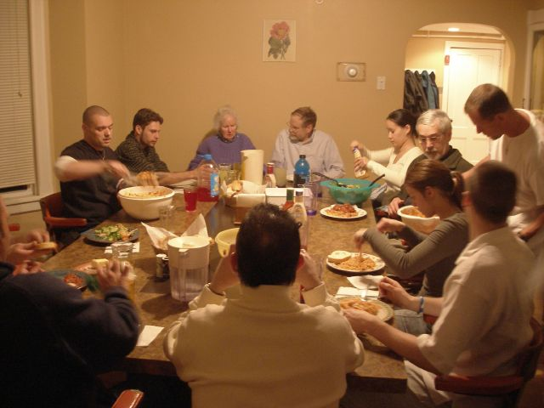
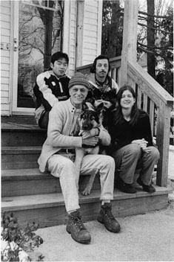
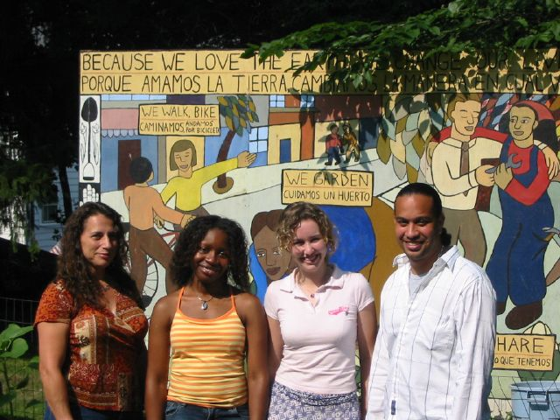
Mapping a Case Study
Community Organization—Dismas House

Slide 41
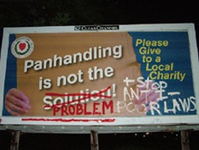
Mapping a Case Study
Community Goals:
1. Increase Low-Income Housing
2. Decrease Local Nimby Campaigns

Slide 42
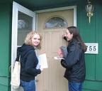

Mapping a Case Study
Service/Research & Project (theory, method, design & time)
What will project entail and how will it meet community goals and learning outcomes (Reciprocity)
1. Meet with Partner to Determine Issues, Scope, Questions, etc.
A. Nimby Claims: Property Values, Crime, Views of Neighborhood Quality
B. Identify Neighborhoods and so-called “Saturation Points”
C. What work will students do:
1. designing tools
2. explaining design and methods
3. Collecting data and analyzing data
  4. Reporting to Community Organization

Slide 43

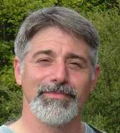
Mapping a Case Study
Strategies for Change & Curriculum
Presentations and Reflections
Presenting Data to Community
Reflecting on Impact on Change
Evaluating Learning Outcomes and Limits
Developing New Projects, Strategies & Curriculum
Corey Dolgon, chair of the Worcester State College Department of Sociology has been and activist and researcher on issues of homelessness and poverty for many years. Corey and his students conducted the department's "Mending Fences" study showing that group homes and social service agencies do not have a negative impact on Worcester's communities.

Slide 44
Critical Map (completed)
Community Organization
Dismas House
Strategies for Change Services/Research
Publicizing findings and impacting local debate stats on prop. Values, crime & QOL perception
Community Goals Higher Ed. Goals
More Housing/Less Nimby Course Outcomes & Center Publicity
Curriculum Project (Theory & Method)
Evaluating learning outcomes statistical research & neighborhood survey
Campus Partnership
Worcester State (SO 305 and CSLCE)

Slide 45
Evaluation and Action
1. Conversation with Dismas:
  what were successes and limitations of the research?
Next steps: more research vs. changing political landscape.
Organizing and Registering Homeless voters
Candidates Night at PIP Shelter
Worcester Telegram &Gazette [10-11-07]
WORCESTER - A City Council candidates night at the People in Peril homeless shelter last night proved to be the largest forum by far in this year's election campaign, with organizers counting more than 140 people in attendance.
Dr. Eric Garcia, who treats PIP shelter residents, asked the candidates whether they support the "Housing First" concept. Even Ms. Haller, a frequent critic of the social service agencies that espouse that concept of ensuring stable housing for people who need it regardless of their readiness to accept social programming, said that it "has merit."
5. Aftermath and Change--Permanent Housing &Housing First

Slide 46
Critical Change Map
Community Organization
Dismas House
Strategies for Change Services/Research
Publicizing findings and impacting local debate stats on prop. Values, crime & QOL perception
voter registration and organizing Experiences, Comparative & Qualitative Data
Community Goals Higher Ed. Goals
More Housing/Less Nimby Course Outcomes & Center Publicity
Political Empowerment PAR versus Research for Order
Curriculum Project (Theory & Method)
Evaluating learning outcomes statistical research & neighborhood survey Research for service vs. research for change Interviews, focus groups, collaborative events
Campus Partnership
Worcester State (SO 305 and CSLCE)

Slide 47

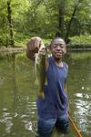
Critical Engagement
Not Just Civic Engagement
Non Profits– “the question of service has to be framed by critically engaging mission & purpose, methods & outcomes.”
Community-Based Learning– “are our students being given a curriculum along with their projects that encourages historical and political and global perspectives on problems and their causes. Does it inspire the big questions of our students, their education, our community partners, policy makers, institutions and social structures as a whole.”

Slide 48
Social Justice, Neoliberalism, and the Institutional Real
The future of radical, critical community engagement “the three R’s”
tRuth and reconciliation
Reparations
Radical, Critical Consciousness

