Slide 1
Christopher M. Seitz, DrPH, MPH, CHES CARL photovoice workshop

Slide 2
Presentation outline
Overview of photovoice process
Goals of photovoice
History of photovoice
Theoretical foundations

Slide 3
Overview of photovoice process
A method of community-based participatory research (CBPR) using photography
Typically with people of marginal influence
Participants take photos of community needs
Participants meet to critically discuss photo content
Participants invite policymakers and community to exhibit to educate/advocate for change (Wang et al., 1997)

Slide 4
Overview of photovoice process
Photovoicekit.org video
http://photovoicekit.org/

Slide 5
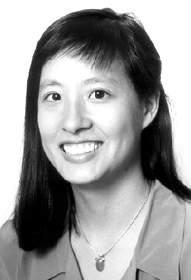
History of photovoice
Caroline Wang…1992 (Wang et al., 1994)
62 women, 50+ villages, 2 rural Chinese counties
They took photos of health issues in daily life:
Lack of education for women
Dirty drinking water
Common health issues associated w/poverty
They advocated to local policymakers

Slide 6
History of photovoice
This methodology has been used since with a wide variety of populations and health issues (Catalani et al., 2010; Hergenrather et al., 2009)
Homeless
Children
Students
Elderly
Low income
Disabilities
HIV/AIDS
Etc.

Slide 7
Goals of photovoice
Three major goals
(1) document needs/strengths of community
(2) stimulate critical discussion among participants
(3) give participants a platform for advocacy (Wang et al., 1997)

Slide 8
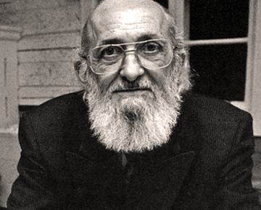
Theoretical foundations
Has three theoretical foundations:
(1) Critical consciousness
Pablo Freire…Brazilian educator of illiterate peasants

Slide 9
Theoretical foundations
The learner & teacher co-create knowledge
There are three levels of consciousness
Magical…believes inferior, status quo, helplessness
Naïve… recognize injustices, but blames others
Critical...aware of responsibility for choices/change (Carlson et al., 2006; Freire, 2000; 2002)

Slide 10
Theoretical foundations
(2) Feminist theory
Women are major force in the world, not objects of other peoples’ actions
Women are authorities over their own lives
Translates to…the oppressed can overcome
Translates to…the oppressed are an authority (Wang et al., 1997)

Slide 11
Theoretical foundations
(3) Documentary photography
Cameras give people power to record the reality of their communities
Documentary photography has a powerful impact on social conscience
(Wang et al., 1997)

Slide 12
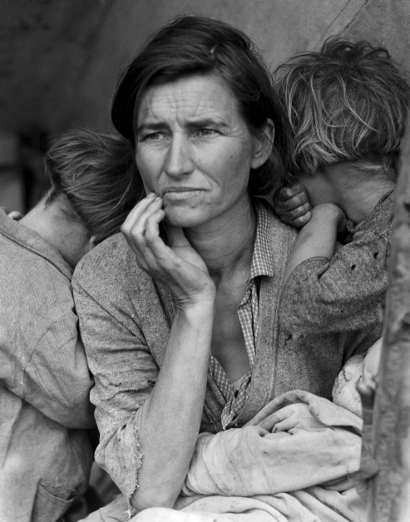
Theoretical foundations
Dorothea Lange (of Florence Thompson…Migrant Mother)

Slide 13
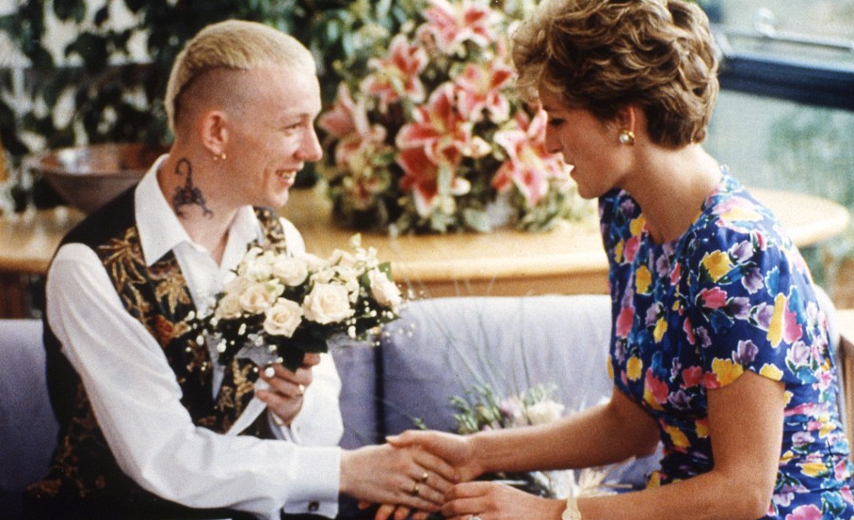
Theoretical foundations
Unknown photographer

Slide 14
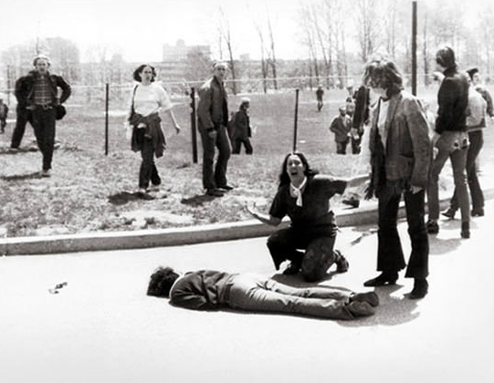
Theoretical foundations
John Filo

Slide 15
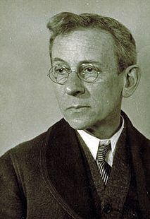
Theoretical foundations
Lewis Hine
Took photos of child labour to advocate for policy change

Slide 16
Theoretical foundations

Slide 17
Theoretical foundations

Slide 18
Theoretical foundations

Slide 19
Photovoice steps
1. Approval by university ethics committee
Ethical considerations of 3 types of participants…
photographers (informed consent form)
those being photographed (photo release form)
those attending exhibit (informed consent)

Slide 20
Photovoice steps
2. Recruit participants
Representative of the community
Stakeholders
Those who will follow through
Over recruitment may be a good idea

Slide 21
Photovoice steps
3. Meeting(s) to train in history, ethics, photo technique
Photovoice background/history/process
Purpose of study, photo assignment

Slide 22
Photovoice steps
3. Meeting(s) to train in history, ethics, photo technique
Ethics for:
Photographers
Those being photographed
Photovoice team
Community

Slide 23
Photovoice steps
3. Meeting(s) to train in history, ethics, photo technique
Ethics for photographers
Informed consent…their decision to participate
Privacy…their decision of what photos to share
Copyright…they own their photos/captions
Photo release…they can release photos to you
Safety…they should not take photos of illegal activity, private spaces of others, places that are dangerous

Slide 24
Photovoice steps
3. Meeting(s) to train in history, ethics, photo technique
Ethics for those being photographed
Unless the person agrees, it is not okay to:
intrude on another person’s privacy or their private affairs.
Ex…person not in public is in private
Ex…person in public still has their ‘private space’
Ex…If identifiable, you need a ‘photo release’ form

Slide 25
Photovoice steps
3. Meeting(s) to train in history, ethics, photo technique
Ethics for those being photographed
Unless the person agrees, it is not okay to:
publicly tell embarrassing information about another person.
Ex…telling of a true fact, but that is embarrassing
No one likes to be embarrassed!

Slide 26
Photovoice steps
3. Meeting(s) to train in history, ethics, photo technique
Ethics for those being photographed
Unless the person agrees, it is not okay to:
Publicly tell untruths about a person or business
Ex…taking a photo and lying in your caption
Ex…this is ‘defamation’

Slide 27
Photovoice steps
3. Meeting(s) to train in history, ethics, photo technique
Ethics for those being photographed
Unless the person agrees, it is not okay to:
Make money from the picture of another person without his/her approval

Slide 28
Photovoice steps
3. Meeting(s) to train in history, ethics, photo technique
Ethics for those being photographed
Do not take photos of illegal or obscene behaviour

Slide 29
Photovoice steps
3. Meeting(s) to train in history, ethics, photo technique
Ethics for those being photographed
If a person/place is identifiable, we need a photo release form
Identifiable…
eyes are visible
she/he is main/significant element of the photo
distinct scar, tattoo, clothing is showing

Slide 30
Photovoice steps
3. Meeting(s) to train in history, ethics, photo technique
Ethics for the photovoice team
Respect those on the team and their views
Be open minded

Slide 31
Photovoice steps
3. Meeting(s) to train in history, ethics, photo technique
Ethics for the community
Will this project embarrass, blame, or damage the reputation of an individual or group?
Are the photos and stories you are planning to share an accurate and fair representation of realities in your neighbourhood and community?
How will community members feel about the intended (or unintended) results of the project?

Slide 32
Photovoice steps
3. Meeting(s) to train in history, ethics, photo technique
Discuss how to prepare cameras
Do they need a camera?
Look at the quality of their mobile phone camera
Are they able to charge their phone/camera?
Do they know how to check their camera memory?
Do they know how to clean the lens?

Slide 33
Photovoice steps
3. Meeting(s) to train in history, ethics, photo technique
Discuss camera steadiness
Do they know that the picture can be blurry if they are not steady?
Tell them to lean against a wall/pole to steady their camera

Slide 34
Photovoice steps
3. Meeting(s) to train in history, ethics, photo technique
Discuss lighting
Tell them to keep the sun/light behind them
Tell them to avoid high-contrast (i.e., light areas too light and shadows are too dark)

Slide 35
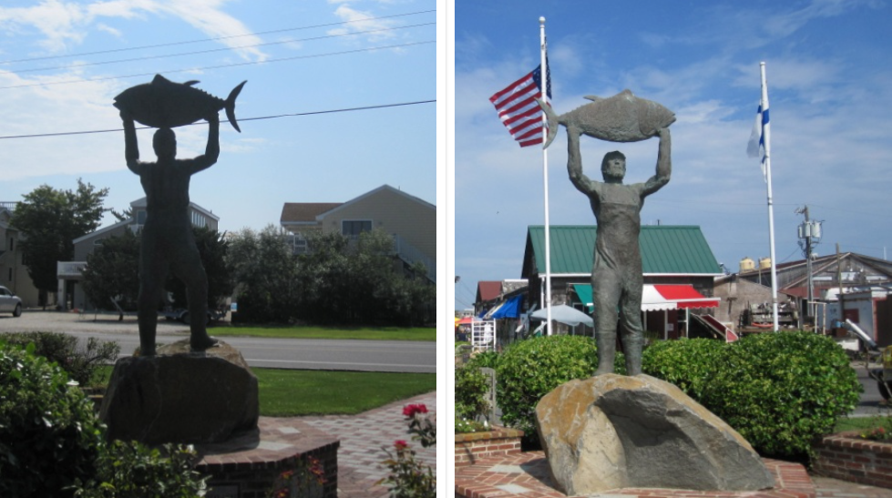
Photovoice steps
3. Meeting(s) to train in history, ethics, photo technique
Which of these photos is better in terms of lighting?
Picture 2, the light source is behind the photographer

Slide 36
Photovoice steps
3. Meeting(s) to train in history, ethics, photo technique
Discuss framing
Tell them to make sure to get close enough that the subject can be seen, but not too close that they can’t identify what’s going on
Tell them to try to avoid distracting backgrounds

Slide 37
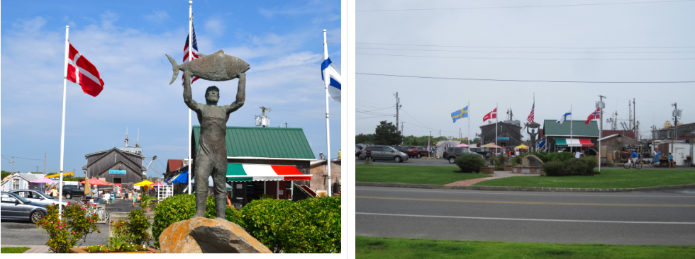
Photovoice steps
3. Meeting(s) to train in history, ethics, photo technique
Which of these photos is better in terms of framing?
Picture 1, we can see the subject of the photo

Slide 38
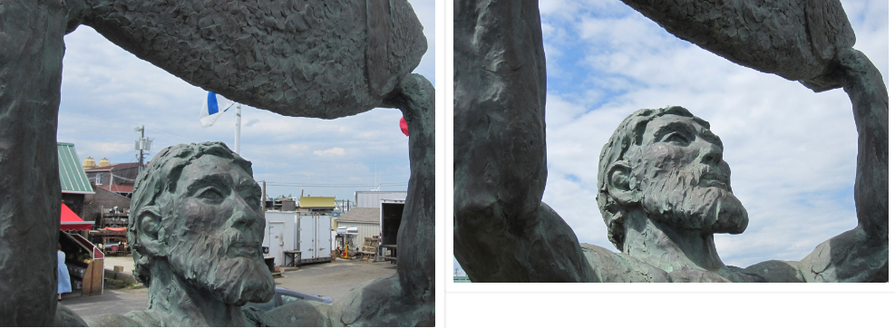
Photovoice steps
3. Meeting(s) to train in history, ethics, photo technique
Which of these photos is better in terms of framing?
Picture 2, it doesn’t have a distracting background

Slide 39
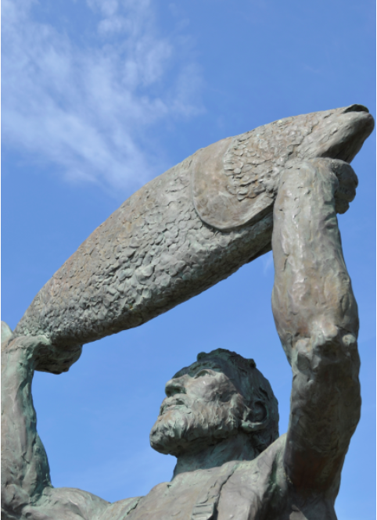
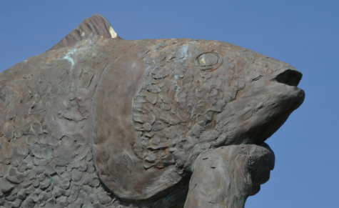
Photovoice steps
3. Meeting(s) to train in history, ethics, photo technique
Which of these photos is better in terms of framing?
Both, it depends on the story that is being told

Slide 40
Photovoice steps
3. Meeting(s) to train in history, ethics, photo technique
Discuss the ‘Rule of Thirds’
Tell them to place photo subjects on imaginary lines that dissect the frame into thirds

Slide 41
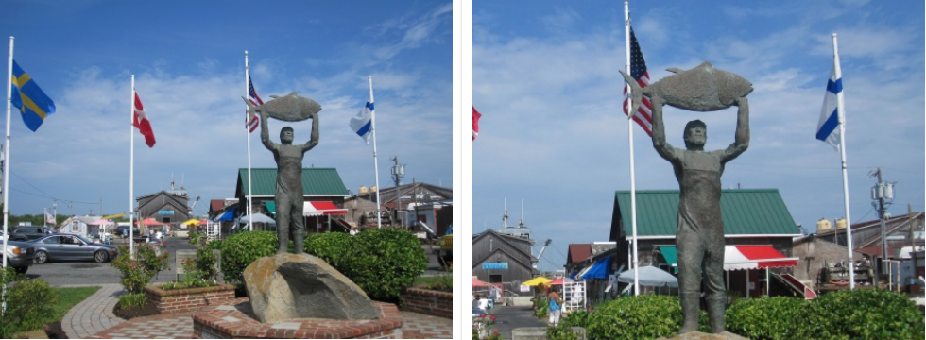
Photovoice steps
3. Meeting(s) to train in history, ethics, photo technique
Which of these photos is better in terms of rule of thirds?
Picture 1, it reflects the rule of thirds

Slide 42
Photovoice steps
4. Meeting(s) for critical dialogue
Participants use SHOWeD to discuss photos
what do you See here?
what is really Happening?
how does this relate to Our lives?
Why does this problem or strength exist?
what can we Do about it?
Participants determine which stakeholders and policymakers can make a difference in issues shown in photos

Slide 43
Photovoice steps
6. Meeting(s) for caption writing
From discussions, participants write captions that will be placed with photos

Slide 44
Photovoice steps
6. Meeting(s) for caption writing
Tell them too write a brief caption with each photo that…
Describes what is happening and why it is a problem
Evokes emotion and is memorable
Calls for an action and how the community could benefit
Uses the present tense, conversational, and is real
Do not use phrases ‘the picture’ or ‘as the photo shows’

Slide 45
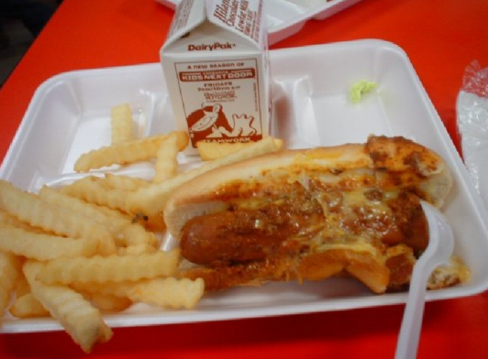
Photovoice steps
6. Meeting(s) for caption writing
Which of these captions are better for the photo?
‘This is my lunch at school. It’s not healthy for us to eat. I wish I could have some food that is good for me.’

Slide 46
Photovoice steps
6. Meeting(s) for caption writing
Which of these captions are better for the photo?
‘This is what the school offers for lunch. Everyday we eat French fries, pizza, chips, hot dogs. It’s not healthy and it makes me think that the school doesn’t care about us. We need healthy options for lunch and we need to get rid of the unhealthy options.’

Slide 47
Photovoice steps
7. Meeting(s) for creating themes & choosing photos
Photo content is categorized
Representative photos are chosen for the exhibit

Slide 48
Photovoice steps
8. Meeting(s) to plan exhibit
Secure a location(s)
Create/send invitations to:
media
entire community
stakeholders
policymakers
Print photos

Slide 49
Photovoice steps
9. Meeting(s) to train participants in advocacy
Elevator speeches
Emphasis on policy change
Emphasis on thoughtful discussion

Slide 50
Photovoice steps
10. Hold the exhibit(s)
Photos erected
Food, drinks
Monitor number of attendees who are…
Community members
Policy makers
Media
Etc.
Provide a pre-post survey to measure impact

Slide 51
Photovoice steps
11. Meeting(s) to determine follow-up efforts
Meet with participants to identify next steps in advocating for change
Most published photovoice projects have not included:
public exhibit(s)
reaching policymakers
follow-up efforts
measuring impact on exhibit attendees

Slide 52
Example photovoice project at UCC
Current project:
Fulbright Scholarship at University College Cork, Ireland
Department of Health wants smoke-free third-level universities
18 students
Undergraduates in Public Health
2nd year medical students

Slide 53
Example photovoice project at UCC
>80 photos
4 themes
1: Environmental Concerns
2: Second-hand Smoke
3: Inconsistent Policy
4: Ignoring “No Smoking” Signs

Slide 54
Theme #1 Environmental Concerns

Slide 55
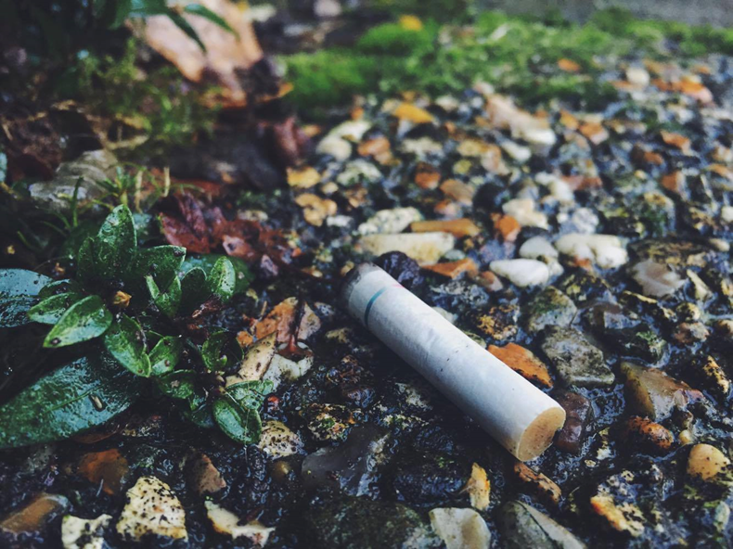
Cigarette butts are scattered all over our beautiful campus. Whether it be one cigarette butt or hundreds of them. This is not good for the environment and it is littering. We need a strict smoking policy on campus.

Slide 56
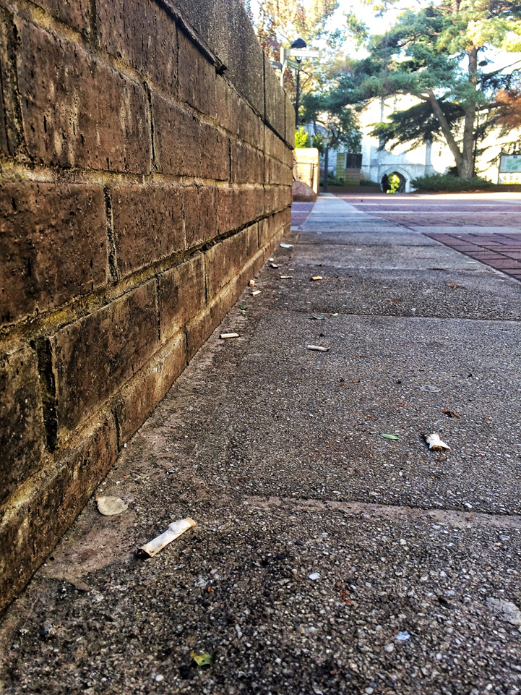
This is a picture outside Boole Library where I noticed many littered cigarette butts. Many people sit on this ledge, smoke, and throw their cigarette butts on the ground. It is upsetting to see so much litter, especially when University College Cork is known as “The World’s First Green Campus.”

Slide 57
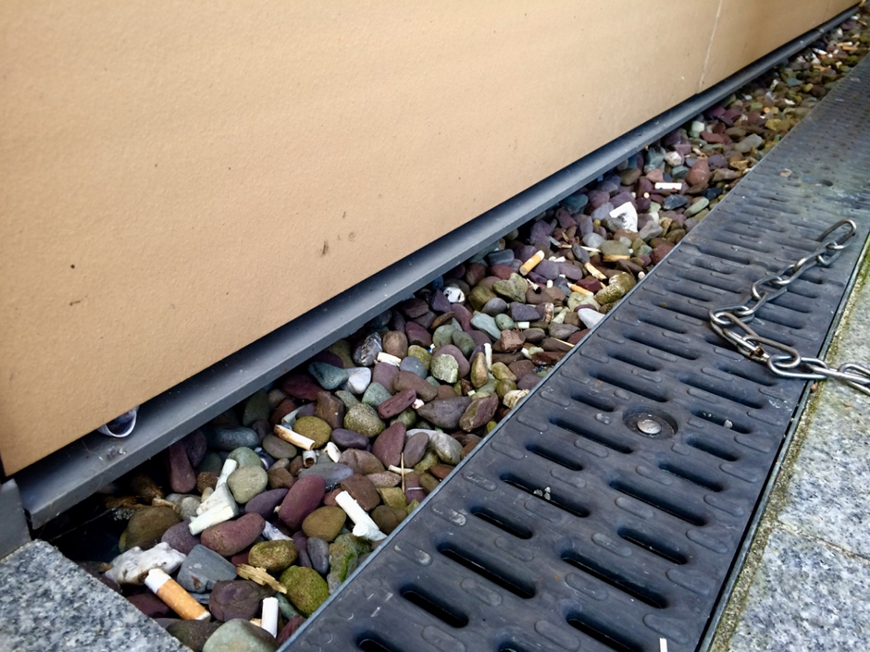
This is a picture along the side of Western Gate Building, near the entrance. Cigarette butts line the entire side of the building and are stuck in all the rocks. They were also scattered around the entire area. It is unfortunate that an area that has such a high volume of people entering and exiting every day is so littered by cigarette butts.

Slide 58
Theme #2 Second-hand Smoke

Slide 59
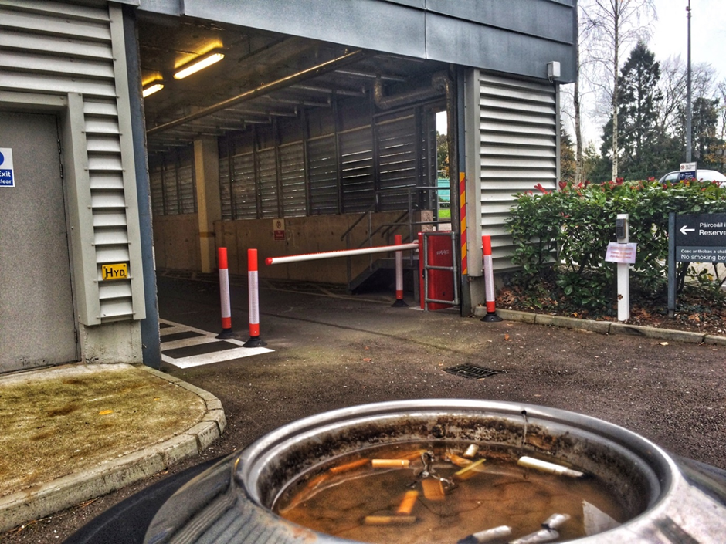
Every day when I walk to class in Brookfield Health Sciences Complex, I walk past people smoking here. I really dislike smelling second hand smoke. For people who may be trying to quit smoking, it is the first thing they might see when arriving on campus. Smoke free environments are important to help encourage people who are trying to quit smoking.

Slide 60
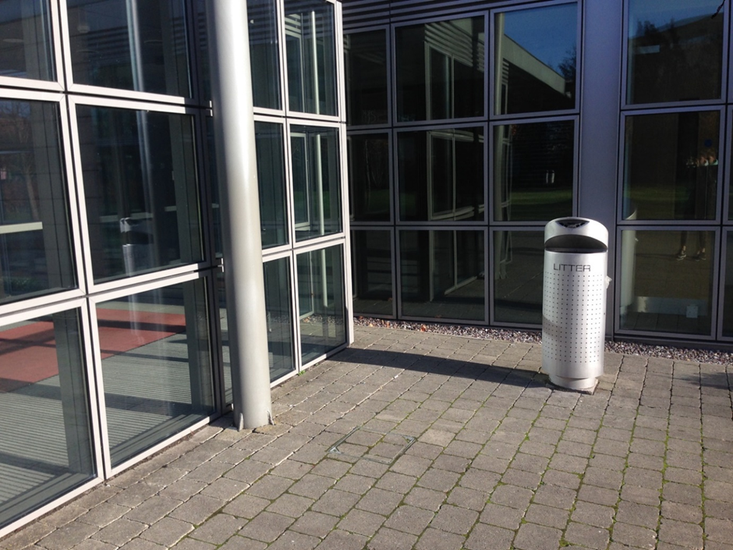
This is a popular area outside the doorway to the Western Gateway Building. Every day I smell the smoke as I enter and exit this building. I am not choosing to smoke myself, therefore, I should have the right to not be exposed to smoke.

Slide 61
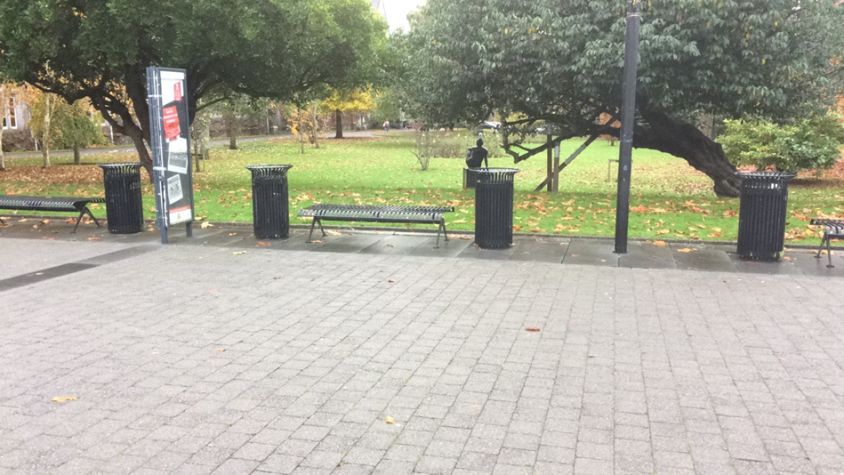
On weekdays, these benches are filled with students socialising and smoking. Right in the centre of UCC’s campus is what almost seems like a purpose built area for smokers, and where many non-smokers are exposed to second-hand smoke from either side. Each bench is framed by two large bin-shaped ash trays. You cannot sit here if you want to enjoy your lunch outside, due to the number of smokers that occupy these benches day in and day out.

Slide 62
Theme #3 Inconsistent Policy

Slide 63
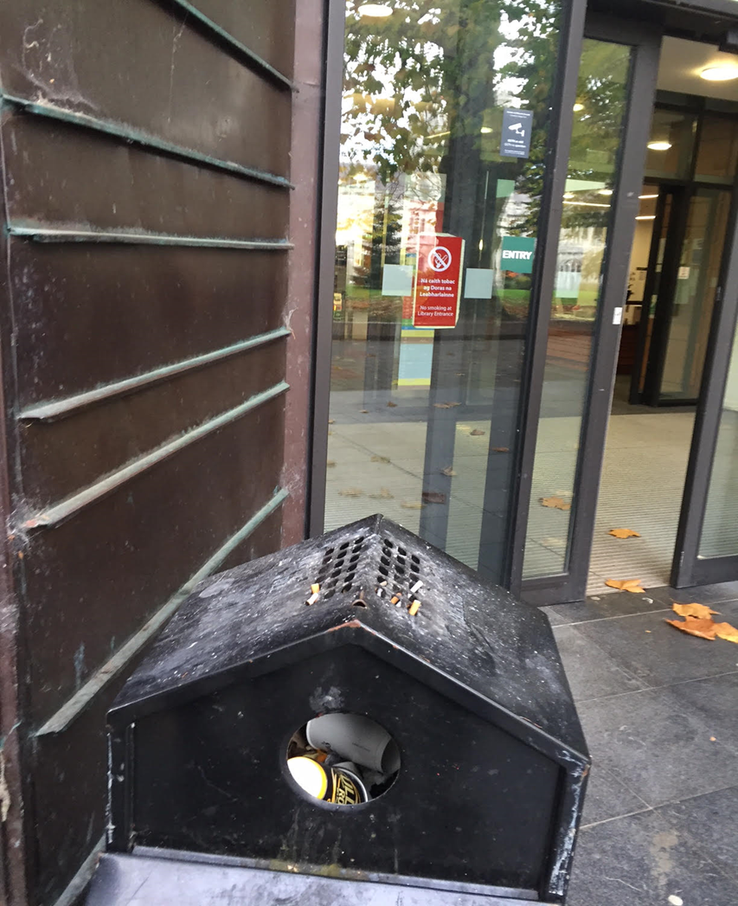
This picture reflects an inconsistent smoking policy. The sign outside the front door of the Boole Library says ‘no smoking at library entrance,’ but the smoking policy only prohibits smoking indoors. Ironically, there is a rubbish bin destroyed by cigarettes and ash just outside the door.

Slide 64
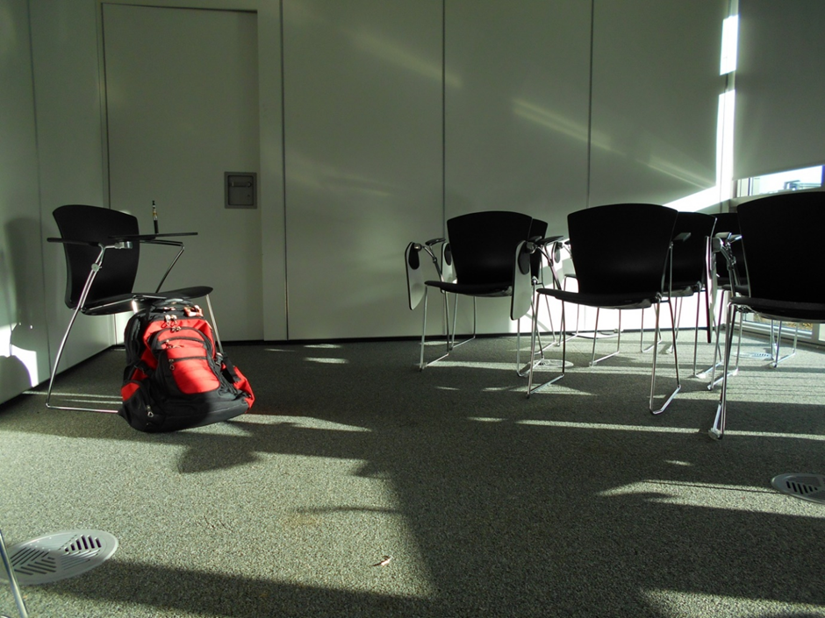
This is a small tutorial classroom where one student took a couple of puffs from his e-cigarettes, because he did not know if rules for e-cigarettes parallel those for cigarettes. While the other students in the classroom were shocked and discomforted by the smoke, they also did not know the policies around e-cigarettes.

Slide 65
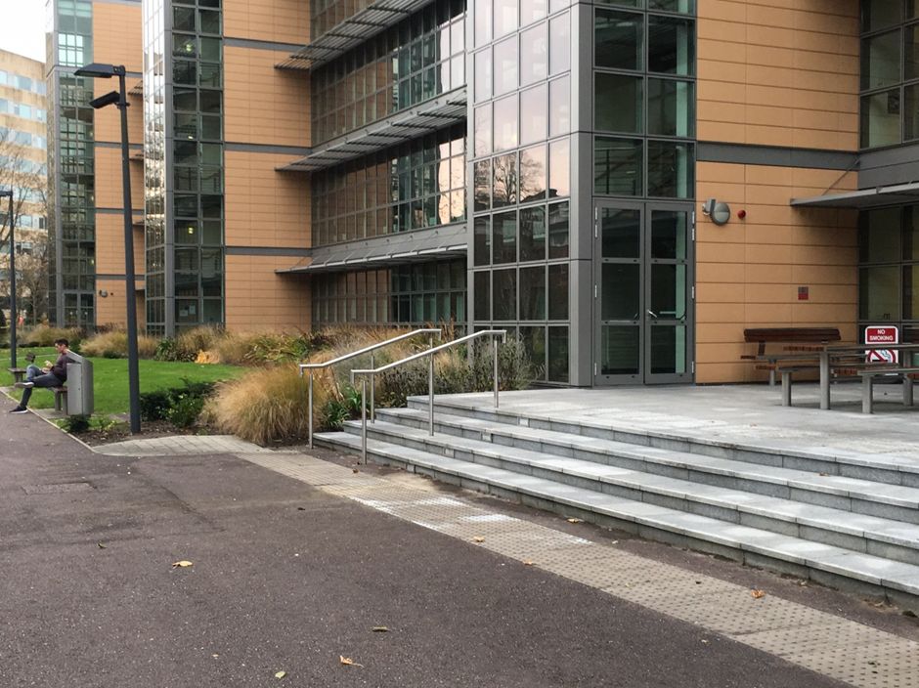
Here is an example of the inconsistency in UCC’s smoking policy. A smoker has obeyed the no smoking sign and chosen to sit next to a cigarette bin. However, both areas are filled with a large volume of students daily, both are near the entrance to a UCC building and both are places to relax. Why should one entrance area allow smoking and the other not?

Slide 66
Theme #4 Ignoring “no smoking” signs

Slide 67
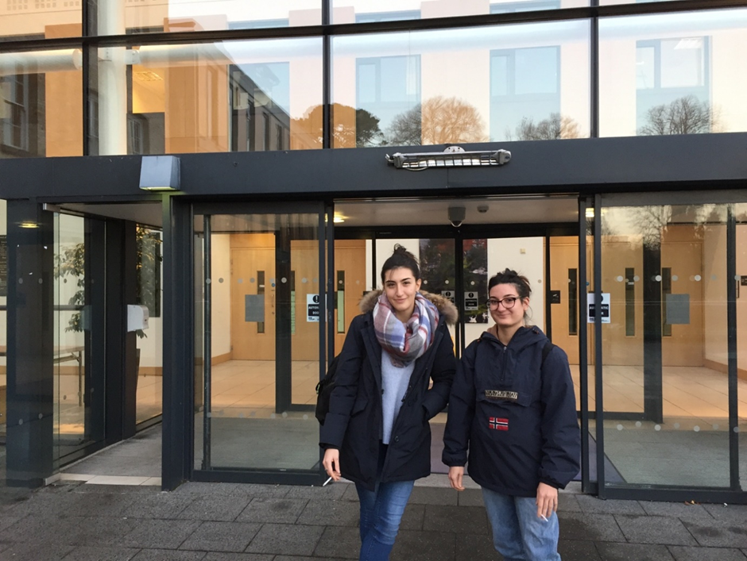
These two were standing at the main entrance to Brookfield Health Sciences Centre – where UCC teaches most of the medical and health sciences courses. There are ‘No Smoking’ signs just out of frame.

Slide 68
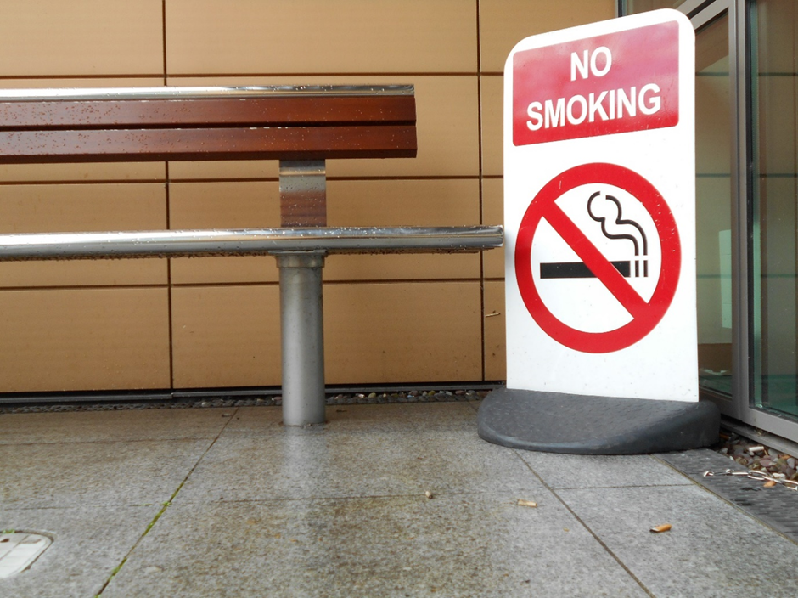
Smokers have disregarded this sign and littered the ground with cigarette butts, letting other smokers know that it is okay to smoke here, because there are no repercussions. The sign is a failed attempt to create a non-smoking area and will continue to be a failure as long as there is no enforcement to back-up the sign.

Slide 69
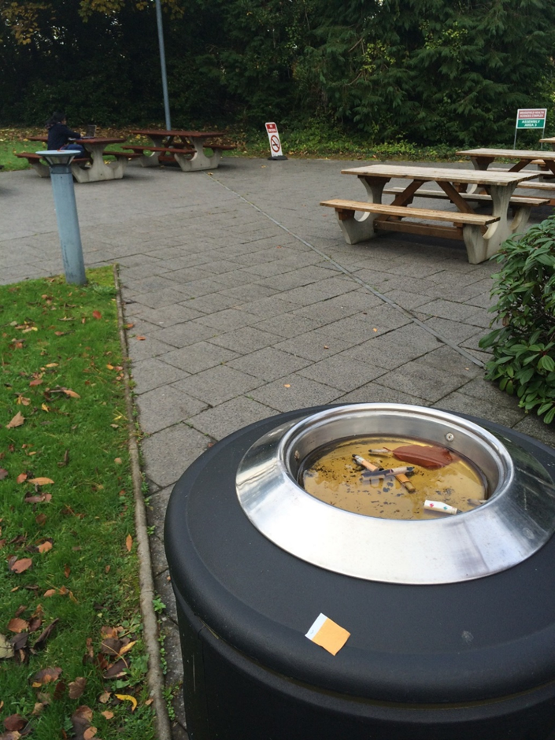
This photo was taken outside the Brookfield Health and Science Building. This building holds most lectures for students studying medicine, nursing, and other health-related degrees. In the background is a sign that clearly states no smoking, however, no one sticks to this rule.

Slide 70
Example photovoice project at UCC
So far…200+ attendees, 150 surveys
President of UCC
Student Union President, Welfare Officer, etc.
Members of UCC’s governing body
Faculty, students, staff, visitors
3 media outlets
3 exhibits (hopefully)
Facilitating meeting to discuss potential referendum
Stay tuned…

Slide 71
Questions? Comments?

Slide 72
References
Carlson, E.D., Engebretson, J., & Chamberlain, R.M. (2006). Photovoice as a social process of critical consciousness. Qualitative Health Research, 16(6), 836-852.
Catalani, C., & Minkler, M. (2010). Photovoice: A review of the literature in health and public health. Health Education & Behavior, 37(3), 424–451.
Freire, P. (2000). Pedagogy of the oppressed. New York: Continuum. (Original work published 1970)
Freire, P. (2002). Education for critical consciousness. New York: Continuum. (Original work published 1973)
Hergenrather, K. C., Rhodes, S. D., Cowan, C. A., Bardhoshi, G., & Pula, S. (2009). Photovoice as community based participatory research: A qualitative review. American Journal of Health Behavior, 33(6), 686–698.

Slide 73
References
Wang, C., & Burris, M. (1994). Empowerment through photonovella: Portraits of participation. Health Education Quarterly, 21(2), 171-186.
Wang, C., & Burris, M. (1997). Photovoice: Concept, methodology, and use for participatory needs assessment. Health Education & Behavior, 24(3), 369–387.
Wang, C.C., & Redwood-Jones, Y.A. (2001). Photovoice ethics: Perspectives from Flint Photovoice. Health Education & Behavior, 28, 560-572.

