Slide 1
The Initial Phase & Interim Assessment How to start the process and implement it !
Mary O’Regan
HR Business Manager Research
University College Cork
@marykateucc
#HRS4R
The CARDEA project is funded by the European Union. Views and opinions expressed are however those of the author(s) only and do not necessarily reflect those of the European Union or the European Research Executive Agency (REA). Neither the European Union nor REA can be held responsible for them.

Slide 2
YOU MIGHT FEEL LIKE THIS???

Slide 3
IF YOU FOLLOW THESE STEPS YOU WILL FEEL LIKE THIS

Slide 4
What’s important?
Initial Phase
committee or working group
endorsement
gap analysis against 40 principles
action plan
OTMR Checklist
focus groups and (survey results)?
WEBSITE
Interim Assessment
Showing progress through actions and embedding
OTMR Policy
Keep the Award!

Slide 5
Committee/ Working Group
An effective and committed WG is very important
Written Working Group Description and Terms of Reference
An Effective and Committed Working Group Chair
Effective Members Appointed
Accountability to the University
Well-run Meetings with minutes and actions

Slide 6
Committee Working Group
Statement of Purpose included in Terms of Reference
“The university shall establish a working group to be known as the HR Excellence in Research Working Group which shall be responsible to the university for the oversight, development, evolution and implementation of the University HRS4R Action Plan. “

Slide 7
Endorsement
Endorsement of the European Charter for Researchers and Code of Conduct for the Recruitment of Researchers (Charter and Code)
Plenty of examples on the Euraxess Website HERE

Slide 8
Gap Analysis

Slide 9
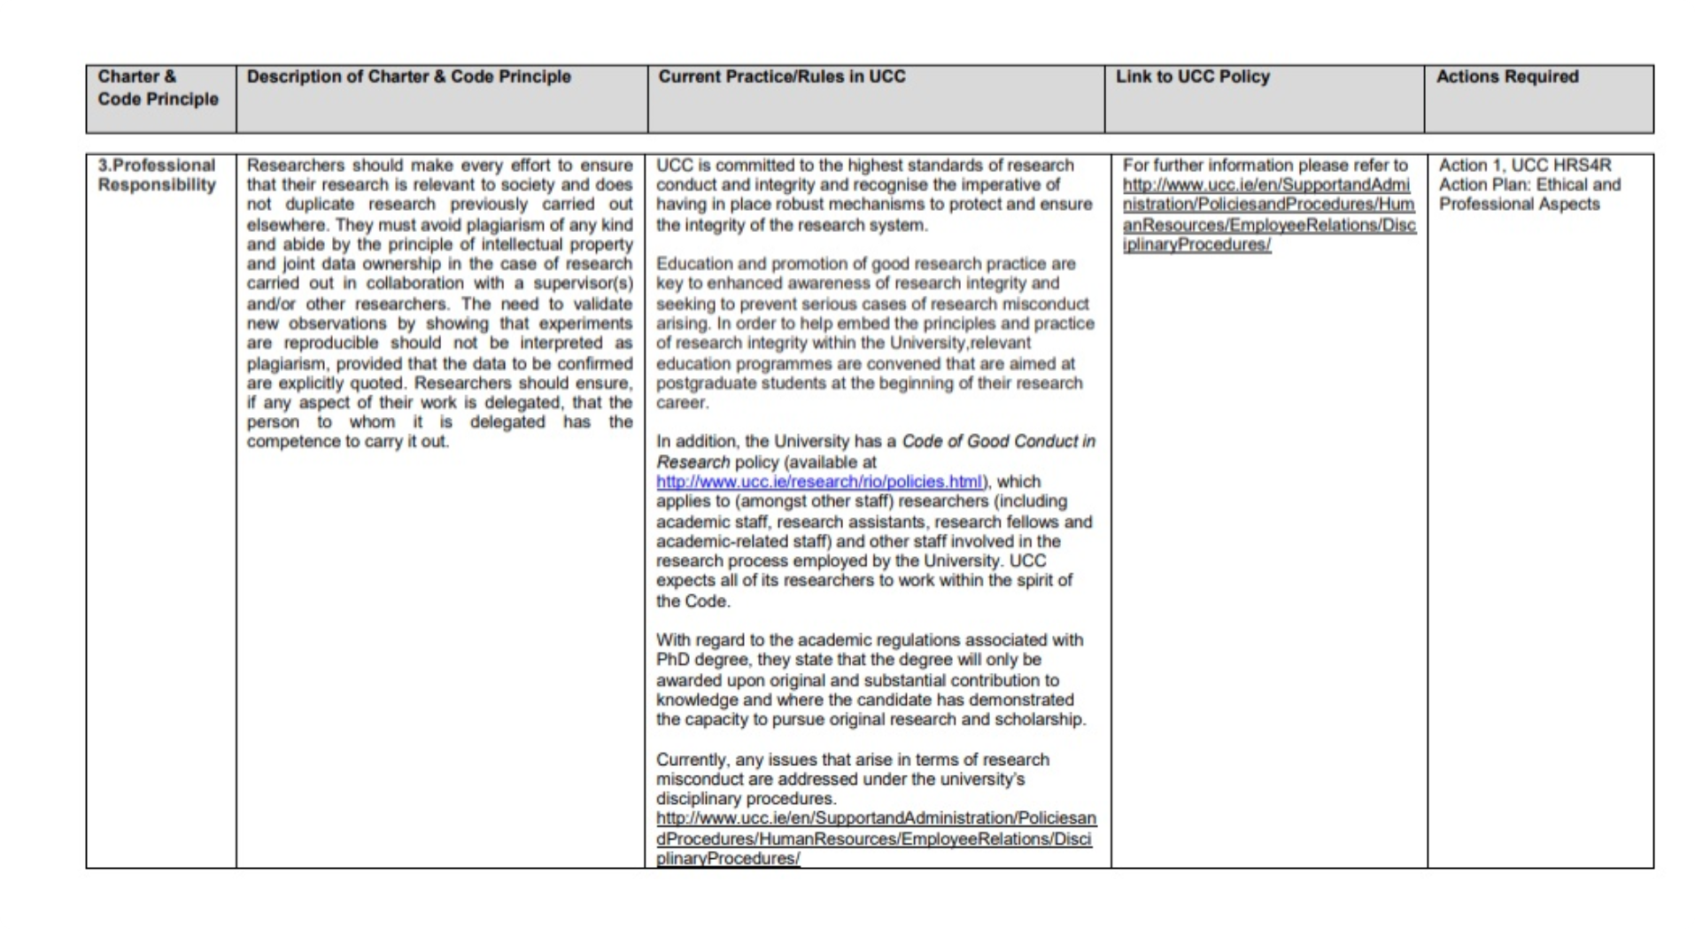

Slide 10
Gap meets Action Plan

Slide 12
Gap takes 7 years to meet Action Plan!

Slide 13
Action Plan Where to begin?
Clearly indicate the Links between the gaps identified in the Gap Analysis and the HRS4R Action Plan – Coherence!
Prioritise – explain the areas your organisation wishes to focus on and the areas that will be addressed later on in the process.
Long term goals and short term goals
Realistic are the actions sensible, achievable, quantifiable, legal?

Slide 14
Action Plan Where to begin?
Divide the action plan into the 4 pillars based on C & C
Logically connect the actions to the gaps identified
Make it easy to follow and don't randomly distribute the actions
Ensure the quality of the actions with time frames and targets/indicators

Slide 15
Action Plan Where to begin?
Be sensible and make actions measurable
Have an overall sense of understandability
Have a coherence between the actions and capacity of the institution
Have unity between the gaps identified and the actions
Ensure short term v’s long term actions
Is it hard to follow, has the report jumped around from idea to idea without consistency or connectivity

Slide 16
Action Plan Where to begin?
Are there quantitative targets in the action plan?
Is there a mechanism for effective on-going implementation and review of the plan
Is it being monitored and by whom
Stakeholder engagement
Coordination across the organisation

Slide 17
Gaps identified versus Actions to be undertaken
For example:
Your organisation may have identified 40 gaps or more based on the 40 principles of the charter and code under the 4 pillars
Translate that into about 6 actions (max) under each of the 4 pillars making 24 actions approx. Prioritise
Much more than that and it may be difficult for your organisation to complete prior to the self assessment in 2 years.

Slide 18
Gaps identified versus Actions to be undertaken
Remember: your organisation will be in a better position to demonstrate progress and will be able to plan for the next phase using the gaps that were not addressed initially in the action plan.
Progress Evolution Change

Slide 19
OTMR Checklist Initial Phase
Complete the checklist See HERE
From this you will have Identified suitable actions to encourage and implement change
You will include these actions in your action plan

Slide 20
Focus groups and (survey results)?
Plan your survey so that the results are known and written up prior to submitting for your submission
Highlight areas for improvement
Highlight areas where you have a good result
Use the gaps identified to point to future actions regarding areas for improvement
Use the progress to point to the completion of older actions and embedding if relevant

Slide 21
Interim Phase
Fulfilment: Action Plan etc ✓
Innovation: New training programmes ✓
Informal: Peer groups and Researcher Groups ✓
Formal: Policies and Strategy ✓

Slide 22
Ambition: Be clear and articulate it!
Our ambition is to:
identify and remove factors that impede representation, development and career development of research staff ?
develop practices and policies that are responsive to the needs of research staff ?
engage research staff from all parts of the university in HR Excellence in Research activities ?

Slide 23
OTMR POLICY
Agree the policy and practices with all stakeholders/researcher focus groups/steering committee
What do you need to do to ensure that all recruitment procedures are consistent with the OTM-R principles?
I know this sounds easy but I also know its not!

Slide 24
Complementary Policies
Remember:
The OTM-R policy is in conjunction with other human resource strategies/policies to improve working conditions of researchers and attract researchers from abroad
It forms part of an institution’s overall policy to increase its level of quality surrounding researcher recruitment and enhance researcher careers
Assessors will be cognisant of your starting place as an organisation

Slide 25
UCC example of what this looks like in practice

Slide 26
Areas to address when starting out and progressing!
Gap Analysis
Working Groups
and/or Surveys
Embedding/Ambition (interim phase)
OTM-R Checklist
Policy (interim phase)
The Action Plan
Actions going forward (interim phase)

Slide 27
WEBSITE: at every stage!!!
https://www.ucc.ie/en/

Slide 28
Don’t forget….Be kind to yourself…..
Its an evolving process!

Slide 29
Thank you
Any Questions?

