Slide 1
Anna is a Research Manager
Mary Kate O’Regan
CARDEA
The CARDEA project is funded by the European Union. Views and opinions expressed are however those of the author(s) only and do not necessarily reflect those of the European Union or the European Research Executive Agency (REA). Neither the European Union nor REA can be held responsible for them.

Slide 2
Anna

Slide 3
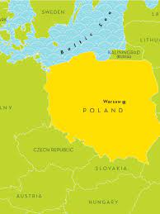
Anna was born in Poland

Slide 4
Anna is 43 and speaks 2 languages
Dzień dobry, to przyjemność poznać was wszystkich. Jestem Anną

Slide 5
She both lives and works in Poland

Slide 6
Anna is a Research Manager with > 10 years of experience

Slide 7
Working in a large (> 1,000) organisation and is motivated to do her very best for her employer

Slide 8
Anna earns €37,600 per year

Slide 9
And…has a PhD…but has never been promoted…

Slide 10
Anna has a permanent contract and is paid from core funds, but progression is not an option that is available to her within her role

Slide 11
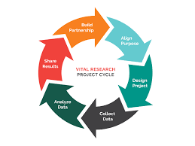
She provides specialised services to a range of research projects

Slide 12
She believes that she has the skills to be an effective research manager

Slide 13
However Anna indicated that training in Transversal skills would benefit her role
Attention to detail
Autonomy
Creativity
Critical thinking
Cultural sensitivity
Decision making
Diversified knowledge set
Efficiency
Flexibility
Leadership
Motivation
Openness
Proactivity
Problem-solving
Reliability
Research integrity/ethical behaviour
Strategic thinking
Stress management
Values appreciation

Slide 14
Anna doesn’t have a Personal Development Plan but does spend between 9 and 40 hours on Continuous Professional Development per year

Slide 15
Anna understands how her role fits into the organisation

Slide 16
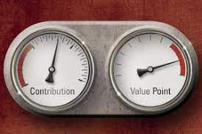
Yet she doesn't feel that her organisation values or recognises her contribution to research management

Slide 17
she doesn’t get opportunities to contribute to organisational decision making

Slide 18
Even though she enjoys work autonomy

Slide 19
Anna saw Research Management as an opportunity for a rewarding career when she first started

Slide 20
She sometimes feels invisible and undervalued by her organisation

Slide 21
Anna wants recognition and a career framework

Slide 22
Visibility – Appreciation - Promotion

Slide 23
Career Pathway – Definition of Role - Progression

Slide 24
CARDEA
Ancient Roman Goddess of the Hinge
Research Managers open Research Doors

Slide 25
What it stands for
Career Acknowledgement for Research Managers Delivering for the European Area

Slide 26
GREECE
BELGIUM
CROATIA
POLAND
ROMANIA
ITALY
SPAIN
IRELAND

Slide 27
Proven Track Record
HR Excellence in Research
EURAXESS

Slide 28
CARDEA Challenge
Research Manager roles are invisible
Policy, Career Development, Progression
No consistency in salary, skills, competencies and training across the ERA
CARDEA

Slide 29
Priority deliverables
Research Manager as a valued career choice
Classification of Research Manager Roles & framework development
Knowledge, Skills, Competencies required
Training and Development
Knowledge Hub/Website
Policy, lobbying and engagement with stakeholders
CARDEA

Slide 30
Priority deliverables
Survey Launched
Survey Report Written
Advisory Board in place & Collaborating with RM Roadmap
Beginnings of a Career Framework in place
Skills and training being identified
Mobility Patterns being reviewed
Policy, lobbying and engagement with stakeholders ongoing
CARDEA

Slide 31
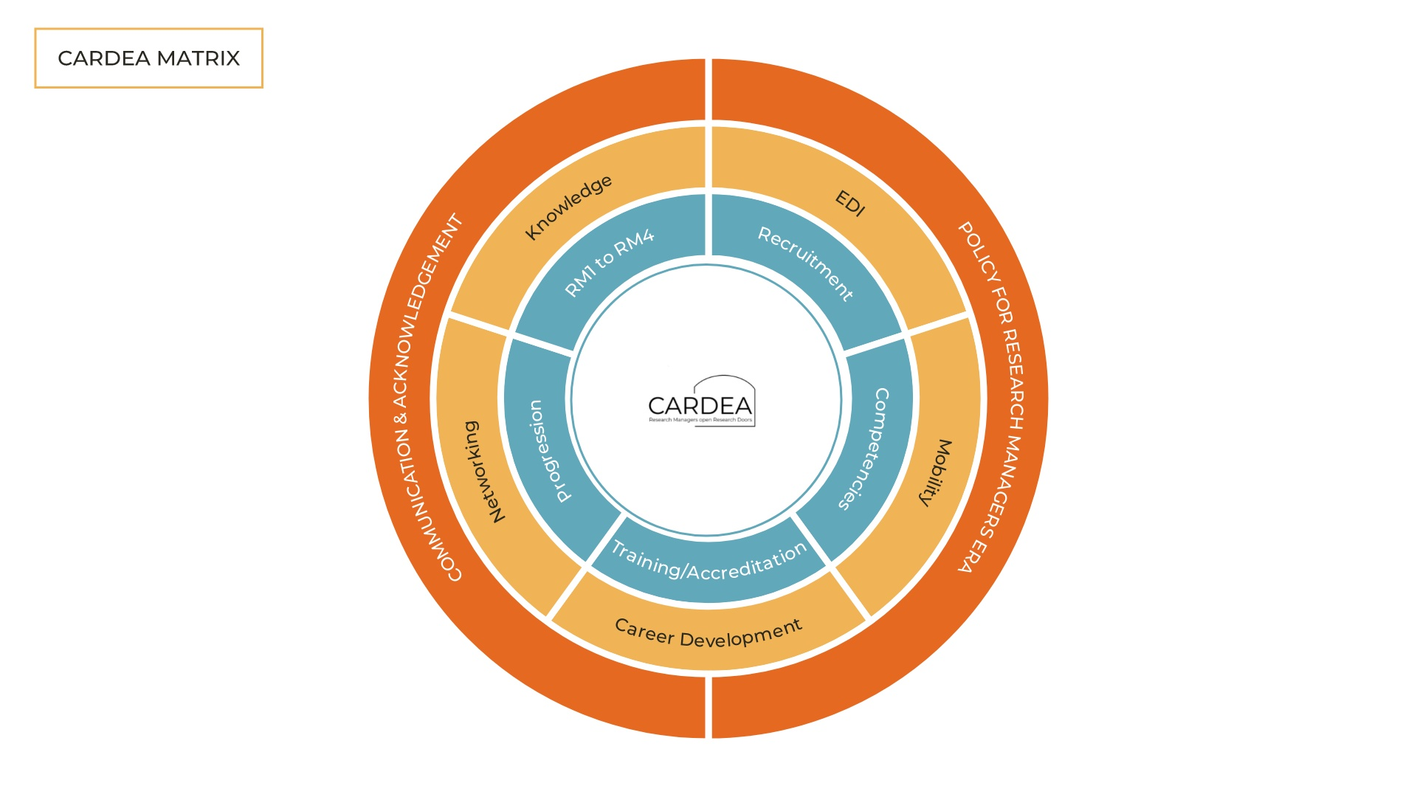

Slide 32
Thank you
Any questions

