Slide 1



Career Acknowledgement for Research Managers Delivering for the European Area
Eduard X. Balbuena, PhD, MBA
CERCA Institute
The CARDEA project is funded by the European Union. Views and opinions expressed are however those of the author(s) only and do not necessarily reflect those of the European Union or the European Research Executive Agency (REA). Neither the European Union nor REA can be held responsible for them.

Slide 2









EC RESEARCH MANAGER Challenges
HORIZON-WIDERA-2021-ERA-01-20: Towards a Europe-wide training and networking scheme for research managers. CSA. 3.000.000 € (2 projects). Deadline: September 21st, 2021.
Improved knowledge for policy making about the training and networking patterns of Research support staff and Research management.
Measures to increase awareness amongst Research management staff about existing training, networking and mobility opportunities at EU, national and regional levels.
Ultimately, increased capacity and compatibility of cooperation and funding systems throughout the ERA for research management, and support to scientists.
Improved awareness of the EU policy drivers and the EU research peculiarity in the Higher Education Institutions and Research organizations.
Preparation of the establishment of a central hub to provide the EU research system with the most appropriate skills in EU research management, including widening countries.
Provide recommendations aiming at facilitating a clear career path for research managers ant national and UE level, enhancing their role towards ERA objectives.
OUTCOMES

Slide 3
EC RESEARCH MANAGER Challenges
HORIZON-WIDERA-2021-ERA-01-20: Towards a Europe-wide training and networking scheme for research managers. CSA. 3.000.000 € (2 projects). Deadline: September 21st, 2021.
Improving training and skills development of Research management staff, to develop better Research and innovative management capacity and guidance for researchers across the entire ERA, as well as pave the way towards institutional acknowledgement of the Research management profession.
Map and analyse the EU landscape of Research management and the financial framework to support it. They should address a wide scope of activities, such as study visits, staff Exchange, Exchange of good practices, guidelines and policy recommendations to deliver of Research management under the new ERA.
Pilot a European network for research managers through the integration of existing capabilities of Research Organizations, networks and umbrella organizations. Projects are expected to generate a wide outreach to the European community of R&I management.
Create new training paths and optimize integration of existing recognized institutional training and certification programs for research managers, developing recommendations.
SCOPE

Slide 4
EC RESEARCH MANAGER Challenges
WHY RESEARCH MANAGERS NEED THE SUPPORT OF EC?
Research managers and research support staff make a valuable yet undervalued contribution to Europe’s research excellence.
RM is a relatively young career profile, but RM's importance is likely to increase in the next 10 years as we tackle more complex problems than ever.

Slide 5
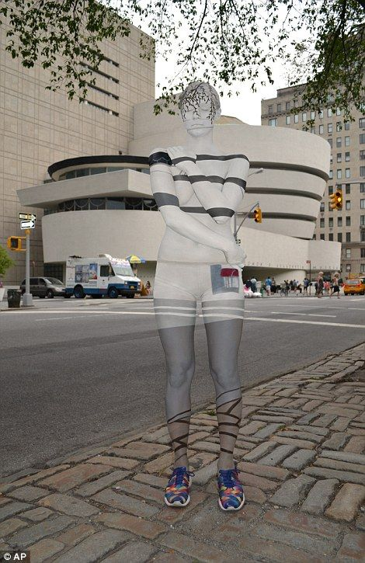
The CARDEA APPROACH: challenges
WHY RESEARCH MANAGERS NEED THE SUPPORT OF EC?
Research Manager roles are invisible
Policies must establish a Career Development scheme to promote professional Progression
No consistency in salary, skills, competencies and training across the ERA

Slide 6


















The CARDEA APPROACH: players

Slide 7




The CARDEA APPROACH: players
PROVEN TRACK RECORD
697 AWARDED ORGANISATIONS
8/8 CARDEA
2.124 R&I PROJECTS
31 % COORDINATED
8/8 CARDEA
600 CENTRES IN 42 COUNTRIES
8/8 CARDEA

Slide 8

The CARDEA APPROACH: objectives
CARDEA MAIN OBJECTIVE:
Professionalization of Research Management as a valued career choice, with identified competencies, progression pathways, standards for benchmarked and indexed salaries and access to appropriate skills development through a translational Research Management hub.
Cardea was the Roman goddess of door hinges and handless who preventing evil spirits from crossing thresholds, protector of children and goddess of health.
Research Managers open Research Doors

Slide 9
The CARDEA APPROACH: objectives
Improve knowledge for policy-making about the training and networking patterns of research support staff and research management.
Increase awareness amongst research management staff about existing training, networking and mobility opportunities at EU, national, and regional levels.
Grow the capacity and compatibility of cooperation and funding systems throughout the European Research Area for research management, and support to scientists.
Improve awareness of the EU policy drivers and the EU research peculiarity in the Higher Education Institutions and Research organizations.
Establish central hubs to provide the EU research system with the most appropriate “fit for purpose” skills in EU research management, with active involvement of entities located in widening countries.
Provide recommendations aiming at facilitating a clear career path for research managers at national and EU levels, enhancing their role towards the achievement of the new ERA objectives.

Slide 10
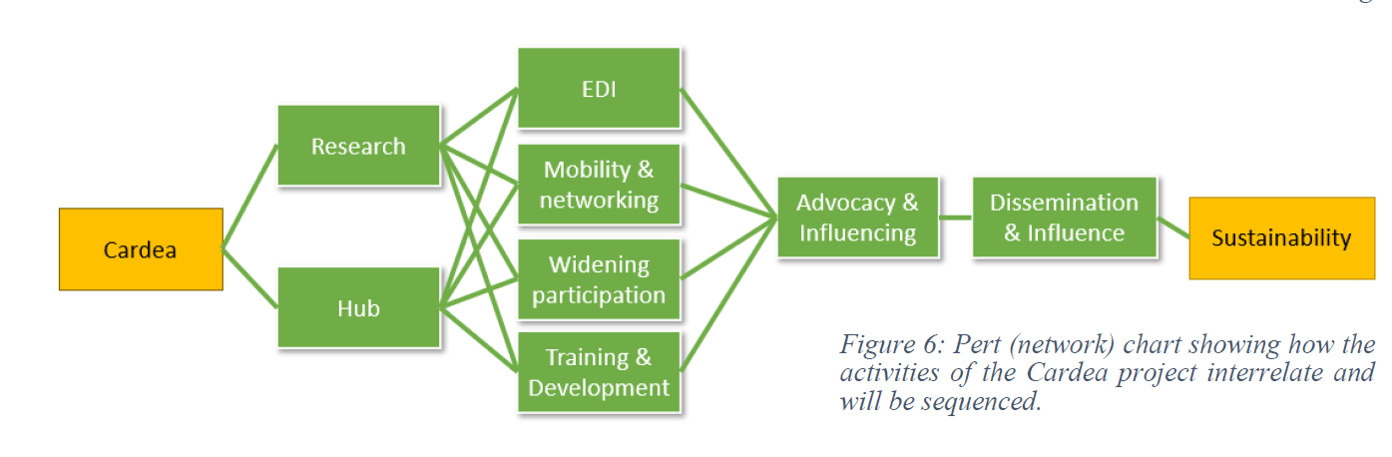




The CARDEA APPROACH: activities

Slide 11
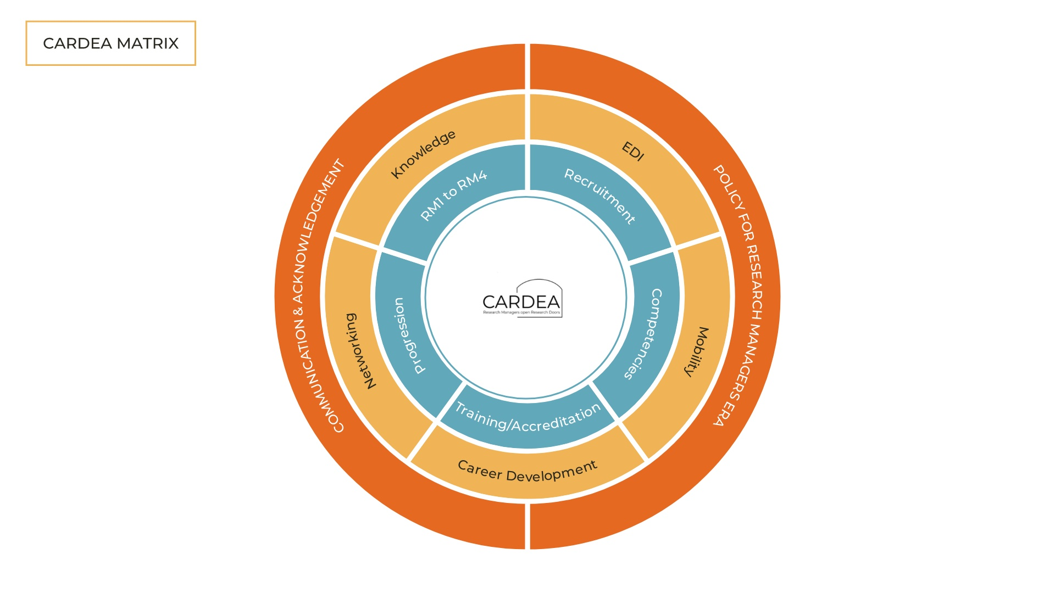


The CARDEA APPROACH: activities
Research Manager as a valued career choice
Classification of Research Manager Roles & framework development
Knowledge Hub/Website
Knowledge, Skills and Competencies required
Policy, lobbying and engagement with stakeholders
Training and Development

Slide 12
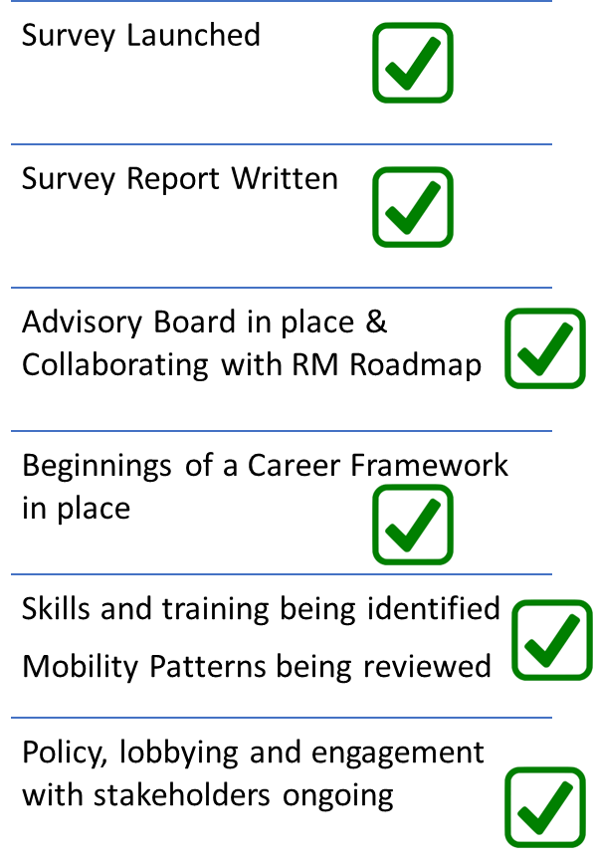

The CARDEA APPROACH: results
CARDEA ACTIVITIES
1st year

Slide 13
The CARDEA APPROACH: results
855 RESEARCH MANAGERS
43 NATIONALITIES

Slide 14
The CARDEA APPROACH: results

Slide 15
The CARDEA APPROACH: results

Slide 16
The CARDEA APPROACH: results

Slide 17
The CARDEA APPROACH: results

Slide 18
The CARDEA APPROACH: results

Slide 19
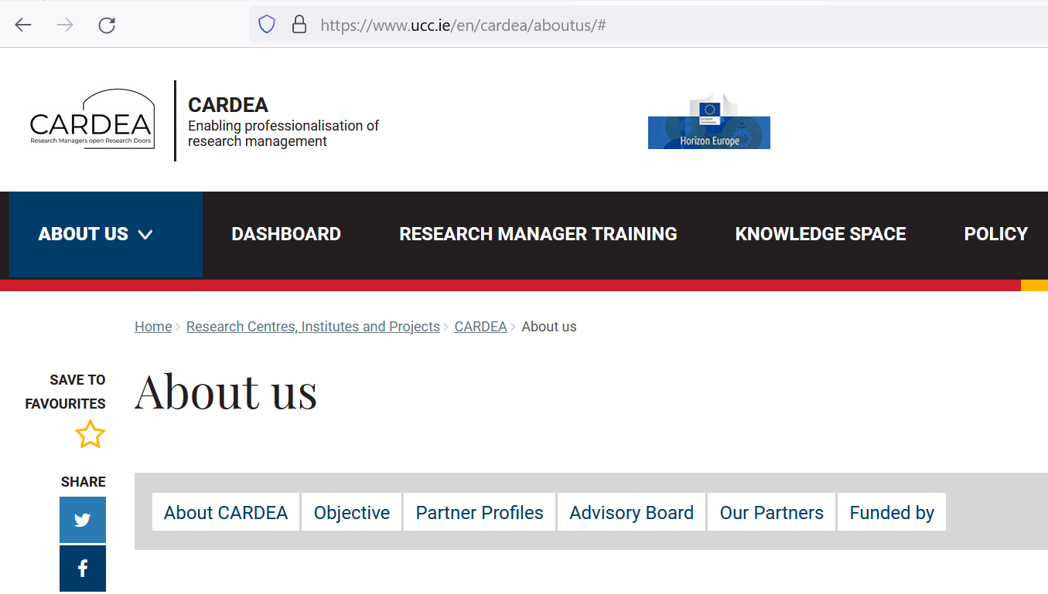

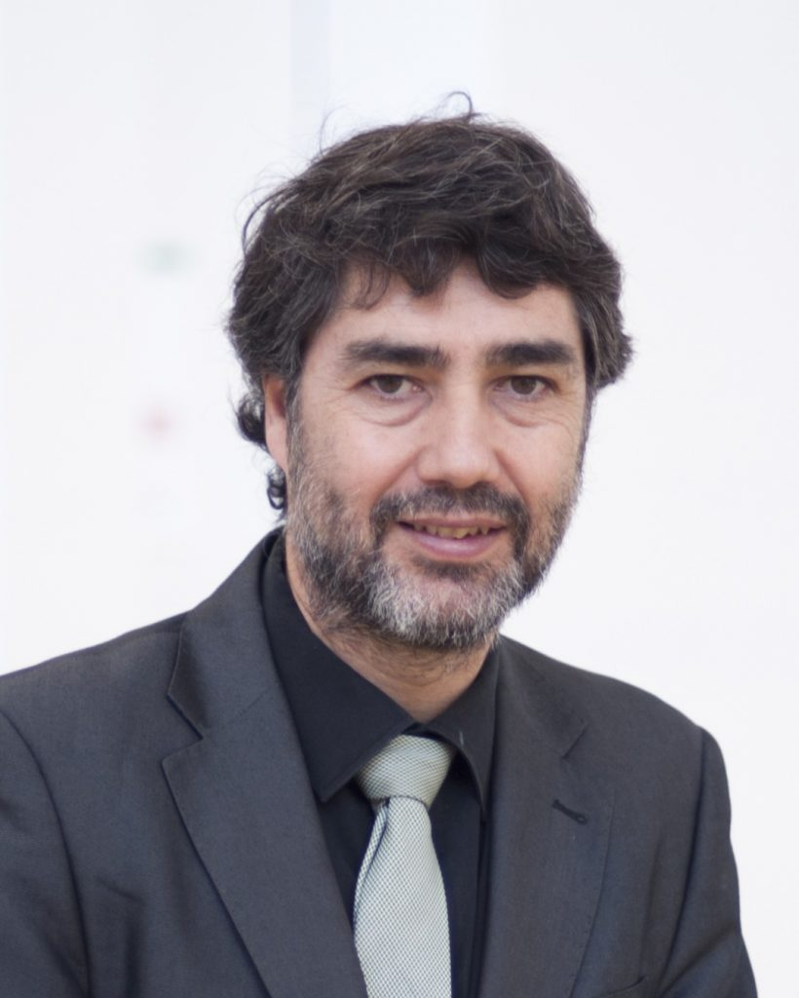
The CARDEA APPROACH: results
https://www.ucc.ie/en/cardea/

Slide 20

The CARDEA APPROACH: results
Adrian Curaj (Politehnica University of Bucharest)
Conor O’Carroll (SciPol Services Ltd)
Dimitris Deniozos (Technical University of Crete)
Doris Alexander (Trinity College Dublin)
Eoin Sherwin (Eli Lilly)
Gabi Lombardo (European Alliance for Social Sciences and Humanities)
George Papamichail (Greek Foundation for Research and Technology FORTH)
Gillian Bruton (MaREI Research Centre UCC)
Isabelle Halleux (University of Liège)
Joanne Ui Chrualaoich (UCC)
Miguel Sierra (INIA Uruguay)
Loredana Marmora (ISINNOVA)
Olaf Svenningsen (EARMA)

Slide 21






The CARDEA APPROACH: results
RESEARCH MANAGEMENT DEFINITION
1- Executive management
2- Communication and Impact management
3- Fundraising and Project management
4- Legal and Ethics management
5- Facilities and IT Systems management
6- Training and People management
7- Administration and Finances management
8- Innovation and Knowledge Transfer management
9- Quality, Data and Knowledge management
10- Strategy and Corporate Development management

Slide 22
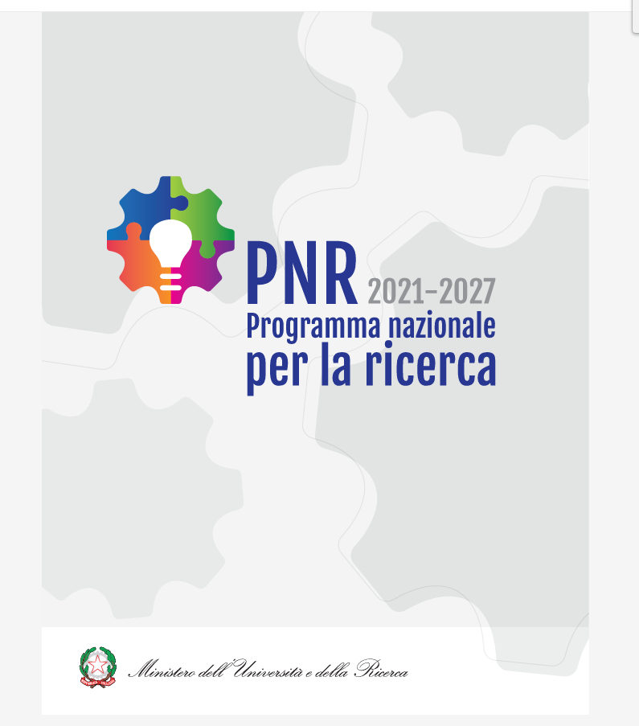
The CARDEA APPROACH: results
RESEARCH MANAGEMENT RECOGNITION
Someone in an organization whose job is to manage the development of new products and ideas (Cambridge Dictionary)
The new generation of researchers, technologists and other professional figures in support of research who, for the sake of brevity, we could here designate as "research managers", will have to be the glue between the training systems at all levels, research, businesses and institutions, to promote and accompany the twin transitions, digital and green…
… highly qualified research managers, who understand the languages of both worlds, that of science and that of business…

Slide 23
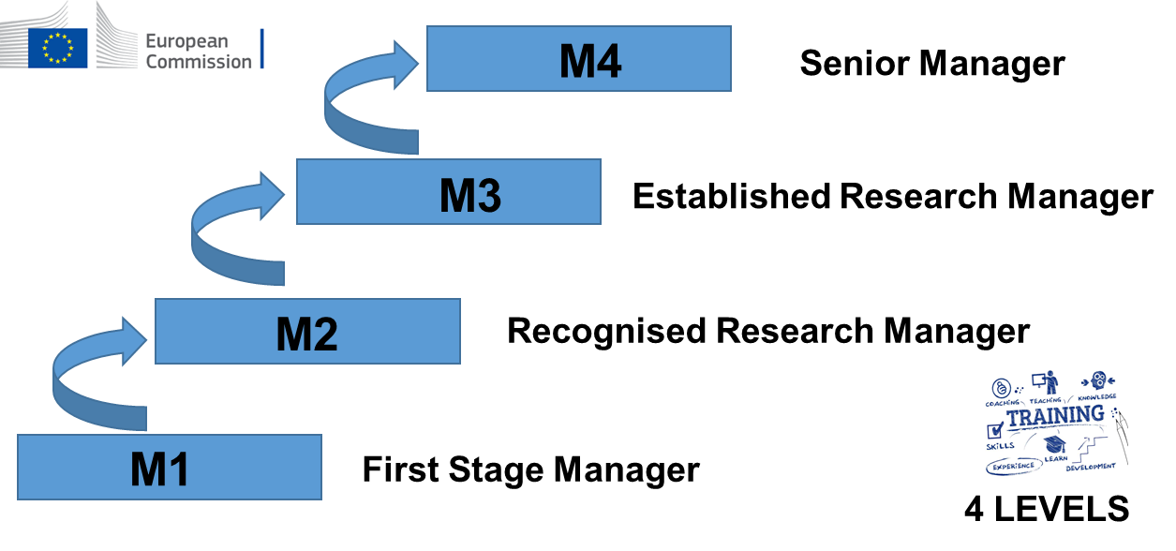
The CARDEA APPROACH: results
RESEARCH MANAGEMENT CAREER
“Towards an European Framework for Research Manager Careers”
CARDEA PROPOSAL

Slide 24
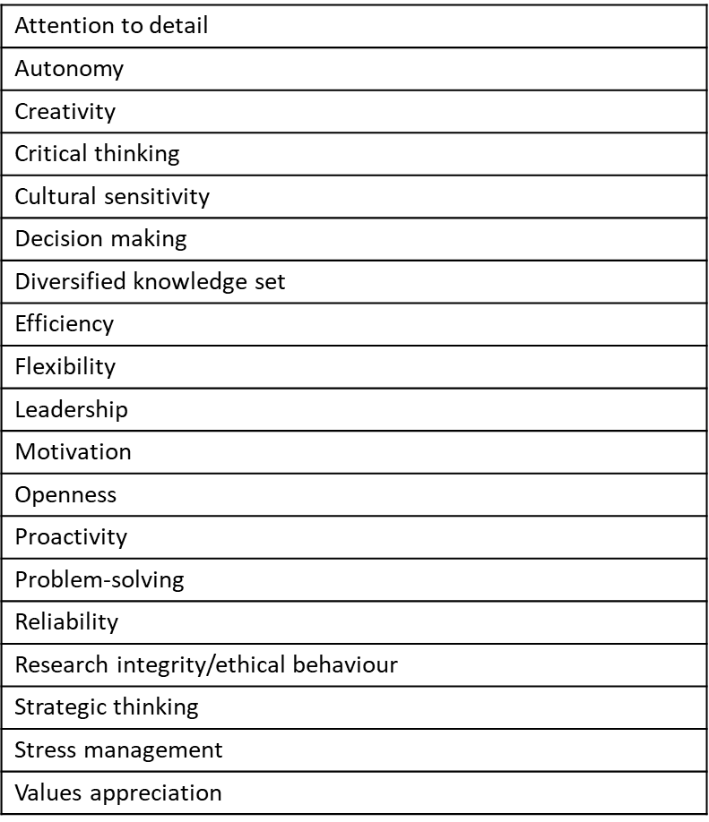
The CARDEA APPROACH: results
RESEARCH MANAGEMENT SKILLS AND TRAINING

Slide 25

The CARDEA APPROACH: results
RESEARCH MANAGEMENT SKILLS AND TRAINING
The role and professional identity of the RMs
UN Sustainable Development Goals
Outreach and Engagement
EU policy and R&I ecosystem and funding instruments
EU Twin priorities (green and digital)
Research Integrity
Research Data Management
Smart Specialisation
Soft skills
Leadership
Collaboration with widening and international countries
Equality and inclusion management
4 LEVELS
16 Modules

Slide 26
The CARDEA APPROACH: results
RESEARCH MANAGEMENT MOBILITY BARRIERS

Slide 27
The CARDEA APPROACH: results
RESEARCH MANAGEMENT MOBILITY BARRIERS

Slide 28

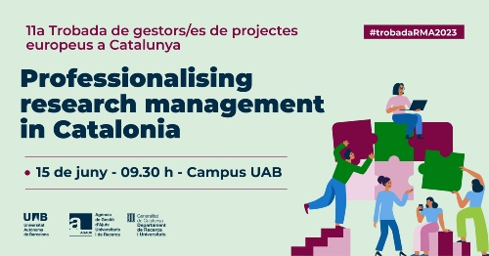
The CARDEA APPROACH: prospects
RESEARCH MANAGEMENT POLICY
“Towards an European Framework for Research Careers” (R1-R4, 2011)
“Towards an European Framework for Research Manager Careers” (M1-M4, 2023-24)

Slide 29
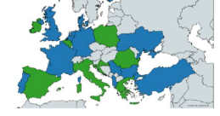
The CARDEA APPROACH: prospects
RESEARCH MANAGEMENT POLICY
There is little consistency across Europe in salary scales, contracts, skills, competencies, and training opportunities for RMs
RM positions are often tied to individual grants leaving RMs often on precarious contracts throughout their careers.

Slide 30
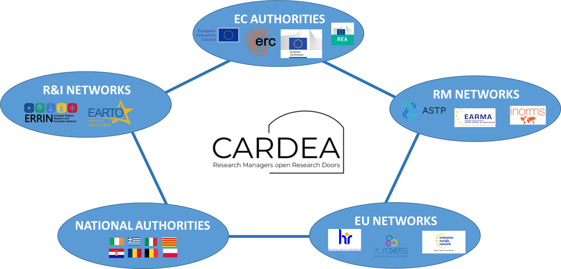
The CARDEA APPROACH: prospects
RESEARCH MANAGEMENT POLICY

Slide 31
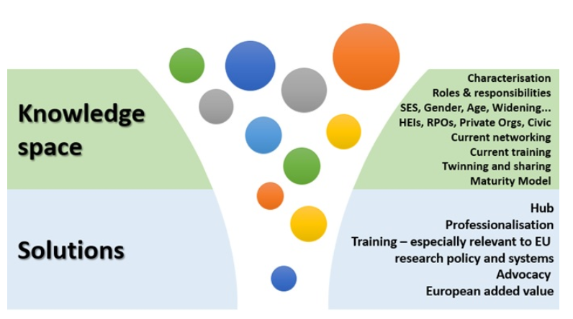
The CARDEA APPROACH: prospects
RESEARCH MANAGEMENT POLICY

Slide 32




Towards an European Management Council (EMC)?
The CARDEA APPROACH: prospects
RESEARCH MANAGEMENT POLICY
16.000 M €
Researchers
6.600 M €
Researchers
Widening participation and spreading excellence
26.200 M €
Researchers
Managers
Mobility
Training
2.960 M €
Researchers
Managers
Widening mobility

Slide 33

The CARDEA APPROACH: prospects
HORIZON-WIDERA-2024-ERA-01-03: Support for the professionalization of research management. CSA. 1.000.000 € (1 project). Deadline: March 12th, 2024.
Involve a large number of public research performing and research funding organisations and their research management staff in the training and networking programmes, including by improving accessibility for staff from regions of lower R&I intensity.
Improve training, skills and career development of research management staff in the participating organisations.
Contribute to professionalization, including through certification of training programmes.
Increase recognition of the research management profession in Member States and the important role of research managers across the ERA.

Slide 34


Köszönöm Thank you for your attention¡
Any questions

