Slide 1
Career Acknowledgement for Research Managers
The CARDEA project is funded by the European Union. Views and opinions expressed are however those of the author(s) only and do not necessarily reflect those of the European Union or the European Research Executive Agency (REA). Neither the European Union nor REA can be held responsible for them.
Mihaela Albu
Politehnica University of Bucharest
Project: 101058572 — Cardea — HORIZON-WIDERA-2021-ERA-01

Slide 2
Priority deliverables
Research Manager as a valued career choice
Classification of Research Manager Roles & framework development
Knowledge, Skills, Competencies required
Training and Development
Knowledge Hub/Website
Policy, lobbying and engagement with stakeholders
Survey Launched
Survey Report Written
Advisory Board in place
& Collaborating with RM Roadmap
Beginnings of a Career Framework in place
Skills and training being identified
Mobility Patterns being reviewed
Policy, lobbying and engagement with stakeholders

Slide 3
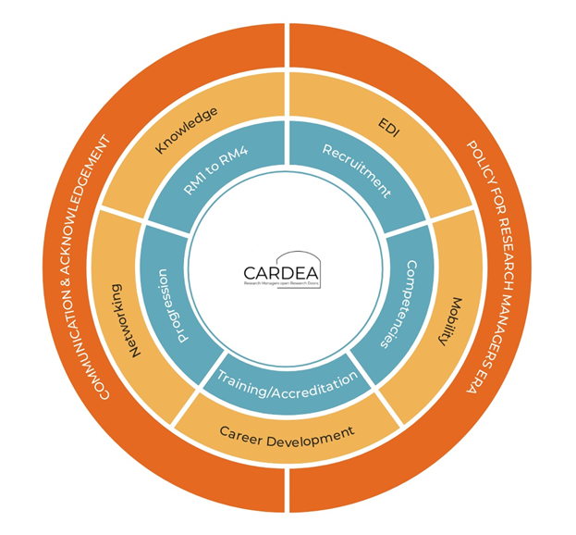
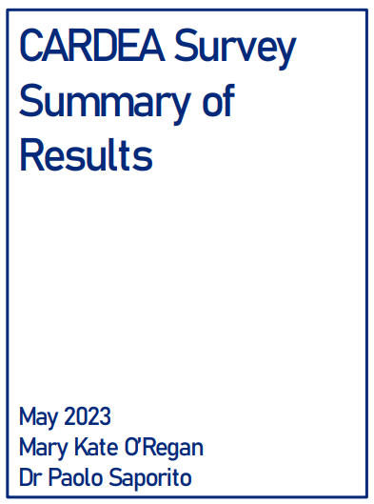
CARDEA matrix
855 Research Managers
97 unique questions (416 individual items)
demographics
employment
skills and education
motivation and satisfaction
professional networks
Mobility
389 (45%) fully completed the survey (11 sections).
456 (53%) respondents completed at least nine of the sections.

Slide 4
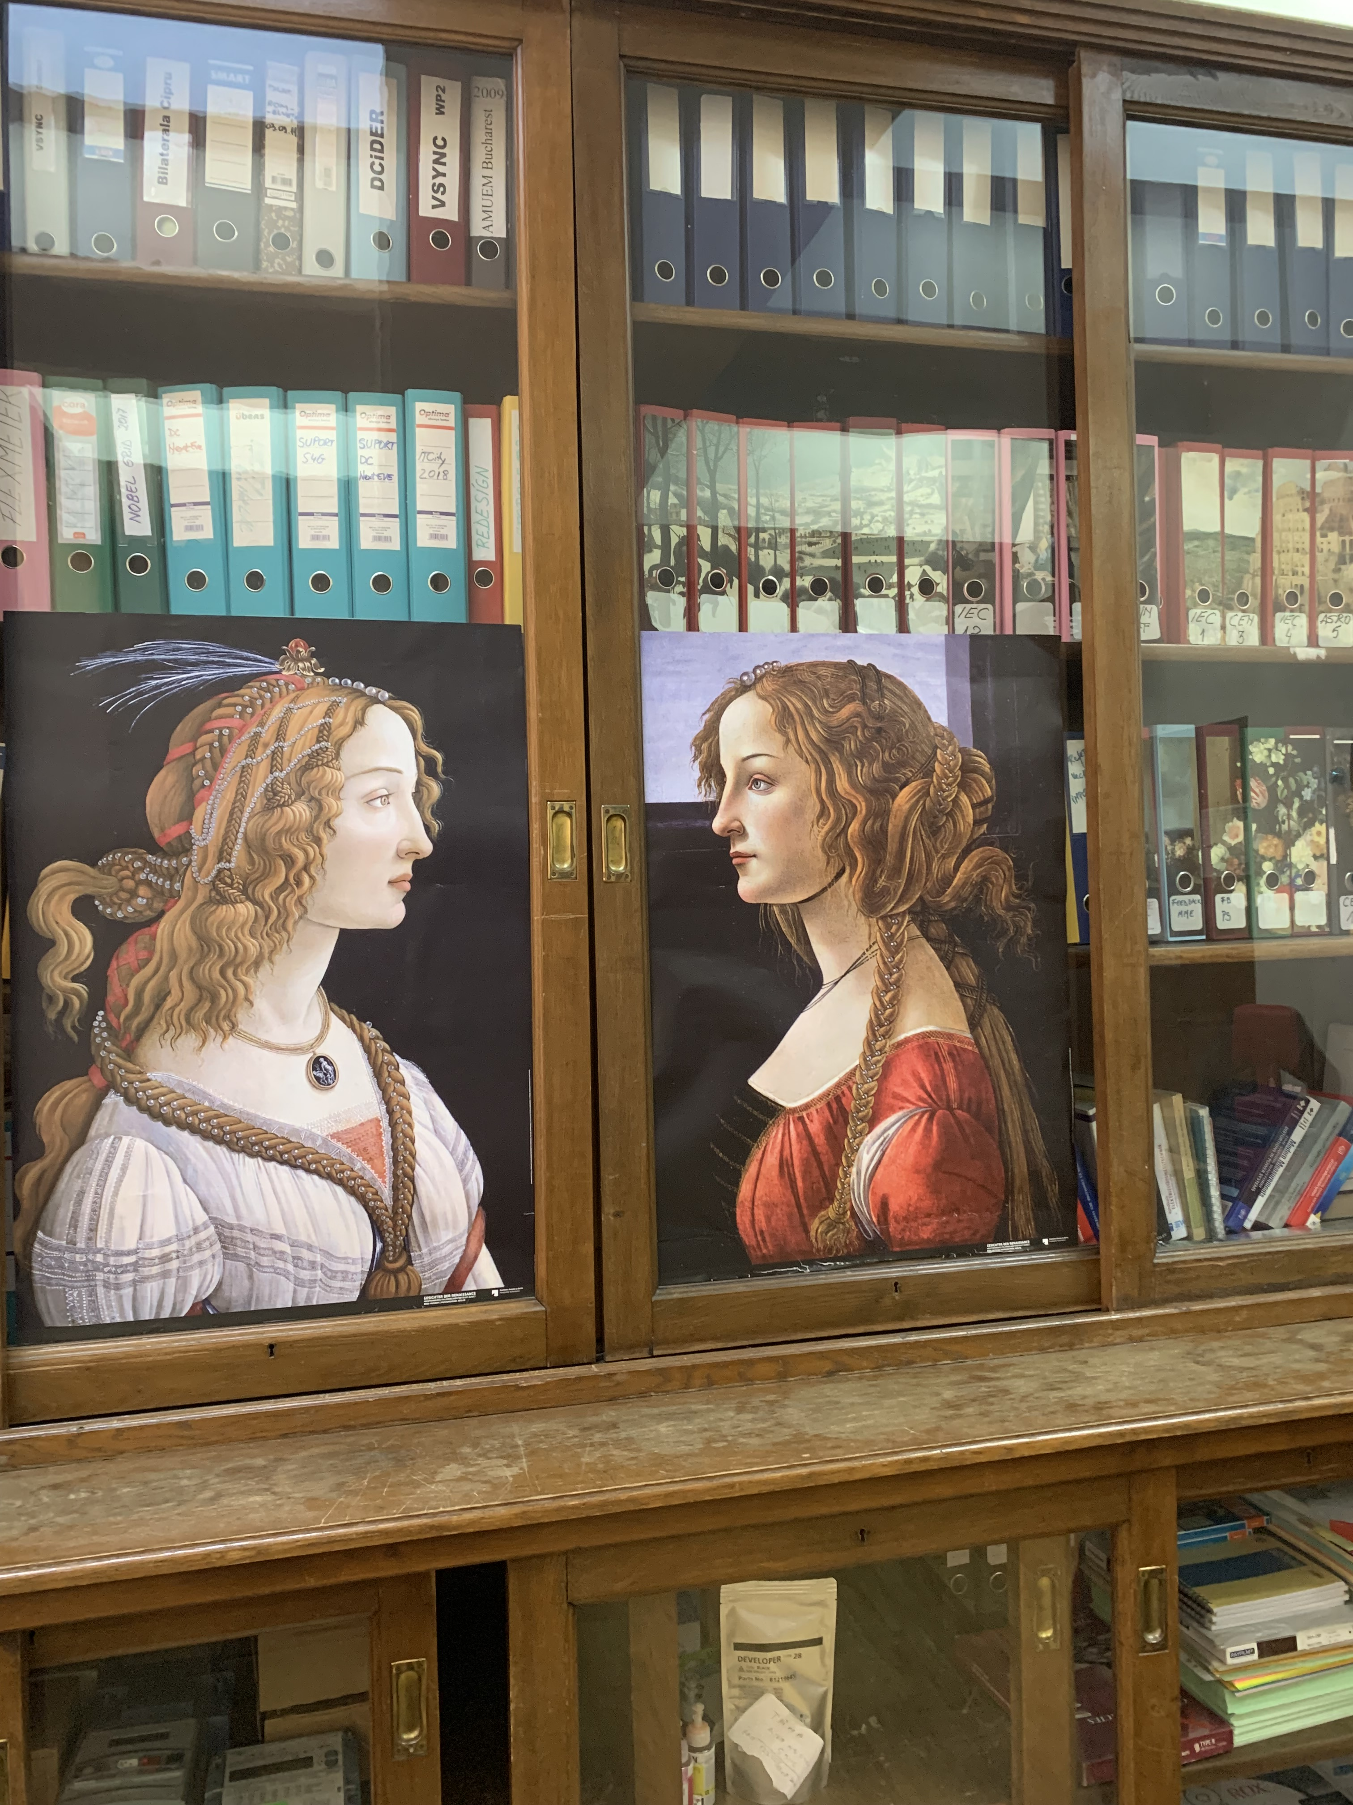
CARDEA RM Participant Profile
Average Age
EU Nationals
43 years
86.5%
Work and live in country of birth
2 Languages
87.6%
79.1%

Slide 5
CARDEA RM Participant Profile
PhD
PhD and Masters
53.9%
90.8%
Member of a professional
RM Association
Specific RM Qualification
42.5%
19%

Slide 6
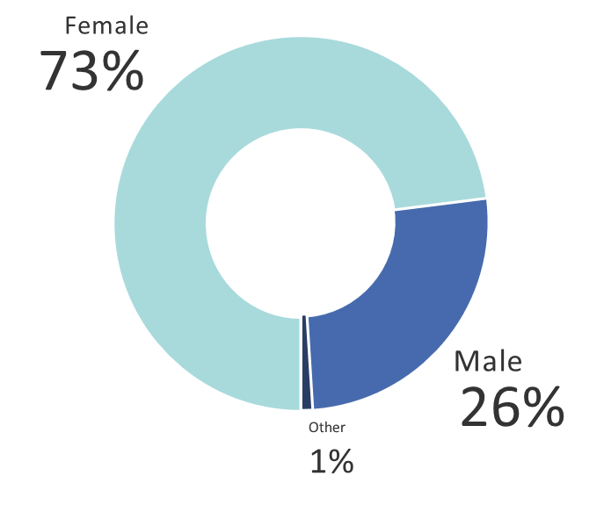
CARDEA RM Participant Profile
Gender
Earn less than 40k
53%
47%
Earn over 40k
RM Years of Experience
Salary Average = €37,600
Over 10 years
At least 6 years
33%
21%

Slide 7
RM Employment and Salary Funding
Permanent or Equivalent Employment Contract
Fixed Term Employment Contract
66%
34%
Core Funded
Research/Other
70%
30%

Slide 8
How RM's Work
Manage an Individual Project
Researcher and Research Manager
9%
9%
Provide Specialised Professional Services to a range of Research Projects
Lead Research Management across an entire institution
35%
14%
Lead a team supplying Specialised Services to Research Projects
Lead Research Management across multiple institutions
13%
1%
Manage several Research Projects directly
Other
8%
11%

Slide 9
Somewhat YES
48%
Definitely YES
Do you have the skills to be an effective RM?
42%
Neutral/Somewhat No/No
10%

Slide 10
RM Quality of Work
Do you feel your organisation values and recognises your contribution to research management appropriately?
Do you understand how your role fits in your organisation?
Yes
90%
No
50%
Yes
50%
No
10%

Slide 11
RM Quality of Work
Do you have suitable opportunities to contribute to organisational decision making at the appropriate level?
Do you enjoy an appropriate amount of work autonomy to choose your methods of working and pace of work?
No
27%
Yes Somewhat
Yes Completely
Yes Somewhat
54%
51%
44%
Yes Completely
No
Other
17%
Other
4%
2%
1%

Slide 12
CARDEA Levels of RM
First Stage Research Manager (RM 1)
First 2 years (FTE) of their RM activity
Recognized Research Manager (RM 2)
2 to 5 years (FTE) experience in RM activity
Established Research Manager (RM 3)
5 to 8 years (FTE) experience in RM activity
Senior Research Manager (RM 4)
Greater than 8 years (FTE) experience in RM activity

Slide 13
RESEARCH MANAGER COMPETENCIES
Technical Skills
Outreach & Community
Communication
Specialised Knowledge
Financing/Contracting
Relationship Management
Project Management
Line Manage. Talent Dev.
Transversal Skills

Slide 14
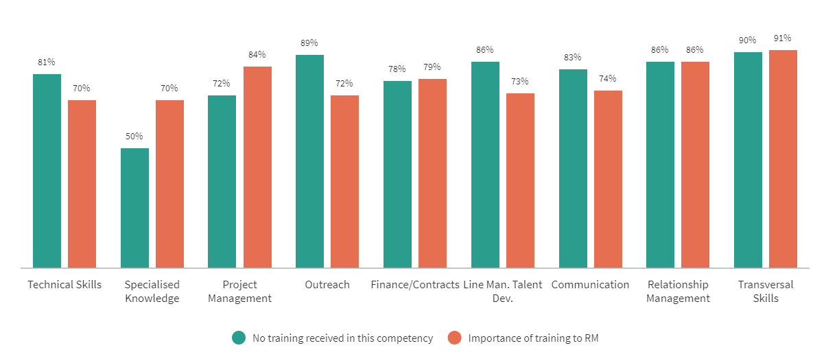
COMPETENCIES - CARDEA Matrix

Slide 15
Routes into Research Management Career
I was interested in supporting research but not conducting research
I have the correct skills profile
Other
3.95
3.73
3.50
It was recommended to me
I needed a job and RM opportunities were available
I saw the opportunity for a rewarding career in RM
2.75
2.76
3.00
I worked in a different area of management/administration and transferred to a research focus
I tried for research opportunities, but they didn’t materialize
1.84
2.25
Values are mean scores on a scale from 1 to 5

Slide 16
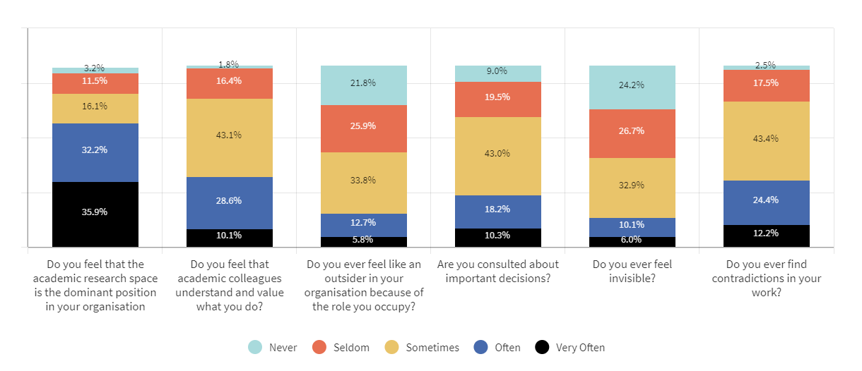
Professional identity - research managers

Slide 17
The CARDEA Hub
Equality, Diversity and Inclusion Strategy Plan
The CARDEA Hub inclusive of the CARDEA Academy will provide a platform for training and development focusing on 3 important aspects
A. Transition Support Programme
B. Pilot Coaching and Mentoring Programme
C. EDI Awareness Training Modules

Slide 18
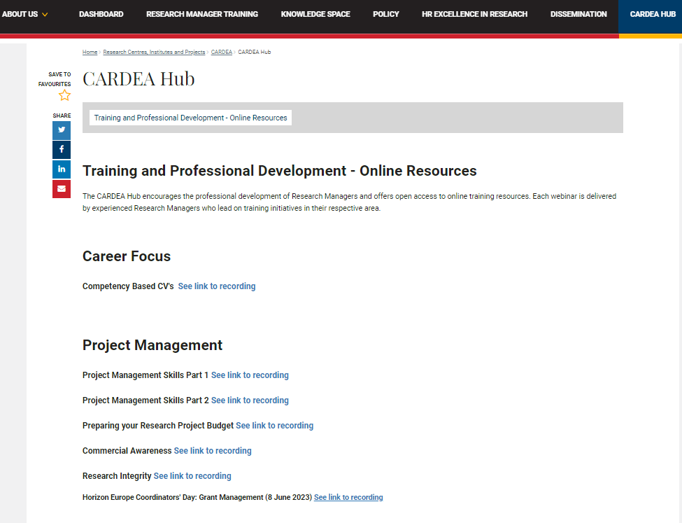
Open doors …
EURAXESS

Slide 19
GREECE
BELGIUM
CROATIA
ITALY
POLAND
ROMANIA
SPAIN
IRELAND

Slide 20
Q&A session
.

