Slide 1


Slide 2
Lessons from 30 years of working with Health and Environmental data (in Ireland!)
Professor Patrick Goodman TU Dublin
patrick.goodman@dit.ie

Slide 3
Key message
Know your Data
Know its limitations
Keep it simple

Slide 4
Thanks to Leonard, A. G. G
winter particulate pollution concentrations measured in Dublin were 2.4 times greater than the summer
for Dublin domestic sources emitted about 3.3 times more particulate pollutants into the air compared with industrial sources
very similar to that observed for a site at Westminister Bridge in London for the same period
for 1941 they report a reduction of over fifty percent in particulate pollution levels
attributed to the reduction in coal burning, due to a shortage with WW2
he reports that pollution levels start to rise again in 1948 and 1949, as coal becomes more available
RESpiratory Mortality at lowest during the war

Slide 6
In the beginning!

Slide 7
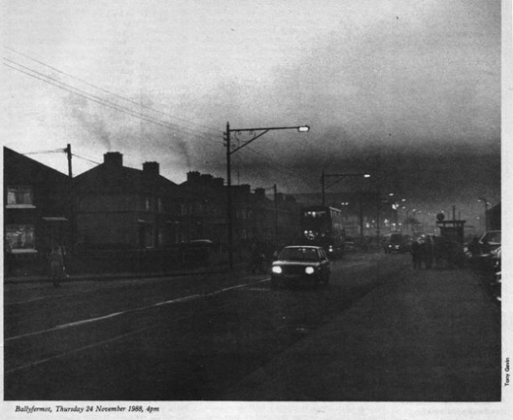

Slide 8
Dublin data 1982

Slide 11
Mortality types!
We observed different response patterns for Respiratory and Cardio-vascular mortality (not really expected!)
Most people thought respiratory mortality was more important!

Slide 12
The Dublin coal ban

Slide 16
Cork
Mean Black smoke concentration decreased from 32 to 17 µg/m³
(-47%)
SO₂ increased from 15 to 18 µg/m³ (+20%)
On October 1, 1995 – Irish Gov’t banned coal sales in Cork

Slide 17
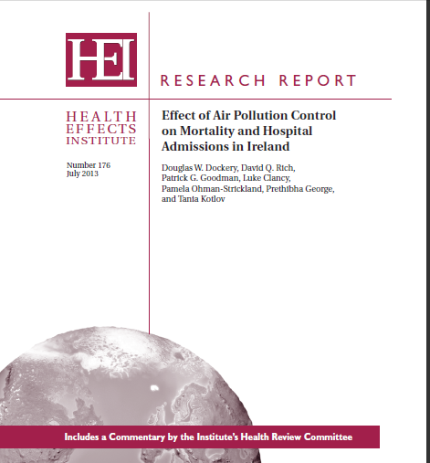

Slide 18
Cork Coal Ban
There was a 9% decrease in Respiratory mortality
A 4% decrease in Hospital admissions for Cardio-vascular events
A 4% decrease in cardiovascular mortality (NS)

Slide 19
Issues encountered!
Influenza (no surveillance system at the time!)
What pollution and meteorology exposures to use?
Hospital admission data !!! On call –system
Acute and extended pollution and meteorology effects
ICD coding and changes with time and EU experiences
Long term trends in society

Slide 20
Some anomalies (mortality data)

Slide 21
Hospital admissions!

Slide 23
Network 2006 2006

Slide 24
Irish Independent Jan 2019
"To put that into perspective, the air quality was so bad that a UCC professor told me that New Ross had worse air quality than Beijing in 2008 - - when there were concerns over athletes exposure to smog during the Olympics."

Slide 26
Key messages
We conclude that particulate air quality in some of the locations monitored in this study is of concern, and this raises the question of whether or not similar locations with no continuous monitoring data may have similar issues in relation to particulate air quality.
An assessment of the continued effectiveness of the bituminous coal ban should be carried out and, if deemed necessary, the possible introduction of a national prohibition on the usage of bituminous coal should be considered.

Slide 27

What constitutes a suitable monitoring site!
A roadside traffic location
Middle of Phoenix park
Residential estate
(Urban background)

Slide 28
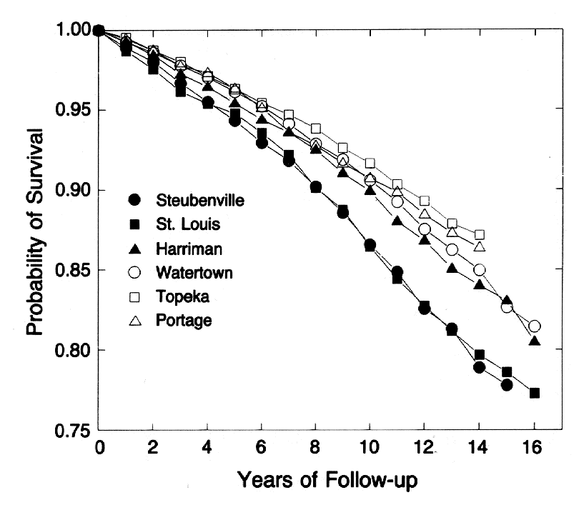
Harvard 6 cities study

Slide 29
Not just an acute affect

Slide 30
Met Data
As we are in Cork, do we use Cork airport data?
Cork airport is about 600 ft (200m) above sea level, and well outside the city centre!
You need to know the limitations and benefits

Slide 31
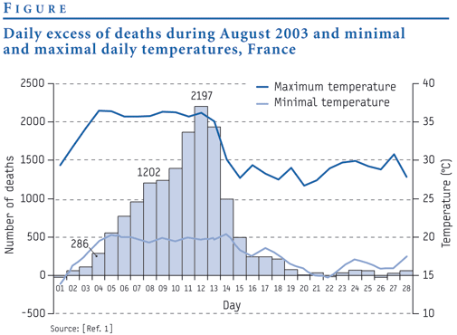
Lessons from Public Health history

Slide 32
Thank you
For the invitation to this event
Thank you for your attention
Thank you to those who provide the exposure and health data, without you this work would be impossible

Slide 33
Key message
Know your Data
Know its limitations
Keep it simple

