Slide 1
INHALE Irish Nationwide Health and Air Quality Linkage
UCC Study Team: Éilis O’Reilly, Stig Hellebust, Claire Buckley, Christina Dillon, Greg Kelly
with John Wenger and Ivan Perry

Slide 2
2017 Climate Call
“Health Impacts of PM10/ PM2.5 in the Irish context linking air quality data to health surveillance data”

Slide 3
2017 Climate Call: Prescribed aims
1. Consider how data measuring health impact of air quality, and PM in particular, is collected in other countries.
2. Identify the relevant data and statistics for assessing the health impact of elevated PM levels on the Irish population.
3. Determine how best to collect and collate the relevant health and air quality data and define infrastructural requirements for developing appropriate systems in Ireland with capacity to interrogate routine health service utilization data and identify linkages between human health and air quality.
4. Provide recommendations for health and other relevant national agencies on how to develop a comprehensive operational system to link health and air quality data, in line with international best practice, including how to provide an estimate of the economic cost of the health impact from poor air quality.

Slide 4
INHALE Work-shop: Our Aim
Aim of INHALE Workshop: To develop an infrastructure to support our project:
1) Promote our project in the area of air pollution and environmental epidemiology
2) To build a supporting network with similar projects
3) To build links with those who will implement our tools
4) To build on the project’s applicability to future environmental health science
Theme 1 EPA Lessons Learned
Theme 2 Implications for linked air quality and health data
Theme 3 Potential and Limitations for Linked Air Pollution and Health Data
Theme 4 Future in Environmental Epidemiology

Slide 5
Problem: matching health outcomes with EXPOSURE
Air Quality monitoring network
PM2.5
PM10
Ozone
Sulphur Dioxide
Nitrogen Oxides
Carbon Monoxide
Black smoke (historical)

Slide 6
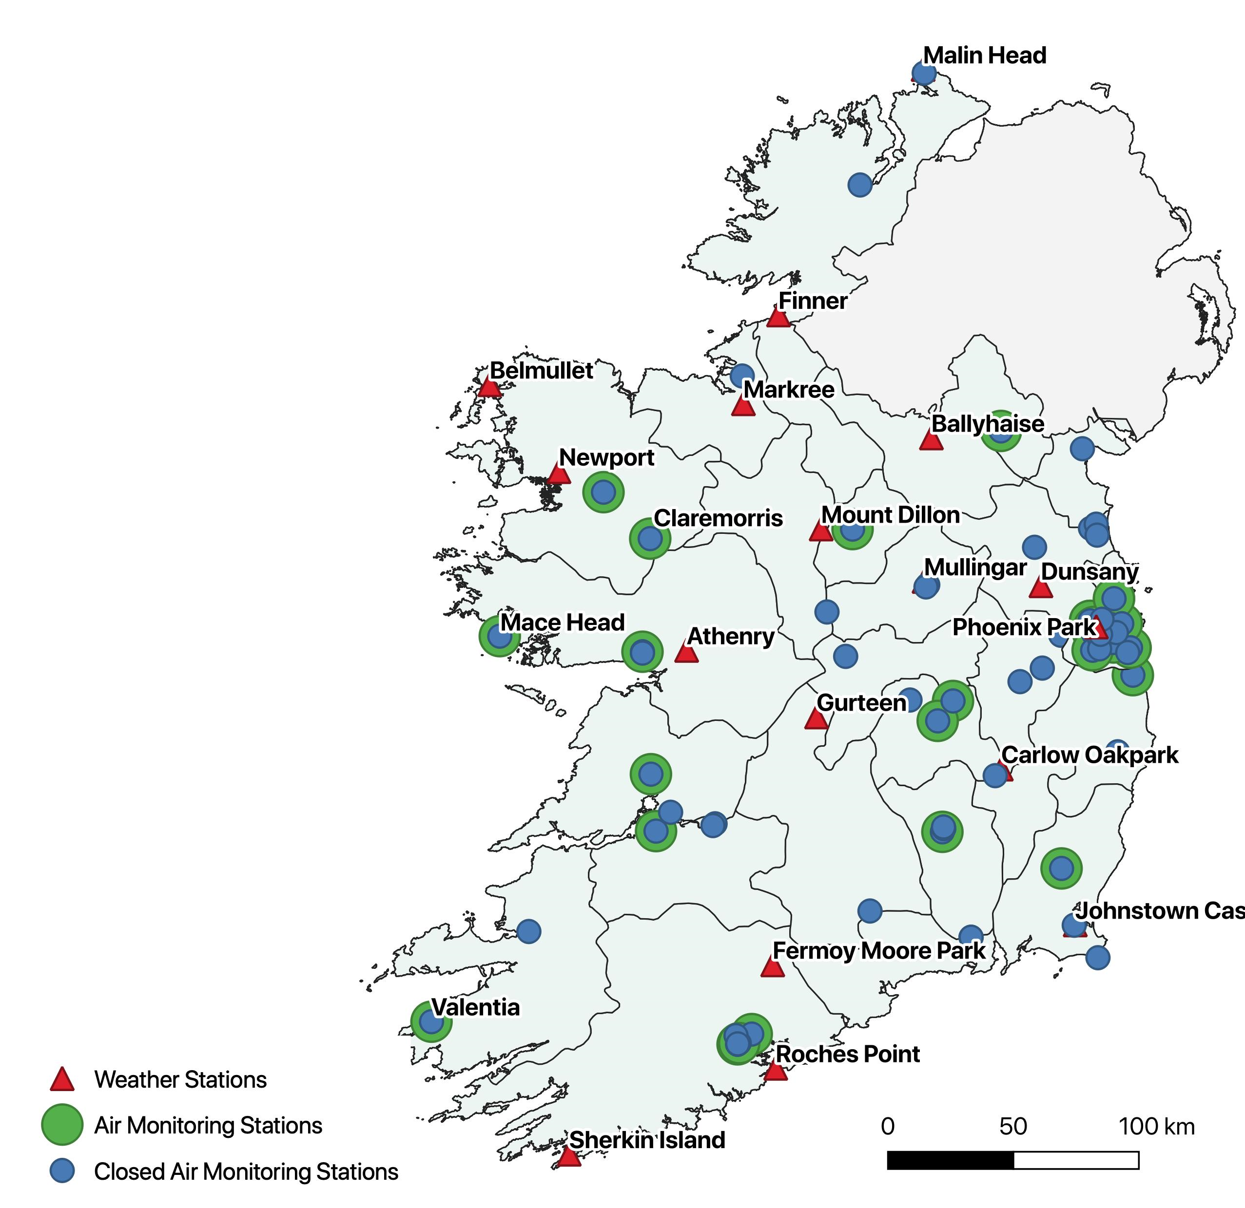
Air Quality data vs. Health data
Individual | Health
1 | -
2 | ++
… | +
4.7 Mill | --
GDPR
?
Area | Air Quality
1 | ++
2 | --
… | +
~60 | +++

Slide 7
High level (e.g. county) aggregates are not meaningfully related to AQ values
Individual | Health
multiple | --
Area | Air Quality
county | +++

Slide 9
Air Quality Zones
AQ Zone | Air Quality
A | --
B | +
C | ++
D | +++
Health outcomes by type of environment:
City centre roadside
Urban background
Small town centre
Rural background
Population density
Land use
Vehicle density
Commuting patterns
Weather!
AQ Zone | Health
A | -
B | ++
C | +
D | --
https://gis.epa.ie/EPAMaps/

Slide 10
Why do we need linking?
Person | Health
1 | +
2 | -
3 | -
4 | +
Person | Useful area code
1 | A
2 | B
3 | C
4 | C
Small Area | Health
A | +
B | -
C | -
AQ zone | Health
AQ1 | +
AQ2 | -
AQ3 | +/-
Area | AQ
A | AQ1
B | AQ2
C | AQ3
Epidemiological models

Slide 11
Why do we need microdata?
Person | Health
1 | +
2 | -
3 | -
4 | +
Area | AQ zone
i | +
ii | -
iii | -
iv | +
AQ zone | Health
AQ1 | +
AQ2 | -
AQ3 | +/-
Epidemiological models
Because health records are not designed for the purpose of environmental health research!

Slide 12
How do we obtain useful aggregate data for AQ and health studies?
Link microdata to relevant spatial identifiers
Requires microdata access
Option 1: Each study goes through the process – high legal barrier
Option 2: third party with legal access to process administrative data produces official aggregates with relevance to air (water, etc.) – low legal barrier
One process pipeline can form basis for all studies – low technical barrier
Enable automatic publication of useful aggregates by including relevant spatial identifiers in health records
Relevant aggregate data can be published without restrictions by data controllers (e.g. HSE)
Low legal barrier
Low technical barriers
Interest?

Slide 13
Three points for discussion
What administrative health data sources exist in Ireland?
Coverage
Geocodes
How useful is aggregate data currently available?
How existing administrative health data can be linked with air quality data in Ireland?
Access to relevant data
Exposure assessment?
How can the process be made more efficient?
Regular reporting of relevant aggregate data (air, water, etc.)
Incorporating air quality zones in health records

