Slide 1
Impact of NO₂ on Health
Margaret O’Mahony & Brian Broderick
Trinity Centre for Transport Research,
Dept of Civil, Structural & Environmental Engineering, TCD
TCD Project Team Members: Prof Martina Hennessy (Medicine), Aonghus Ó Domhnaill, (Engineering), Eimir Hurley (Health Policy & Management)
Collaborators: Dr. Seán Lyons, Dr. Anne Nolan, Philip Carthy, ESRI & TCD
Presented at Symposium on Linking Air Quality and Health Data in Ireland, 22nd May 2019

Slide 2
Background
In March 2015, the Committee on the Medical Effects of Air Pollutants (COMEAP), concluded that:
Evidence of associations of ambient concentrations of NO₂ with a range of effects on health has strengthened in recent years.
It would be sensible to regard NO₂ as causing some of the health impact found to be associated with air pollution in epidemiological studies.
To some extent, NO₂ acts as a marker for the effects of other traffic-related pollutants.
In Dec 2015, COMEAP further noted uncertainty regarding causal agents and what proportion of health effects can be attributed to NO₂.
The extent to which these associations reflect an effect that is additional to the effect found to be associated with PM_{2.5} is not clear.
In 2018, COMEAP reported on associations of long-term average concentrations of NO₂ with mortality but a number of committee members dissented and the recommendations include caveats.

Slide 3
EPA Research Call
Important that the implications for Ireland of this new research and the findings of the UK review are assessed.
A desk study is proposed to establish country specific drivers and vulnerabilities.
This new research should be viewed in the context of very significant challenges across Europe in meeting the existing targets for the reduction of NOx emissions from the transport sector.

Slide 4
Project Objectives 1
To conduct a review of the literature that consolidates early evidence of the health effects of NO₂ and to determine how it pertains to Ireland.
Using currently available air pollution measurements, and recent research results on the influence of meteorological and source parameters (including transport vehicle and population mobility demands), identify a set of characteristics for the locations in Ireland that are at most risk of experiencing high levels of NO₂.
Use the HSE-Primary Care Reimbursement Service (PCRS) prescribing database to establish much needed baseline data linking NO₂ levels with the prescription of drugs used to treat asthma and chronic obstructive airways disease with the intention to consider methodologies to facilitate the collection of prospective data in the future.

Slide 5
Project Objectives 2
Explore the Growing up in Ireland (GUI) and the Irish Longitudinal Study on Ageing (TILDA) databases to investigate if relationships between prevalence of respiratory symptoms in vulnerable groups e.g. children, the elderly and the socio-economically deprived, and NO₂ levels exist, within database constraints.
Review policies and strategies being implemented by other countries to bring NO₂ within compliance levels and identify a set of effective and efficient solutions to reduce and mitigate the impact of the transport sector on NO₂ levels in Ireland.
In the air quality directive (2008/EC/50) the EU has set two limit values for NO₂ for the protection of human health: the NO₂ hourly mean value may not exceed 200 µg/m³ more than 18 times in a year and the NO₂ annual mean value may not exceed 40 µg/m³.

Slide 6
Focus of presentation
How we are using the EPA NO₂ monitoring data
Initial work using HSE-PCRS prescribing database
Modelling NO₂ exposure levels, used as input to the TILDA analysis to be presented later today by Dr. Seán Lyons, ESRI & TCD

Slide 7
EPA NO₂ Monitoring Data
Characterising locations at most risk of experiencing high levels of NO₂
Identifying where transport policy mitigation strategies may need to be employed
To test for associations between respiratory medication prescribing levels and NO₂ concentrations

Slide 8
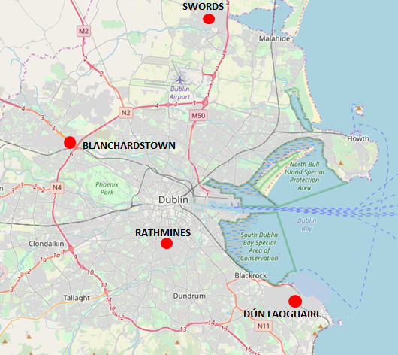
EPA NO₂ Monitoring Data
Source EPA Maps
Blanchardstown:
Urban Coverage on N3 route (Approximately 750m from M50/N3 Interchange) 2018 AADT: 76880
Swords:
Suburban Coverage at Fingal County Council Services Depot (Adjacent R125 route)
Rathmines:
Suburban Coverage on Wynnefield Road (Approximately 75m from R114 route into Dublin City)
Dún Laoghaire:
Urban Coverage at junction of Glenageary Road with R118

Slide 9

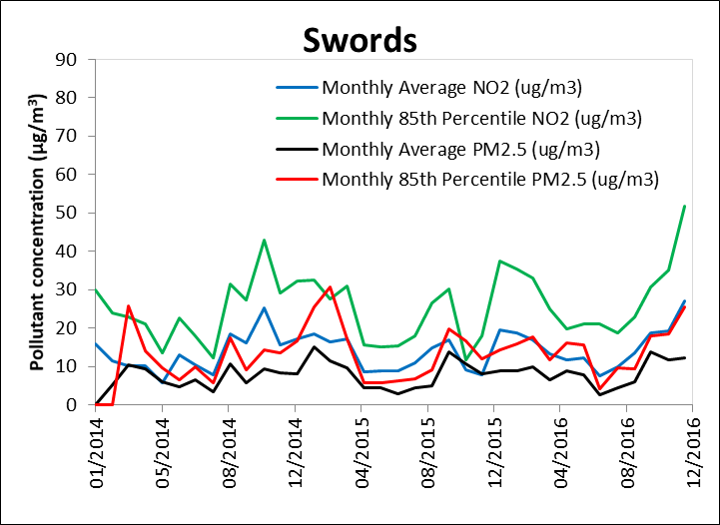
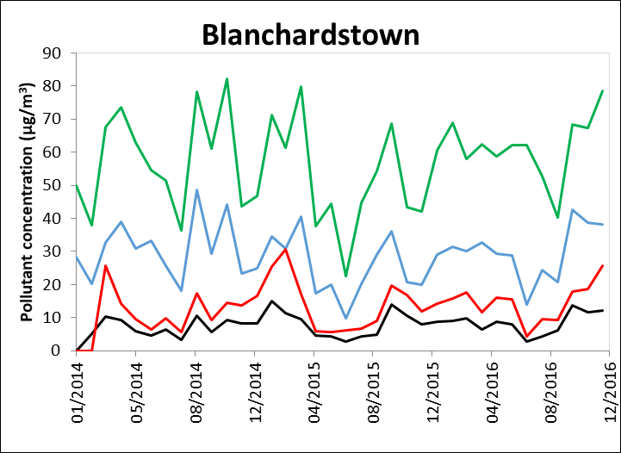
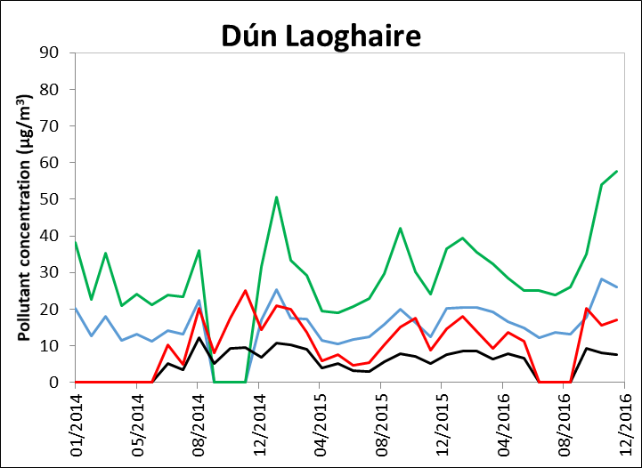
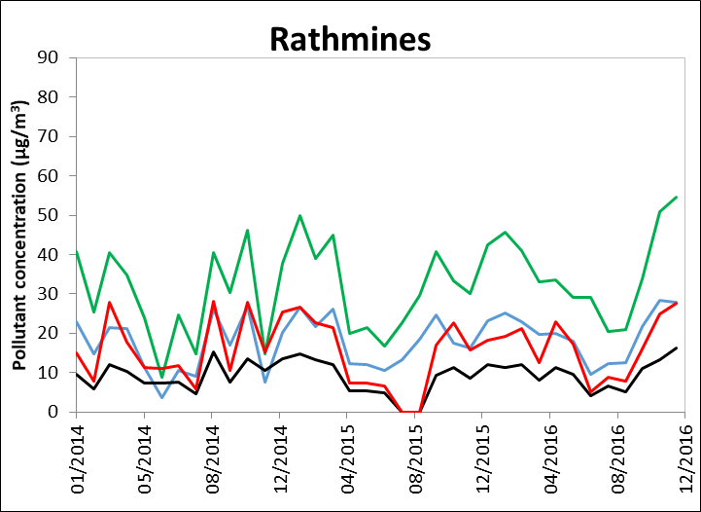
Monthly average and 85%ile NO₂ & PM_{2.5} conc. (µg/m³)
Notes:
This shows the percentage of the GMS population (in each month) aged 0-4 years that were dispensed a respiratory medication.
Respiratory medication includes all inhalers, nebules, syrups and tablets. Respiratory medication DOES NOT INCLUDE Rx for oral steroids,. They are analysed separately. See next slide
For example in North Cork in December 2015, almost 15% of kids 0-4 with a medical card were dispensed a respiratory medication. Large variation across the country, also large variation in terms of the seasonality as one would expect– peaks in November, troughs in July/August

Slide 10

HSE - PCRS prescribing database analysis
Analysis by Eimir Hurley, PhD Scholar, Centre for Health Policy & Management, TCD
Monthly variation in dispensing of respiratory medication to medical card holders (General Medical Services (GMS) Scheme) by age and Local Health Office (LHO) from Sept 2014 to December 2016

Slide 11
National Air Quality Modelling & Forecasting
From simple inputs to accurate forecasts
Historical AQ data sets
Land use and traffic
Weather
Statistical modelling
Point Forecasts
National annual mean concentration model
National background forecasting model
Urban AQ modelling and forecasting
Air Quality Index for Health forecasts

Slide 12

Air Quality Measurements:
Influence of Wind Speed and Direction
Urban Site
Rural Site
Seasonal PM₁₀ concentration roses at a rural monitoring site
Regression analysis
Aoife Donnelly, Bruce Misstear

Slide 13

Land Use Regression Modelling
Department of Civil, Structural and
Environmental Engineering

Slide 14
Wind-Sector Land Use Regression
Department of Civil, Structural and
Environmental Engineering

Slide 16
Department of Civil, Structural and
Environmental Engineering

Slide 17
Department of Civil, Structural and
Environmental Engineering

Slide 18
Department of Civil, Structural and
Environmental Engineering

Slide 19
Department of Civil, Structural and
Environmental Engineering

Slide 20
Department of Civil, Structural and
Environmental Engineering

Slide 21
Department of Civil, Structural and
Environmental Engineering

Slide 22
Department of Civil, Structural and
Environmental Engineering

Slide 23
Department of Civil, Structural and
Environmental Engineering

Slide 24
Department of Civil, Structural and
Environmental Engineering

Slide 25
Wind Sector - Land Use Regression Analysis
Concentration measurement
Wind Direction Sector
Land Use & Source Data for Sector
Quantify influence on ambient concentrations of land uses / sources at various distances upwind
Sample Model Equations
Aoife Donnelly, Owen Naughton

Slide 26
Department of Civil, Structural and
Environmental Engineering

Slide 27
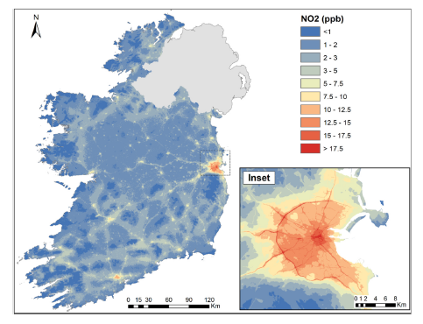
O Naughton, A Donnelly, P Nolan, F Pilla, BD Misstear, B Broderick. A land use regression model for explaining spatial variation in air pollution levels using a wind sector based approach. Science of The Total Environment 630, 1324-1334

Slide 28
Questions/topics for discussion
Availability of and accessibility to relevant health data for researchers
How do we achieve temporal and geographical granularity harmonization of air pollution and health data sets?
Is a coordinated air pollution and health data collection design framework achievable?

Slide 29
Thank You
Thank you.
Contacts:
Margaret O’Mahony: margaret.omahony@tcd.ie
Brian Broderick: brian.broderick@tcd.ie
Aonghus Ó Domhnaill: domhnaia@tcd.ie

