Slide 1
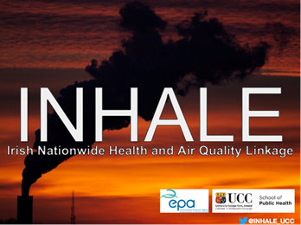
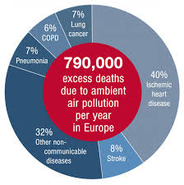
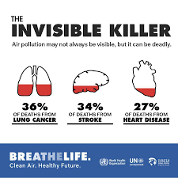
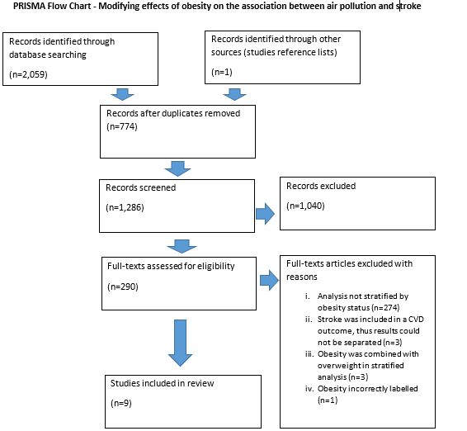
THE MODIFYING EFFECTS OF OBESITY ON THE ASSOCIATION BETWEEN AIR POLLUTION AND STROKE −
A SYSTEMATIC REVIEW.
Christina B Dillon^{1,2}, Aileen Callanan¹, Stig Hellebust ^{2,3}, Claire M Buckley ¹, Éilis J O’Reilly^{1,2,}.
¹ School of Public Health, University College Cork
² Environmental Research Institute, University College Cork
³ School of Chemistry, University College Cork
⁴ TH Chan School of Public Health, Harvard University
Corresponding author
Dr Christina Dillon
University College Cork, Cork, Ireland
Email: Christina.dillon66@yahoo.co.uk
Introduction:
In 2016, WHO attributed 4.2 million deaths worldwide to ambient air pollution.
Ambient air pollution:
may play a causal role in cerebrovascular and cardiovascular morbidity and mortality
is linked to many other adverse health outcomes including respiratory disease, mental health disorders and overall mortality
Although ambient air pollution is considered a risk factor for stroke, there remains unexplained heterogeneity in findings. It has been proposed that human susceptibility to adverse health outcomes as a result of air pollution exposure may be related to underlying personal characteristics including demographics, race, genetic profile, and existing illness.
Recent research has suggested that adults and children with high BMI are more susceptible to the respiratory effects of air pollution. However, the modifying effect of obesity on the association with stroke is unclear.
Stroke has been reported as the 2nd leading cause of death worldwide, the 5th leading cause of death in low-income countries, and the 3rd most important cause of disability worldwide (WHO 2018).
Air pollution has been cited as a leading contributor to the global burden of stroke. A recent narrative review by Graber et al., (2019) identified three meta analyses and concluded that “Air pollution should be recognized as a silent killer inducing stroke whose mortality rates remain elevated by its role as a new modifiable neurovascular risk factor.”
Objective:
Our objective was to systematically screen, appraise and synthesise the evidence of a modifying effect of obesity status on the association between air pollution and stroke.
Methods:
Population level studies published in English between 1/1/1990 and 31/03/2019 were included for review.
PROSPERO registration number: CRD42019145176
Reporting standards: PRISMA
Databases: Scopus, PubMed and Web of Science
Search strategy: ("air quality” or "air pollution" or "particulate matter" or "carbon monoxide" or "nitrogen oxide" or "nitrogen dioxide" or "sulfur dioxide" or ozone or "black carbon") AND (stroke)
Quality Assessment: Joanna Briggs Institute and a modified case-crossover appraisal tools
Evidence grading: The Scottish Intercollegiate Guidelines Network (SIGN)
Key study findings of included studies
Author (year) | Key findings
Huang et al., (2019) | Long-term PM2.5 was associated with higher risk of incident ischaemic, haemorrhagic, total stroke. No effect modification by BMI.
Ljungman et al. (2019) | Same year, 1-5 and 6-10 years prior black carbon were associated with higher risk of incident total stroke (subtypes not reported). No effect modification by BMI. Non-significant trend across BMI for black carbon [<25 (1.08 (0.91-1.27)); 25-<30 (1.20 (1.01-1.43)); 30+ (1.30 (0.94-1.81))]
Sun et al., (2019) | Short-term (3d/lag) NO₂ and NO_{x} but not PM, were associated with higher risk of haemorrhagic stroke. BMI modified the risk of ischaemic (PM2.5), haemorrhagic (NO₂ NO_{x} PM2.5 PM10), total stroke (PM2.5): BMI>30 lower risk (p<0.05)
Fisher et al., (2019) | Short-term (0-3d/average) PM10 associated with higher risk of ischaemic stroke and (1d/lag) PM10 with lower risk of haemorrhagic stroke.. No effect modification by BMI.
Hart et al., (2015) | Long-term (moving yrly ave) PM2.5, PM2.5-10, but not PM10, were associated with higher risk of incident total stroke (subtypes not reported). No effect modification by BMI.
Beelen et al., (2014) | Long-term (annual) PM2.5, PM2.5-10, PM10, NO₂ NO_{x} were not associated with risk of fatal total stroke (incident / subtypes not reported). No effect modification by BMI.
Qin et al., (2015) | Long-term (3 year ave) PM10, NO₂ were associated with higher risk of total stroke (subtypes not reported). BMI modified the risk of total stroke from PM10, not NO₂: BMI>25 higher risk (p=0.018)
Stafoggia et al., (2014) | Long-term (annual) PM2.5, PM2.5-10, PM10, NO₂ NO_{x} were not associated with risk of total stroke (subtypes not reported). No effect modification by BMI.
To et al., (2015) | Long-term PM2.5 was associated with higher prevalence and incidence of total stroke (subtypes not reported). No effect modification by BMI.
Results:
A total of 1,286 titles were identified of which 290 had their full-text reviewed and nine met eligibility criteria.
Six cohort, two case-crossover within cohorts, and one cross-sectional studies were included.
The design of the included studies varied across exposure assessment methods, exposure window (very long-term vs annual vs acute), included pollutants, outcome ascertainment (adjudicated records, self-report, mortality only) and type (prevalent, incident total stroke or subtype), and confounder selection, while populations varied by age, race, geographical location, and time of enrolment.
Findings across studies were heterogeneous. In summary, seven studies observed at least one pollutant associated with higher stroke, while one found lower risk in haemorrhagic stroke; however, only two observed significant effect modification of these associations by obesity status.
The review included mainly high quality cohort studies with a low risk of confounding or bias. However, publication bias is common when considering stratified associations.
Conclusion:
Evidence is weak and hampered by different study designs.
Further research using large, nationally representative studies with stringent outcomes and exposure measurement methods in addition to fixed linking methodology between air-pollution and health data are needed to uncover effect modification if it exists.
References available on request.
Acknowledgements
This project is funded under the EPA Research Programme 2014-2020 (reference EPA 2017-CCRP-MS.47).

