Slide 1
Air quality changes during the COVID-19 restrictions – observations and modelling
Stig Hellebust, Eimear Heffernan, Niall O’Sullivan, John Wenger
Centre for Research into Atmospheric Chemistry, UCC

Slide 2
What can we expect during restrictions?
NO₂:
Less traffic => less NO₂ emissions => better air quality
PM_{2.5}:
Less traffic => less PM_{2.5} emissions => better air quality
More time spent indoors => more residential heating emissions => worse air quality
Ozone:
Less NO₂ emissions => higher ozone levels => worse air quality

Slide 3
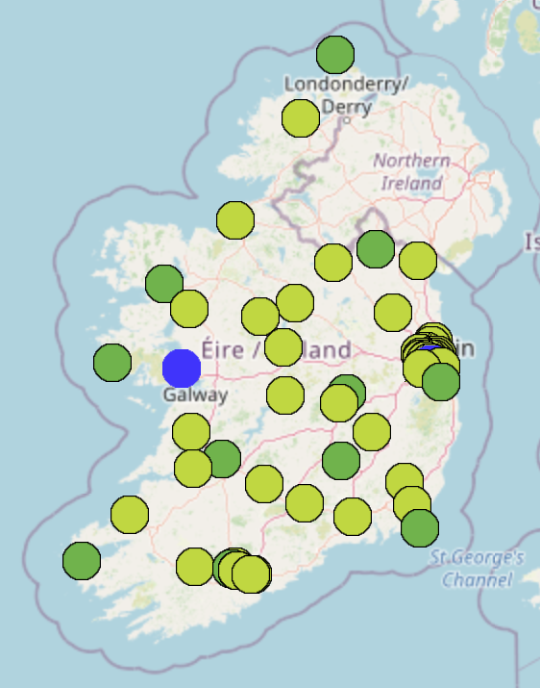
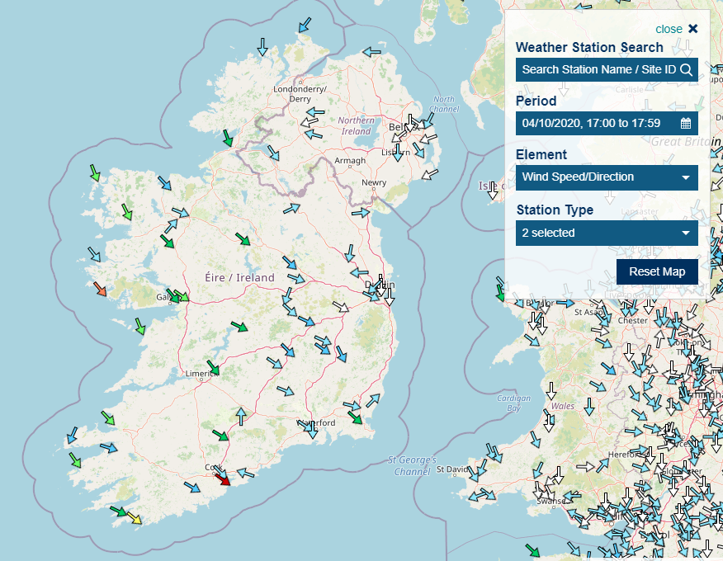
What evidence can we make use of?
EPA monitoring network PM_{2.5}, NO₂ and Ozone
MET Eireann weather observations
Outline of analysis
In normal times: emissions are regular and predictable
Modulated by weather and boundary layer conditions
Weather-normalised pollutant levels 2018-2020

Slide 4
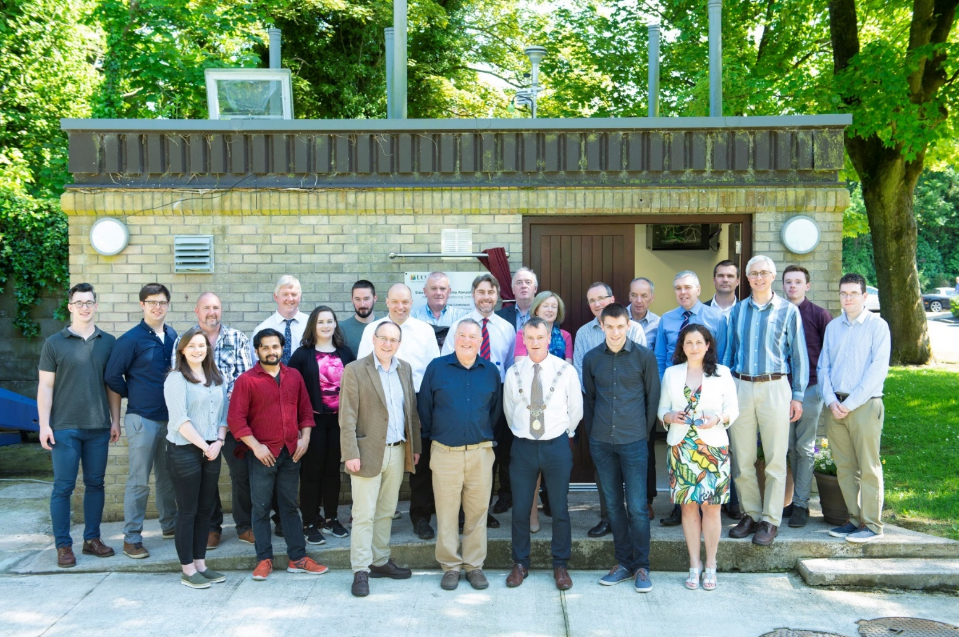
UCC Atmospheric Monitoring Station
Official opening 28 May 2018 – collecting data since 2017
Notes:
Black smoke and its partner in crime sulphur dioxide

Slide 5
Does 2020 look different?

Slide 6
Meteorological normalisation of AQ
Emissions are typically regular and predictable
Removal processes depend on the weather
Some emissions depend on the weather (cold starts, residential heating)
In a given location, the main reason for “random” variation in pollution levels is the weather (local and synoptic)
Unusual changes in emissions are observable in model deviation from measured levels

Slide 7
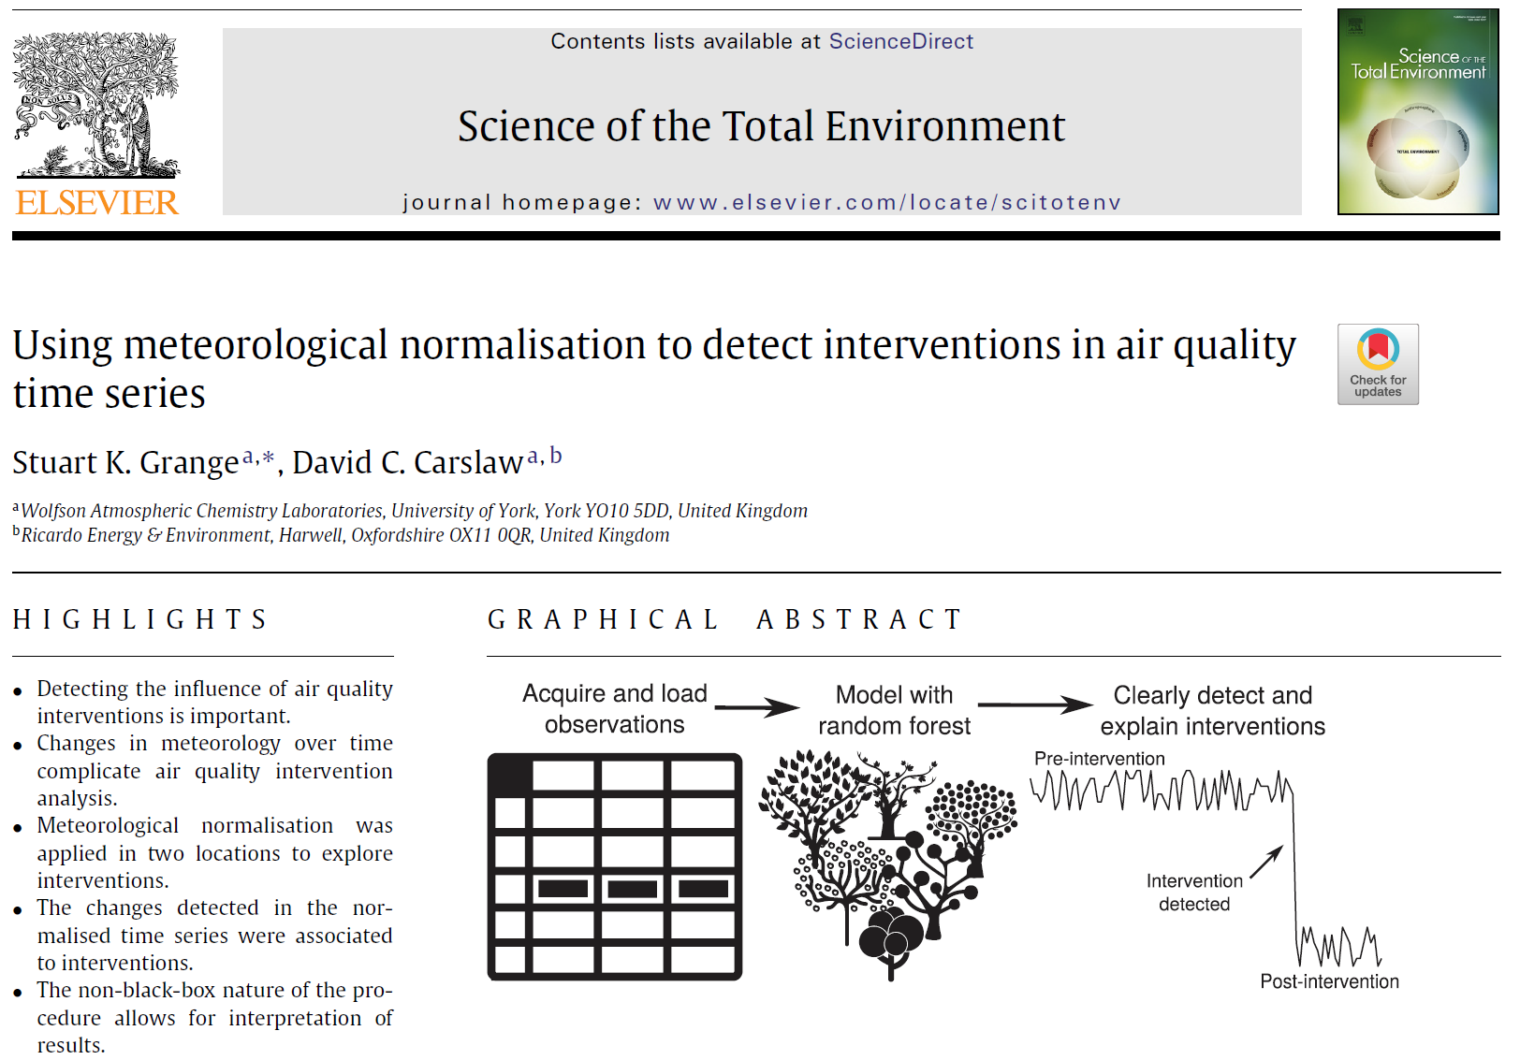
Meteorological normalisation of AQ
Historic AQ data
merge
Develop Supervised learning model
Random forest
Neural networks
etc.
Historic weather data
Weather data
Apply Predictive model
Predicted AQ
= business as usual scenario

Slide 8
Predicted AQ
= Business As Usual
YES
Situation is normal
Compare
Agreement?
What do we mean by agreement?
When does it become disagreement?
Situation has changed!
Measured AQ = new situation
NO

Slide 9
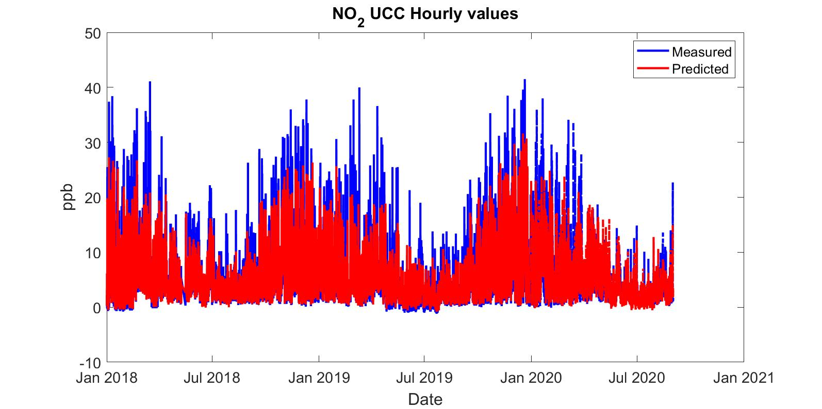
How good are the models?

Slide 10
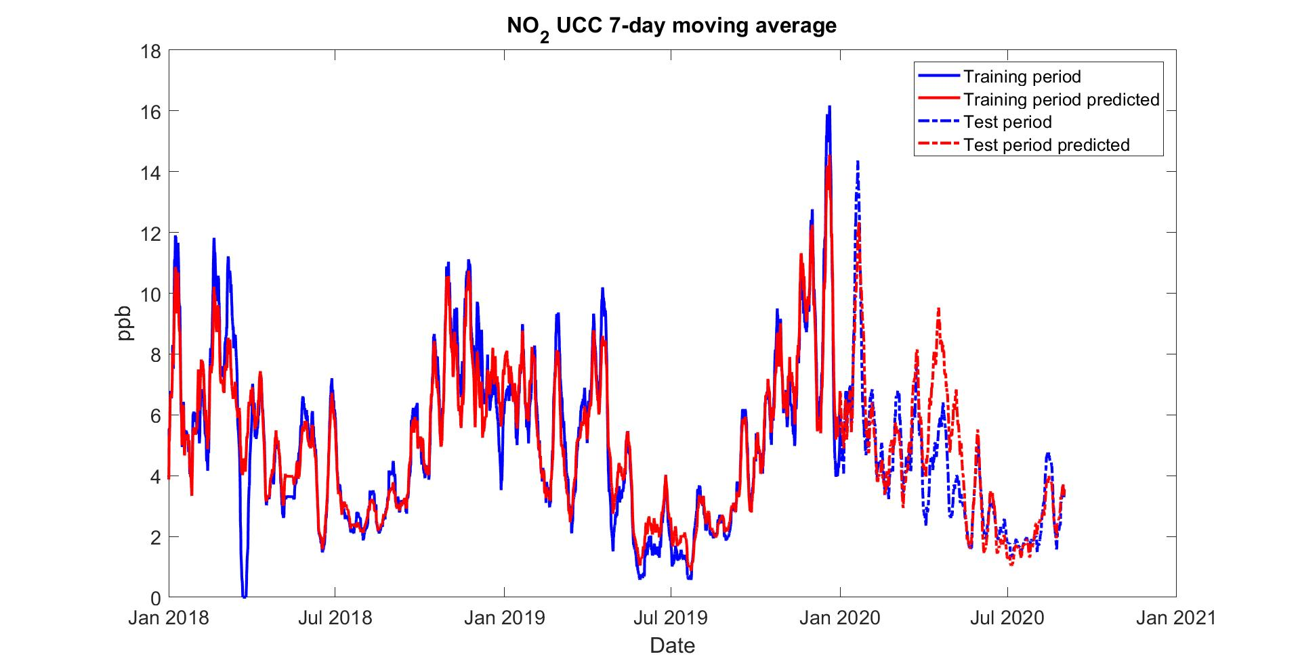
R² = 0.71
Avg Δ = -0.35 %

Slide 11
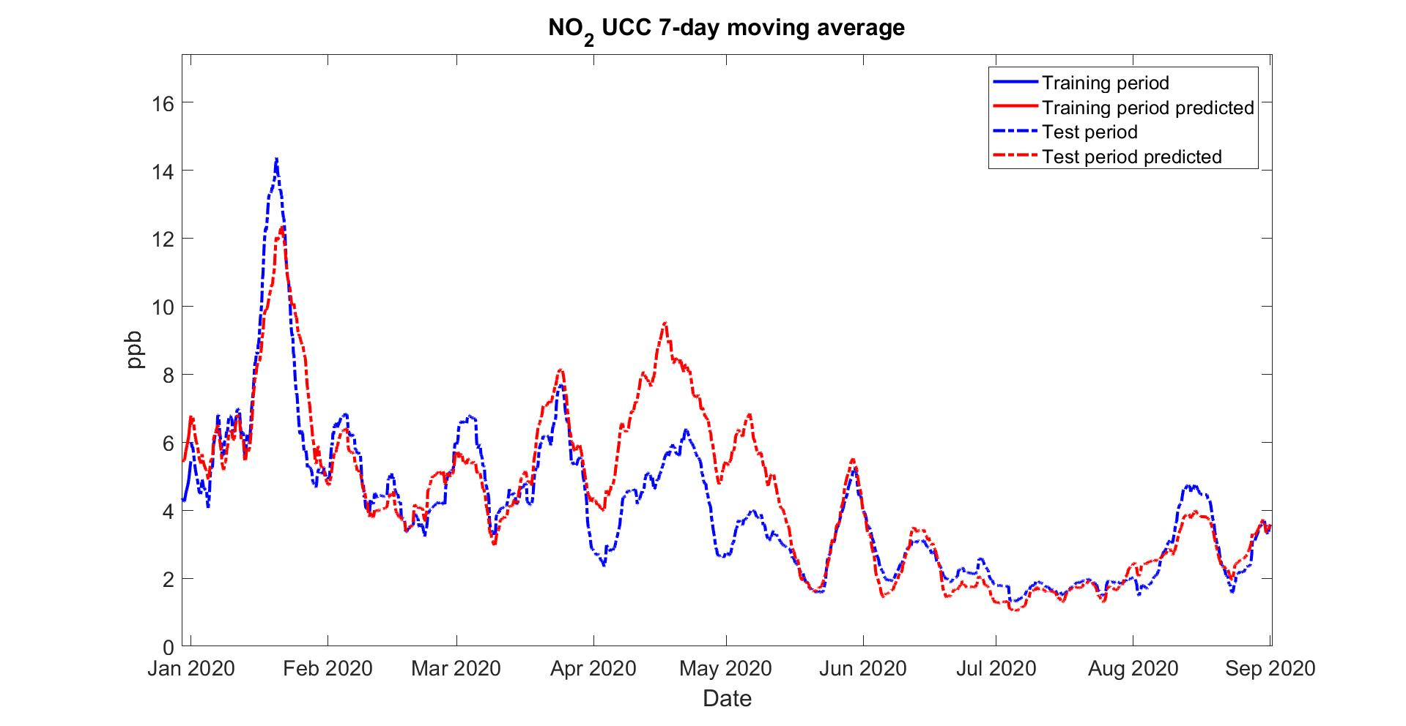
2020
Average prediction error = -38 %
12 March – 18 May
28/03
Average prediction error = 3 %

Slide 12
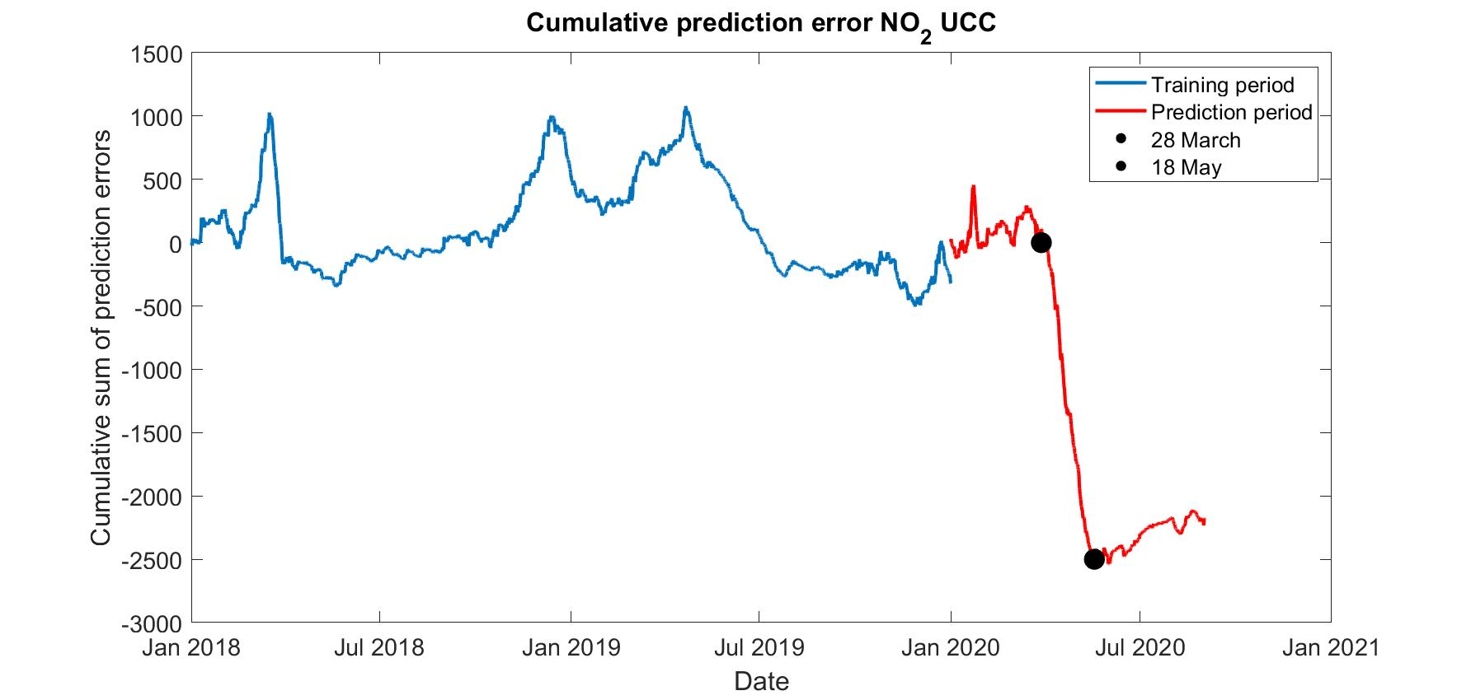

Slide 13
How different is PM_{2.5} in 2020?

Slide 14
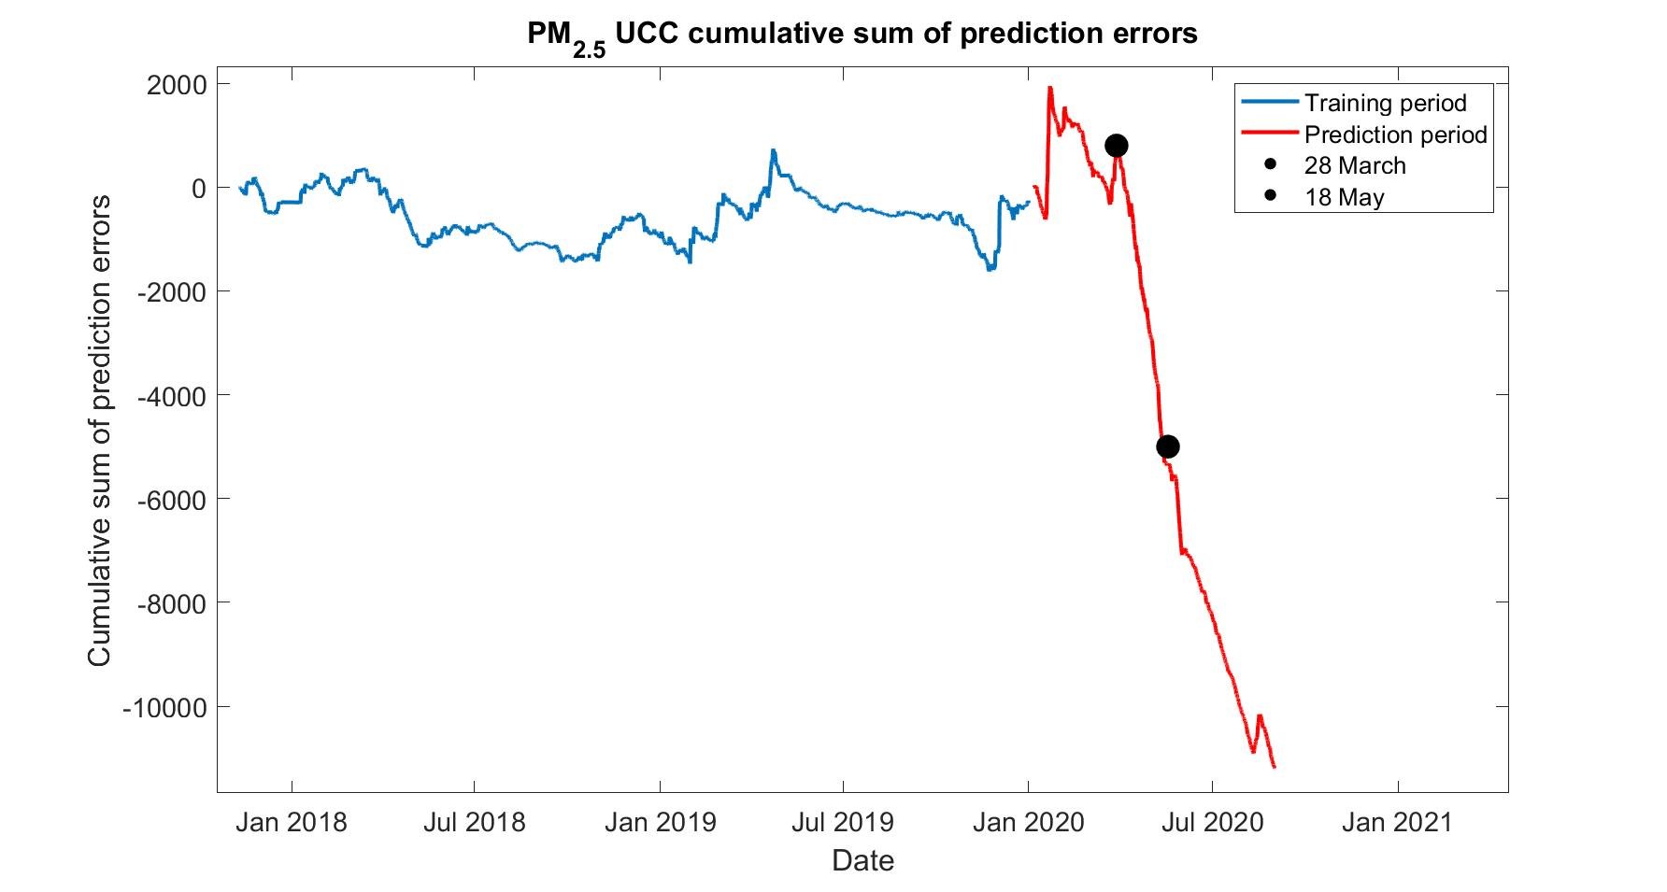
Model overpredicts PM_{2.5} also after easing of restrictions !

Slide 15
Average prediction error = -36 %
Average prediction error = -77 %
Average prediction error = 4.7 %

Slide 16
Dublin Rathmines
Easing of restrictions leads to a step change, but not a full return to normal levels

Slide 17
Dublin Finglas
Easing of restrictions leads to return to normal levels

Slide 18
Dublin Ringsend
Easing of restrictions leads to a step change, but not a full return to normal levels

Slide 19
Dublin Phoenix Park
Easing of restrictions leads to return to normal levels

Slide 20
What influences the prediction?
Dublin city: wind speed, weekday and time of day
Cork Urban background: Wind, season, time of day and temperature
Hints at the main sources

Slide 21
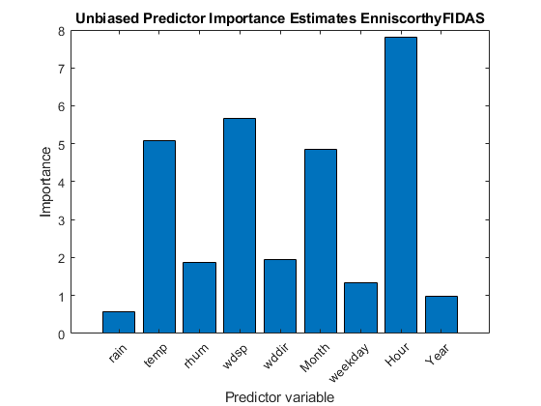
Enniscorthy – population ~12k
Easing of restrictions leads to return to normal levels

Slide 23
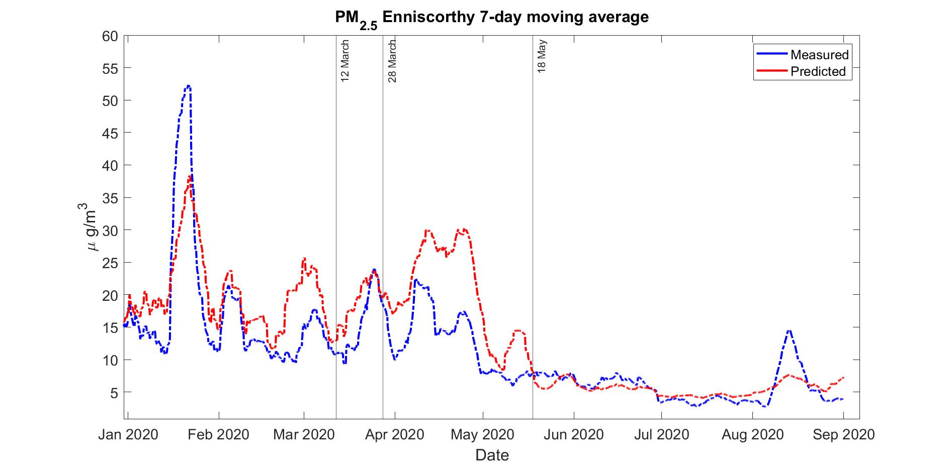
Average prediction error = -15 %
Average error = -49 %

Slide 24
Summary
These models explain and predict measured levels of air pollutants on the basis of weather and temporal cycles alone. The reason this yields a good forecast most of the time is that local emissions vary relatively little from day to day, and local variations in air quality are predominantly influenced by variations in weather and cycles of economic activity, mass transport and energy use.
There is a real impact of COVID-19 restrictions on both NO₂ and PM_{2.5} levels, but reductions are unevenly distributed geographically
Improvements in AQ are more persistent in some locations
Surprising levels of reductions in PM_{2.5} were found in both traffic- dominated and solid fuel-dominated emission environments
Weather normalisation models are a useful tool in understanding factors controlling air pollution and can help determining the impact of interventions, e.g. travel restrictions.
They are computationally inexpensive
Requires co-ordination of meteorological and air quality monitoring

Slide 25
Thank you to
Micheal O’Dwyer & Stephen Somerville, EPA Air Quality Team

