Slide 1
RECOGNITION OF PRIOR LEARNING THE CIT MODEL
Phil O’Leary MSc MA
Extended Campus
Cork Institute of Technology
phil.oleary@cit.ie 4335132

Slide 2
RECOGNITION OF PRIOR LEARNING
What is RPL ?
Various terms
How RPL can be used
Explain CIT model
My research
Issues arising

Slide 3
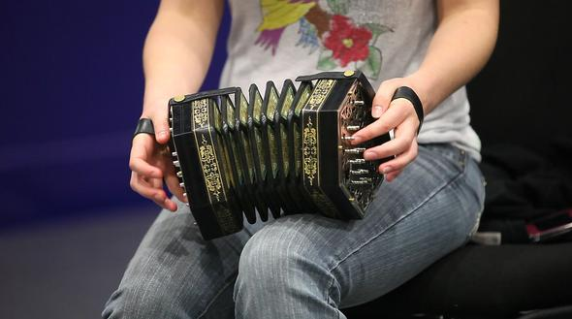
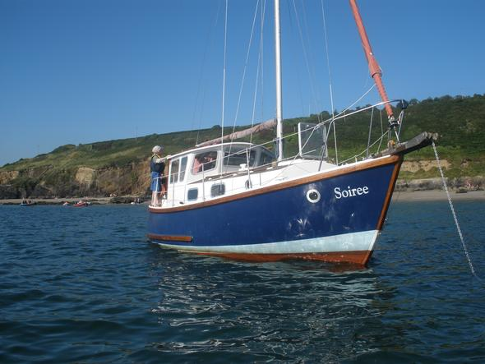
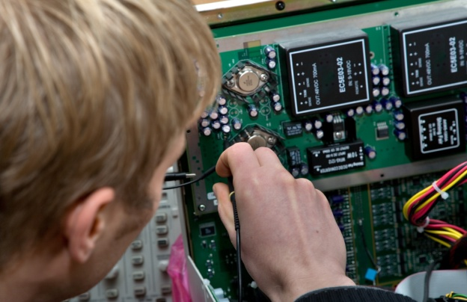
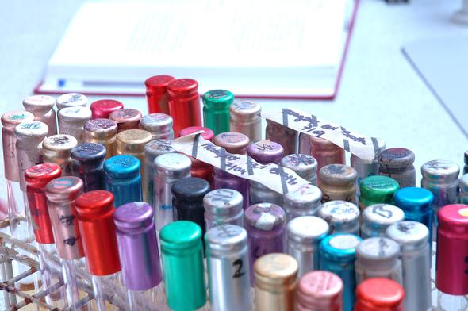
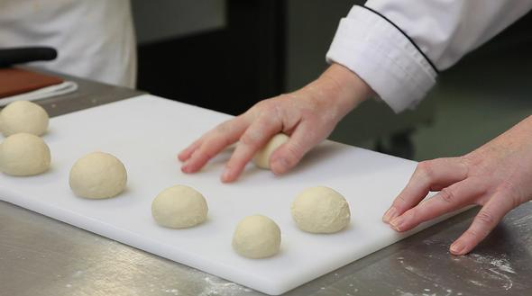
RECOGNITION OF PRIOR LEARNING (RPL)
Where recognition is given for what is already known prior to coming onto a programme of study
Large numbers
Individual queries ?

Slide 4
CONTEXT
Significant increase in demand for RPL
Mature learners, reskilling, upskilling, balancing study with family life

Slide 5
RPL is known by a number of terms around the world
RPL
APL
APEL
PLAR
PLA
Identification and validation of non formal and informal learning

Slide 6
RECOGNITION OF PRIOR LEARNING (RPL) CAN BE:
CIT is concerned with providing summative RPL
Ruud Duvekot’s ‘L3-triangle’ and the various forms of RPL (Duvekot, 2010)

Slide 7
RECOGNITION OF PRIOR LEARNING (RPL) CAN BE USED FOR:
Non standard admissions
Advanced entry
Credits on a programme
Source: www.cit.ie/rpl

Slide 8
LEARNING IS CATEGORISED AND PRESENTED AS

Slide 9
SUPPORTING RECOGNITION OF PRIOR LEARNING; Is it possible to create a service that can handle high demand and still maintain the flexibility to address the needs of the individual ?

Slide 10
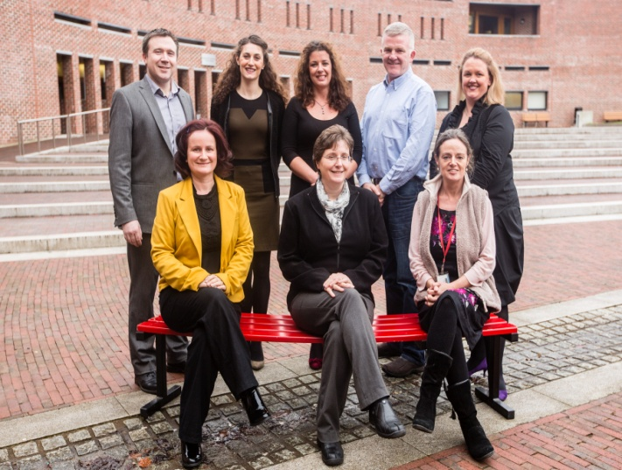
MY ROLE
Deliver RPL for CIT, students, systems in place.
MY STUDIES
MA through research. Looking at ways to support the student with RPL case preparation.

Slide 11
METHOD Action research methodology
Practice based form of research
Collaborative
Reflective aspect
2010-2013
RESEARCH MA – SUPPORTING STUDENT WITH RPL
Action Research approach to creating a systemised service to delivering RPL provision which still allows for individual one to one support if needed.
The Action Research cycle, Barrett 2011

Slide 12
RPL DELIVERED IN CIT SINCE 1996
Year | Overall numbers of RPL cases
2013 | 550
2012 | 523
2011 | 589
2010 | 502
2009 | 531
2008 | 330
2007 | 308
2006 | 284
2005 | 142
2004 | 87
2003 | 85
2002 | 82
2001 | 63
2000 | 53
Policy and Procedures revised three times
Numbers increasing:

Slide 13
Last Semesters’ numbers
Total Number of RPLS 265 | Levels
Combination 9 | 6 combination 6
Experiential 44 | 6 experiential 18
Formal 191 | 6 formal 153
Non formal 21 | 6 non formal 5
 | 7 combination 3
Total number of assessors 89 | 7 experiential 8
 | 7 formal 33
Top 5 modules | 7 non formal 1
CMOD6001 CIT module 25 | 8 experiential 4
COMH8001 Enterprise Storage Systems 15 | 8 formal 5
COMH9004 Cloud Storage Infrastructures 10 | 8 non formal 13
PHYS6020 Physics for Marine Engineers 6 | 9 experiential 14
MRKT6004 Introduction to Marketing 6 | 9 non formal 2

Slide 14
Policy RPL

Slide 15
Page 2

Slide 16
Page 3

Slide 17
Page 4

Slide 18
CIT MODEL FOR RPL PROVISION
Website
Workshops
Individual mentoring

Slide 19
MODEL
Basic information on RPL
Downloadable portfolio templates
Comprehensive website www.cit.ie/rpl

Slide 20
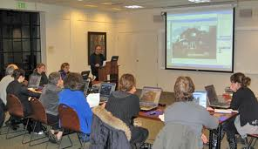
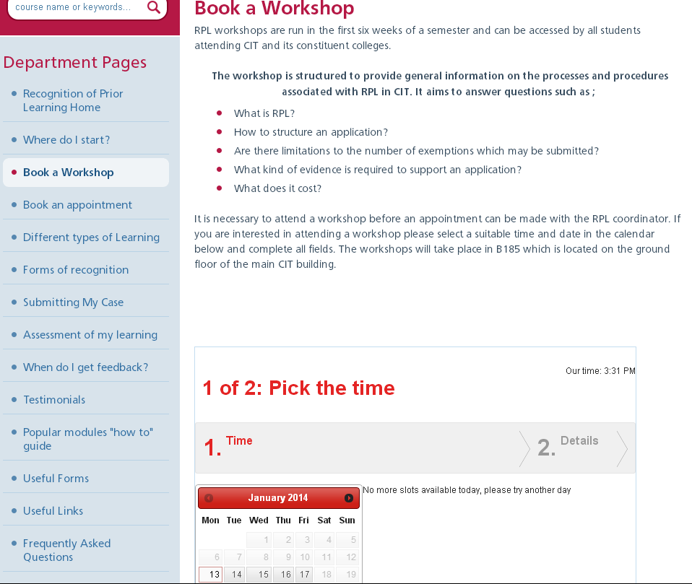
WORKSHOPS - LUNCHTIME AND TEATIME

Slide 21
ONE TO ONE APPOINTMENTS (ONLY AFTER ATTENDING WORKSHOPS)

Slide 22
WHY I FINALLY CHOSE THIS MODEL
Research explained
2008 - 2009 numbers increasing

Slide 23
I WANTED A systemised approach that would still allow for the individual (the human factor)
Get the information out there
Group queries
One to one attention

Slide 24
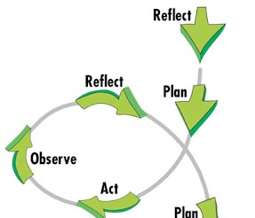
RESEARCH CONTEXT FIRST CYCLE
Questionnaire exploring picture of RPL case preparation in 2010 – 30 students, 13 questions
Data yielded valuable insight – students wanted more online supports

Slide 25
CONTEXT SECOND CYCLE
2. Focus groups exploring reflection and developing reflective ability (2011)

Slide 26
Can a student develop as a reflective learner ?
7 themes emerged
Reflection is difficult
Learning environment important
Tools to help with reflection – learning journals
Examples of reflective writing good/bad
Feedback
Reflection provides valuable self awareness
“Document everything as you go through life. Capture every experience no matter how small or insignificant. Get into the lifelong learning mindset and build a portfolio of all you have achieved”
Poster at NAIRTL Conference, NUI Galway 2011

Slide 27
THIRD CYCLE
Redeveloped RPL website
www.cit.ie/rpl
Overhaul layout
Photos and videoclips
Downloadable paperwork
Examples
Testimonials

Slide 28
FOURTH CYCLE
Evaluated RPL website
www.cit.ie/rpl
93 students asked to evaluate RPL website
They suggested the following:
More videoclips and examples
Promote idea of document repository to support reflective practice
Use Google Sites for e portfolios

Slide 29
FIFTH CYCLE
Adding the Valuing Learning page to RPL website
www.cit.ie/rpl/valuinglearning/

Slide 30
6th CYCLE
Trial of e portfolios using Google Sites
https://sites.google.com/

Slide 31
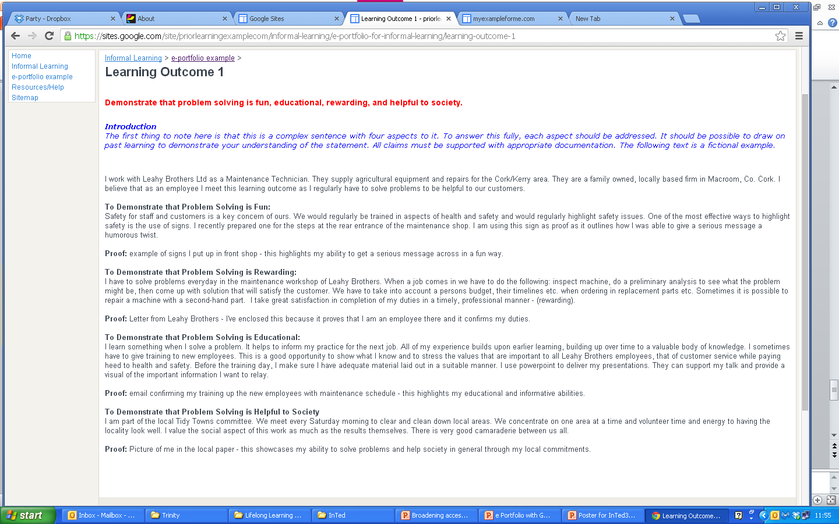
EXAMPLE OF E PORTFOLIO

Slide 32
7th CYCLE
Evaluating trial of e portfolios
With students on BA Community Development
and the Higher Certificate in Computing
Conclusion:
e portfolios significant tool to activate learner’s lifelong learning mindset
e portfolios purpose built scaffolds for RPL

Slide 33
CURRENTLY
www.cit.ie/rpl
Conclude that delivering this model of RPL provision maintains overall quality with case preparation
System that can cope with volume
We allow for the individual
Data capture

Slide 34
ISSUES ARISING
Uncertainty on behalf of candidate
Submitted incomplete
Paperwork not organised
Not registered for module

Slide 35
ISSUES ARISING
Overseas qualifications www.qualrec.ie

Slide 36
ISSUES ARISING
Submitted Late
Paperwork needs to be translated
Not sure who assessor is
Outcome not what candidate wants

Slide 37
THANK YOU phil.oleary@cit.ie
REFERENCES
BARRETT, H. 2011. Balancing the two faces of e Portfolios. Education for a Digital World: Advice, Guidelines and Effective Practice from Around the Globe [Online]. Available: electronicportfolio.org/balance/balancingarticle2.pdf.
BARRETT, H. & GARRETT, N. 2009. Online Personal Learning Environments. On the Horizon, 17, 142-152.
BROWN, J. 2009. Experiential Learning E-Portfolios: Promoting Connections Between Academic and Workplace Learning Utilizing Information and Communication Technologies. American Educational Research Association Conference. Miami, Florida.
COHEN, E. & HIBBITTS, B. 2004. Beyond the Electronic Portfolio: A Lifetime Personal Web Space. Educause Quarterly, 4.
DUVEKOT, R. 2010. The age of APL, activating APL in a diversity of perspectives. NVR seminar on Kvalitekskodeks for realkompetence. Aarhus, Denmark.
Hager, L. (2012). Wading into the Technology Pool: Learning e-Portfolios in Higher Education. International Conference on Information Communications Technologies in Education, Rhodes, Greece, University Or Oregon.
JAFARI, A. 2004. The 'Sticky' Eportfolio System: Tackling challenges and identifying attributes. EDUCAUSE Review. EDUCAUSE.
LATHROP, C. 2011. Electronic, Portable and Green: Imperatives for Creating Today's e-Portfolio. Americal Medical Writers Association Journal, 26, 165-166.
Leiste, S. M. and K. Jensen (2011). "Creating a Positive Prior Learning Assessment (PLA) Experience: A Step-by-Step Look at University PLA." The International Review of Research in Open and Distance Education 12(1).
LOUREIRO, A., MESSIAS, I. & BARBAS, M. 2012. Embracing Web 2.0 & 3.0 tools to support lifelong learning - Let learners connect. Procedia; Social and behavioural Sciences, 46, 532-537.
O'LEARY, P. & O'SULLIVAN, S. 2013. e Portfolios can support students with Recognition of Prior Learning case preparation. International Technology, Education & Development Conference. Valencia.
Werquin, P. (2010). Recognising Non-Formal and Informal Learning; Outcomes, Policies and Practices. Paris, OECD.

