Slide 1
Using Twitter in Teaching
Dr. Theresa Reidy & Ms. Fiona Buckley
Department of Government

Slide 3
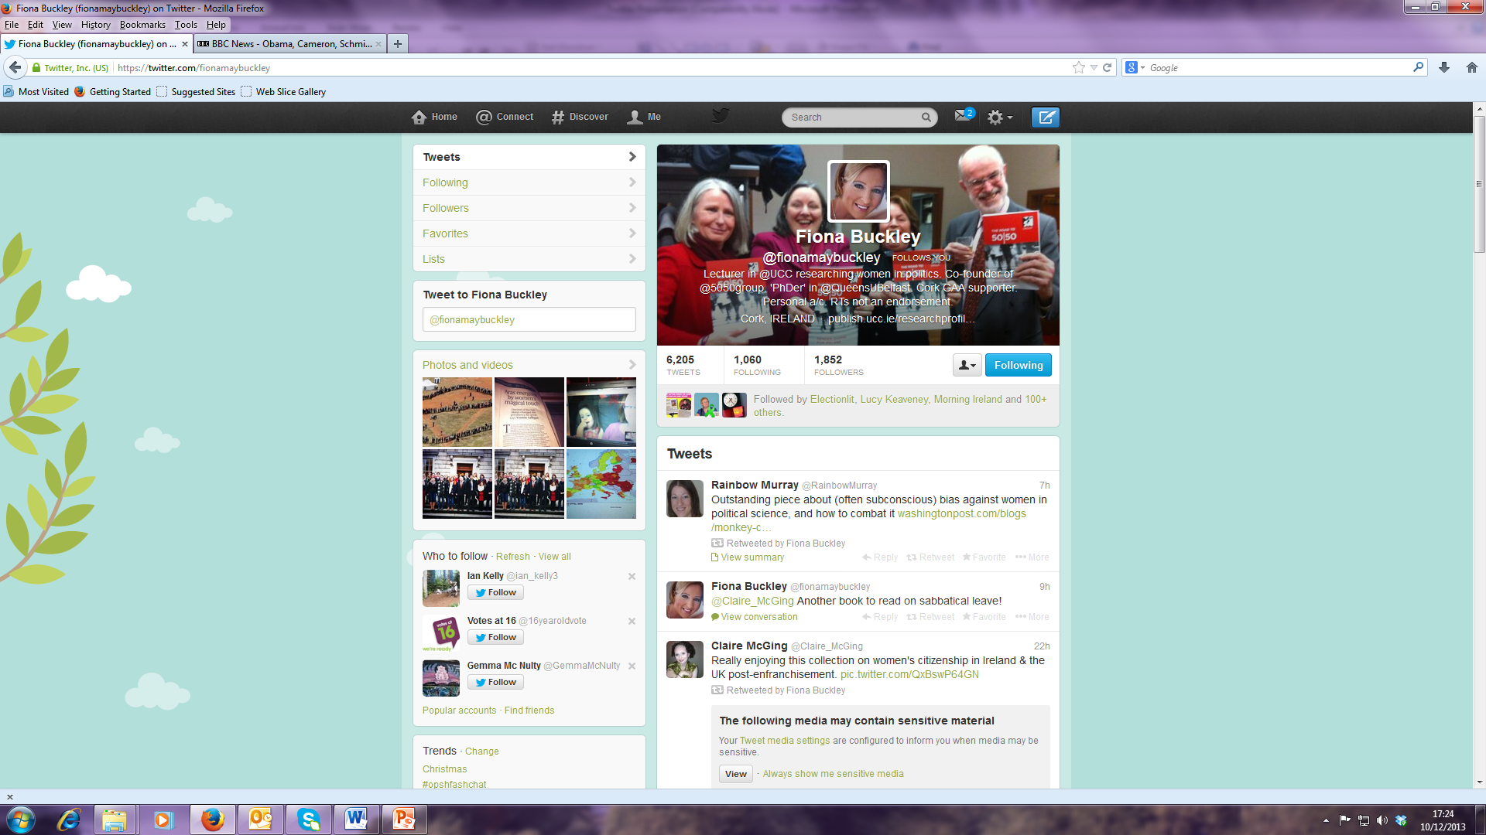

Slide 5
Who We Follow?
Professional
Politicians
Irish Political Parties
Global and National Commentators and Media Analysts
Newspapers
Polling Companies
Academics
Professional Associations
International Organisations
Think Tanks
Policy Institutes
Journals
Publishing Houses
Influential Blogs/Bloggers
Personal
Friends
Family
Personal Interests

Slide 6
Using Twitter in Teaching
Personal Accounts
Course twitter accounts
Programme twitter accounts
Project accounts
Need to tweet regularly

Slide 7
Tweeting n Teaching
Information dissemination
Documenting and archiving events
Promoting interaction
Specific Projects

Slide 8
Programme Twitter Account
UCC_Politics
Notifying students of events
Tweeting information on upcoming events, speakers
Providing a forum for debate and discussion of political issues
Political Reform
Gender Politics
General Election
Referendums

Slide 9
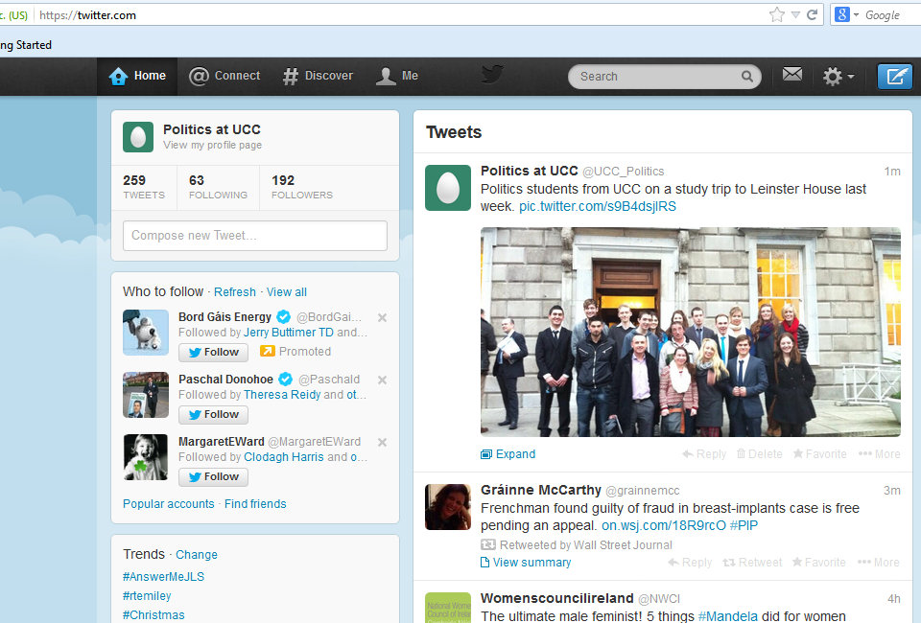

Slide 10
UCC_Campaign_Monitor
Seanad Referendum campaign monitoring project
BSc Government I and BA Politics I
Students document and analyse twitter during tv and radio debates
Write a report on their own data
Present their research at Politics conference in April

Slide 11
Funded by:
President’s Awards for Research on Innovative Forms of Teaching and Learning in Higher Education 2013

Slide 12
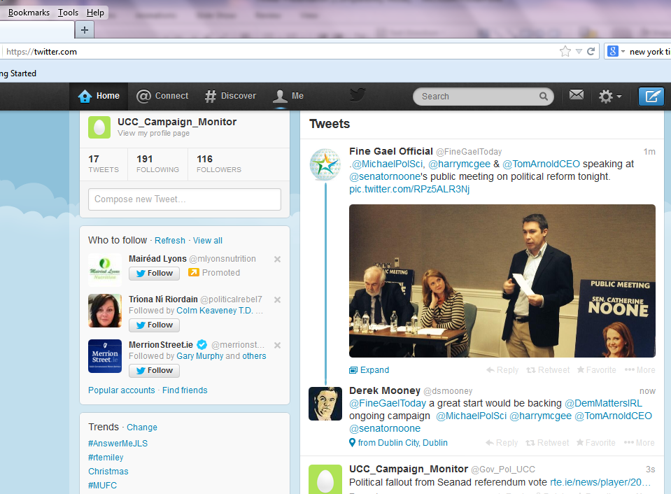

Slide 13
 | 0 – 10 mins | 11 – 20 mins | 21 – 30 mins | 31- 40 mins | 41 – 50 mins | 51 – 60 mins
Who is tweeting during the debate?
Political Parties
Politicians
Campaign Groups
Referendum Commission
Academics
Journalists
Your friends
Anyone Else
NO TWITTER ACTIVITY

Slide 14
Project Goals
Assess the extent and frequency of student engagement with Twitter.
Consider the degree to which ‘political’ social media tools increase political knowledge and critical thinking;
Assess the relationship between student engagement with twitter and course learning outcomes.
Evaluate the impact of an active learning project on levels of civic engagement.

Slide 15
Governance, Democracy and Sustainable Development
Irish Aid project
GV3209 – Political Economy (BComm III and BScGov)
Series of seminars and workshops on the theme
Assessment integrated into the programme
Communication an essential element
Twitter community being developed
Project resources
Student communication and discussion
Promotion of project conference
Live tweeting on conference day (hashtag)

Slide 16
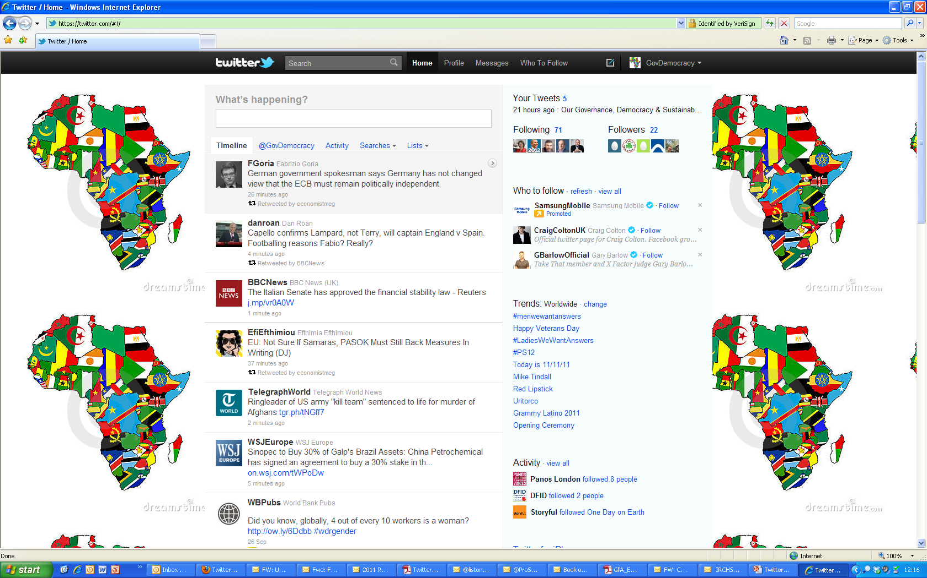

Slide 17
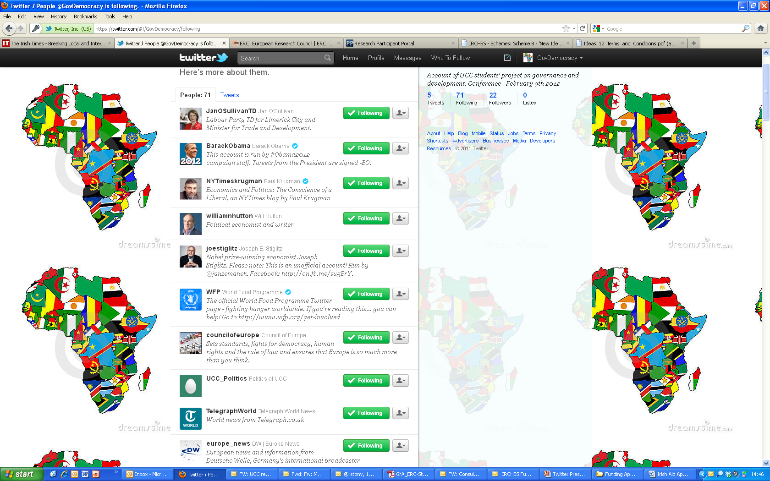

Slide 18
Using Twitter - Academic
Research and professional development tool
Political science community
Political Reform blog www.politicalreform.com
Build profile in subject area
Communicating research on Irish politics and gender politics
Commenting on events
Notes:
Professional or Personal

Slide 19
Multiple Personalities
Fiona
Theresa
@fionamaybuckley
@5050group
@UCC_Campaign_Monitor
@theresareidy
@IrishPolStudies
@UCC_Politics

Slide 20
LSE Guide to Twitter
Building your following and managing your profile
Using Twitter to maximise the impact of your research project
Making the most of Twitter alongside your own blog
Using course accounts with students
A step by step guide to adding a Twitter feed to Moodle
Extra resources and links to blog posts and articles on academic blogging and impact
http://blogs.lse.ac.uk/impactofsocialsciences/2011/09/29/twitter-guide/

Slide 21
LSE Advice
Being careful with Twitter
It is important for all those in the public eye to manage their online reputation.
Academics and researchers still need to bear in mind the importance of not broadcasting views on Twitter that could radically backfire with their employers, colleagues, students and other university stakeholders.
Remember, all tweets are public unless you change your settings.

