Slide 1
Assistive Technology in
UCC
11th December 2013

Slide 2
Assistive Technology:
What is it?
The most commonly used definition is the American definition, which is
"Any item, piece of equipment or product system whether acquired commercially off the shelf, modified, or customised that is used to increase, maintain or improve functional capabilities of individuals with disabilities"

Slide 3
The Role of Assistive Technology in Enhancing Learning
Empower students to become independent learners
Improves equality of access to the curriculum
Students can integrate with their peers in terms of course work, project work.
Increase the students employability.

Slide 4
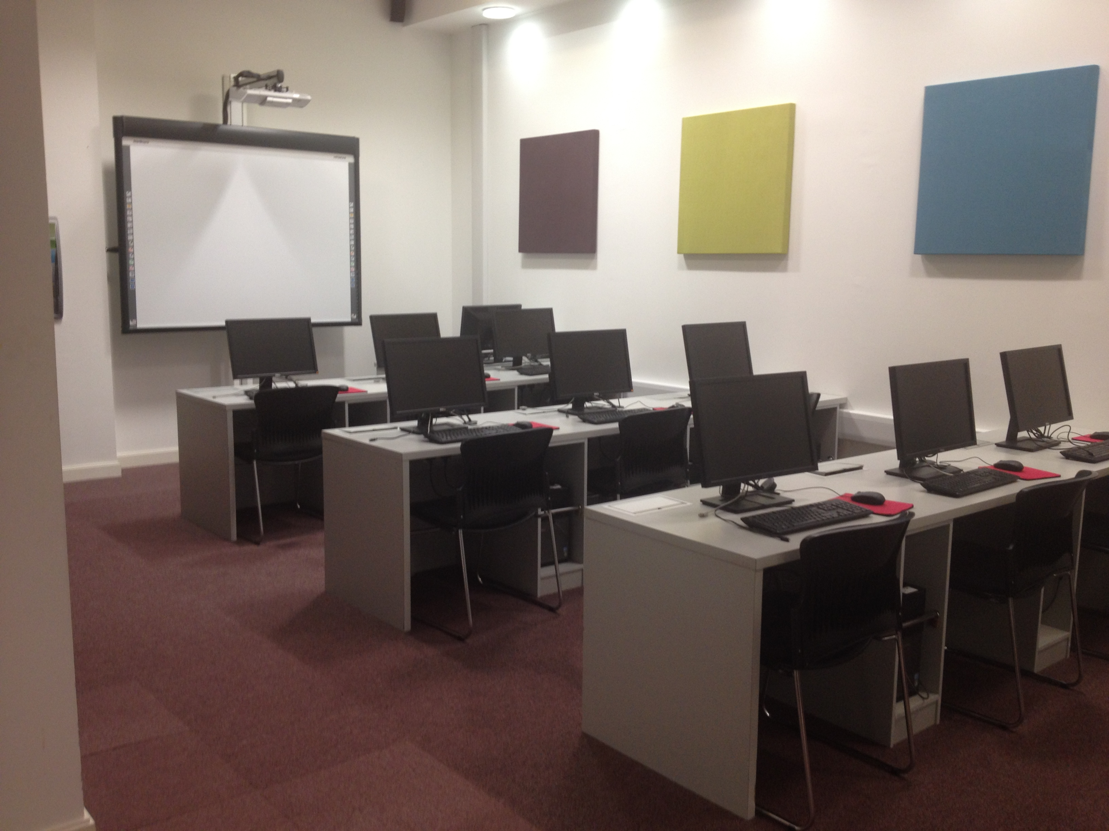
Assistive Technology Unit
Boole Library

Slide 5
Assistive Technology Unit in UCC
Assistive Technology Office
Alternative Media Format Office
Open Access Lab with 16 PC’s including 1 Touchscreen
  There is a wide range of specialised software on the PC’s including
    Read & Write Gold, Jaws. Dragon, AudioNotetaker, Kurzweil 1000
    Kurzweil 3000, Zoomtext, Inspiration, Easy Convertor,
    Easy Reader,
Scanners – 2 High Speed, 1 Zeta Scanner
Tiger Embosser – Braille Printer
CCTV – Print magnification
Area for Group Training
Booth for 1 to 1 training

Slide 6
Computer Access
Access to computers using alternative
input/output devices
Hardware
  Specialised keyboards, mouse etc.
  Touchscreens, Switches
  Braille display
Software
  Word prediction, voice recognition software
  Magnification, screen reader

Slide 7
Main Challenges faced by
Students with Disabilities in the
Learning Environment

Slide 8
Writing/Typing Speed Clarity Completing – on time Assignments Projects Exams Note-taking Access to Core Textbooks Class hand-outs Course material Material in blackboard | Organisation Skills Time Management Memory Speed Reading Concentration

Slide 9
Assistive Technolgoy supporting UCC students with
Notetaking
Accessing Course Material & Text
Assignments
Exams
Work Placement

Slide 10
Specialised Software
Blind & Vision Impaired Students | Jaws - Screen Reader Zoomtext - Magnification Kurzweil 1000 - OCR & Reading
Students with Physical Difficulties | Dragon - Voice Recognition Co Writer - Word Prediction Read & Write Gold - Literacy Support Audionotetaker - Notetaking
Students with Specific Learning Difficulties | Read & Write Gold - Literacy Support Inspiration - Mid Mapping Dragon - Voice Recognition Audionotetaker - Notetaking
Deaf & Hard of Hearing | Speed Text - Notetaking

Slide 11
UCC Site Licenses
All are part of the Student image rolled out across Campus
Accessible and relevant to all UCC students
Read & Write Gold
suite supports struggling readers and writers, those with literacy difficulties (including dyslexia) and English language learners, through a host of reading, writing and study/research features.
Inspiration – Mind Mapping
AudioNotetaker
provides a visual and interactive form of note taking – one where audio, text and images are used to create truly comprehensive notes.

Slide 12
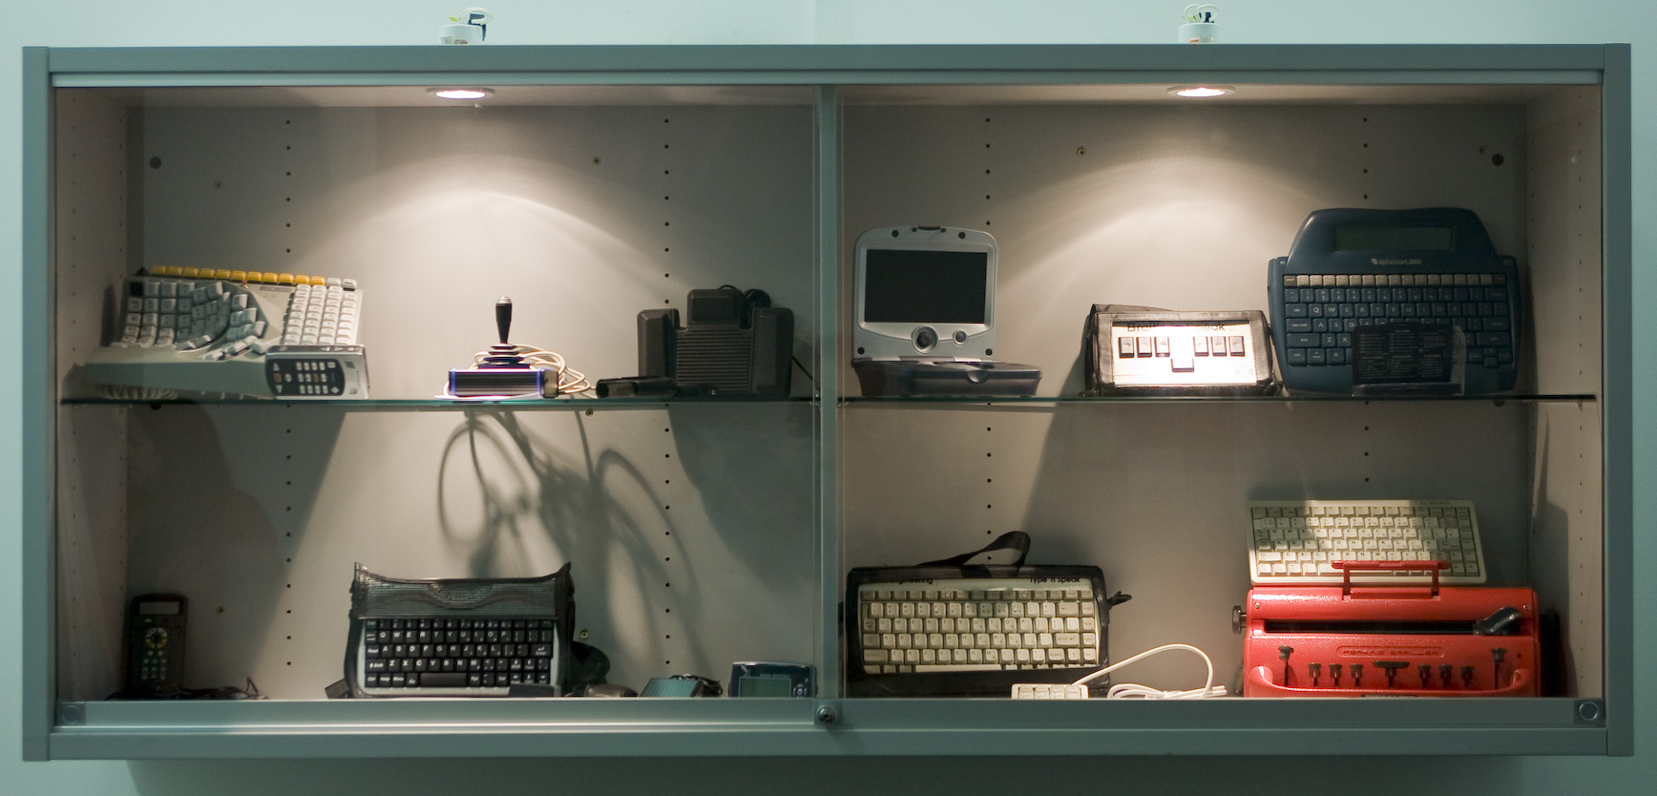
Specialised Hardware

Slide 13
Hardware/Equipment
Blind & Vision Impaired Students | iPad Braille Display Braille Embosser
Students with Physical Difficulties | Adaptive keyboards / mice Digital Dictaphone Go Mic Echo Pen & Livescribe
Students with Specific Learning Difficulties | Digital Dicataphone Go Mic Echo Pen & Livescribe
Deaf & Hard of Hearing | Communication Master Conversor

Slide 14
Technology in Exams
Blind & Vision Impaired Students | Laptop with Jaws and electronic exam paper Laptop with Zoomtext and electronic exam paper CCTV and hard copy of exam paper
Students with Physical Difficulties | Computer with Word ( spell check disabled) and hard copy of exam paper
Students with Specific Learning Difficulties | Computer with Word ( spell check disabled) and hard copy of exam paper Computer with Read & Write and electronic exam paper

Slide 15
Course Material and Textbooks
Electronic options
Accessible
Reading Lists in advance

Slide 16
Software for company computer or
DSS laptop with software
Work Placement
Notes:
Being accessible is about being canny – good e-learning is good for tutors as well as learners and – done well – will save time for tutors as well as increasing benefits for learners.
I can make my documents
Easier to navigate
Easier to read
Easier to transform
More engaging and user-friendly
I can make my presentations
Easier to revise from by using the Notes field
Suitable for mobiles
More interactive and collaborative
www.techdis.ac.uk/accessibilityessentials
Being accessible is about being canny
I can make my documents
Easier to navigate
Easier to read
Easier to transform
More engaging and user-friendly
I can make my presentations
Easier to revise from – by using the Notes field
Suitable for mobiles (see also 3.5 min Video clip)
More interactive and collaborative
www.techdis.ac.uk/accessibilityessentials

Slide 17
Panopto
The Disability Support Service is linking with AVMS and Academic Depts.
Lectures are recorded manually or automatically.
These recordings can be accessed by all students or just students registered with the DSS

Slide 18
Contact Details
Linda Doran
Assistive Technology Officer/
Disability Advisor for Blind & Vision Impaired Students
Disability Support Service
University College Cork
021 490 3422
l.doran@ucc.ie
http://www.ucc.ie/dss/

