Slide 1
Early Intervention for Infants with Down Syndrome: Developing Social Communication Skills
Vesna Stojanovik¹,
with Emily Seager ¹ and Courtenay Norbury²
¹ University of Reading, ²University College London

Slide 2
Presentation structure
Importance of early social communication skills as foundation for language development
Pilot intervention study – background and results
Planned forthcoming intervention trial

Slide 3
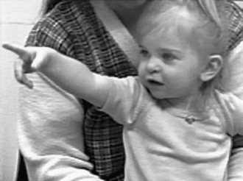
Early Social Communication Skills
Requesting and Commenting
Requesting Commenting
(Initiating Behavioural Requests) (Initiating Joint Attention)
Notes:
Requesting (also referred to as proto-imperatives, or initiating behaviour regulation): infants indicate to their caregiver or playmate that they want some desired object or event.
Commenting (also referred to as proto-declaratives or initiating joint attention): involves directing another’s attention in order to establish a joint focus on something.
Requesting, is seen as an instrumental behaviour (McDuffie et al., 2005), whereas commenting, is considered a social approach behaviour, and involves directing the attention of a social partner (McDuffie et al., 2005).
Conflicting due to different types of matching (language matched or mental aged matched). Also different ways of assessing this skill (parental report or observation either in natural set ups or more structured set ups).
Perhaps relative strength to compensate for delays in spoken language.
Smith & von Tetzchner (1986): nonverbal requesting at 24 months predictive of expressive language one year later in children with DS.
Mundy et al., (1995): in infants with DS, differences in nonverbal requesting at 22 months were associated with later development of expressive language at 35 months. In TD infants measures of nonverbal communication were predictive of both expressive and receptive language.
YODER AND WARREN (2004) Criticise other longitudinal studies for not controlling for initial language status.

Slide 4
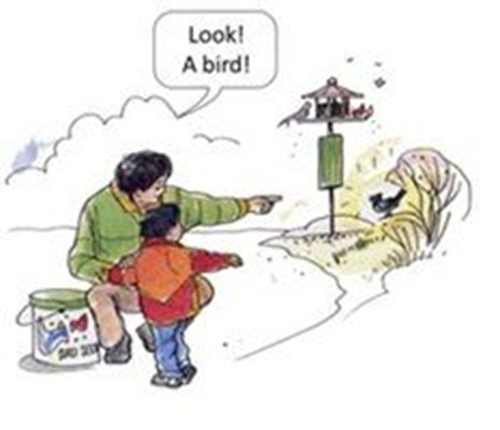
Early Social Communication Skills
Responding to Joint/Shared Attention
“ability to change the direction of head and eyes in response to a change in direction of adult focus” (McDuffie, Yoder & Stone, 2005)
Helps children with word learning and critical to language and social development
Attention-following is related to word production, and understanding, both concurrently, and longitudinally (Carpenter, Nagell, & Tomasello, 1998; Delgado et al., (2002); McDuffie et al., 2005; Morales et al., 2000; Mundy & Gomes, 1998; Mundy, Kasari, Sigman, & Ruskin, 1995; Mundy, Sigman, Ungerer, & Sherman, 1986
Notes:
Several studies have shown that differences in responding to joint attention in 6-18 month old infants are predictive of language ability at 24 to 36 months
Delgado et al., (2002) however criticise earlier studies for not taking target location into account, as these studies combined infants’ abilities to respond to targets within their visual field (90º or less to the left or right of the infant) and outside their visual field (greater than 90º to the left or right of the infant). Delgado et al., (2002) state that this is important, as before 12 months, infants are typically limited to targets within their visual field when responding to joint attention. The ability to locate targets outside of their visual field or behind them, does not develop until sometime between 12 and 18 months (Butterworth & Jarrett, 1991; Butterworth & Cochran, 1980).
Delgado et al., (2002) examined the effects of target location on the relationship between responding to joint attention (at 15 months) and subsequent language development (at 24 months). This study supported a developmental progression in the infants’ ability to locate targets from within to outside their visual field.
At 15 months, children were capable of locating targets within their visual field, but fewer showed a consistent ability to locate targets outside of their visual field.
Not really investigated in DS.

Slide 5
Background to pilot intervention study
We ran a longitudinal study looking at which early skills in infants with Down syndrome (at age 18-21 mos) are the strongest predictors of language at 32-36 monts
(Mason-Apps, Stojanovik, Houston-Price & Buckley, 2018)
PERCEPTUAL (speech segmentation)
2. SOCIAL (early social communication skills)
3. COGNITIVE (non-verbal abilities)

Slide 6
Findings: precursors of language skills
Responding to joint attention at 18-21 mos - a unique predictor of expressive language and expressive vocabulary 12 months later
Responding to Joint Attention
Adj.R² = .645
p = .002
Expressive Communication
Auditory Comprehension
Adj.R² = .354
p = .025
Expressive Vocabulary
Receptive Vocabulary

Slide 7
Pilot Intervention study
Intervention aiming to improve an early social communication skill: responding to joint attention
Notes:
Intervention aiming to improve RJA
Longitudinal study – children followed for 1 year in total
Control data came from previous experiment

Slide 8
Pilot intervention research questions
If Responding to Joint Attention really is important for language in infants with Down syndrome, can we work on it so that we can improve children’s language?
Will the children who have received the intervention have better later speech and language outcomes than a group who did not receive the intervention?

Slide 9
participants
Recruited from support groups, local charities, Down Syndrome Association and Down Syndrome Education International
Intervention group
16 children, 17-23 months, 9 males and 7 females
Control group
14 children, 18-21 months, 9 males and 5 females
No significant differences for parental education or occupation status (p> .05)

Slide 10
Measures
Intervention group
Control group
Pre-test -17-23 months
Assessment 1 – 18-21 months
Post-test
6 month follow up – 24-29 months
Assessment 2 – 24-29 months
1 year follow up – 30-35 months
Assessment 3 – 30-35 months
Notes:
ESCS – gaze following and proximal points task

Slide 11
Intervention
Based on methodology of Whalen and Schreibman (2003)
1. Response to hand on object
2. Response to tapping object
3. Response to object activation
4. Eye contact
5. Following points – two toys
6. Following points – in book
7. Following points – around room
Notes:
Intervention based on previous research from children with ASD
10 weeks – 1 researcher session per week and 3 parent sessions
Toy based – important to keep child motivated and engaged
‘What’s in the bag’ – shakers, wind up toys, Mr Tumble etc.
Levels .... Engage with toy, provide verbal and physical prompts if needed, constant language input

Slide 12
Intervention
Every session follow same protocol – 4 sets of 3 trials
Child required to ‘pass level’ before moving onto next activity
Parent manual, diary and instructions
Current task
Maintenance task
Reward
Notes:
Current task e.g. level 3 → maintenance L1 and L2 → reward → repeat 4 times
Lots of positive reinforcement and language input throughout
Pass level – score correct responses for 2 sets of trials
Parent to practice ‘current level’ at home

Slide 13
follow up- 12 months after the intervention

Slide 14
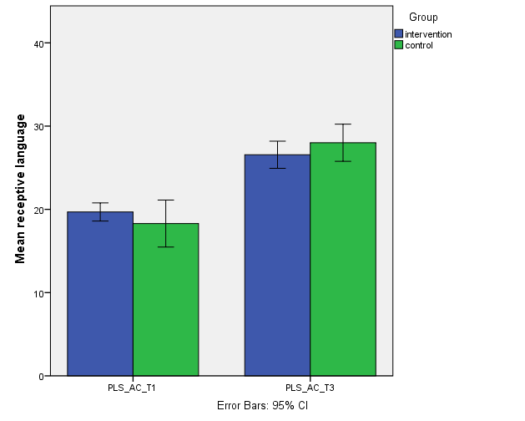
LANGUAGE understanding (pls-4)
Post-intervention
Pre-intervention

Slide 15
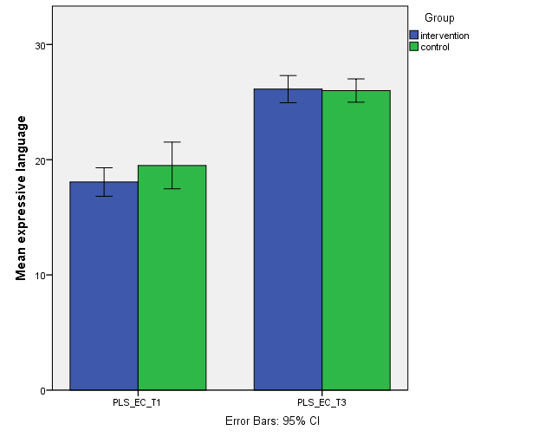
EXPRESSIVE LANGUAGE (pls-4)
Post-intervention
Pre-intervention

Slide 16
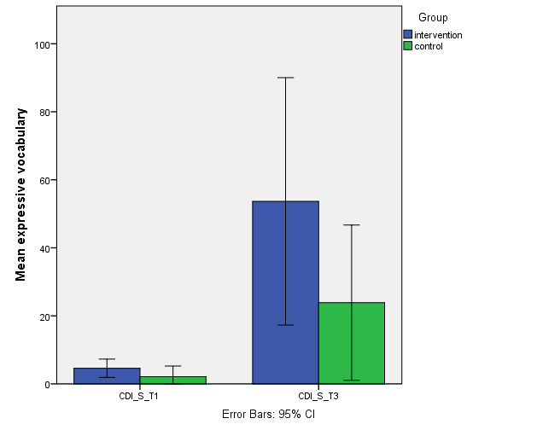
EXPRESSIVE VOCABULARY (cdi)
Post-intervention
Pre-intervention

Slide 17
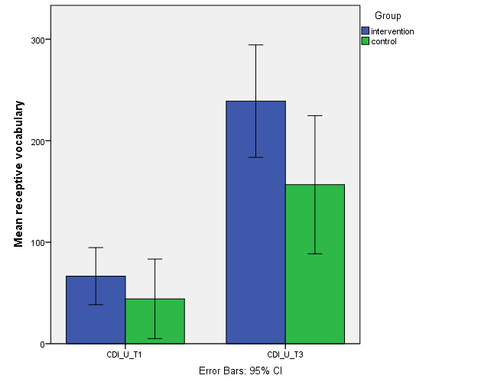
RECEPTIVE VOCABULARY (cdi)
Post-intervention
Pre-intervention

Slide 18
Post test results
Parental questionnaire
13/16 parents returned questionnaire
100% extremely satisfied with intervention
100% felt child’s RJA improved
77% felt speech and language had improved
92% noticed changes in other areas of development
92% changed how they communicated with their child
Notes:
Also gave parents a questionnaire to find out if they found the intervention useful and it they felt that had seen effects

Slide 19
What did the parents say?
“We had no problem following the session instructions”
“Helped us [parents] learn about this important aspect of communication”
“Understanding what joint attention means has really boosted our communication style”
“The structure of each session was clear and effective”

Slide 20
Conclusion – pilot intervention
A 10-week joint researcher/parent intervention focusing on responding to joint attention skills may be helpful in developing children’s vocabulary skills
Most significant gain – children’s understanding of words (receptive vocabulary)
Next step - to run a randomised control trial with a larger cohort

Slide 21
FORTHCOMING intervention study
AIM: to build the evidence-base for clinically valid interventions for infants with Down syndrome
Feasibility study – to find out if an early intervention with infants with Down syndrome delivered by parents would be feasible to be rolled out through the NHS
Randomised Controlled Trial
Collaborators: Dr Emma Pagnamenta, Prof Victoria Joffe, Dr Kate Harvey, Dr Ben Thomson, Dr Hayley Perry, Mrs Sarah Rae, Dr Elena Pizzo

Slide 22
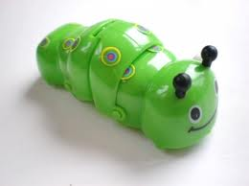
Early Social Communication Scales
Mundy et al., (2003)
Object Spectacle Tasks
Plastic Jar Task
Book Presentation Task
Gaze Following Tasks
Used to derive measures of:
Initiating Joint Attention (IJA)
Responding to Joint Attention (RJA)
Notes:
Selected the tasks for the measures we want.
RJA (%age of success)
IJA/IBR Continuous measures (frequency)
Gaze Following tasks used by Delgado as their attention following task.

