Slide 1
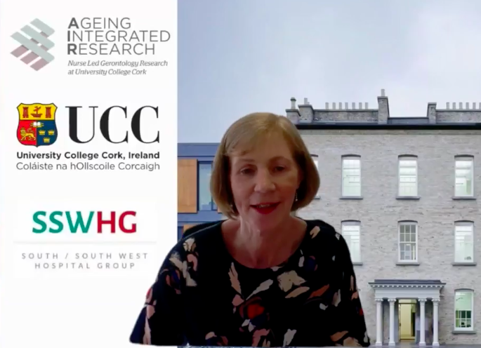
Ageing Integrated Research School of Nursing & Midwifery Web Conference 18th April 2024
Cognition Impairment in Older Adults- Assessment & Management.
Gemma McCarthy RANP, MPH, CUH/South Lee Integrated Care team for older persons.
2. Optimising health and wellbeing in older people through integrated Care.
Dr Bart Daly Consultant Geriatrician in the CUH/South Lee Integrated Care team for older persons.
3. What is integrated care and how can this be applied to patients with cardiac arrhythmias?
Prof Jeroen Hendriks Cardiovascular Nursing Chair at the College of Nursing and Health Sciences, Flinders University
4. Addressing multimorbidity in older people atrial fibrillation patients through interdisciplinary, patient-centred, systematic care pathways.
Prof Gerry Lee, University College Cork.
Thank you to Bridie O’Sullivan, Chief Director of Nursing and Midwifery for the South/Southwest Hospitals Group (SSWHG), HSE for opening the conference and sponsoring the event. We had 4 excellent speakers and 200 delegates registered. Discussion on the concept of integrated care was rich and the development of this concept.
Link to the recording
Join us for the next conference 17th April 2025

