Slide 1
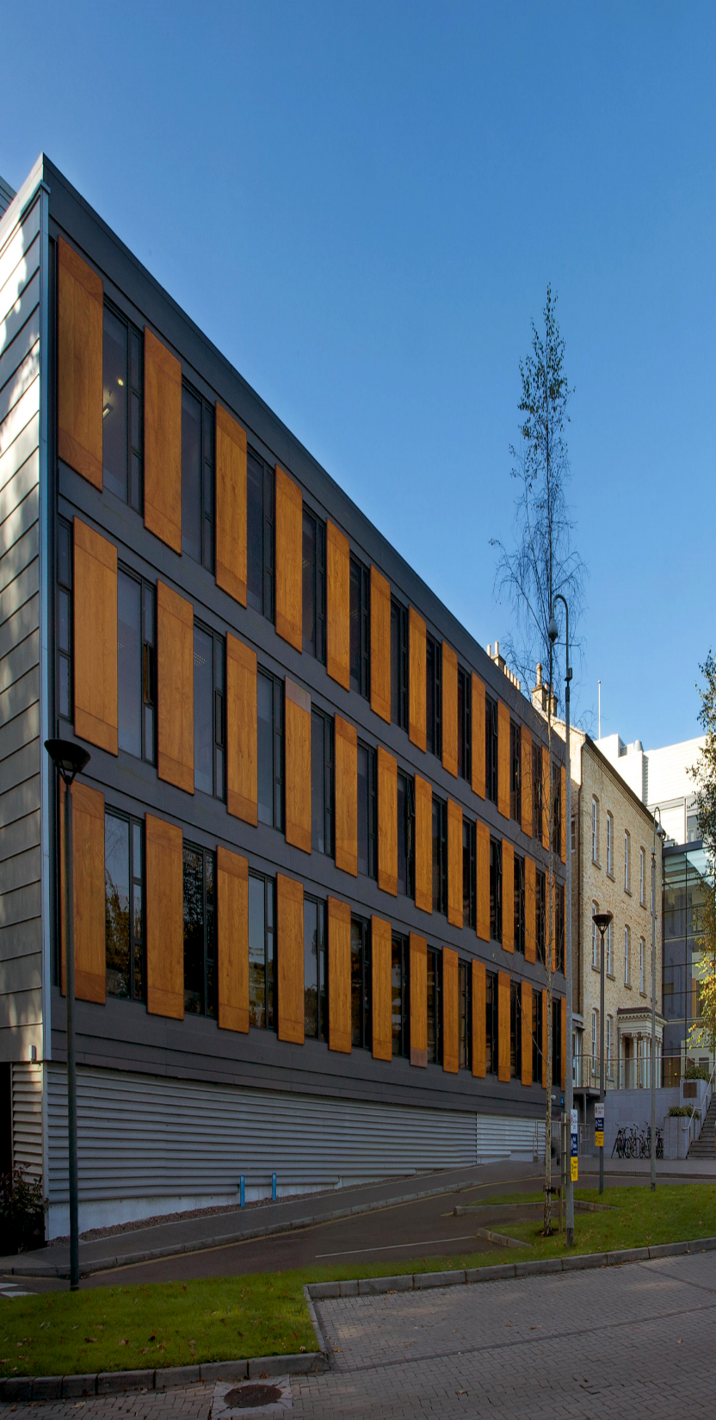
Registration now open!! We are delighted to announce that registration for the 21st Annual Research Conference is now open. The registration page can be accessed at the following link: https://conference.ucc.ie/sonm-annual-conference-2022/regpage/Site/Register This year's Annual Conference is taking place in person in Room G05 in the Brookfield Health Sciences Complex, UCC from 9am to 4pm. We will be also streaming all the talks out live and will send details on how to access the Conference online closer to the date. You can choose below whether to attend the conference in person or online.
“Enhancing opportunities for Diversity and Inclusion in Nursing, Midwifery, and Healthcare”
March 31st, 2022
Follow us on Twitter @uccnursmid

