Slide 2
Supervising Social Work Students
Fiachra Ó Súilleabháin & Olwen Halvey
School of Applied Social Studies
University College Cork

Slide 3
Where we come from, What we bring …

Slide 4
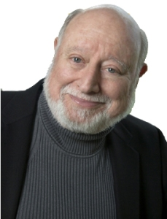
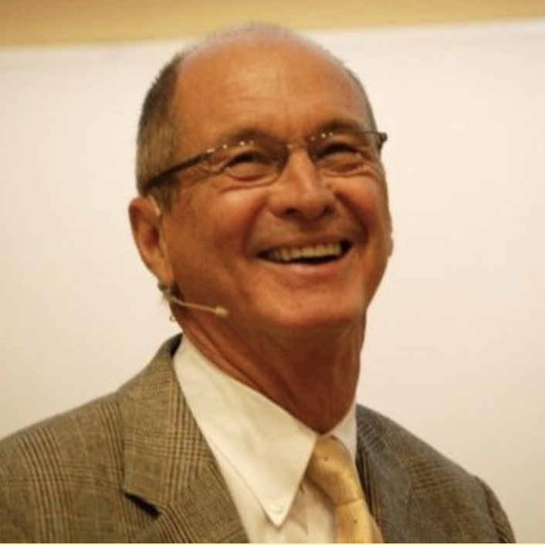
Our Source of Material
Lee Shulman
David Kolb
Tony Morrison

Slide 5
Service Learning (Shulman 2007)
“How are they educated … where knowing is not enough? You have to be able to do, to act, to perform. Even that's not enough, because in addition to knowing and performing you've got to become the kind of human being whom the rest of us can trust to perform with integrity, responsibility, honesty, and – dare I use an old-fashioned word – virtue?”
(Shulman, 2007, p. 13).
Notes:
Shulman (20005) asserts that in addition to knowledge-acquisition, professionals must also ‘come to understand in order to act, and they must act in order to serve’ (Shulman, 2005, p.53).

Slide 6
Social Work: Our role in the World!
“Social work is a practice-based profession and an academic discipline that promotes social change and development, social cohesion, and the empowerment and liberation of people. Principles of social justice, human rights, collective responsibility and respect for diversities are central to social work. Underpinned by theories of social work, social sciences, humanities and indigenous knowledge, social work engages people and structures to address life challenges and enhance wellbeing” (IFSW).

Slide 7
CORU Code of Professional Conduct and Ethics for Social Workers (2019)
Act in the best interests of service users
Respect the confidentiality and privacy of service users
Maintain high standards of personal conduct and behaviour
Use social media responsibly
Comply with obligations regarding registration
Address health issues related to your fitness to practise
Obey laws, regulations and guidelines
Comply with requirements for the protection of children and vulnerable adults
Act within the limits of your knowledge, skills, competence and experience
Keep your professional knowledge and skills up to date
Obtain consent from service users
Assess service users’ capacity to consent where necessary
Communicate effectively with service users and others involved in their care
Act in accordance with the principles of open disclosure
Assist, advise and support colleagues, recently qualified registrants and students
Teach, supervise and assess students and other professionals
Supervise tasks that you delegate to others
Keep accurate records
Assess health, safety and welfare risks
Raise concerns about safety and quality of care
Maintain adequate professional indemnity insurance
Demonstrate ethical awareness
Respect the rights and dignity of service users
Avoid conflicts of interest
Undertake research in an ethical manner
Make sure that any advertising is truthful, accurate, lawful and not misleading
Responsibilities specific to Social Workers

Slide 8
CORU Code of Professional Conduct and Ethics for Social Workers (2019)
27. Responsibilities specific to Social Workers
You must:
not knowingly work with a service user with whom you have or have had a personal relationship that may compromise your professional practice
if you are working with people under a legal mandate, respectfully and clearly state your legal responsibilities and the potential consequence of non-cooperation and also clarify those matters which are open to negotiation and agreement
seek and engage in supervision in professional practice on an on-going and regular basis, in line with your knowledge, skills, competence and experience.
You should:
promote social justice in your practice, through:
challenging negative discrimination and unjust policies and practices
respecting diversity, different cultures and values
advocating for the fair distribution of resources based on identified levels of risk/need
working towards social inclusion.

Slide 9
Let’s hear from you?
What does supervision look like in Social Work Practice?
Define student social work provision?
What are the similarities or differences in supervising students and workplace supervision?
Notes:
Supervision is a process by which one worker is given responsibility by the organisation to work with another worker(s) in order to meet certain organisational, professional and personal objectives. Source Text:, Tony Morrison, 2005, Staff Supervision in Social Care. Pavilion Publication

Slide 10
Supervision and Professional Development (Hawkins and Shohet, 1989)
Level 1 | Level 2 | Level 3 | Level 4
Dependent on Supervision | Fluctuates between dependence and autonomy Over-confidence vs overwhelmed | Increased professional confidence Supervision more collaborative Overview of user in context and more fluid adjustment to user’s changing circumstances | Professionally autonomous Able to conceptualise and generalise Capable of supervising and teaching
Childhood stage | Adolescent stage | Adult Stage | Sage
Novice | Journey-person | Craftsman | Expert

Slide 11
Supervisees value:
Availability
Knowledge about Professional Tasks and skills
Guidance through organisational processes
Linking Theory with Practice
Shared Expectations and Values
Safe and Supportive Space
Validation and Encouragement
Role modelling
Feedback on observed practice
Teaching and Learning
Specific Ideas about Intervention
Delegated Responsibility
Mutual and Interactive Communication
Same
Discipline
(CWDC, 2010)

Slide 12
Supervision and Professional Development (Hawkins and Shohet, 1989)
Level 1 | Level 2 | Level 3 | Level 4
Dependent on Supervision
Childhood stage | Adolescent stage | Adult Stage | Sage
Novice
Students on placement are generally in the Novice category!

Slide 13
Students’ views about the Supervisory Relationship:
Social work students consistently report that the supervisory relationship is the key to their learning.
In predicts satisfaction with all aspects of the field experience (Bogo, 2006; Fortune et al., 2001; Knight, 2000).
Cleak, H., Roulston, A., & Vreugdenhil, A. (2016). The inside story: A survey of social work students' supervision and learning opportunities on placement. The British Journal of Social Work, 46(7), 2033-2050. https://doi.org/10.1093/bjsw/bcv117.

Slide 14
Students’ entry into placement supervision:
Students usually begin the supervisory experience with apprehension, recognizing the fear of having to perform, to be intellectually and professionally honest, and having to be graded and evaluated by the supervisor (Schneider & Berman, 1991).
Ketner, M., Cooper-Bolinskey, D., & VanCleave, D. (2017). The meaning and value of supervision in social work field education. Field Educator, 7(2)

Slide 15
The Onus is on Practice Educators!
Many social work students do not know how to initiate and sustain a relationship with field instructors (Everett et al., 2011).
Ketner, M., Cooper-Bolinskey, D., & VanCleave, D. (2017). The meaning and value of supervision in social work field education. Field Educator, 7(2)
So, what does that mean for you?
The Practice Educator need to take the lead … to foster trust in the supervisory relationship
… to mentor, to listen,
… to decide the timing and manner and format of feedback.

Slide 16
Supervision on Placement: Spaces and Places
Formal
Planned
Ad hoc
Informal

Slide 17
4 x 4 x 4 Stakeholders x Functions x Elements
Supervision:
The sum of all parts?
Morrison

Slide 18
Management
Development
Experience
Plans and Action
Service Users
Staff
Organisation
Partners
Reflection
Analysis
Support
Mediation

Slide 19
The Functions of Supervision

Slide 20
Supervision Functions
Supervision is…
Supervision is not…
Development
Support
Management
Mediation
Counselling
Consultation
A License to vent
Notes:
Management: The management function is concerned with ensuring that the work of the supervisee is in line with agency expectations and standards. This function aims:
To provide a regular, structured, opportunity to discuss work, review practice and progress and plan for future development
To hold the professional accountable for performance and practice, to ensure safe, quality care for service users
To improve/ensure service quality, safety and clinic practice
To provide oversight of the practitioners practice
To ensure good practice and to challenge and manage poor practice
Support: The support function is about enabling the supervisor to identify and deal with the personal impact of his or her work through a safe trusting environment. This function is
For the individual in what is a demanding and potentially stressful working environment
To ensure that health and well-being at work issues are addressed
To ensure the supervisee meets the health service objectives
The development of supportive and positive climate for evidence based practice and performance
Learning and development: The educational function is concerned with assisting the supervisee to assess and develop their own level of skill and competence by assisting them:
To identify their knowledge-base, attitudes, learning style and skills
To identify learning needs and the strengths and areas for development
To plan and set targets for ongoing professional development (CPD)
To develop employee’s skills in and capacity for reflective practice
Engagement/Mediation: The mediation function is concerned with establishing a healthy feedback mechanism from the organisation to the supervisor and equally from the supervisor to the organisation. This function acknowledges
Supervision is an important working relationship
Supervision is about feeling and thinking as well as doing
Supervision is part of the intervention process
That it is important to ensure healthy engagement with and communication between the practitioners and with the organisation

Slide 21
Giving Feedback
Bogo, Regehr, Power, and Regehr (2007) cautioned that giving only positive feedback is not conducive to student learning!
A strong, well-established relationship between supervisor and supervisee needs to be in place to enable the giving and receiving of more critical feedback.
Giving feedback should be systematic, timely, clear, and invite dialogue.

Slide 22
Students value the function of Supervision in their learning journeys:
“
Supervision to me is a time for me to ask any questions, bring up any concerns and getting to debrief about any cases I was involved in during the week that had remained on my mind. I feel like supervision recharged me because I was able to get everything out that I may have been holding in during the week and got to ask questions if I hadn’t already got them answered by staff.
Student Participant in Ketner et al. (2017)
”
Ketner, M., Cooper-Bolinskey, D., & VanCleave, D. (2017). The meaning and value of supervision in social work field education. Field Educator, 7(2)

Slide 23
Notes:
Trusting relationships create an environment where supervisees can discuss difficulties in practice without fear of censure (Nickson, Gair, & Miles, 2016).

Slide 24
Foundations of a good supervisory relationship
Respect
Commitment
Respect
Spirit of Enquiry
Supervision
These principles underpin the importance of the supervision contract.
Trust
Honesty
Openness
Reciprocity
Understanding

Slide 25
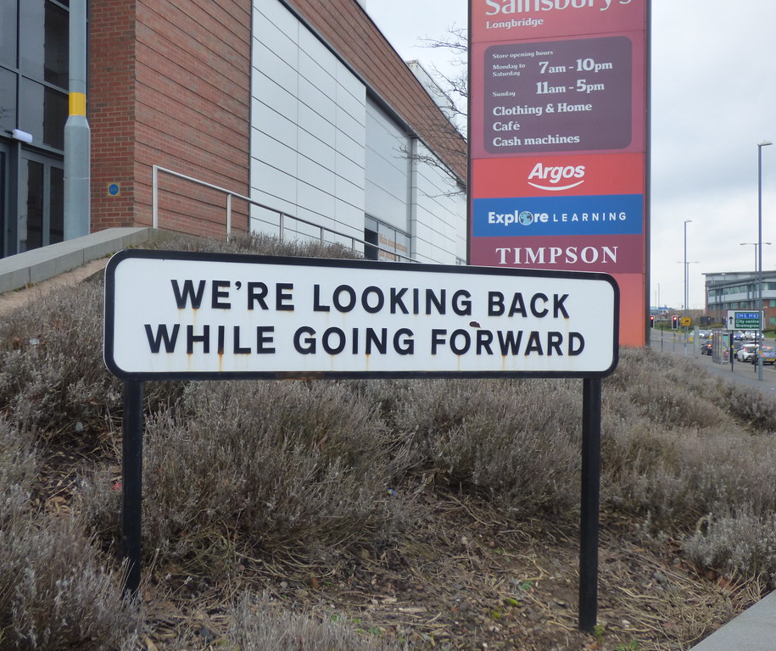
Supervision Histories:

Slide 26
Supervision Histories? Suggested questions to generate discussion
Tell me about your experiences of being supervised in the past, if you have any experience?
What do you think are the differences in social work supervision and task-based management (such as your prior experience in …?
Can you identify a supervisor in a work/volunteer space who has been helpful to you in the past?
What did they do that was helpful? Why was that important to you?
What was it about that supervisor that you found particularly helpful?
Did demographic factors such as similarities or differences in terms of age, gender, ethnicity, class, sexual orientation, disability etc. play a part in the level of trust established?
Have you had experience of supervisors who worked ethically and collaboratively with you or did they misuse the authority of their role? If so, how?
Have your views about what makes a ‘good’ supervisor changed since you started your social work programme?

Slide 27
Why ask about students’ past experiences?
It incites reflection.
It sets an inquiring tone to the supervision space.
It provides shared insight into the student’s learning style – what works for them?
It honors and respects previous experiences – positive and negative?
It provides an opportunity to discuss power as well as dignity and respect in the learning space (including racisms, heterosexism, exclusion, harassment, discrimination etc).

Slide 28
The elements of Supervision
Creating and Maintaining Learning spaces

Slide 29
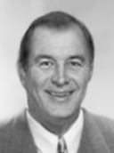
Kolb’s Learning Cycle
Experience
‘The story’
What happened?
What was my experience?
What was the service-user’s experience?
Action Plans
What next?
What is the next chapter in the story?
What will I take from the experience?
What are the implications for me?
Reflection
‘Feelings’
Feelings about the story?
Making sense of
my
experiences
Analysis
Seeking to understand
What does the story mean?
For the service-user?
For me?
For the service?
What went well/not well? Why?

Slide 30
Activists
Enjoy the here and now
Dominated by immediate experiences
Pragmatists
Keen to try out ideas, theories and techniques to see if they work in practice.
Reflectors
Like to sit back, ponder experiences and observe them for many different perspectives
Honey and Mumford’s Learning Styles
Theorists
Think problems through step-by-step, in a logical way.
Like to analyse and make sense of situations

Slide 31
Practice Educator’s
Pragmatist
Reflector
Learning Pattern
Theorist
Activist
Student’s
Reflector
Learning Pattern
Pragmatist
Theorist
Activist
Supervision

Slide 32
Practice Educator’s
Theorist
Reflector
Learning Pattern
Pragmatist
Activist
Student’s
Reflector
Learning Pattern
Pragmatist
Theorist
Activist
Supervision

Slide 33
Experience
Here and Now
The Short Circuit
Problem recurs
Same issues repeated
Reflection
‘Feelings’
Feelings about the story?
Active Experimentation
Quick fix
No Reflection
No Analysis
Analysis
Seeking to understand
What does the story mean?
For the service-user?
For me?
For the service?
What went well/not well? Why?

Slide 34
Practice Educator’s
Pragmatist
Theorist
Learning Pattern
Activist
Reflector
Student’s
Reflector
Learning Pattern
Pragmatist
Theorist
Activist
Supervision

Slide 35
Experience
‘What’s the problem?
The Emotional Depths
Action Plans
What next?
What is the next chapter in the story?
What will I take from the experience?
What are the implications for me?
Reflection
‘Feelings’
Feelings about the story?
No Decisions
No Analysis
Result:
Stuck in the emotional impact
Analysis
Seeking to understand
What does the story mean?
For the service-user?
For me?
For the service?
What went well/not well? Why?

Slide 36
Practice Educator’s
Pragmatist
Reflector
Learning Pattern
Activist
Theorist
Student’s
Theorist
Learning Pattern
Pragmatist
Activist
Reflector
Supervision

Slide 37
Experience
‘What’s the problem?
Stuck in the Mud
Action Plans
What next?
What is the next chapter in the story?
What will I take from the experience?
What are the implications for me?
Reflection
‘Feelings’
Feelings about the story?
No Reflection
No Decisions
Result:
ANALYSIS PARALYSIS
Analysis
Seeking to understand
What does the story mean?
For the service-user?
For me?
For the service?
What went well/not well? Why?

Slide 38
So what can we do in Student Supervison about Learning Styles?
Consider discussing your learning styles in the beginning phase of placement
Discuss each other’s learning styles.
Use Kolb’s Learning Cycle / and Honey & Mumford Learning Styles to chart case discussions/learning incidents.
Be vigilant about drifting into one learning space
Self awareness
Honesty – recognise and value different approaches
Openness to feedback
Willingness to move

Slide 39
Placement Supervision: Emphasising Stakeholders

Slide 40
Supervision and Service-users
Why did we start with this definition?
Because:
“Social work is a practice-based profession and an academic discipline that promotes social change and development, social cohesion, and the empowerment and liberation of people. Principles of social justice, human rights, collective responsibility and respect for diversities are central to social work. Underpinned by theories of social work, social sciences, humanities and indigenous knowledge, social work engages people and structures to address life challenges and enhance wellbeing” (IFSW).
Social work is and should be a service-user focused profession!
Therefore, the service-user experience should be central to supervision – especially with students.
Their experience is mediated by us and through us…so we need to remember that in supervision.

Slide 41
Inciting students’ critical reflection: Student Supervision in Context What does social work do in, for and with society?
Care versus Control
Transformation versus Reformation/Maintenance
Regulation versus Emancipation
Responsibilisation versus Relational/Systemic
Powerful versus empowering

Slide 42
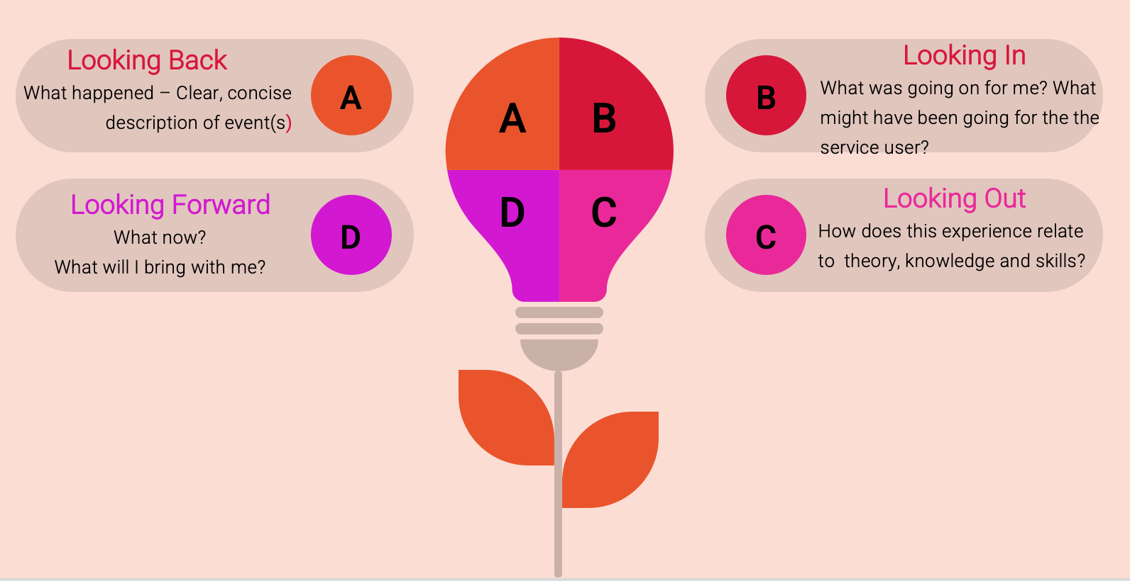
Amplifying the Reflective Cycle in Supervision
Connect and Embed personal learning to wider structural systems

Slide 43
Why is critical reflection helpful to placement learning?
It reinforces a socially just approach to practice.
It is not value neutral and reminds students that fairness and equity underpin their work.
It prompts students to look beyond their experience, the specific incident and to see the broader context.
It encourages the capacity to explore and tolerate uncertainty - it enables students to understand that they are not expected to have all the answers at the end of a student placement/learning enquiry.
Adapted for student placements from Fook, J., & Gardner, F. (2007). Practising critical reflection: A resource handbook. McGraw-Hill Education

Slide 44
Placement Supervision Triad
Collaborative
Learning
Environments

Slide 45
Student – University – Fieldwork Setting: Collaborative Learning
Respectful attitudes
Clear policies and procedures
Positive and engaged leadership
Concern for service-users
Clear roles and responsibilities
Sense of belonging, mutual support and shared responsibility
Clear and open communication
Positive engagement with other stakeholders
Commitment to resolve conflicts
Acknowledgement of feelings
Commitment to explore practice
Differences acknowledged and valued
Supervision seen as a priority
Theory and research used to assist practice
Commitment to learning and development
Willingness to receive constructive feedback
Positive use of team meetings
Active participation with and from service-users

Slide 46
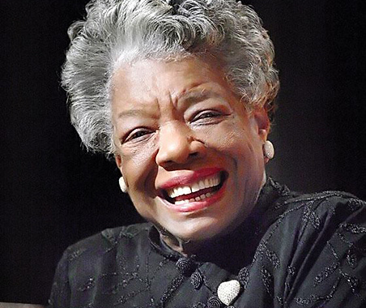
A final mantra for Students and for Practice Educators:
“My mission in life is not merely to survive, but to thrive; and to do so with some passion, some compassion, some humor, and some style.”
Maya Angelou

Slide 47
Thank You and Best Wishes
Fiachra Ó Súilleabháin (he/him/his)
Fiachra.OSuilleabhain@ucc.ie
@FiachraOS
Olwen Halvey (she/her/hers)
Olwen.Havley@ucc.ie

