Slide 1
College of Medicine and Health
Undergraduate Programmes for 2026 entry

Slide 2
College of Medicine and Health
Undergraduate Programmes
CAO ENTRY CK701 Medicine⁺ CK702 Dentistry⁺ CK703 Pharmacy⁺ CK704 Occupational Therapy⁺ CK705 Speech and Language Therapy⁺ CK706 Public Health Sciences# CK707 Medical and Health Sciences# CK708 Paramedicine*# CK710 General Nursing^{+#} CK712 Children's and General Nursing (Integrated)^{+#} CK720 Mental Health Nursing^{+#} CK730 Intellectual Disability Nursing^{+#} CK740 Midwifery^{+#} +Accredited Programme for Professional Registration | DIRECT ENTRY Dental Nursing Dental Hygiene BSc Nursing Studies BSc Paramedic Studies - Practitioner Entry GRADUATE STUDY OPTIONS CK791 Medicine (Graduate Entry)⁺ Alternative Entry Tertiary Pathway to BSc Occupational Therapy # QQI/FET Entry available

Slide 3






Registered Healthcare Professionals

Slide 4
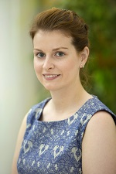
CK701 Medicine Overview
DURATION 5 Years EU Places ~120
MINIMUM CAO POINTS 2025 730
Subject Requirements: H4 Chemistry, H4 either Physics or Biology.
Additional Requirements
Garda Vetting and Fitness to Practise
480 points in the Leaving Certificate
Complete HPAT
  https://www.ucc.ie/en/medical/ https://www.ucc.ie/en/ck701
Key Subject Areas (earlier years)
Foundations of Medicine: Anatomy, Physiology,
Biochemistry, Pathology, Pharmacology
Clinical Science & Practice
Person, Culture and Society
Special Study Modules (electives)
Key Subject Areas (Later years)
Medicine, Surgery, Paediatrics, Obstetrics & Gynaecology, Psychiatry, Sub-specialties etc
Focus on Diagnosis
Management, Holistic approach to patient care
“The teaching is great and the facilities are top-class, with simulated wards and early patient contact. We have a large range of different hospital attachments in Kerry, Waterford, Tipperary and Cork, allowing us to experience different specialities and different hospitals. it is a thoroughly enjoyable five years!"
Career Opportunities
Most graduates work as doctors, caring for people in the community or the hospital. Others choose to work in related fields such as medical research, public health, pharmaceutical or biomedical device companies, health insurance companies, or occupational medicine.
Dr Niamh Ryan,
Medical Graduate

Slide 5
Medicine Points Explained
MODERATION OF LEAVING CERT POINTS
Points > 550 counted differently for Medicine
Every 5 points > 550 = 1 point
555 points becomes 551
560 points becomes 552
590 points becomes 558
601 points becomes 560
613 points becomes 563
And 625 points becomes 565
Combination of HPAT and Leaving CERT Points
Adjusted Leaving Cert points (up to 565); HPAT (up to 300) scores the highest combined scores get entry; applicants with max LC points may not get a place if their HPAT score is low.
HPAT
2.5 hour paper usually late February (register Jan)
MCQ – Online, with remote invigilation; students given their score /300 and a percentile
3 parts:
Logical reasoning and problem solving
Interpersonal understanding
Non-verbal reasoning.
https://hpat-ireland.acer.org/
Minimum combined score | 730 (round 1)
Min Leaving Cert points | 549
Min HPAT score | 164
Highest HPAT score | 241
Highest combined score of those admitted to First Year | 806
From 2027
No moderation of LC points – all points will count the same:
  625 points will count as 625 points
  600 points will count as 600 points etc.
HPAT will be worth only 150 points (not 300)
Max score from 2027 (LC+HPAT) will be 775

Slide 6
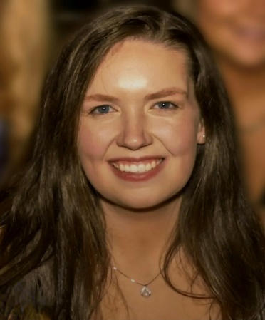
CK702 Dentistry Overview
DURATION 5 Years EU PLACES ~26
MINIMUM CAO POINTS 2025 613*
“The degree blends academic excellence with clinical experience and a true sense of community. At the Dental School and Hospital, it’s so much more than just teeth; every student is known and supported, fostering confident, capable, and compassionate practitioners who are ready for the real world.”
Subject Requirements:
H4 Chemistry, H4 either Physics or Biology.
Additional Requirements
Garda Vetting and Fitness to Practise.
1.5 years mainly on campus studying basic medical sciences.
3.5 years in the CUDSH and the attached Cork University Hospital allowing students extensive experience in the diagnosis and treatment of patients.
Dr Martha Woods
Dentistry Graduate
Key Subject Areas
1. Anatomy, Physiology, Biochemistry,
2. Pathology, Pharmacology,
3. Clinical Dentistry
4. Restorative Dentistry
5. Dental Surgery
6. Oral Health and Development
Career Opportunities
General practice, work in the community dental service, undertake further study with a view of specialising, or become university academics. Qualified dentists can currently work in EU countries, Australia, Canada, Malaysia, and Singapore.
https://www.ucc.ie/en/dentalschool/
https://www.ucc.ie/en/ck702/

Slide 7
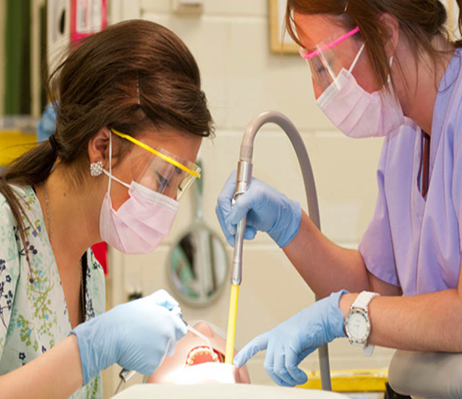
Dental Nursing Overview
DURATION 2 Years (Full time)
16 month (Part-time)
employed as a Dental Nurse of time of application
The main duties of a dental nurse include:
Infection Control
Chair-side assistance
Preparation and maintenance of the dental surgery
Patient care and administration of the dental surgery.
Subject Requirements:
Minimum grade O6 /H7 in 5 subjects
All applicants are interviewed
Additional Requirements
Garda Vetting and Fitness to Practise
Career Opportunities
Dental Nurses are valuable members of the dental team. The employment rate of our graduates is extremely high and it is also possible to work abroad with this qualification. Further study is possible, including dental radiography, conscious sedation, oral health promotion, dental hygiene and dental science.
Skills required include:
Communication and organisational skills
Ability to use initiative
Good manual dexterity
Ability to provide support during dental treatment.
https://www.ucc.ie/en/dentalschool/
https://www.ucc.ie/en/dipdentnurs/

Slide 8
Dental Hygiene Overview
DURATION 2 Years (Full time)
The main duties of a dental hygienist include carrying out procedures including scaling teeth, taking and recording radiographs, local infiltration and inferior block anaesthesia, application of fissure sealants, application of desensitising agents and providing dietary advice.
Entry Requirements:
Minimum grade H5 in two subjects
Minimum grade O6/H7 in four other subjects. Must include Irish, English, another language, Mathematics, Biology
Additional Requirements
Garda Vetting and Fitness to Practise
Sonja Cronin
Dental Hygiene
Graduate
“I thoroughly enjoyed my time studying dental hygiene at UCC. Although the course was challenging at times, I learned great practical skills and gained confidence in my abilities.”
Working under the supervision of a dentist, the dental hygienist carries out preventive and periodontal treatments
Career Opportunities
The majority of our graduates will find work in a
general practice under the supervision of a dentist,
in the community with the Health Service Executive
(HSE), or in a dental hospital setting.
https://www.ucc.ie/en/dentalschool/
https://www.ucc.ie/en/dipdh/

Slide 9
Nursing and Midwifery Overview
PROGRAMMES AND DURATION CAO 2025 PLACES
CK710 - General Nursing (4 yrs) 452 ~134
CK720 - Mental Health Nursing (4 yrs) 400 ~42
CK730 - Intellectual Disability Nursing (4 yrs) 356 ~29
CK740 - Midwifery (4 yrs) 441 ~40
CK712 - Children’s & General Integrated (4.5 yrs) 522 ~32
“I always knew I wanted a career which involved caring for others. I always felt drawn to a career in nursing however I was never sure what type of nursing I would like to pursue.
Having done my transition year work experience in a school that supports children with an intellectual disability, I realised I had a passion for supporting individuals with an intellectual disability. Intellectual disability nursing is extremely rewarding.”
Distinct programmes with different emphases and different points of entry to the professional register of the Nursing and Midwifery Board of Ireland (NMBI).
Transferring between programmes is not feasible
EILEEN KELLEHER
Intellectual Disability Nursing
Graduate
Subject Requirements:
Academic elements take place in the Brookfield Health Sciences Complex and Practical modules take place at various health service provider sites around Cork City and County.
Subject Requirements:
Laboratory science subject (Biology, Chemistry, Physics, Physics with Chemistry ( joint) or Agricultural Science)
Additional Requirements
Garda Vetting and Fitness to Practise
https://www.ucc.ie/en/nursingmidwifery/

Slide 10
Nursing and Midwifery Overview
General Nursing
Children’s & General (Integrated)
The General Nursing programme contains the essential elements that facilitate the development of professional knowledge, skills, and attitudes necessary to meet the nursing needs of patients who are acutely or chronically ill.
Career Opportunities
As a general nurse working in a wide range of areas,
including hospitals, community/home nursing,
schools, and nursing homes.
Some of our recent graduates are working as nurses in the HSE, Bon Secours Hospital, Mater Private.
https://www.ucc.ie/en/ck710/
This programme offers dual registration in both the children’s division and the general division of the NMBI Register.
Children’s nurses provide nursing care for children and young people, mostly within the hospital environment. Children’s nurses work in partnership with the child and the family
Career Opportunities
As children’s or general nurses working in areas, including hospitals, community/home nursing, schools, and nursing homes.
Recent graduates are working as nurses in Beacon Hospital, Cork University Hospital, Crumlin Hospital, and Great Ormond Street Hospital in London.
https://www.ucc.ie/en/ck712/

Slide 11
Nursing and Midwifery Overview
Mental Health Nursing
Intellectual Disability Nursing
The Registered Nurse Intellectual Disability works with persons with an intellectual disability and has a diversity of roles. This includes providing nursing support across a variety of environments such as home, education and community settings, as well as specialist practice, e.g. the family home, residential and respite services, schools, primary healthcare and acute settings.
Mental Health (Psychiatric) nursing also known as mental health nursing is a specialist nursing discipline. Mental Health nurses work in partnership with people who are experiencing mental health challenges, their family and supporters to enable them to mobilise their own inner resources along with professional support.
Career Opportunities
Psychiatric nurses work in a wide range of areas,
including hospitals and community mental health facilities.
Recent graduates from this programme are
working as nurses for Cork University Hospital, Mercy
Hospital, and the HSE.
https://www.ucc.ie/en/ck720/
Career Opportunities
Graduates can seek employment as an intellectual disability nurse, working in a wide range of areas, including acute care, community facilities, nursing homes, residential facilities, respite care, retirement care, and schools.
Recent graduates are working as nurses for Brothers of Charity, Cope Foundation, and The Hope Foundation, Ireland.
https://www.ucc.ie/en/ck730/

Slide 12
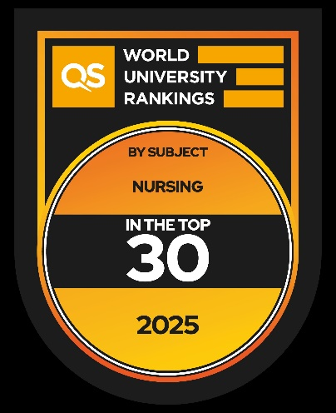
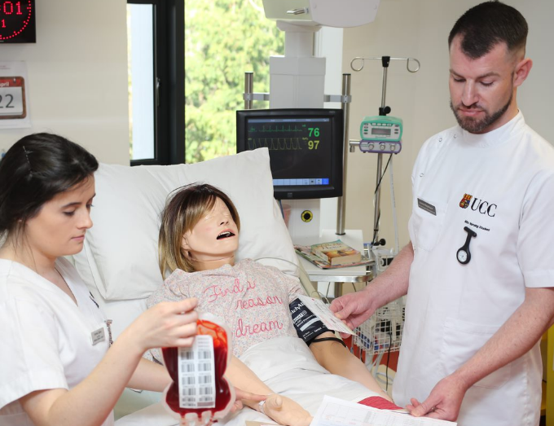
Nursing and Midwifery Overview
Midwifery
Top School of Nursing in Ireland
In the top 30 in the World
Midwifery involves the provision of care and support to women during pregnancy, labour and birth, and to women and their babies following birth. Midwives provide health promotion and education for women, their babies and their wider family circle. The concept of partnership between the woman and the midwife is fundamental to midwifery practice and is based on mutual trust, support and collaboration
Career Opportunities
Midwives are highly sought-after in Ireland, and other countries, in particular within Australia, Canada and the UK.
Recent graduates from this programme are working as Midwives across Ireland and abroad including Cork University Maternity Hospital
https://www.ucc.ie/en/ck740/
Clinical Skills Simulation Resource Centre
Traditionally, Irish Nurses are highly regarded by other countries, enhancing work opportunities abroad, particularly in the UK, Australia, Canada, and the US.
https://www.ucc.ie/en/nursingmidwifery/

Slide 13
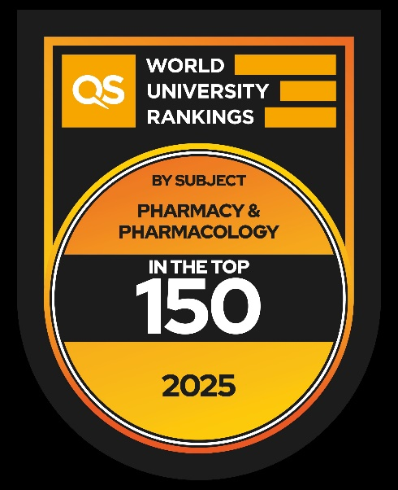
CK703 Pharmacy Overview
DURATION 5 Years EU PLACES ~74
MINIMUM CAO POINTS 2025 602
…..provided me with a tremendous amount of medicinal knowledge, I also gained really useful soft skills like presentation, team working and research skills.
This combination of skills and knowledge went a long way to help impressing recruiters, which gave me the best opportunity to find the most suitable job to start my career.
Subject Requirements:
H4 Chemistry, H4 either Physics or Biology.
Additional Requirements
Garda Vetting and Fitness to Practise
Integrates the science and practice of pharmacy through hands-on learning, industry and healthcare site visits and multiple placement opportunities with an eight-month placement in the final year.
Key Subject Areas
Pharmaceutical and medicinal chemistry
Formulation design
Drug action in the body
Practice of pharmacy
LONG NGUYEN QUANG
Pharmacist, McCabes Pharmacy
Career Opportunities
Professional careers in community pharmacy, hospital or industrial practice, research, lecturing, or wholesaling and regulatory work are possible.
Augment an entrepreneurial interest to manage or own your pharmacy-related business.
https://www.ucc.ie/en/ck703/
https://www.ucc.ie/en/pharmacy/

Slide 14
CK704 Occupational Therapy Overview
DURATION 4 Years EU PLACES ~40*
MINIMUM CAO POINTS 2025 566
“The small class size allows for eye-opening class discussions and means that all students are noticed and supported by lecturers. Even if students do not end up practising occupational therapy after their degree, they will leave UCC with a more open-minded and compassionate view of the world and many skills that can be applied to any area of work.”
Subject Requirements:
H4 in a laboratory science subject (Biology, Chemistry, Physics, Physics with Chemistry (joint) or Agricultural Science).
Additional Requirements
Garda Vetting and Fitness to Practise
Occupational therapists are experts in analysing the activities that people need, want, or have to do, in their day-to-day life.
Occupational therapy is about enabling people to live
life to the fullest, when they have been prevented from
doing so due to ill-health, disability or other obstacles.
Louise Coombes
Occupational Therapy Graduate
*Entry via Tertiary Degree Pathway
20 additional places are available for students entering via the Tertiary Degree Pathway. Students take a Foundation Year in either Morrisson’s Island (Cork) or Kerry College (Tralee) comprising modules in anatomy, physiology, occupational theory, healthcare communication and academic writing in addition to a 5-credit module in UCC. They then apply through CAO to enter Year 1 of the UCC degree.
Key Subject Areas
Psychology, anatomy and physiology
Occupational therapy theories
Assessment and treatment approaches and practice
https://nto.hea.ie/courses/bsc-hons-occupational-therapy/
Career Opportunities
In a wide range of settings, including hospitals, health centres, care homes, schools, prisons, in the community and in peoples’ homes and workplaces. Our graduates are employed as therapists, researchers, managers, and educators
https://www.ucc.ie/en/clinical-therapies/
https://www.ucc.ie/en/ck704/

Slide 15
CK705 Speech and Language Therapy
DURATION 4 Years EU PLACES ~32
MINIMUM CAO POINTS 2025 552
“I decided to pursue a career in
SLT as I felt it was an exciting mixture of both school-based and clinical-based services, which would allow me to work with infants, school-aged children, adults and the elderly population. It is the perfect career option for individuals who are caring, passionate and willing to advocate for those who may not be able to advocate for themselves.”
Subject Requirements:
H4 in a laboratory science subject (Biology, Chemistry, Physics, Physics with Chemistry (joint) or Agricultural Science).
Additional Requirements
Garda Vetting and Fitness to Practise
Speech and Language therapists provide treatment, support and care for children and adults who have difficulties with communication, or with eating, drinking and swallowing.
DAVID O’SHEA
Speech and Language
Graduate
Career Opportunities
You can work in hospitals, primary care community centres, voluntary organisations, and in private practices in Ireland or abroad.
Recent workplace destinations for our graduates include the Daughters of Charity, The Kids Clinic, The Language People and the HSE.
Key Subject Areas
Anatomy and physiology
Linguistics and speech science
Behavioural science
Speech and language therapy theory, assessment and
treatment approaches.
https://www.ucc.ie/en/ck705/
https://www.ucc.ie/en/clinical-therapies/

Slide 16
CK706 Public Health Sciences Overview
DURATION 4 Years EU PLACES ~34
MINIMUM CAO POINTS 2025 414
“The BSc in Public Health Sciences affords students the opportunity to experience a multitude of subjects from biological sciences, sociology, epidemiology, nutrition, politics, statistics and social research. The course, while multidisciplinary in its approach has the added advantage of small classes that deliver personalised attention”
Subject Requirements:
H4 in either a laboratory Science subject, Mathematics or Applied Mathematics.
Additional Requirements
Garda Vetting
Public Health professionals focus on preventing disease and promoting health in populations. The BSc Public Health Sciences will equip students with the wide range of knowledge and skills necessary to become a public health practitioner.
Martin Keenan
Public Health Sciences
Graduate
Career Opportunities
Graduates are employed in diverse public health roles and settings, including data analysis and disease surveillance, health and nutrition, health and safety, health communication, health promotion, international aid agencies, media and public relations, and public health research.
Some Subject Areas 1st Year
Epidemiology
Health Information Systems and determinants of Health
The Environment & Human Health,
Microbiology in Society,
Public Health & Health Promotion
https://www.ucc.ie/en/ck706/
https://www.ucc.ie/en/publichealth/

Slide 17
CK707 Medical and Health Sciences
DURATION 4 Years EU PLACES ~50
MINIMUM CAO POINTS 2025 532
“This course is perfect for anybody with a keen interest in the field of medical science and healthcare. It has exposed me to a variety of different modules and exciting career pathways in the pharmaceutical industry, scientific research and even business.”
Subject Requirements:
Min. grade H4 in two subjects, including Chemistry
Min. grade O6/H7 in four other subjects, including either Physics, Biology or Agricultural Science.
Students acquire a solid grounding in the core disciplines underlying the medical and health sciences, as well as having a
strong focus on research.
Ava O’Flynn
Medical and Health Sciences
Graduate
Example Some Subject Areas 1st Year
Epidemiology
Human Biology
Cardiovascular Biology
Respiratory Biology
Gastrointestinal
Nutritional & Metabolic Biology
Translational Medicine
Pharmacology
Career Opportunities
Employment in the pharmaceutical, biotechnology
and medical devices industries, and in health
promotion, education and policy. Jobs to choose from in these fields, including clinical trials analyst, laboratory scientist, lecturer, medical researcher, medical sales representative, medical writer, and pharmaceutical scientist.
https://www.ucc.ie/en/medical/prosstud/
https://www.ucc.ie/en/ck707/

Slide 18
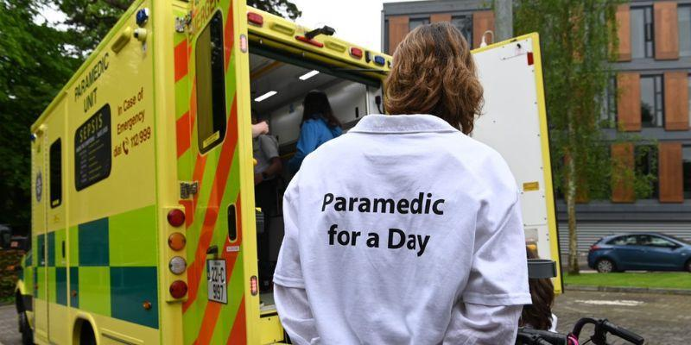
CK708 Paramedicine Overview
DURATION 4 Years EU PLACES ~30
MINIMUM CAO POINTS 2025 496
Subject Requirements:
H4 in a laboratory science subject (Biology, Chemistry, Physics, Physics with Chemistry (joint) or Agricultural Science).
Minimum grade H5 in one subject and minimum grade O6/H7 in four other subjects
Additional Requirements
Garda Vetting
Students on this programme will be required to obtain a full C1 driving licence by semester 2 of Year 3.
Placements
In major hospitals and ambulance bases throughout the State, enabling you to consolidate your learning and gain clinical exposure throughout the programme.
Clinical placements are facilitated by the HSE National Ambulance Service. Our extensive network of teaching hospitals includes Cork University Hospital which is a Major Trauma Centre.
The course will provide you with a variety of modules in numerous settings including modules in theory and clinical practice.
In addition, you will participate in ambulance-supervised placements and multiple clinical settings such as emergency departments, coronary care units etc.
https://www.ucc.ie/en/medical/emergencymedicineprehospitalcare/
https://www.ucc.ie/en/ck708/

Slide 19

Student Financial Supports
& Advice Office
If you require any financial and/or budgetary advice, please make sure to contact us.
The Hub, Main Campus, UCC.
https://www.ucc.ie/en/sfsa/
studentbudgetingadvice@ucc.ie
The Hub, Main Campus, UCC.
https://www.ucc.ie/en/sfsa/
studentbudgetingadvice@ucc.ie

Slide 20





Join Our Community

