Slide 1
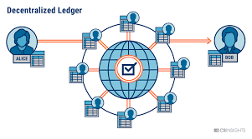
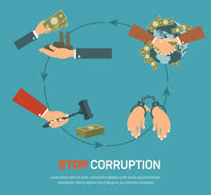
ONLINE INTERNATIONAL CONFERENCE
“Good Governance and Anti-Corruption:
Opportunities and Challenges in the Era of Digital Technology”
Blockchain for Anti-Corruption
LE HUY HOA
BitCoin+ Vietnam Communities
www.facebook.com/lehuyhoa

Slide 2
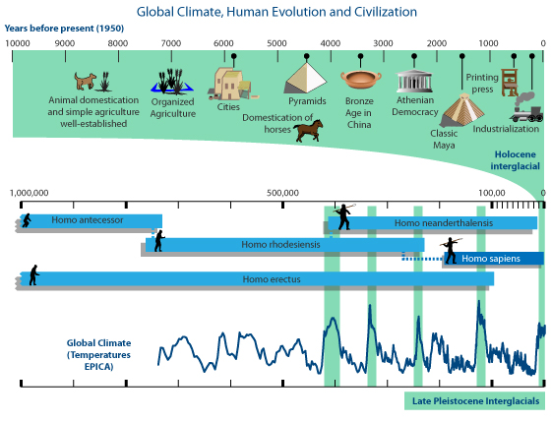

Slide 3
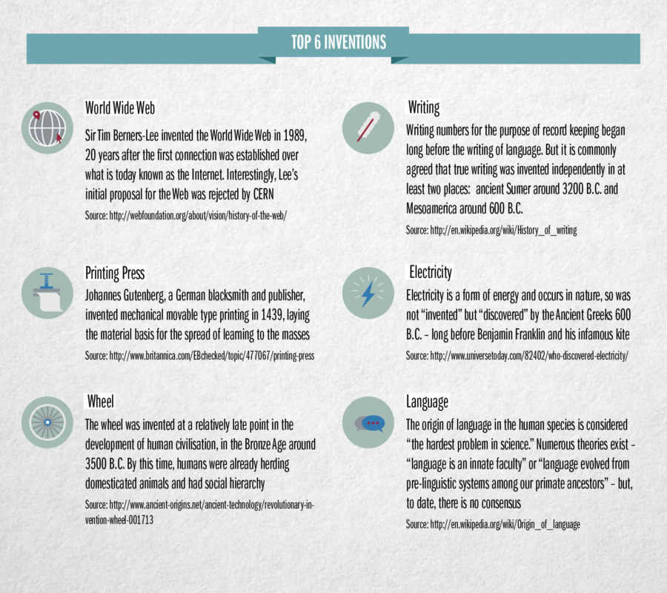
CONTENTS

Slide 4
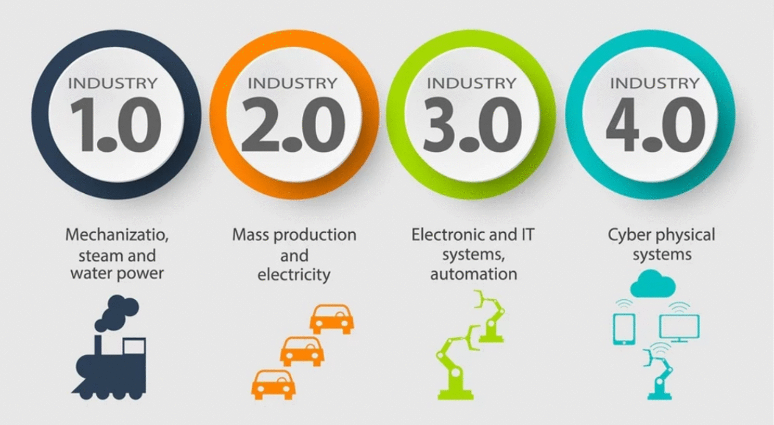

1. A new economy

Slide 5
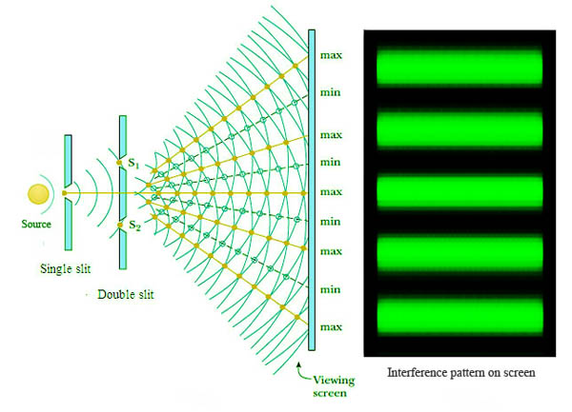

Slide 6
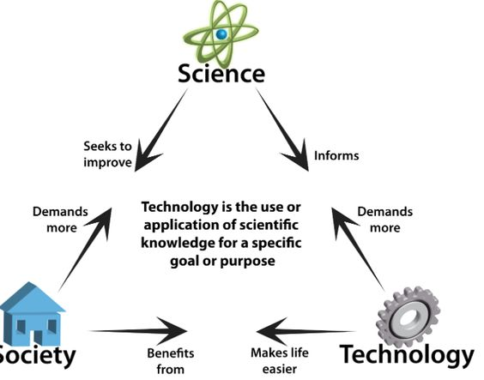
Technology
  The application of scientific knowledge for practical purposes, especially in industry.
  It can also be stated as the branch of knowledge dealing with engineering or applied sciences.
  Machinery and devices developed from scientific knowledge

Slide 7


Industry 4.0–Technology revolution
“New ways in which technology becomes embedded within societies and even the human body.”
Internet of Things
Sharing Economy
Cyber
Physical
System
BioTech
Blockchain
3D Printing
BigData
Artificial Intelligence
Nano

Slide 8

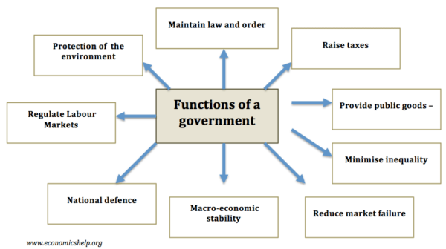

Slide 9
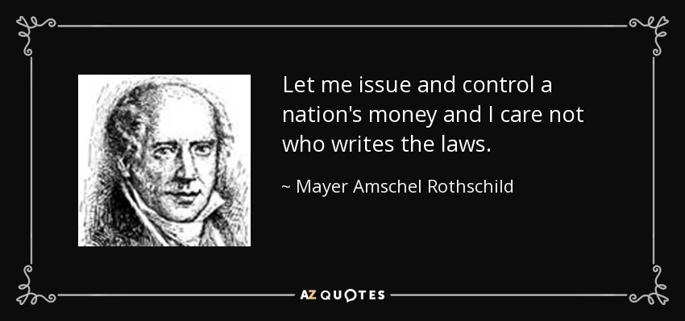

Slide 10
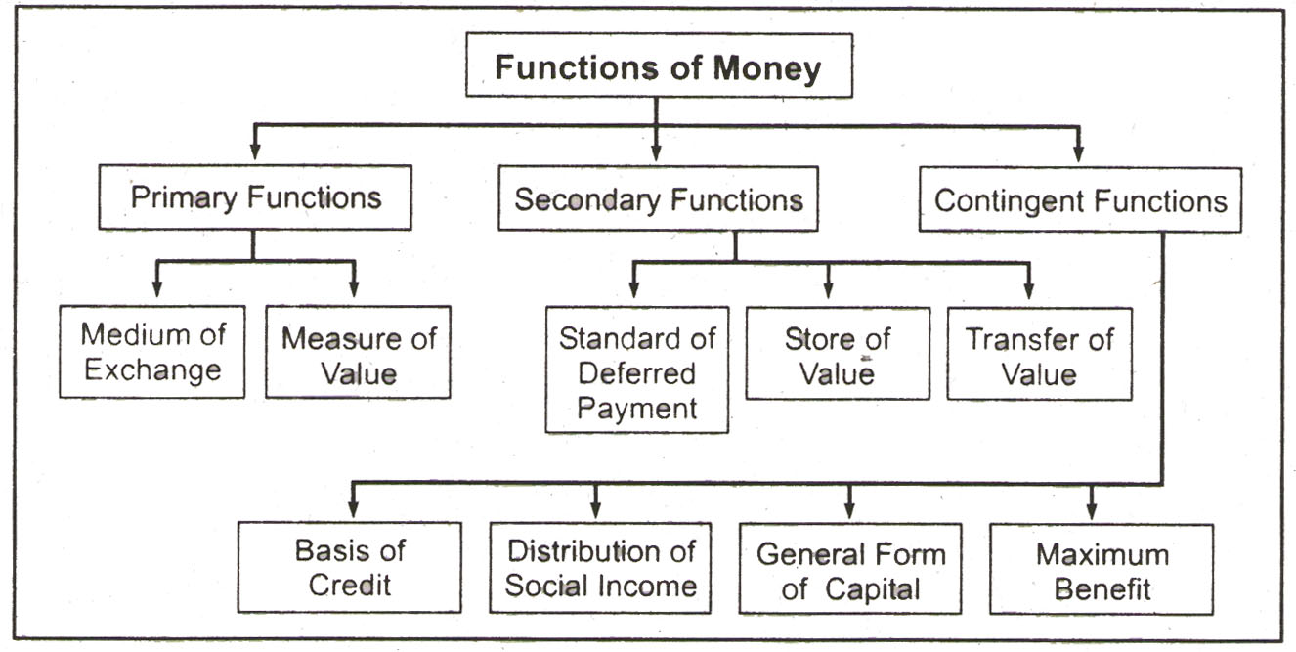
Money
The role of currency in our society

Slide 11
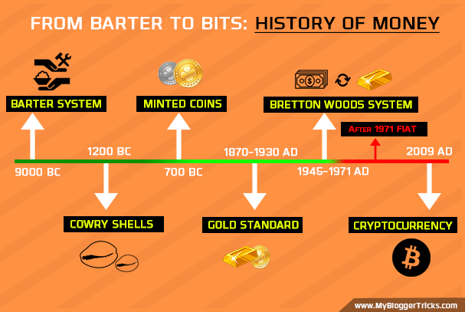
CONTENTS

Slide 12

IN CODE WE TRUST

Slide 13
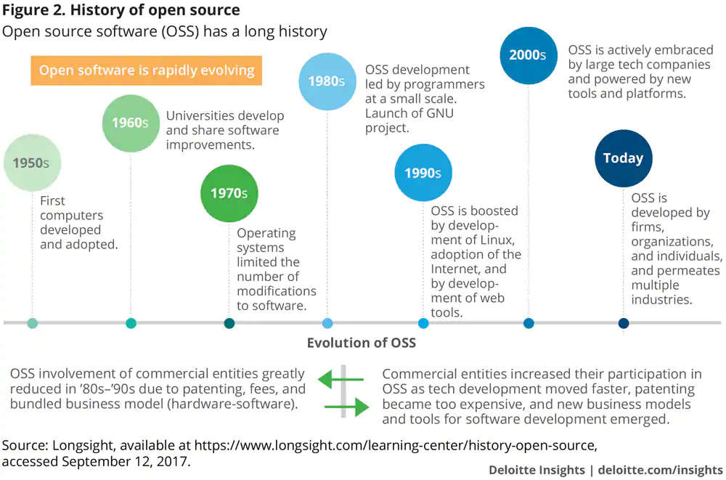

Slide 14
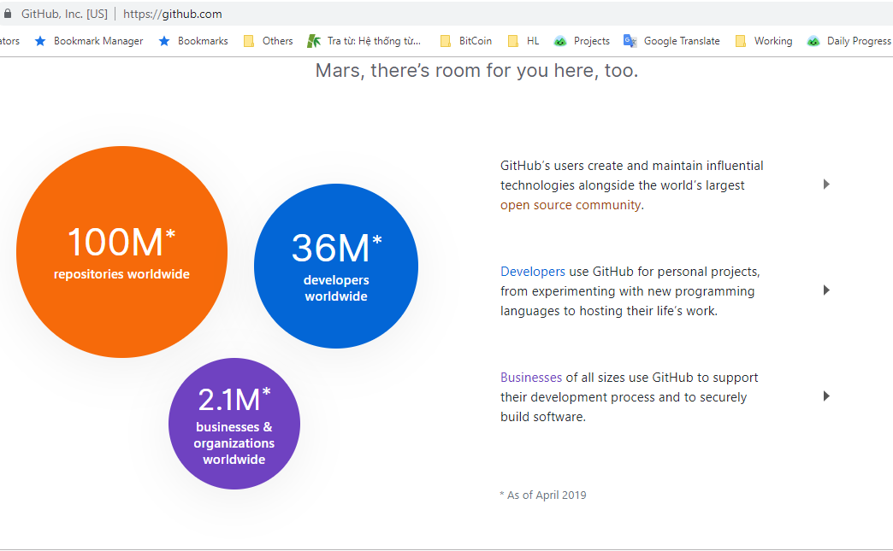


Slide 15
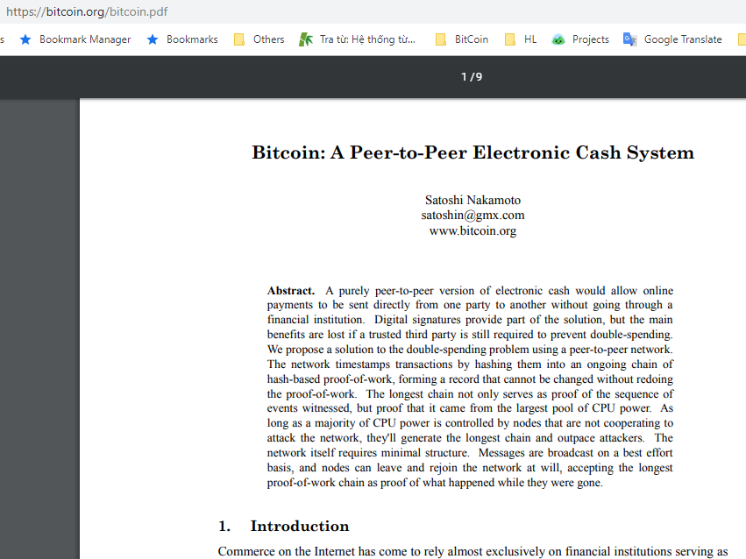
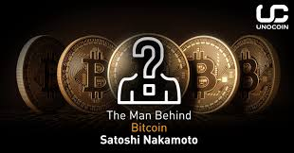

Slide 16
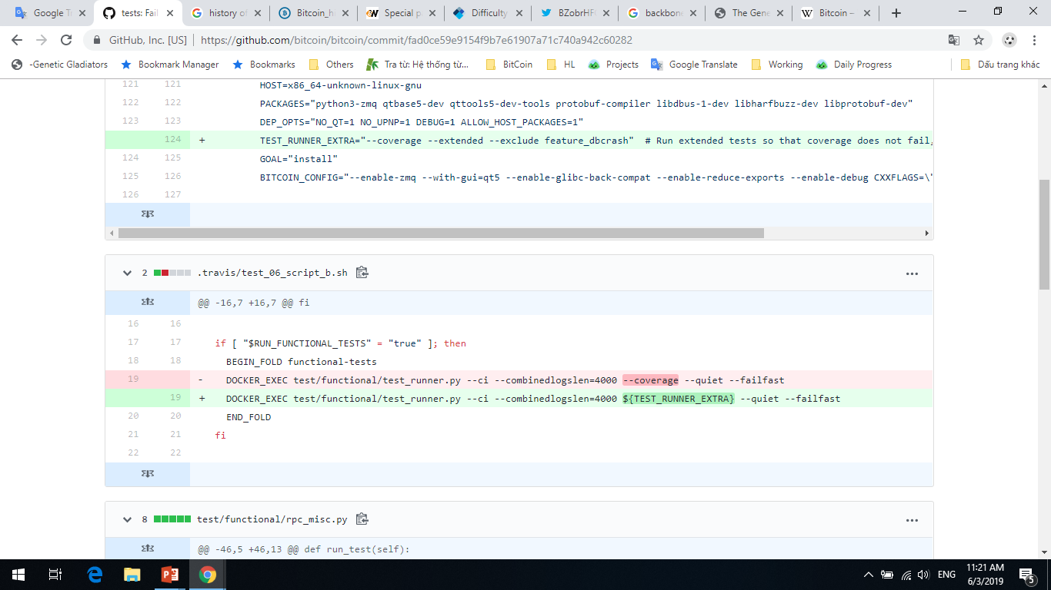

Slide 17


Bitcoin is an open source digital currency, a protocol, and a software that enables…
Instant peer to peer transactions
Worldwide payments
Fee by size of transaction data
And much more!
Source: http://bitcoin.org

Slide 18
Bitcoin is an open source digital currency, a protocol, and a software that enables…
Trustless
Can't be faked, but it can be mined.
Smart contract
Source: http://bitcoin.org

Slide 19
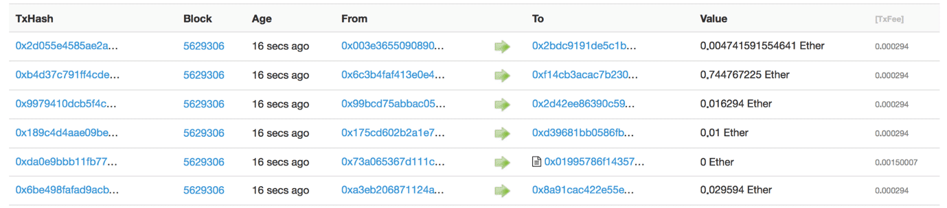
Bitcoin is an open source digital currency, a protocol, and a software that enables…
Source: http://bitcoin.org

Slide 20
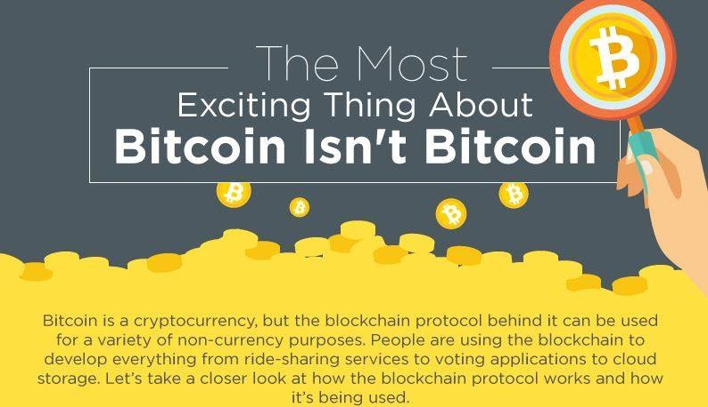

Slide 21
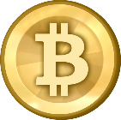
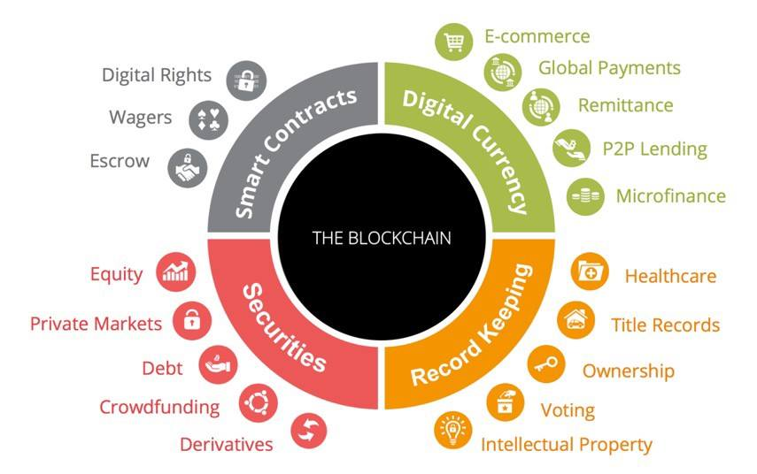
BlockChain
Open source
Distributed ledger

Slide 22
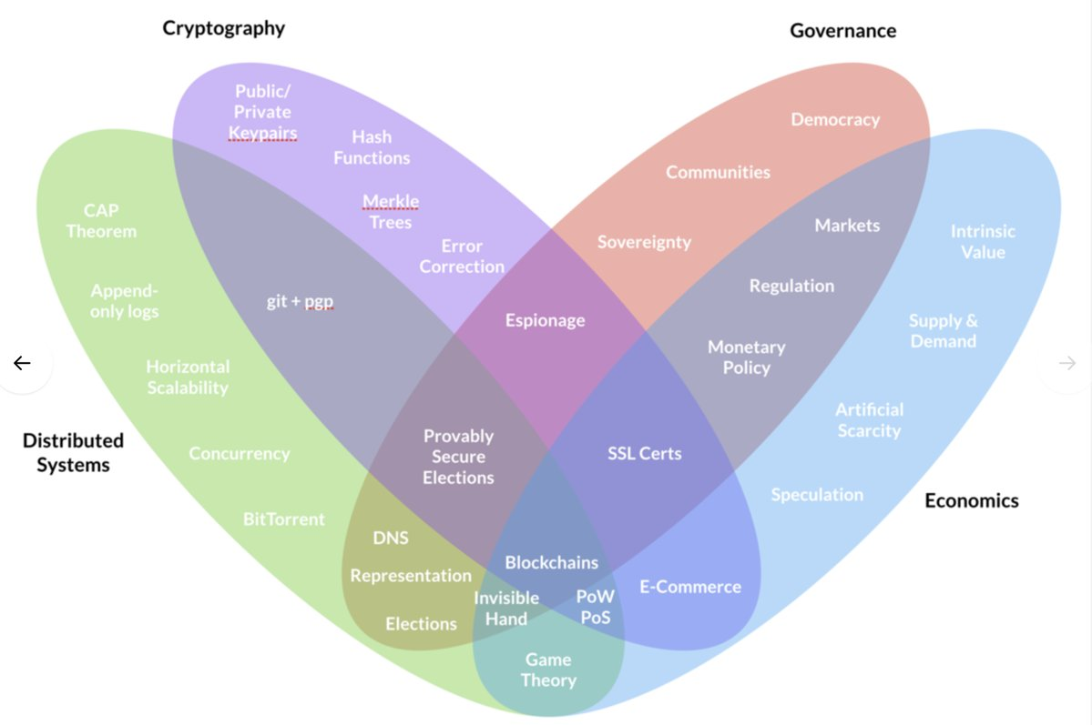
1. Concepts

Slide 23

Blockchain
According to the World Economic Forum, blockchain may become the perfect solution to corruption within government processes.
Decentralized system makes it difficult for any larger organization to mask illicit transactions or processes that take place in the government.
The chain of blocks uses encryption and codes practically impossible to fraud since one block is linked to another, and to “break” one of them it would be necessary to break them all.
Source: https://medium.com/@Weltsys.en/blockchain-can-be-used-on-the-fight-against-corruption-86af9e8c5e17

Slide 24
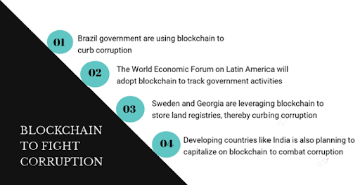
Blockchain

Slide 25
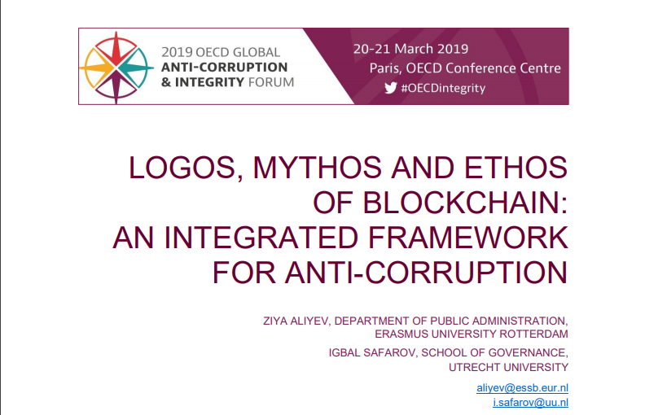

Slide 26
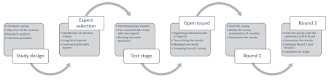
Blockchain
Framework

Slide 27
Blockchain
Thanks for watching!

