Slide 1
The role of civil society in the recovery of stolen assets and proceeds of corruption
Asset Recovery in Anti-Corruption
24-25 November 2020
Sara Brimbeuf

Slide 2
The « BIENS MAL ACQUIS » case in a nutshell
Publication of a major report by CCFD based on public sources assessing the value of accumulated assets in western countries of 23 dictators and their entourage
Paris Court of Appeal confirms Obiang’s conviction
2007
2010
2017
2019
2020
2008
Historic conviction
Paris Criminal Court convicts T. N. Obiang for money laundering
TI-F is not allowed to join the case as a civil party
French Supreme Court recognized TI-F legal standing
French Senate unanimously adopts in first reading a bill on responsible asset repatriation
IDENTIFICATION OF STOLEN ASSETS
INCLUSION IN ASSET RETURN PROCESS
LEGAL STANDING

Slide 3
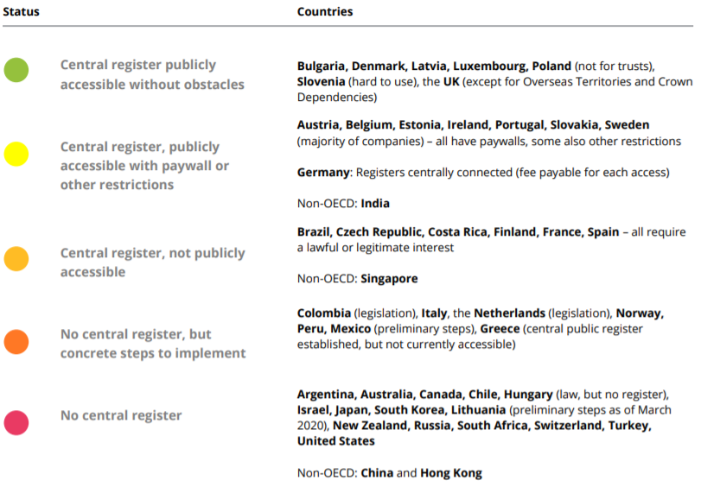
1/ Identification of stolen assets
BENEFICIAL OWNERSHIP TRANSPARENCY
Beneficial ownership refers to the natural person or persons who ultimately own or control an asset.
Public central registers of the beneficial ownership of companies and trusts would reduce bribery and money laundering opportunities and enhance detection and investigation of foreign bribery and related money laundering cases.
Source: Exporting Corruption 2020

Slide 4
2/ LEGAL STANDING
“Standing” (locus standi) refers to whether the complainants are legally entitled to bring a case to court
In France, broad standing provisions allow citizens or civil society organisations to bring claims in the public interest
Anticorruption associations’ legal standing was made possible thanks to TI-F and other CSOs’ legal battle in the « biens mal acquis » case
French law recognizes anti-corruption associations’ legal standing in corruption cases
TI-F is not allowed to join the case as a civil party
2007
2008
2010
2013
French Supreme Court recognized TI-F legal standing
Public prosecutor rejects NGOs criminal complaint

Slide 5
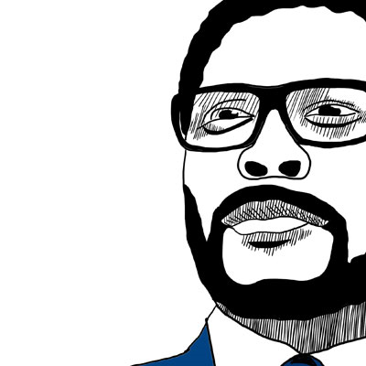
3/ asset restitution process
T. N. Obiang, Vice-president of Equatorial Guinea, convicted in 2017 of money laundering in connection with embezzlement of public funds
Conviction confirmed in 2020 by Paris Court of Appeal
3-years suspended jail sentence
Fine of €30 millions
Confiscation of all his seized assets amounted approx. to € 150 million (US$ 174 million)
French law does not allow the repatriation of autonomously confiscated assets to the countries of origin. Such confiscated assets go instead to the French Public Treasury
TI-F therefore advocates for the creation of a transparent asset restitution process building on 5 key principles

Slide 6
5 key principles
Funds derived from grand corruption should be separated from France’s general state budget and placed in a special account pending their allocation
Transparency
Accountability
Effectiveness
Integrity
Solidarity
The consultation process which seeks to determine the specific ways of allocating the funds should be conducted in an inclusive manner
Moral and financial reports must be prepared each year by the beneficiaries of the funds and published in full so as to record the rigorous management of the funds and the use made of them
Funds must be administered rigorously to prevent them being channelled back into corrupt circles. Any suspicion of irregularities must lead to the opening of an investigation and suspension of the transfer.
Allocation the funds must be decided on a case by case basis depending on particular circumstances to ensure the optimal utilisation of the funds

Slide 7
© 2020 Transparency International France. All rights reserved.

