Slide 1
RECENT DEVELOPMENTS IN EU NATURE LAW Suzanne Kingston UCC, 18 October 2019

Slide 2
Structure
Context
Focus on 3 selected judicial developments
Injunctions
Agriculture/Nitrates
Species protection / Hunting

Slide 3
The global context
Proceedings of the National Academy of Science, 2017
1,000,000 species currently threatened with extinction
UN Intergovernmental Science-Policy Platform on Biodiversity and Ecosystem Services (IPBES) Report, May 2019
The average abundance of native species in most major land-based habitats has fallen by at least 20%, mostly since 1900. More than 40% of amphibian species, almost 33% of reef-forming corals and more than a third of all marine mammals are threatened

Slide 4
The state of EU nature
+80% protected habitats; +60% protected species = unfavourable conservation status
EU State of Nature Report, 2013
Only 50% of Natura 2000 sites have management plans with conservation objectives and measures
2017 Commission Action Plan for Nature, People and the Economy

Slide 5
The state of Irish nature
April 2019 - 3rd assessment report to Commission:
Habitats
85% Unfavourable Status
46% ongoing declines
Species
57% Favourable
30% Unfavourable
72% Stable or improving trends

Slide 6
The state of EU nature law?
Vogel’s vision (2003): Policy gridlock and limited dismantling?
Fitness Check (REFIT) Birds/Habitats Directives 2014
Largest ever response to a Commission consultation (500,000)
“Fit for purpose”: December 2016

Slide 7
Reactions (I): Focus on compliance and management
Focus shifts to compliance:
EU Action Plan for Nature, People and the Economy (2017 – 2019) – 4 Priority Areas
Improving guidance + ensuring “better coherence with broader socio economic objectives”
Building “political ownership” and strengthening compliance
Investment and synergies with EU funding instruments
Better communication and outreach
Environmental Implementation Review (Biannual)
2018 Communication “EU actions to improve environmental compliance” (Rural areas, IMPEL peer review)

Slide 8
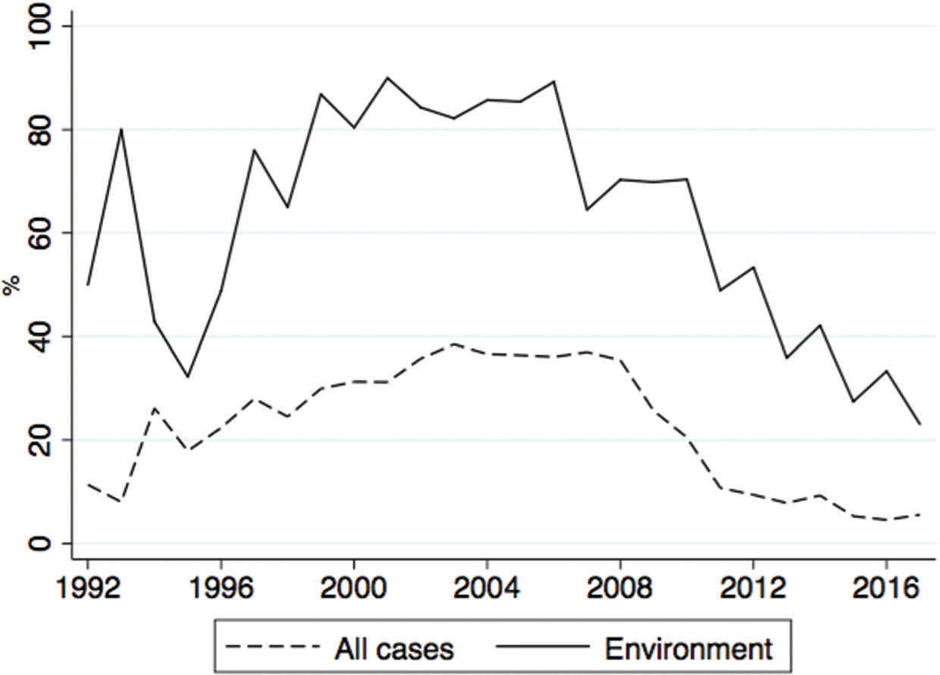
Reactions (II): Focus on decentralised enforcement
Share of Commission-initiated cases before the CJEU (Hofmann, 2019)
Bottom line denotes environmental cases

Slide 9
Reactions (III): Changing COM governance
Timmermans – VP for Green New Deal
An upgrading of environmental issues?

Slide 10
Judicial Developments (I): Injunctive relief
Case C-441/17 R Commission v Poland (Bialowieska Forest)
Grand Chamber, November 2017
COM succeeds in request for interim measures
Major active forest management operations allegedly in response to spread of spruce bark beetle – no AA
Genuineness of justification queried by CJEU in main judgment

Slide 11
Judicial Developments (I): Injunctive relief
1. Prima facie case: Action not prima facie without reasonable substance (POL accepted that did not check if adverse effect on integrity of the site)
Differing scientific opinions
Precautionary principle
2. Urgency: Operations are likely to cause irreparable and serious damage to the environment
Transformation would be “irreversible” – prima facie lack of scientific information excluding beyond all reasonable doubt that damaging and irreversible effects

Slide 12
Judicial Developments (I): Injunctive relief
3. Weighing up of interests
POL had not explained why a temporary cessation of works would cause serious damage via spruce beetle
Socio-economic interests “do not appear to be of greater value than the interest of preserving the habitats and species at issue”

Slide 13
Judicial Developments (I): Injunctive relief
Exclusion from the order:
Where active management is strictly necessary and proportionate to ensure public safety of persons, where less damaging measures are “impossible” (signposting, etc)
POL must “take photographs” before and after to discharge its burden

Slide 14
Judicial Developments (I): Injunctive relief
“Unless” order: POL to send COM details of all measures adopted to comply – or COM can apply to reopen matter (at least 100K per day if proven)
POL hadn’t stopped works following VP provisional order July 2017
“Sufficient material” on file to prove ongoing works (Satellite images)
Rejects claim that only Art 260 TFEU permits this – Object and effectiveness of Art 279 TFEU

Slide 15
Judicial Developments (I): Injunctive relief
COM did not re-apply to the Court
April 2018: Substantive judgment against POL
Important Rule of Law implications
Viz Portuguese, Polish judges cases

Slide 16
Judicial Developments (I): Injunctive relief
FIE v MCCAE (Simons J, 23 July 2019)
Interim injunction granted suspending the entirety of an S.I. pending the outcome of the main proceedings
Applying Okunade in EU law context
Transfer of exclusive enforcement competence for industrial peat extraction to EPA, away from planning authorities; “Enforcement holiday” of transitional provisions

Slide 17
Judicial Developments (I): Injunctive relief
Simons J stayed 1 of 2 S.I.s comprising the new regulatory framework
Temporary suspension of exemption from planning
Acknowledges jurisdiction to suspend legislation should be “most sparingly exercised”
“Highly unusual” facts of the case
“Very strong” case of breach of EU law
“Especially serious breach in retrograde step
“At least in some instances” a risk of harm to the environment would be created in interim period

Slide 18
Judicial Developments (I): Injunctive relief
Status quo ante
Dual enforcement regime (EPA and planning)
Bulrush v ABP (2018): confirms peat extraction is not exempted development
Applies Okunade (2012)
Has applicant established an arguable case?
Where does the greatest risk of injustice lie?
Would damages be an adequate remedy?
Due weight to be given to the strength/weakness of the applicant’s case

Slide 19
Judicial Developments (I): Injunctive relief
Simons J: Dowling v Minister for Finance (2013) adds a “gloss” to Okunade in challenges based on EU law
Question is whether respondent has shown an arguable defence

Slide 20
Judicial Developments (I): Injunctive relief
Main judgment (Sept 2019)
Regulations cannot temporarily remove the possibility of enforcement, even if the aim is ultimately to move to a more effective regime
Must ensure that the requirements of the EIA and Habitats Directive are not circumvented
Applying C-411/17 Inter Environnement Wallonie

Slide 21
Judicial Developments (II): Agriculture/Nitrates
C-293/17 etc Coöperatie Mobilisation for the Environment
NL authorisation schemes for agricultural activities causing nitrogen deposition on Natura 2000 sites
Referring court: 118/162 NL Natura 2000 sites = excessive nitrogen deposition – “Nitrogen cover” means risk to site
“Programmatic” Nitrates Action plan in NL 2015 – 2021
Decide in advance what the critical overall deposition levels are per area
Authorisation granted per project by NL provinces on the basis of that programme

Slide 22
Judicial Developments (II): Agriculture/Nitrates
CJEU 2018:
Cattle grazing and application of fertilizers in vicinity of Natura 2000 sites = a “project” under Habitats Directive even if they are not a project under the EIA Directive (as not a physical intervention)

Slide 23
Judicial Developments (II): Agriculture/Nitrates
NL approach may be contrary to Art 6(3):
Must be individual assessment of plans and projects
Advance programmatic approach enables cumulative effects to be considered
For national court to decide whether the scientific software used for the authorisation process here ensures that for each individual project Art 6(3) is complied with (no reasonable scientific doubt as to lack of adverse effect on integrity of the site)
Can’t take account of possible future intended nitrogen emissions unless these are certain

Slide 24
Judicial Developments (II): Agriculture/Nitrates
May 2019: NL Council of State rules that Provinces cannot grant authorisations on the basis of the Programme

Slide 25
Judicial Developments (II): Agriculture/Nitrates

Slide 26
Judicial Developments (III): Species protection
Case C-647/17 Finnish Wolf Hunting
Art 16 derogation to control population derogating from Art 12 ban on hunting only permitted if
Based on rigorous scientific evidence
No other means of achieving the aim
Favourable conservation status must be ensured
Must be an evaluation of the state of the populations and the impact thereon
The Waddenzee of species protection?

Slide 27
Conclusion
Tenor of CJEU’s Habitats judgments clear, consistent, and very demanding
Facts are stark
Means by which the issues are reaching the CJEU now largely preliminary reference, not infringement
➔ Fundamental rule of law challenges
Almost 20% EU land area
Vital challenge for MS (and society) to win “hearts and minds” of all stakeholders

