Slide 1
Enforcing our right to clean air
Katie Nield
Clean air lawyer
18 October 2019

Slide 2
“Air pollution is the world’s largest single environmental health risk”
(World Health Organization, 2014)

Slide 3
“Air pollution is the new tobacco”
Dr Tedros Adhanom, (Head of WHO, 2018)

Slide 4
The battle for clean air in the UK

Slide 5
The legal tools
Directive 2008/50/EC
Article 13 – sets limit values
Article 23 – requires air quality plans to keep the period of exceedance “as short as possible”
Air Quality Standards Regulations 2010
…establish the Secretary of State as the responsible authority
Pollutant | Period | Limit values (μg/m³)
NO₂ | 1 year | 40
 | 1 hour | 200 (18x/year)
PM₁₀ | 1 year | 40
 | 24 hours | 50 (35x/year)
PM_{2.5} | 1 year | 25

Slide 6
2010 | NO₂ limit value in force: 40 out of 43 zones in breach
2011 | ClientEarth launch first legal challenge
May 2013 | Supreme Court refers questions to the CJEU
Nov 2014 | CJEU judgment – establishes the right to clean air
Apr 2015 | First win: Supreme Court orders new Air Quality Plan
Dec 2015 | New Air Quality Plan published – commits 5 cities and London to introduce clean air zones
Nov 2016 | Second win: High Court orders publication of new Air Quality Plan
Apr 2017 | Third win: High Court dismisses application for time extension
Jul 2017 | New Air Quality Plan published – requires individual plans from 23 local authorities
Feb 2018 | Fourth win: High court orders publication of supplemental Air Quality Plan

Slide 7
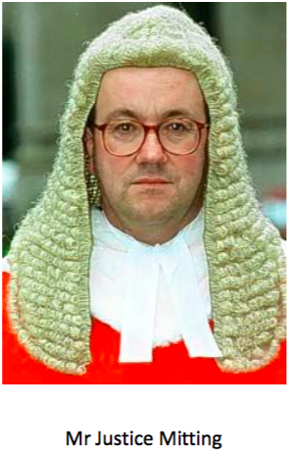
The High Court, 2011
“…[t]he means of enforcing...lie elsewhere”, and a mandatory order would “raise serious political and economic questions which are not for this court”
ClientEarth (No.1) [2011] EWHC 3623 (Admin)

Slide 8
The CJEU, 2014
“…it is for the national court…should a case be brought before it, to take…any necessary measure, such as an order in the appropriate terms, so that the authority establishes the plan required by the directive in accordance with the conditions laid down by the latter”
CJEU (2014) C-404/13

Slide 9
2010 | NO₂ limit value in force: 40 out of 43 zones in breach
2011 | ClientEarth launch first legal challenge
May 2013 | Supreme Court refers questions to the CJEU
Nov 2014 | CJEU judgment – establishes the right to clean air
Apr 2015 | Supreme Court orders new Air Quality Plan
Dec 2015 | New Air Quality Plan published – commits 5 cities and London to introduce clean air zones
Nov 2016 | High Court orders publication of new Air Quality Plan
Apr 2017 | High Court dismisses application for time extension
Jul 2017 | New Air Quality Plan published – requires individual plans from 23 local authorities
Feb 2018 | High court orders publication of supplemental Air Quality Plan

Slide 10
The High Court, 2016
“the Secretary of State fell into error … in fixing on a projected compliance date of 2020 (and 2025 for London); and by adopting too optimistic a model for future emissions”
ClientEarth (No.2) [2016] EWHC 2740 (Admin)

Slide 11
Air quality plans must…
aim to achieve compliance as soon as possible;
choose a route to compliance which reduces human exposure as quickly as possible;
ensure that compliance with the limit values is not just possible but likely.

Slide 12
Cost can only be secondary to efficiency…
X
“…I reject any suggestion that the state can have any regard to cost in fixing the target date for compliance or in determining the route by which the compliance can be achieved where one route produces results quicker than another. In those respects the determining consideration has to be the efficacy of the measure in question and not their cost”
(per Garnham J, ClientEarth (No.2))

Slide 13
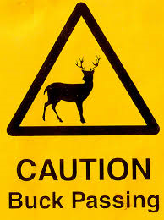
Local authorities pushed centre stage…
Directions have been issued under s85 of the Environment Act 1995 to:
61 English LAs
2 Welsh LAs
…requiring each to come up with its own proposals for local measures to reduce NO₂

Slide 14
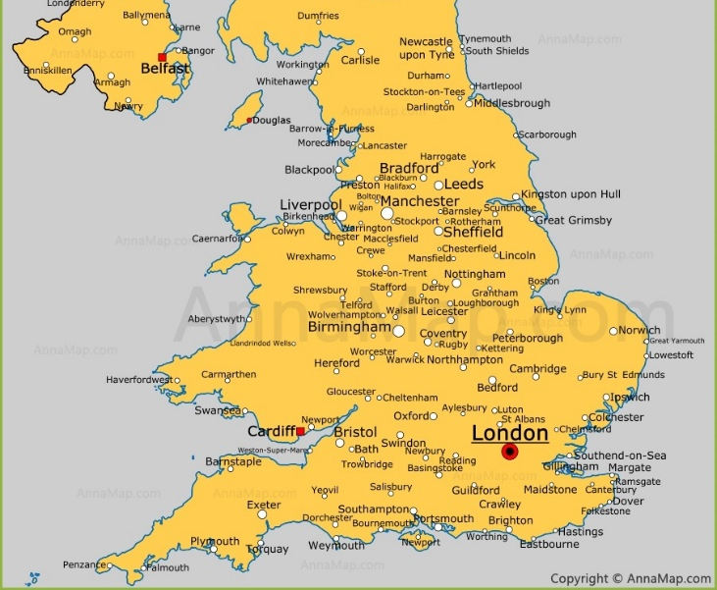
Where has this got us to…
Newcastle: ?Class C CAZ?
Leeds: Class B CAZ
Manchester: ?Class B/C CAZ?
Sheffield: ?Class C CAZ?
Coventry: ?Class D CAZ?
Birmingham: Class D CAZ
Bristol: ?Class C CAZ?
Bath: ?Class C CAZ?
London: Ultra Low Emission Zone

Slide 15
The battle isn’t over yet
Many local authorities are yet to commit to action
Reticence to tackle the most significant pollution source: private cars
Central government meanwhile remains relatively inactive
In 2018 illegal levels of NO₂ reported in 36 of 43 zones

Slide 16
Monitoring failures in Brussels
Image: Emmanuel Raza (flickr)

Slide 17
Location of monitoring stations (Article 7 and Annex III)
Macroscale siting criteria
“areas … where the highest concentrations occur”
Microscale siting criteria
As far as practicable:
Flow around inlet
Between 1.5 and 4 m above ground
At least 25 m from junctions and no more than 10 m from kerbside

Slide 18
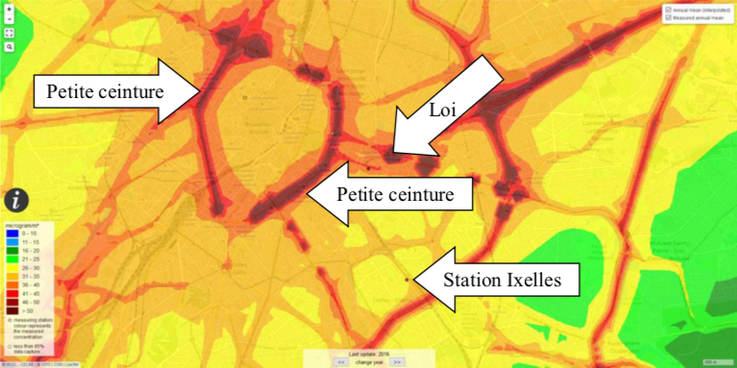
NO₂ concentrations in Brussels

Slide 19
Case C-723/17 Craeynest and Others v Brussels
“…it is the responsibility of the competent national authorities to choose, within the limits of their discretionary powers, the actual location of the sampling points…However, the existence of such discretionary powers does not in any way mean that the decisions taken by those authorities in that connection are exempt from judicial review…”
“it is for a national court […] to verify whether the sampling points […] have been established in accordance with the criteria…”
“…and, if they were not, to take all necessary measures in respect of the competent national authority, such as […] an order, with a view to ensuring that those sampling points are sited in accordance with those criteria”

Slide 20
AG Kokott’s Opinion – 21 February 2019
“…Directive 2008/50 is based on the assumption that exceedance of the limit values leads to a large number of premature deaths. The rules on ambient air quality therefore put in concrete terms the Union’s obligations to provide protection following from the fundamental right to life under Article 2(1)...
If the sampling points were not sited in the areas where the highest concentrations actually occur, the effectiveness of Directive 2008/50 could be seriously impaired.
…doubts calling into question the achievement of the protective aims of the directive must be reviewed more intensively”

Slide 21
Implications of Craeynest
Strengthening the right to clean air
Limiting authorities’ margin of discretion
A new role for citizen science?
Expanding the scope of judicial review for other environmental matters affecting fundamental rights?

Slide 22
Thank you
Katie Nield
Clean Air lawyer
KNield@clientearth.org

