Slide 1
Asset Recovery in the EU
24 November 2019 Matilde Manzi Transparency International EU

Slide 2
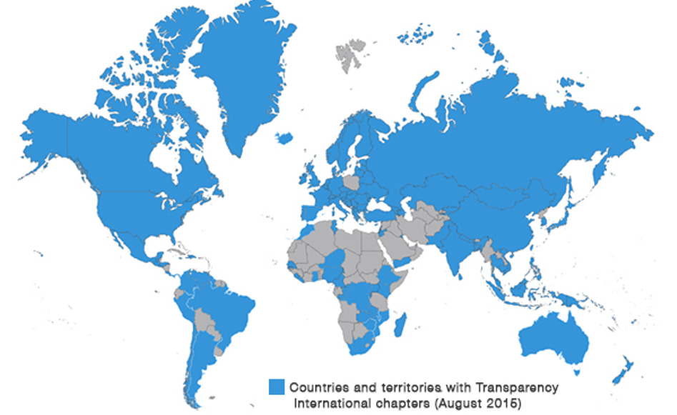
Transparency International
A global NGO coalition fighting corruption:
100+ National Chapters worldwide
24 Chapters in 28 EU Member States
International Secretariat in Berlin
EU Office in Brussels

Slide 3
Asset Recovery in the EU
I
Crime still pays in Europe
II
Europe’s attractiveness for kleptocrats
What is the EU problem?
III
IV
What the EU should do?

Slide 4
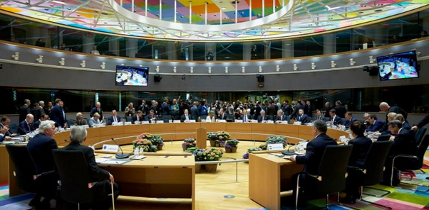
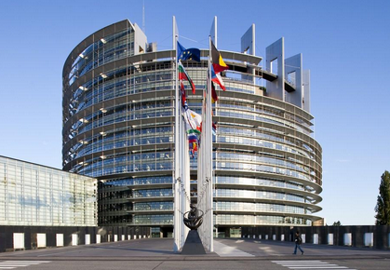
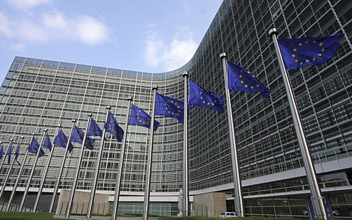
The European Union

Slide 5
Crime still pays in Europe
€110 billion per year generated by criminal activities in the EU
0.7 – 1.28% of annual EU GDP involved in suspect financial activity
Only about 2% of criminal proceeds are frozen and 1% confiscated in the EU

Slide 6
Europe’s attractiveness for kleptocrats
Estimates of assets stolen by former country leaders and/or family members
Ben Ali, former President of Tunisia | EUR 15 billion
Gulnara Karimova, daughter of former President of Uzbekistan | More than EUR 1 billion
Hosni Mubarak, former President of Egypt | EUR 64 billion
Isabel dos Santos, daughter of former President of Angola | EUR 1.8 billion
Viktor Yanukovych, former President of Ukraine | EUR 33 billion

Slide 7
What’s the problem?
Freezing
Confiscation
Restitution
Process stuck when securing a conviction in the country where the offence was committed is not possible
Not addressed in EU legislation for international asset recovery cases

Slide 8
What should the EU do?
Freezing
Confiscation
Restitution
Extend the use of non-conviction based confiscation to cases where securing conviction of the individual in a third country not possible
Enshrine principles for responsible asset recovery in EU law

Slide 9
10 principles for responsible asset recovery
1
2
3
4
5
The freezing, confiscating and returning of assets must be transparent and accountable, from beginning to end.
Confiscated assets must be traceable and kept apart from countries’ national budgets.
Independent civil society organisations must be able to participate in the asset recovery process.
Agreements on the confiscating and repatriation of assets must be made publicly, transparently accessible and with the inclusion of civil society.
When stolen assets are returned, they must never be allowed to benefit the person who stole them – either directly or indirectly.

Slide 10
10 principles for responsible asset recovery
6
7
8
9
10
There must be a process for monitoring the return of funds, with a complaints mechanism and the power to trigger an independent investigation.
Anti-corruption, rule of law and accountability mechanisms should be in place to provide oversight of recovered assets.
Victims must have access to justice in cases of illicit activities like bribery and money laundering, and be able to engage with these cases.
Recovered assets must be used to benefit the people of the country from which they were stolen.
A wide range of stakeholders, including civil society and victims’ organisations, should determine how best to use recovered assets to repair the harm done and to benefit the people they were stolen from.

Slide 11
THANK YOU FOR YOUR TIME

