Slide 1
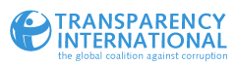
Asset Recovery – What Civil Society can do
David Ondráčka
Director, TI-Czech Republic
Member of Transparency International
Global Board of Directors

Slide 2
Asset recovery – civil society
The ultimate aim is to trace, freeze, seize and return stolen public funds to the country of origin. Compensate victims of corruption
Concept of asset recovery, to strengthen and support capacities of transition countries to recover stolen public assets, confiscate illicit funds
We discuss particular focus on civil society involvement, transparency of information, rapid assistance from another country and collaboration between anti-corruption and asset recovery agencies.

Slide 3
Asset recovery – civil society
Collaboration
Exchange of information
Awarenes Raising – Name and Shame
Communication
Demand Government Action
Investigation
Most countries: sporadic and lax prosecution and punishment of officials responsible for grand corruption (did launder illegal money, what crime?)
judges, prosecutors, lawyers and activists doing their part of work: seeking channels, ways and options to repair the damage caused by corruption and ensure compensation and redress for the public (corruption’s real victim).

Slide 4
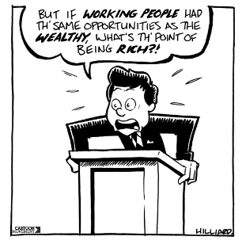
Rich, Enablers, Banks, Regulators

Slide 5
Azerbaijani laundromat
a complex money-laundering scheme revealed by the OCCRP) in September, 2017. The investigations exposed that during two years between 2012 and 2014 about USD 2.9 billion was siphoned through European companies and banks. The money was used to pay off European politicians in an attempt to whitewash Azerbaijan’s reputation abroad.
Source of money isn’t always clear, but it comes from companies linked to Azerbaijan’s president, Ilham Aliyev, state ministries and the International Bank of Azerbaijan, the country’s largest bank, which recently filed for bankruptcy protection. The cash was transferred into four offshore-managed UK companies. From there, it was spent in various countries, including Germany, the UK, France, Turkey, Iran and Kazakhstan.

Slide 6
Azerbaijani laundromat
Where does the data come from?
An anonymous source leaked the data to the Danish newspaper Berlingske in Copenhagen. The paper shared it with the Organized Crime and Corruption Reporting Project (OCCRP), the Guardian, and other media partners. There are details of more than 16,000 transactions, including names of beneficiaries, bank payment details, and amounts in various currencies.
Who benefited?
Several prominent European politicians.

Slide 7
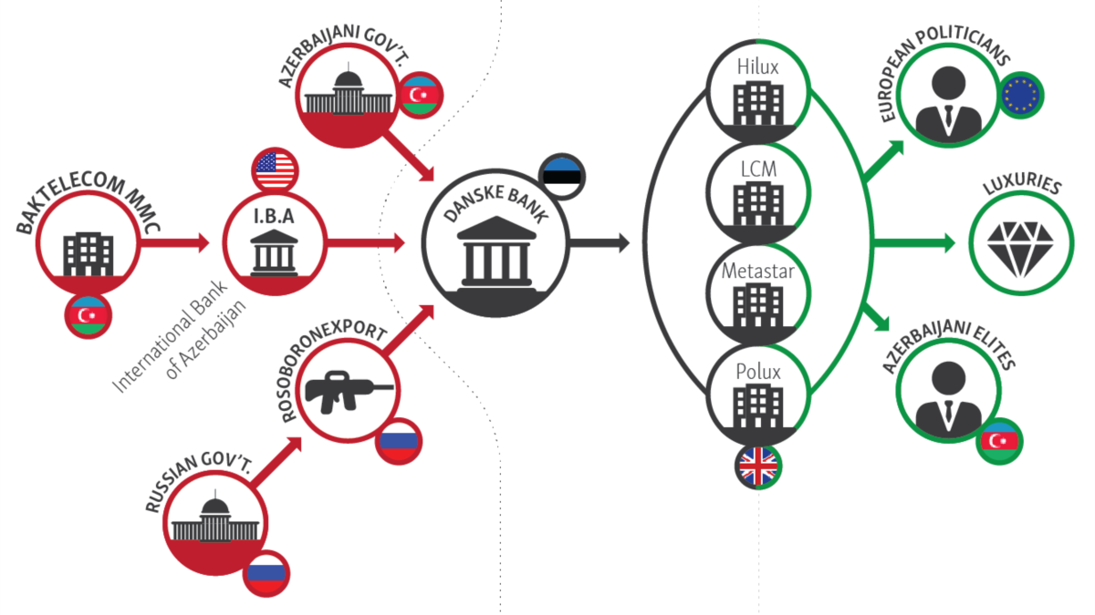
Azerbaijani laundromat

Slide 8
Troika Laundromat
purpose of the system we’ve named the Troika Laundromat was to channel billions of dollars out of Russia. But it was much more than a money laundering system: The Laundromat allowed Russian oligarchs and politicians to secretly acquire shares in state-owned companies, to buy real estate both in Russia and abroad, to purchase luxury yachts, to hire music superstars for private parties, to pay medical bills, and much more.

Slide 9
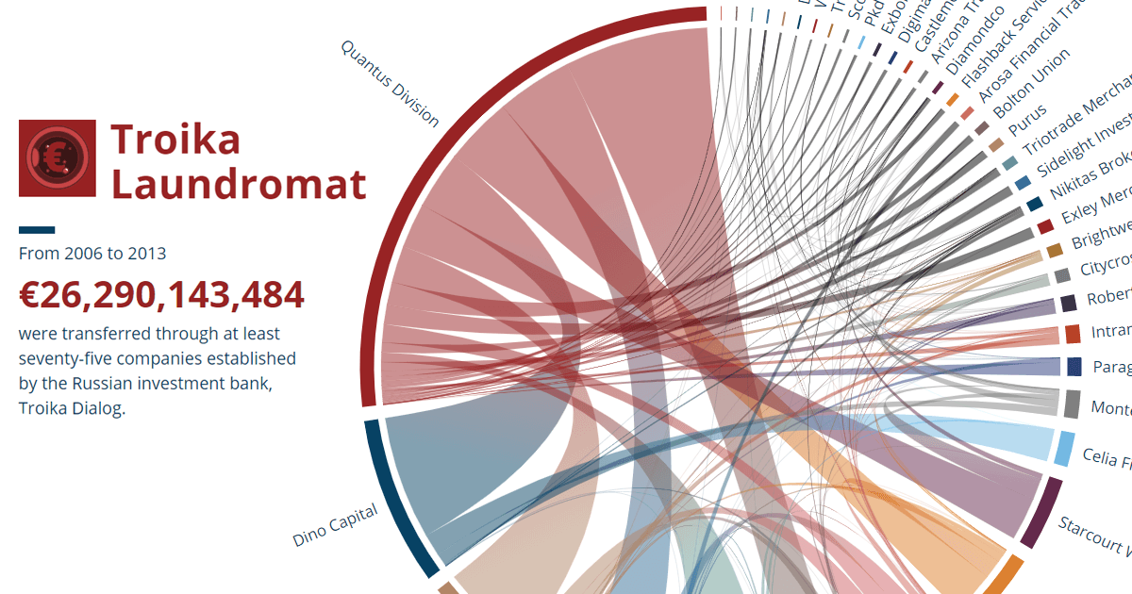
Troika Laundromat (OCCRP)

Slide 10
Thank you
David Ondráčka
david.ondracka@transparency.cz

