Slide 1

Unacknowledged legislators:
Irish Poets and the Law
Dr Adam Hanna, lecturer in Irish literature, English Department, UCC
Adam.hanna@ucc.ie

Slide 2
into the our Bastille.
— from Seamus Heaney, “The Unacknowledged Legislator”, draft poem, c.1972-74,
held at the National Library of Ireland.

Slide 3
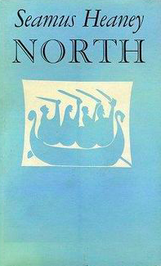
THEMES of tHIS lecture
1- What is an ‘unacknowledged legislator’?
2 - The links between law and poetry in Ireland
3- Theories of law and literature
4 - A detailed look at Heaney’s poem ‘The Unacknowledged Legislator’s Dream’ (North, 1975)

Slide 4
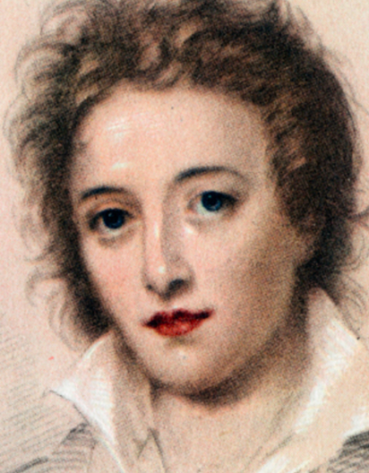
1- What is an unacknowledged legislator?
‘Poets are the hierophants of an unapprehended inspiration; the mirrors of the gigantic shadows which futurity casts upon the present; the words which express what they understand not; the trumpets which sing to battle, and feel not what they inspire; the influence which is moved not, but moves. Poets are the unacknowledged legislators of the World.’
- Percy Bysshe Shelley, A Defence of Poetry (1821)

Slide 5
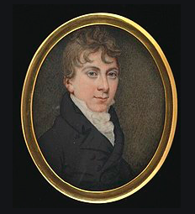
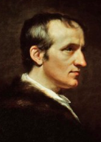
The origins of the words ‘unacknowledged legislators’
Came out of Shelley’s disagreement with his contemporary, Thomas Love Peacock
Was adapted from a phrase by William Godwin

Slide 6
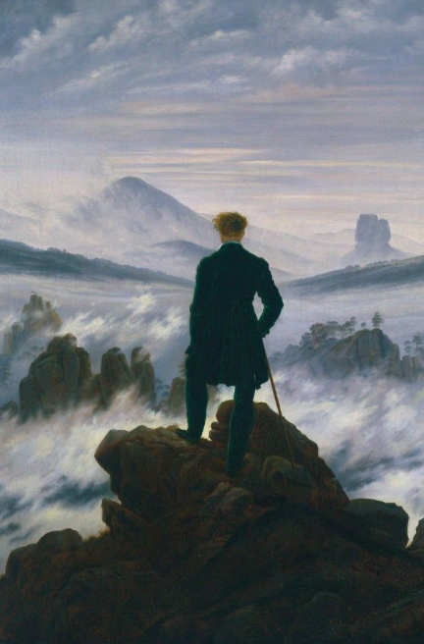

Slide 7
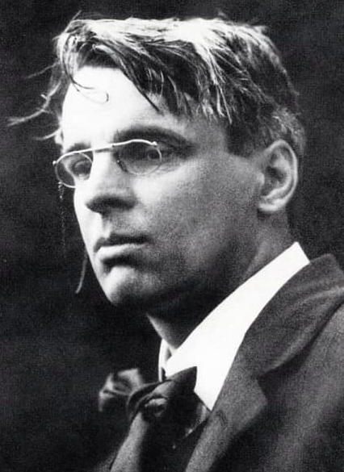
2 - The links between law and the poet in Ireland
Poets have a central status in Irish national life
This was illustrated by the appointment of W. B. Yeats to the first Senate
Michael D. Higgins and #keepthepoet

Slide 8
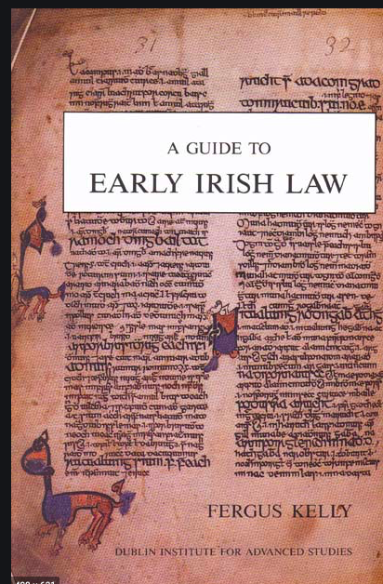
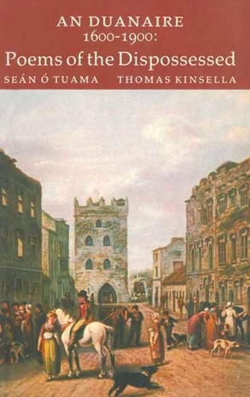
The links between law and the poet in Ireland
Evidence of links between law and poetry can be found in the earliest Irish documents
The Anglo-Norman polity on the island in the late twelfth century both reinforced and complicated these links
Protest at “lawful” but unjust authority is a consistent theme in the landmark collection of Irish-language poetry from the three centuries that followed the Elizabethan conquest of the 1590s, An Duanaire (1981)

Slide 9
“Society makes statements and sends forth instructions, edicts, laws, definitions of reality. Literature makes counterstatements, Greek when the official designations are Roman”.
Denis Donoghue (quoted in Richard Rankin Russell, Poetry and Peace: Michael Longley, Seamus Heaney and Northern Ireland (Notre Dame: Notre Dame University Press, 2010), 1.)

Slide 10
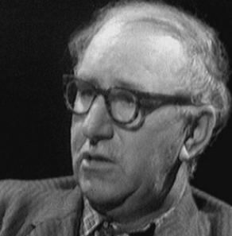
Modern complications in The Links between poetry and law
Modernist suspicion of suspicion of totalizing narratives and identifications in art have changed poetry since World War One.
Patrick Kavanagh, Derek Mahon and Paul Muldoon’s poetry all display skepticism in the face of traditional expectations on Irish poets.

Slide 11
3– THEORIES OF LAW AND LITERATURE
‘As new problems arise, equity and justice will direct the mind to solutions which will be found, when they are scrutinized, to be consistent with symmetry and order, or even to be the starting points of a symmetry and order theretofore unknown. […] We find a kindred phenomenon in literature, alike in poetry and in prose. The search is for the just word, the happy phrase, that will give expression to the thought, but somehow the thought itself is transfigured by the phrase when found. There is emancipation in our very bonds. The restraints of period or balance, liberate at times the thought which they confine, and in imprisoning release.’
Benjamin N. Cardozo, The Growth of the Law (Westport, CT: Greenwood Press, 1924, repr. 1966).

Slide 12
THEORIES OF LAW AND LITERATURE
If the law were to be completely absorbed into the internal discipline of honest men, there would be no more law, and we should all be living in the Garden of Eden. We are not there, but in the meantime law still depends upon the imagination, and the fostering and cherishing of the imagination by the arts is mainly what makes your profession honourable, perhaps even what makes it possible.’
- Northrop Frye, “Literature and the Law (1970),” quoted by C. R. B. Dunlop in “Literature Studies in Law Schools,” Cardozo Studies in Law and Literature 3, no. 1 (spring – summer 1991): 77-78.

Slide 13
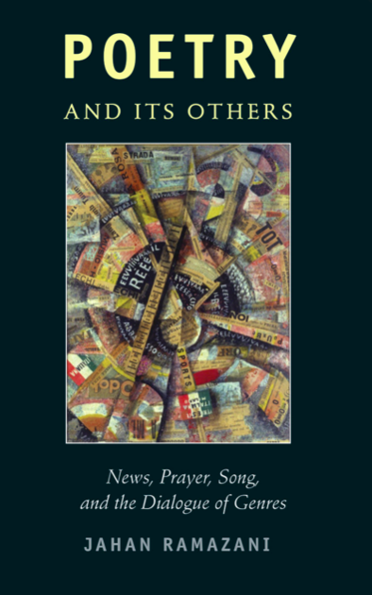
THEORIES OF LAW AND LITERATURE
Jahan Ramazani, in a recent essay in which he considers the links between law and poetry suggests, as Benjamin Cardozo did before him, that poems and laws have significant parallels.
Jahan Ramazani, Poetry and Its Others: News, Prayer, Song and the Dialogue of Genres (Chicago: University of Chicago Press, 2013), 59.

Slide 14
4 - Heaney’s poem ‘The Unacknowledged Legislator’s Dream’ (North, 1975)
Archimedes thought he could move the world if he could find
the right place to position his lever. Billy Hunter
said Tarzan shook the world when he jumped down out of a tree.
I sink my crowbar in a chink I know under the masonry
of state and statute, I swing on a creeper of secrets
into the Bastille.
My wronged people cheer from their cages. The guard-
dogs are unmuzzled, a soldier pivots a muzzle at
the butt of my ear, I am stood blindfolded with my hands
above my head until I seem to be swinging from a strappado.

Slide 15
4 - Heaney’s poem ‘The Unacknowledged Legislator’s Dream’ (North, 1975)
The commandant motions me to be seated.
‘I am honoured to add a poet to our list.’ He is
amused and genuine. ‘You’ll be safer here, anyhow.’
In the cell, I wedge myself with outstretched arms
in the corner and heave, I jump on the concrete flags to
test them. Were those your eyes just now at the hatch?
Seamus Heaney, North (London: Faber and Faber), 56

Slide 16
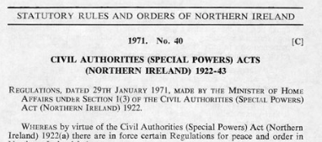
The legal context
Civil Authorities (Special Powers) Acts (Northern Ireland) 1922-43
In 1971 and 1972 the Government of the Republic of Ireland lodged applications with the European Court of Human Rights against the United Kingdom
However, the poem strives to escape both its legal context and the quasi-legislative status of the poet

Slide 17
into the our Bastille.
— from Seamus Heaney, “The Unacknowledged Legislator”, draft poem, c.1972-74,
held at the National Library of Ireland.

