Slide 1
A checklist for the stable heart failure patient
Mairead Lehane, Candidate ANP: Cardiology
Mallow General Hospital
9th February 2019

Slide 2
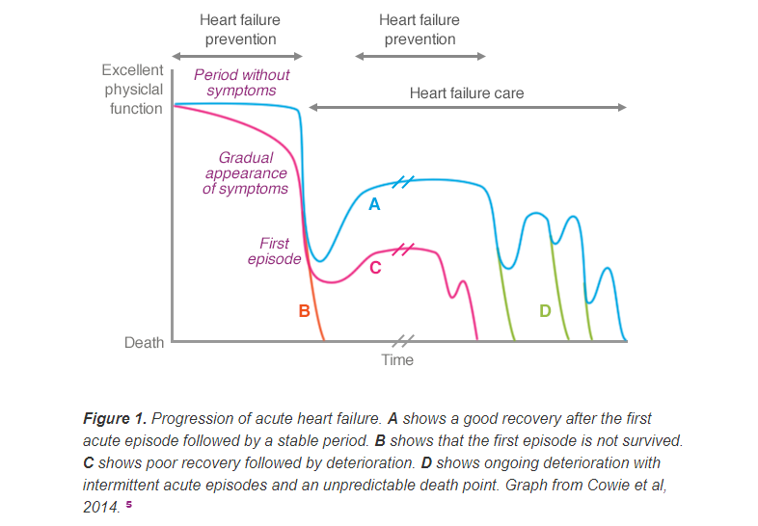

Slide 3
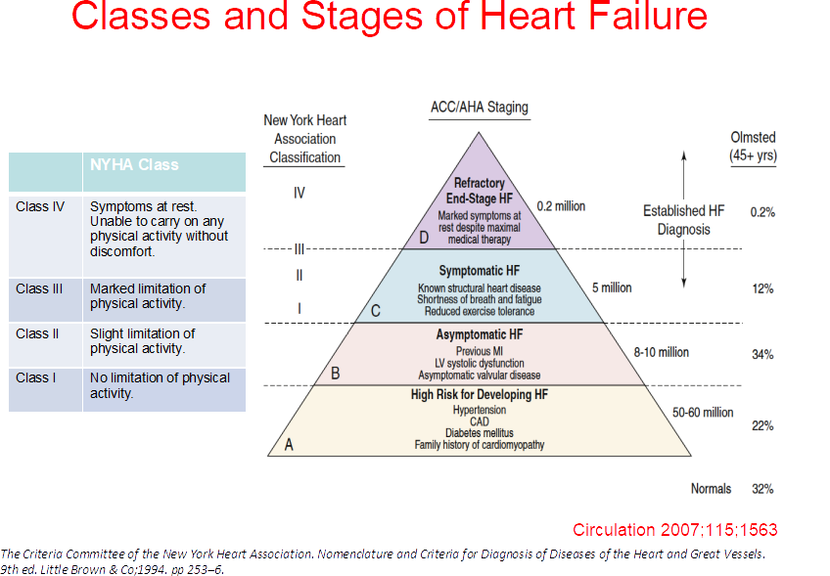

Slide 4
The stable heart failure patient
Patients with heart failure (HF) are often considered clinically stable if they are receiving treatment and show no physical signs and symptoms suggestive of worsening cardiac function (Hani et al , 2017).
Heart Failure Model of Care (2012) advocates two structured visits per year in primary care
1. Clinical assessment
2. Review of medications
3. Assessment of self care and education
However, a lack of clinically observable signs and symptoms of worsening HF may not always be indicative of a patient's long‐term prognosis
HF is a progressive disorder, and ongoing cardiac structural and functional deterioration is present in many patients who are asymptomatic or mildly symptomatic.
Sudden cardiac death is most common in patients with mild or moderate HF symptoms who could be considered ‘clinically stable’
Silent disease progression in clinically stable heart failureHani N. Sabbah Eur J Heart Fail. 2017 Apr; 19(4): 469–478.

Slide 5
PARADIGM HF Trial (2014)
Angiotensin receptor-neprilysin inhibitor V enalapril.
Double-blind trial, n=8442, EF<40%
Primary outcome composite of death CV causes or hospitalisations
A total of 711 patients (17.0%) entresto group and 835 patients (19.8%) enalapril died (hazard ratio for death from any cause, 0.84; 95% CI, 0.76 to 0.93; P<0.001);
1 in 4 HF patients will die within 3 years &
Sudden death is often the first manifestation
McMurray, J.J., Packer, M., Desai, A.S., Gong, J., Lefkowitz, M.P., Rizkala, A.R., Rouleau, J.L., Shi, V.C., Solomon, S.D., Swedberg, K. and Zile, M.R., 2014. Angiotensin–neprilysin inhibition versus enalapril in heart failure. New England Journal of Medicine, 371(11), pp.993-1004.

Slide 6
1. Clinical assessment
HEART FAILURE MODEL OF CARE (2012)
Record on a practice heart failure register, EF, last echocardiogram | Heart rate, B/P, weight | Smoking
Determine unscheduled primary care/secondary care visits | Oedema, bibasal creps, New Symptoms | Alcohol intake
Annual ECG | Dyspnoea & function | Social issues
Creatinine | Co-morbidities: diabetes, COPD, IHD, depression

Slide 7
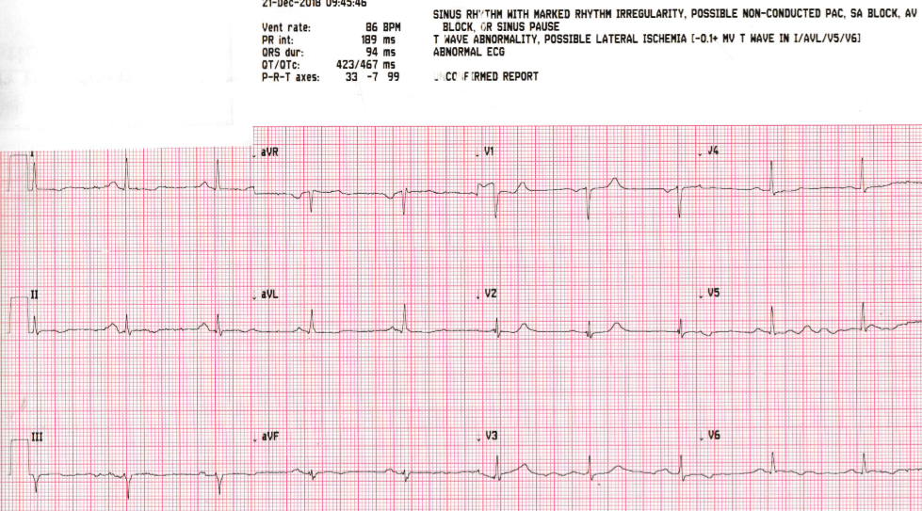
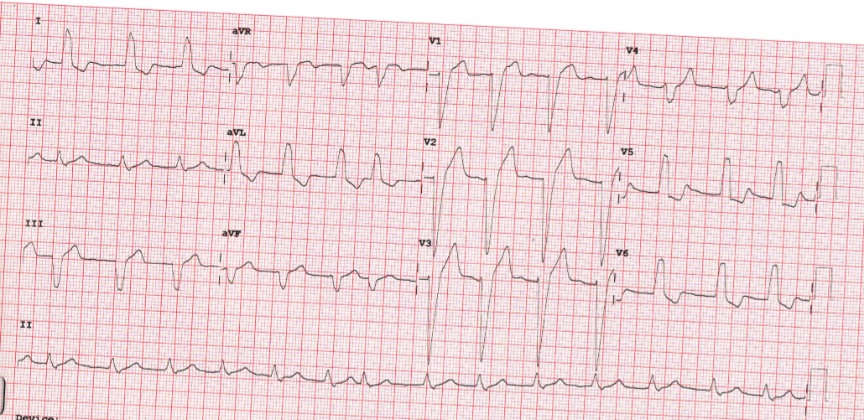
Clinical assessment
ECHO following GDMT achieved x 3-6 months
Decision regarding device therapy
Change in clinical status
Routine surveillance in the absence of change in clinical status is unwarranted

Slide 8
Heart Rate Matters
373 (67.9%) were within heart rate target guidelines of less than 70 beats per minute (bpm).
176 (32.1%) ≥ 70 bpm and 117 (21.3%) patients had resting heart rates > 75 bpm. Average HR 80
42% of the diabetic cohort not at target
56% of COPD group not at target.
Those not achieving target HR only 76% on betablockers
Persistent tachycardia may be a manifestation of severe cardiac dysfunction or noncardiovascular disease, such as thyroid dysfunction.
Higher heart rates are associated with increased risk of cardiovascular death and or hospitalisations due to heart failure.
For every 1 bpm increase in heart rate the risk increased by 3% . (SHIFT Trial, 2010)
N=549 / 12 centres

Slide 9
Competing priorities of multimorbidity
ARISE-HF Framework
A- Acknowledge multimorbidity as a clinical syndrome that is associated with poor health outcomes
R- Routinely profile all patients hospitalised with HF to determine the extent of concurrent multimorbidity
I- Identify individualised priorities and person centred goals based on the extent and nature of multimorbidity
S- Support individualised home-based multidisciplinary case management to supplement standard HF management
E- Evaluate health outcomes well beyond acute hospitalisation and encompass all-cause events

Slide 11
Anxiety & Depression
Incidence of depression in HF 2-3x that of general population.
Depression estimated as 21% (19.6-33.3%)
Anxiety disorders 19%.
NYHA I =11%
NYHA IV =42%
The relationship between depression and poorer HF outcomes is consistent and strong across multiple end points
Depression and anxiety disorders in HF patients are common, under recognised, and linked to adverse outcomes.
JACC¹ and EJHF² Meta-analysis:
Rutledge T, Reis VA, Linke SE, Greenberg BH, Mills PJ. Depression in heart failure: a meta-analytic review of prevalence, intervention effects, and associations with clinical outcomes. Journal of the American college of Cardiology. 2006 Oct 17;48(8):1527-37.
Haworth JE, Moniz‐Cook E, Clark AL, Wang M, Waddington R, Cleland JG. Prevalence and predictors of anxiety and depression in a sample of chronic heart failure patients with left ventricular systolic dysfunction. European journal of heart failure. 2005 Aug;7(5):803-8.

Slide 12
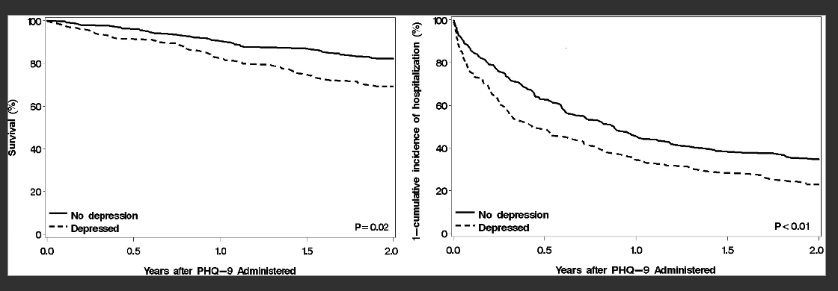
Jani BD, Mair FS, Roger VL, Weston SA, Jiang R, Chamberlain AM (2016) Comorbid Depression and Heart Failure: A Community Cohort Study. PLoS ONE 11(6): e0158570.

Slide 13
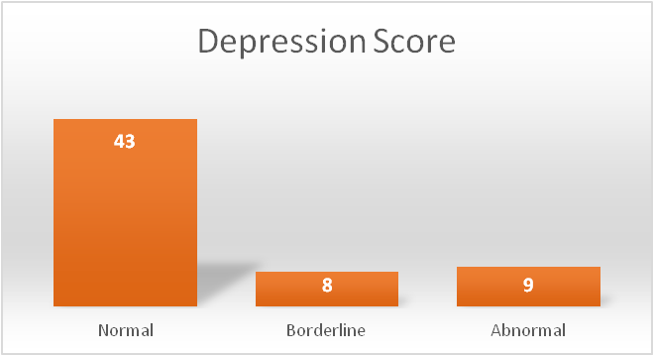
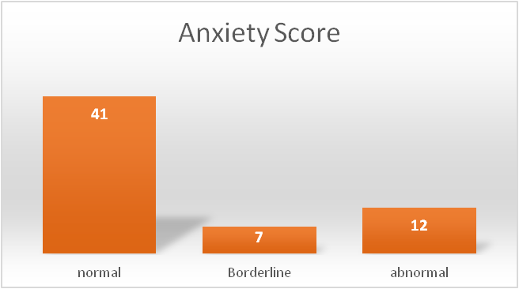
Audit of Anxiety & depression HF Clinic MGH
AIM: To assess the rates of patients who are at risk of anxiety and depression in the Nurse-led HF clinic using HAD Score Tool.
N=104 patients attending HF Clinic (Jan-June 2018),
N=86 invited to participate by postal survey
N= 60
Exclusions; cognitive impairment, co-morbid schizophrenia/bipolar, end of life/palliative care.
15% Abnormal Depression score (expected at least19-33%), or higher due to severity
20% Abnormal Anxiety score

Slide 14
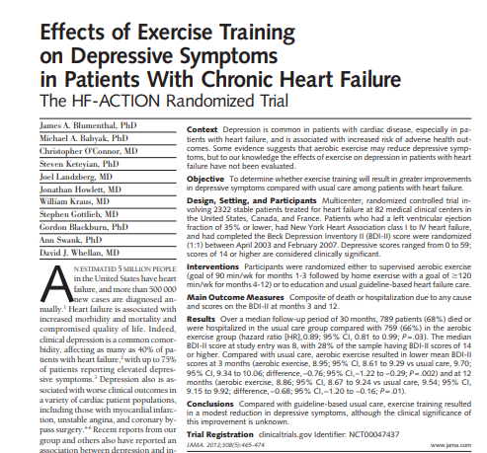

Slide 15
2. Review of medications
Heart Failure Model of Care (2012)
Determine if on appropriate medications and doses
Introduce new medications if required or liaise with heart failure nurse/unit
Determine if any contraindicated medications being used

Slide 16
TRED HF (2019) Trial Description: Patients with dilated cardiomyopathy who had recovered their LVEF were randomised 1:1 to either HF medication withdrawal or medication continuation. 6 month follow up
Primary end points
Reduction LVEF >10% and to <50%
Increase in LVEDV by >10% and to above normal range
Two fold rise in NT-pro BNP and >400ng
Clinical evidence of heart failure
Halliday et al (2019) Withdrawal of Pharmacological treatment for heart failure in patients with recovered dilated cardiomyopathy (TRED-HF); an open label, pilot, randomised trial. The Lancet, 393 (10166) 61-73.

Slide 17
Potentially harmful drugs in heart failure
Class | Examples | Reasons
NSAID’s | Diclofenac, naproxen | Fluid retention, acute renal failure, increased risk in combination with diuretics
Corticosteroids | Prednislone | Fluid retention
Calcium Channel Blockers | Verapamil, Diltiazem | Fluid retention, worsening HF, increased hospitalisations. Negative inotropic effect
Thiazolidinediones Hypoglycaemic agents | Rosiglitazone, pioglitazone metformin | Fluid retention, worsening HF Metformin linked to lactic acidosis in renal failure
Anti-arrhythmic drugs | Sotolol, flecanide Dronedarone | Reduced contractility Pro-arrhythmic Increased mortality
Cytotoxic drugs | Anthracyclines, mitoxantrone, cyclophosphamide, fluoracil, trastuzumab | Disrupt myocardial cells Free radical formation leading to cardiomyopathy
Alpha blockers |  | Neuro-humoral activation
 |  | Fluid retention, worsening HF

Slide 18
3. Assessment of self care and education
Assessment of self care and education
Determine if undertaking self-monitoring of weight
Exercise
Salt restriction
Alcohol advice
Medication adherence
Smoking Cessation
Vaccinations

Slide 19
Sexual dysfunction in heart failure patients
N=100 HF patients 52% men 38% women reported sex was important. (Schwarz et al 2005)
Prevalence 81% of cardiac patients.
52% men 40-70yrs = ED
Jaarsma et al (2014). Sexual dysfunction in Heart Failure Patients Curr Heart Fail Rep. 11(3). 330-336
Any chronic condition can affect erectile function.
Chronic disease can lead to depression which is a risk for Erectile Dysfunction
Sexual activity is not the main topic of concern for HF patients.
Legitimate Quality of Life issue/ psychological well-being
10% British marital breakdown 2014 related to sexual dysfunction
140 million men are currently affected by erectile dysfunction (Jackson et al. 2006).
84% men and 87% women with chronic heart failure suffer from sexual dysfunction. Schartz et al 2008

Slide 20
Inclusion:
- RCT or quasi-RCT. MI, PCI, CABG, heart failure, transplant, ICD, CRT.
3 RCT included (Froelicher 1994, n=258, post MI, Seattle) Klein 2007, n=92, CR Pts, Israel) (Steinke 2004, n=115, CR Pts, USA)
- High risk of bias:
Attrition 25-42%,
1 trial conducted 1977-79, 2 trials underpowered
Findings:
-Little evidence on the effectiveness of sexual counselling for improving outcomes
- No significant differences in QOL, psychological well-being, relationship satisfaction
- Limited evidence, Group-based interventions show promise

Slide 21
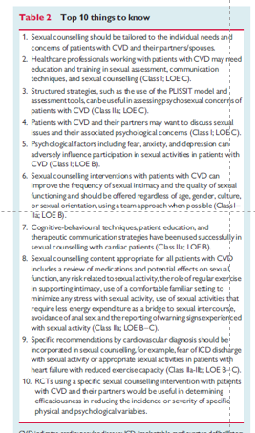
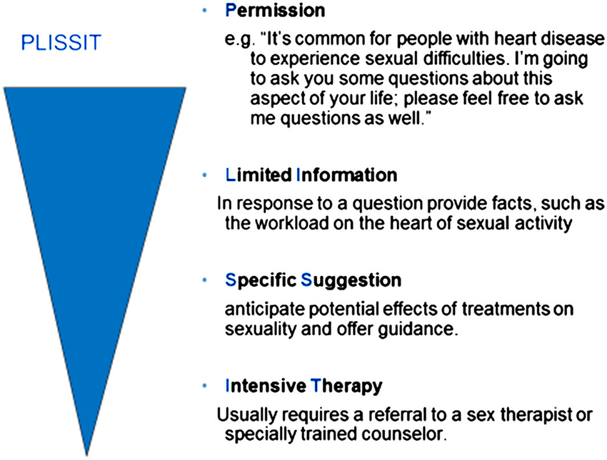
Steinke, E.E., Jaarsma, T., Barnason, S.A., Byrne, M., Doherty, S., Dougherty, C.M., Fridlund, B., Kautz, D.D., Mårtensson, J., Mosack, V. and Moser, D.K., 2013. Sexual counselling for individuals with cardiovascular disease and their partners: a consensus document from the American Heart Association and the ESC Council on Cardiovascular Nursing and Allied Professions (CCNAP). European heart journal, 34(41), pp.3217-3235.
Jaarsma, T. (2016). Sexual function of patients with heart failure: facts and numbers:
Sexual function and heart failure. ESC Heart Failure 4(1)

Slide 22
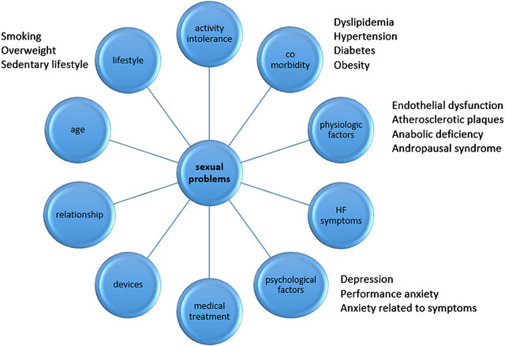
ED is a vascular predictor of CVD
The role of endothelial dysfunction and ED in non-ischemic cardiomyopathy is unknown
Exercise improves mood & libido
Knowledge relieves anxiety
↑ confidence alleviates fear

Slide 23
The penis is a barometer of endothelial or vascular health……..
Assuming sexual dysfunction isn’t ignored…….
Do we have a very narrow view of sexuality?
Is it a purely biomedical approach?

Slide 24
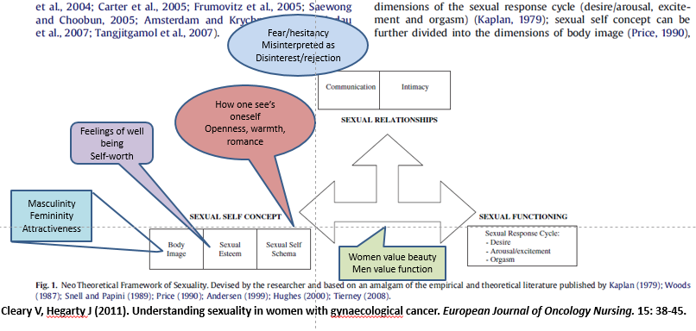

Slide 27
TRED HF speaking points
Recovered LVEF: Remission or Cure????
Primary end points: - reduction LVEF >10% and to <50%
Increase in LVEDV by >10% and to above normal range
Two fold rise in NT-pro BNP and >400ng/l
Clinical evidence of heart failure
Four in ten patients with recovered dilated cardiomyopathy will have a relapse within 6 months of starting phased withdrawal of pharmacological treatment for heart failure.
Most relapsed within 8 weeks
Likely to be even greater in the long term
If the patient insists on trial of withdrawal a robust monitoring plan should be in place
Until robust predictors of relapse are defined, treatment should continue indefinitely.

