Slide 1
Prevention of heart failure

Slide 2
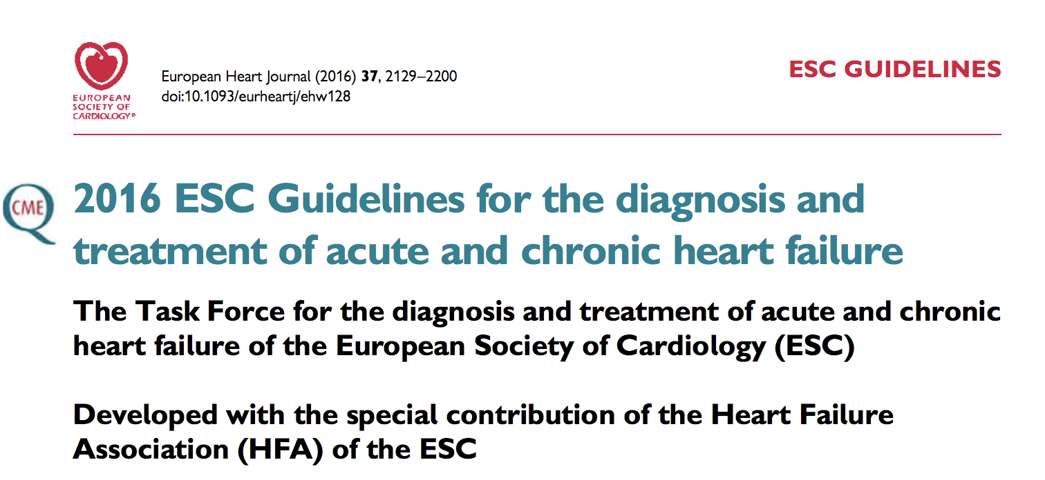
“There is considerable evidence that the onset of HF may be delayed or prevented through interventions aimed at modifying risk factors for HF”

Slide 3
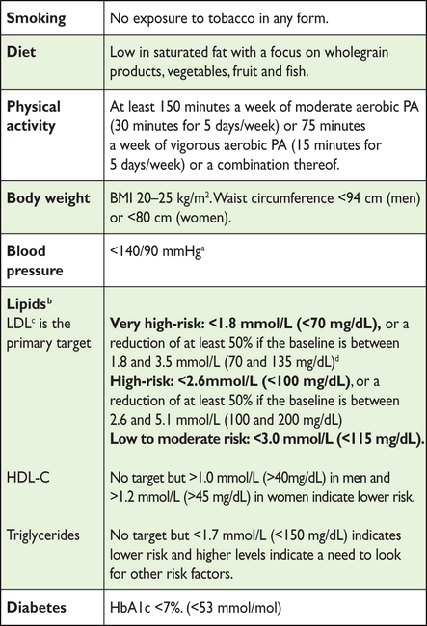

Slide 6
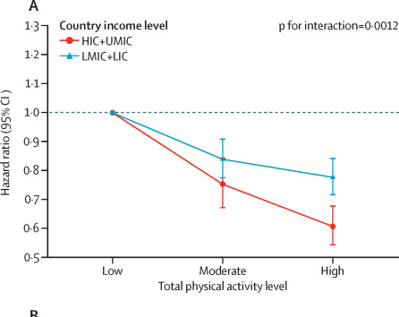
The Wonder Drug!
The effect of physical activity on mortality and cardiovascular disease in 130 000 people from 17 high-income, middle-income, and low-income countries: the PURE study
The Lancet 2017
Models were adjusted for age, sex, education, country income level, urban or rural residency, family history of CVD, and smoking status, taking into account household, community, and country clustering

Slide 7
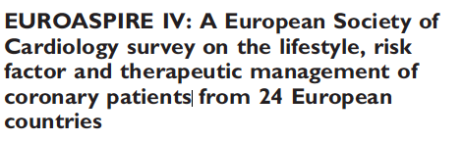
7998 patients who had had CABG, PCI or acute coronary syndrome
16% smoking
59.9% little or no physical activity
37.6% obese
42.7% BP above recommended target of 140/90
80.5% above recommended LDL level of 1.8mmol/l

Slide 8
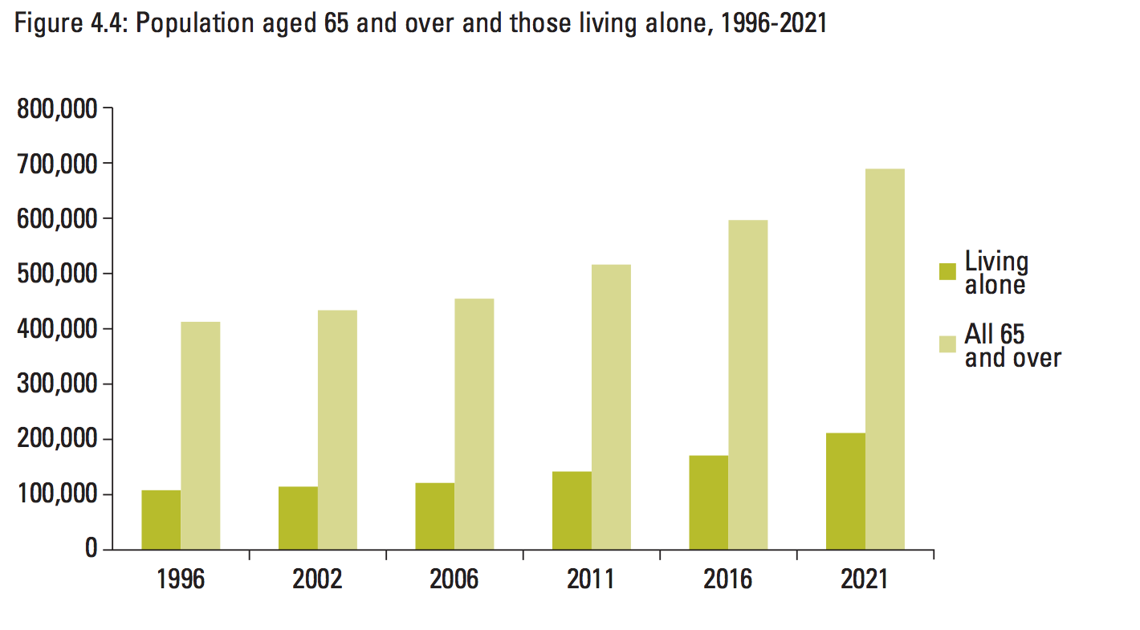
Aging Population
Population Ageing in Ireland Projections 2002-2021
National Council on Ageing and Older People

Slide 9
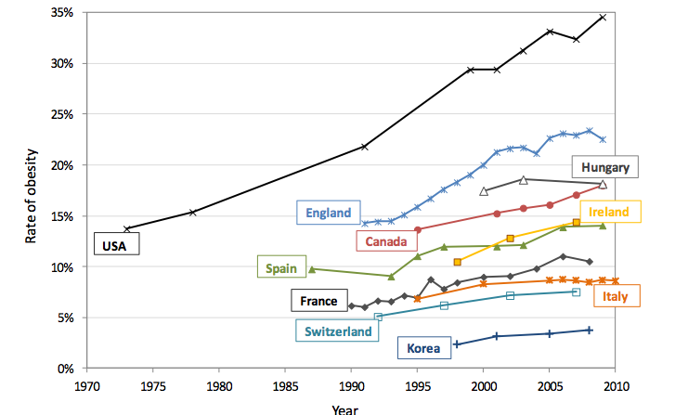
Obesity
OECD obesity update 2012

Slide 10
For a GP to manage the top 10 chronic conditions according to current guidelines they would need
10.6 hours a day
Not including
  Time for diagnosis
  Treatment of complications and sequelae
  Other acute and chronic diseases
Østbye T, Yarnall KSH, Krause KM, Pollak KI, Gradison M, Michener JL. Is There Time for Management of Patients With Chronic Diseases in Primary Care? Annals of Family Medicine. 2005;3(3):209-214.
Hyperlipidaemia Hypertension
Depression
Asthma
Diabetes
Arthritis
Anxiety
Osteoporosis
COPD
Ischemic Heart Disease

Slide 11
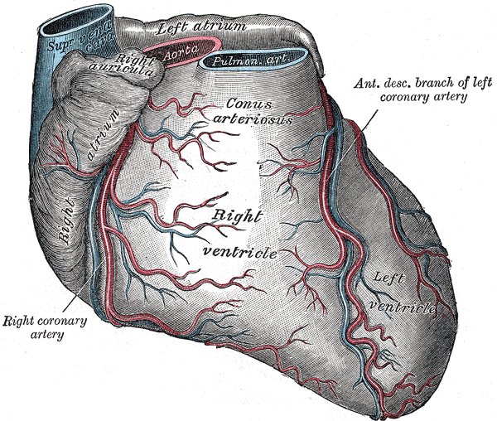
Inflammation
Ischaemia
Fibrosis
Strain
Fluid overload
Natriuretic peptide release

Slide 12
Disease Burden
Cost
STOP HF intervention
Current intervention
Earliest clinical detection
Earliest molecular detection
Baseline risk
Time

Slide 13
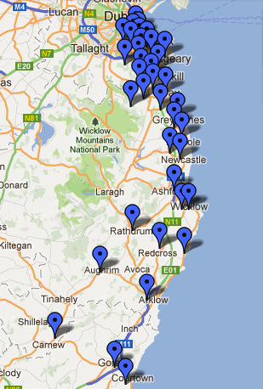
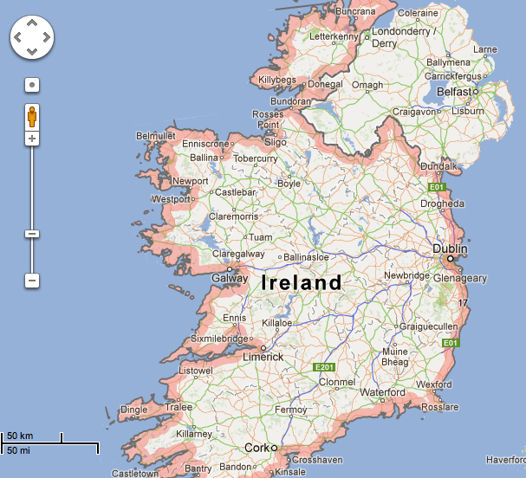
NP-driven screening and targeted collaborative care in the general at-risk population will decrease the prevalence of LVD and HF
39 collaborating primary care practices with a single referral centre

Slide 14
Primary Endpoint – HF and LVD
OR 0.46 [0.27, 0.77], p=0.003
N=44
OR 0.59 [0.38, 0.90], p=0.01
N=59
N=25
N=39
Total Population
Any BNP > 50 pg/ml

Slide 15
Endpoint – MACE Event Rate
Event Rate OR 0.54 p=0.001 vs. Control
N=71 (10.5%)
N=51 (7.3%)

Slide 16
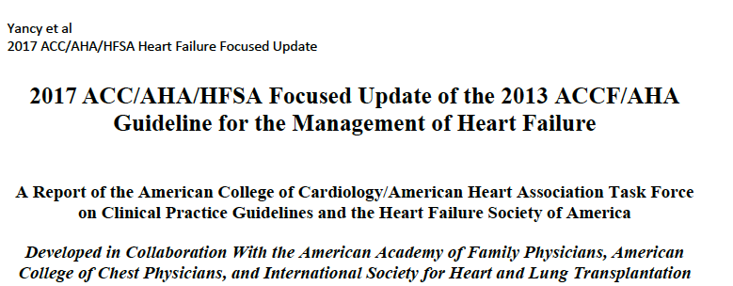
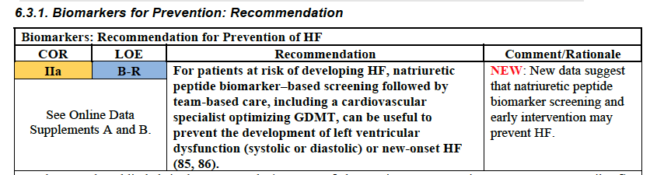

Slide 17
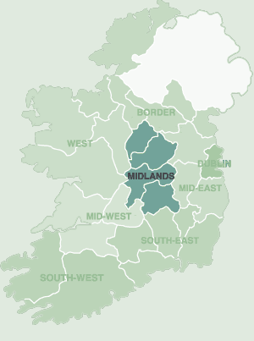
STOP HF Midlands
Structured community diabetes scheme
Echocardiography provided in the community

Slide 18
 | Midlands Echocardiography cohort | ADVANCE trial end Intensive arm | LOOK AHEAD study end Intensive arm
Age | 71.9 years | 66 years | 58.6 years
Male | 58.3% | 57.4% | 40.6%
HbA1c | 48.8mmol/mol | 48mmol/mol | 56mmol/mol
Total cholesterol | 3.8mmol/l
LDL | 2.2mmol/l | 2.64mmol/l | 2.31mmo/l
HDL | 1.4mmol/l | 1.24mmol/l | 1.26mmol/l
Systolic blood pressure | 128 mmHg | 135.5mmHg | 126mmHg
Diastolic blood pressure | 71mmHg | 73mmHg | 66.3mmHg
NTproBNP | 417pg/ml

Slide 19
 | Echo cohort 209
EF <50% (LVSD) | 7.4%
LAVI >34 | 48.8%
LAVI>34 and Lat e’<10cm/s | 28.9%
LVSD and/or LVDD | 32.8%

Slide 20
Did GPs act on this?
Over 2.5 years
  NTproBNP levels decreased in 47% of patients
  The number of patients on ACE inhibitors/ARB at baseline was 62%
              40% had an ACE inhibitor or ARB increased or added to their regime.
    The number on beta blocker at baseline was 64%
            17% had a beta blocker added or increased in dose.

Slide 21
Case
Medications
Simvastatin 40mg nocte
Aspirin 75mg daily
Metformin 500mg TDS
Amlodipine 5mg daily
Mr S is a 65 year old man who has a history of hypertension and type 2 diabetes
Her BP is 145/92, pulse 76 regular, chest and cardiovascular examination is normal. Ankle oedema noted.
Recent results:
HbA1c 68mmol/mol
LDL 3.2mmol/L
Creatinine 78umol/l
He has no shortness of breath but you did a NTproBNP test due to the ankle swelling. NTproBNP was 275 pg/ml.
His echocardiogram is reported as normal.

Slide 22
Elevated NTproBNP in those with CV risk factors
Emphasize importance of lifestyle measures
  Weight loss, diet, exercise, smoking cessation
Is blood pressure controlled?
  Consider ambulatory blood pressure monitoring
If BP is controlled and is the patient on an ACE inhibitor or angiotensin receptor blocker?
  If not consider adding or switching to one of these agents
Are lipids controlled?
  Add or increase statin dose.
  Consider switch to SGLT2 inhibitor or GLP1 agonist in diabetes
  Echocardiogram in those with significant elevation (NTProBNP>250pg/ml or BNP >100pg/ml)

Slide 23
Case 2 (STOP HF Midlands)
74 year old female
  Angina with PCI (2010)
  Type 2 diabetes (2006)
  Hypertension (2007)

Slide 24
Medications
Aspirin 75mg
Amlodipine 5mg OD
Atorvastatin 40mg
Metformin 500mg TDS

Slide 25
Case 2
BP: 114/67mmHg
HbA1c 42 mmol/mol
ACR normal
Total cholesterol: 3.9 mmol/L
LDL: 1.5mmol/L
HDL 1.35mmol/l
Trig 1.81mmol/l
Creatinine 66umol/l
NTproBNP 1705pg/ml

Slide 26
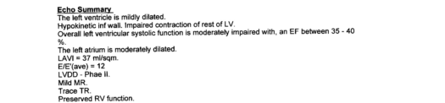

Slide 27
Management:
Coronary angiography: Significant lesions in RCA and LAD with PCI to these lesions
Amlodipine changed to perindopril 5mg
Added bisoprolol 2.5mg
Echocardiography 12 months later. EF now 50-55%

