Slide 1
Self–care in heart failure: What does your patient need to do?
Mairead Lehane cANP, RNP
Candidate Advance Nurse Practitioner: Cardiology
Mallow General Hospital
9th February 2019.

Slide 2
Self-Care or Self-Management?
Model of self‐care and related concepts: There is a shift in responsibility with the progression from the top (full responsibility of the person) to the bottom of the figure (full responsibility of the healthcare providers).
The overlaps of the concepts are represented by the different circles inserted one inside the other. The progressive reduction of the circle size identifies the increasingly specific activities that are included in each concept.
Matarese, M., Lommi, M., De Marinis, M.G. and Riegel, B., 2018. A Systematic Review and Integration of Concept Analyses of Self‐Care and Related Concepts. Journal of Nursing Scholarship, 50(3), pp.296-305.

Slide 3
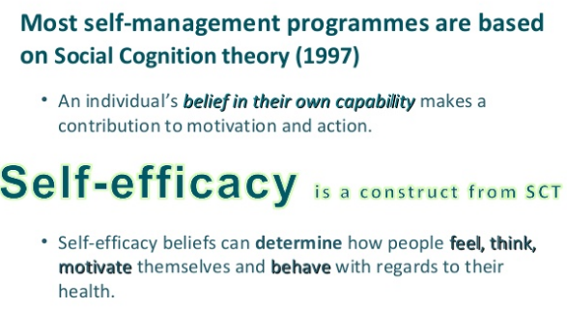

Slide 4
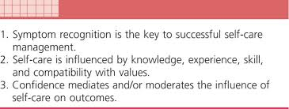
Which Model?
Jaarsma, T., Cameron, J., Riegel, B. and Stromberg, A., 2017. Factors related to self-care in heart failure patients according to the middle-range theory of self-care of chronic illness: a literature update. Current heart failure reports, 14(2), pp.71-77.
Riegel, B. and Dickson, V.V., 2008. A situation-specific theory of heart failure self-care. Journal of cardiovascular Nursing, 23(3), pp.190-196.

Slide 5
Self-care of Heart Failure
HF Self-care Maintenance:
Take medications as prescribed
Attend appointments
Lower dietary salt
Regular exercise
Balance activity & rest
Actively monitor for HF signs & symptoms
Quit smoking
Limit alcohol intake
Avoid illness / annual vaccination
HF Self-care Monitoring:
Daily Weight Monitoring
Records a monitoring diary
Monitor for signs & Symptoms
Blood pressure monitoring
INR monitoring
Blood glucose monitoring
HF Self-care Management
Decision making in response to signs and symptoms
Recognise a change such as increasing weight or oedema
Decide to take action such as contact HF Clinic or take an extra diuretic
Evaluate their response to treatment

Slide 6
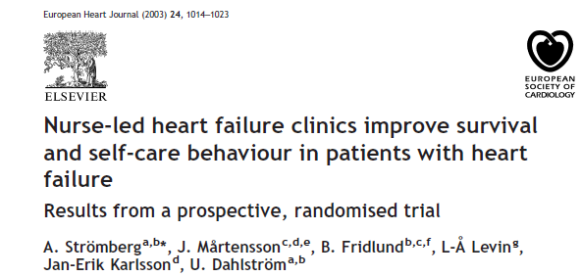
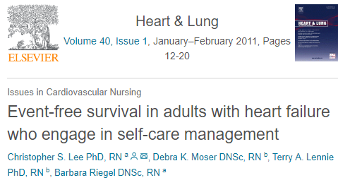
Self-care – show me the evidence
Reduction in readmission
Improved survival
Increased quality of life
Enhanced sense of control
Decreased cost of care
However….. the evidence is inconsistent

Slide 7
Patient Engagement and Patient Activation are often used interchangeably

Slide 8
An inconvenient truth
Education alone is ineffective
One size doesn’t fit all
Behaviour change is challenging
An unwritten rule exists:
40% are pre-contemplators
40% are contemplators
20% are in preparation/action
(Norcross et al, 2011, Prochaska & Velcier)

Slide 9
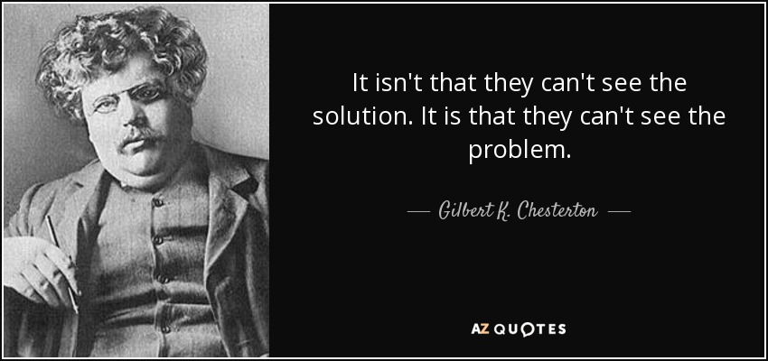
They don’t know what they don’t know!
But I don’t use any salt!
I threw away the salt shaker
Using the example of salt: many patients are unaware of hidden salt in processed or ultra-processed foods

Slide 10
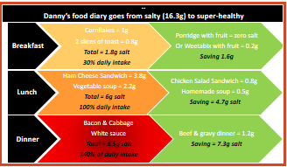
Strategies to improve self-care
Screen for barriers to self-care e.g. literacy, visual impairment
Tailor and reinforce education eg limit number of subjects per session
Use teach back techniques
Adapt communication to patients history, expectations, treatment
Include family/friends/carers in education & counselling
Provide different educational materials and methods
Set mutually agreed goals
Teach skills e.g food label reading
Consider flexible diuretic regimen
Lainscak, M., Blue, L., Clark, A.L., Dahlström, U., Dickstein, K., Ekman, I., McDonagh, T., McMurray, J.J., Ryder, M., Stewart, S. and Strömberg, A., 2011. Self‐care management of heart failure: practical recommendations from the Patient Care Committee of the Heart Failure Association of the European Society of Cardiology. European journal of heart failure, 13(2), pp.115-126.

Slide 11
Self-care activities
Symptoms are subjective
Breathlessness, fatigue, dizziness, loss of appetite
Optimal method to teach this skill is unknown
Striving for euvolaemia: Volume overload versus volume depletion
No evidence for fluid restriction, tailored advice
Daily weights, dry weight, report 1-2kg in 1-2 days
Sick day rules

Slide 12
Sick Day Rules: for example, Spironolactone
Juurlink, DN, Mamdani, M, Lee, D, Kopp, A., Austin, PC., Laupacis, A., Redelmeier, DA. (2004) Rates of Hyperkalemia after Publication of the Randomized Aldactone Evaluation Study. N Engl J Med 351:543-51

Slide 13
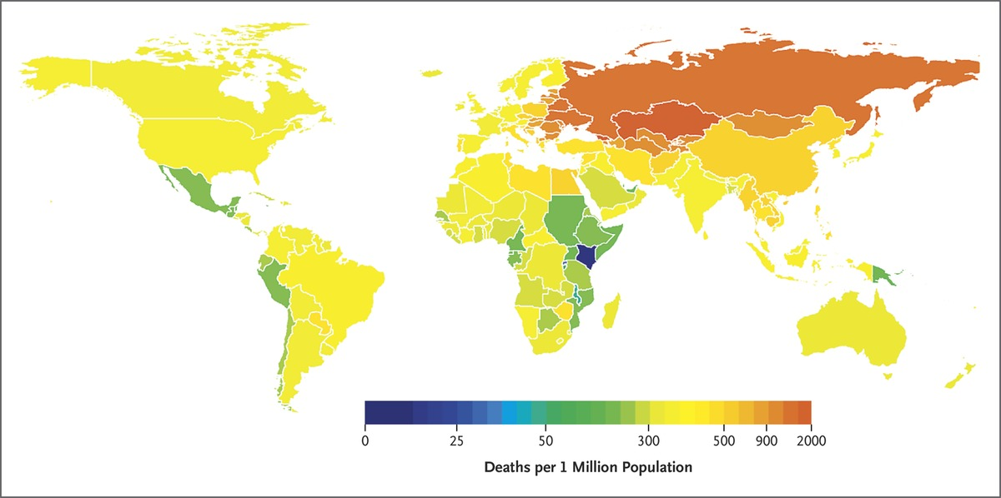
1.65 million deaths
1 in every 10 CVD deaths
40.4% were premature (<70yrs)

Slide 14
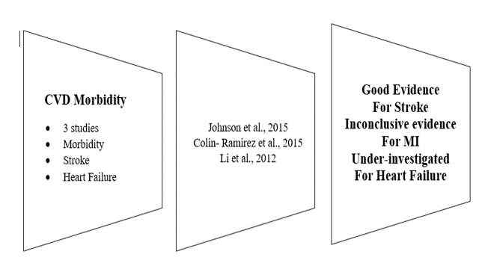
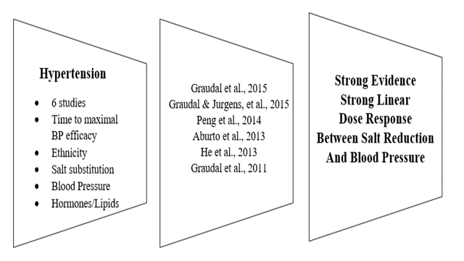
Dietary salt restriction
A dietary pattern of convenience emerging
Increasing consumption of industrially processed foods
Ultra-processed foods are obesogenic & consumption is rising
10.2% in Portugal, 45.9% in Ireland, 50.7% in the UK.
A perception of time scarcity

Slide 15
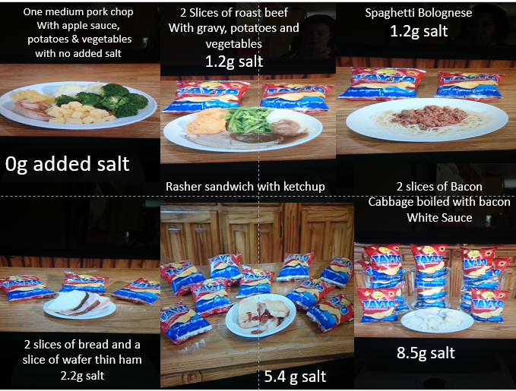

Slide 16
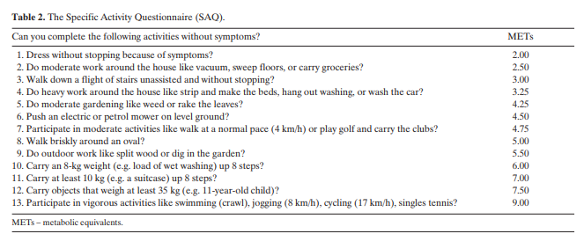
A specific activity questionnaire to measure the functional capacity off cardiac patients. Rankin, Sarah L. et al.
American Journal of Cardiology , Volume 77 , Issue 14 , 1220 - 1223

Slide 17
Exercise / Physical Activity
Limitation of exercise capacity HF symptom
Inactivity & deconditioning results in worsening of symptoms
Class 1 recommendation
Exercise benefits:
increase in functional capacity
Reduction of symptoms
Improved quality of life
Reverses muscle wasting, endothelial dysfunction, ventricular remodelling
HF-ACTION (2009)- non significant 7-11% reduction in primary endpoint due to non-adherence
Every MET/week increase in exercise intensity produced 5% reduction in 90/d risk death/hospitalisation
Education regarding benefits, safety, process
Goal setting, problem solving, positive reinforcement, target self-efficacy
FITT principle
O’Connor, C.M., Whellan, D.J., Lee, K.L., Keteyian, S.J., Cooper, L.S., Ellis, S.J., Leifer, E.S., Kraus, W.E., Kitzman, D.W., Blumenthal, J.A. and Rendall, D.S., 2009. Efficacy and safety of exercise training in patients with chronic heart failure: HF-ACTION randomized controlled trial. Jama, 301(14), pp.1439-1450.
Piepoli, M.F., Conraads, V., Corra, U., Dickstein, K., Francis, D.P., Jaarsma, T., McMurray, J., Pieske, B., Piotrowicz, E., Schmid, J.P. and Anker, S.D., 2011. Exercise training in heart failure: from theory to practice. A consensus document of the Heart Failure Association and the European Association for Cardiovascular Prevention and Rehabilitation. European journal of heart failure, 13(4), pp.347-357.
Conraads, V.M., Deaton, C., Piotrowicz, E., Santaularia, N., Tierney, S., Piepoli, M.F., Pieske, B., Schmid, J.P., Dickstein, K., Ponikowski, P.P. and Jaarsma, T., 2012. Adherence of heart failure patients to exercise: barriers and possible solutions: a position statement of the Study Group on Exercise Training in Heart Failure of the Heart Failure Association of the European Society of Cardiology. European journal of heart failure, 14(5), pp.451-458.

Slide 18
Daily alcohol should be limited to 10-20g /day
Abstinence in alcohol induced cardiomyopathy
No prospective studies of smoking in HF
Contributes to 42.1% CVD deaths
Smoking cessation as effective as ACE or beta blocker in reducing mortality
Influenza can lead to premature death and hospitalisation
No HF specific RCT’s
Reduced relative risk of mortality at 1 year

Slide 19
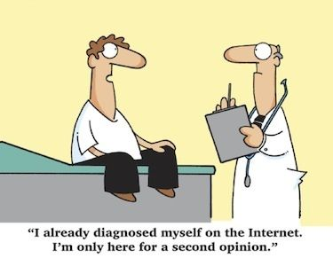

Slide 20
In Conclusion
Patients should be seen as active partners in their healthcare.
The most effective self-care interventions are multi-faceted, tailored to individual needs and pro-active in developing self-efficacy.
Collaboration is key between patients, carers, health professionals and support services.

