Slide 1
Essay Writing & Referencing Guidelines
Prof. Laura Rascaroli
For student use – do not upload / distribute

Slide 2
Phases of the work
Understand the question
Make a rough outline plan to guide your research
Identify and familiarise yourself with your sources
Develop an argument
Review, revise and refine the plan while you read and study
Write first draft
Edit draft for structure and content
Edit draft for style & check referencing
Proof read for spelling/punctuation
Produce final copy

Slide 3
Today we will concentrate on:
Understand the question
Make a rough outline plan to guide your research
Identify and familiarise yourself with your sources
Develop an argument
Review, revise and refine the plan while you read and study
Write first draft
Edit draft for structure and content
Edit draft for style & check referencing
Proof read for spelling/punctuation
Produce final copy

Slide 4
For everything else check:
UCC RED Writing Skills https://www.ucc.ie/en/red/writing/

Slide 5
Understand the question
Read the question several times and analyse it:
Highlight keywords that help you identify the sources
Highlight the verbs that tell you what you are expected to do (e.g.: discuss, assess, compare)
Highlight any other significant words that identify the scope of what you have to write about (e.g.: simply, fundamentally, only, currently, respectively).

Slide 6
Identify your sources
Primary Sources
Secondary Sources
Any original text that is at the centre of your inquiry:
Film
Video
Theory text
Book
Artwork
Song
Etc.
Relevant scholarship on the primary sources, i.e. journal articles, books, reviews on:
The films
The directors / film movements / actors / producers
The films’ artistic contexts
The film’s historical contexts
Etc.

Slide 7
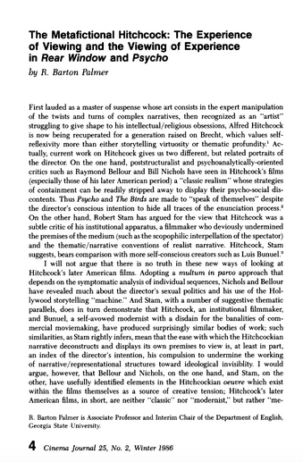
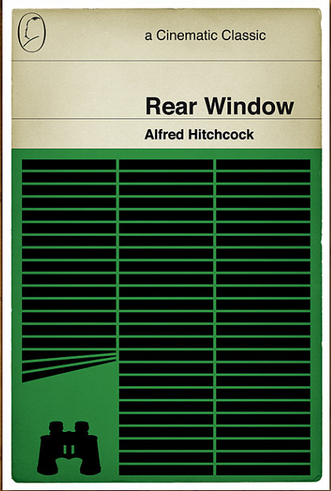
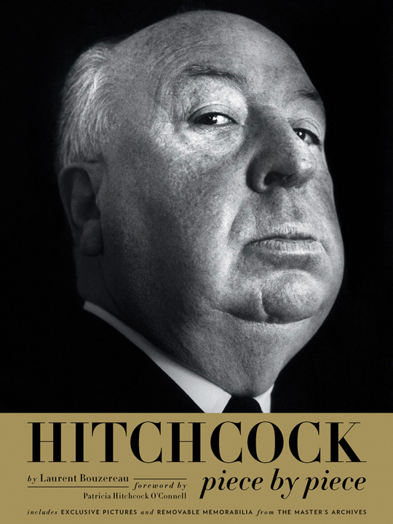
Primary Source
Secondary Sources

Slide 8
Why refer to secondary sources?
It gives authority and credibility to your work
It shows that you are aware of existing and relevant research in your field
It reinforces your points and supports your argument

Slide 9
When choosing secondary sources, focus particularly on their:
Relevance – Authority – Accuracy – Currency
Consider such questions as the following:
Is the source directly relevant to your question/problem?
Who is the author of the work, and what are the author’s credentials for writing and publishing this work?
Who is the publisher?
Is the work peer-reviewed—that is, has it been read and recommended for publication by experts?
When was it written and published?

Slide 10
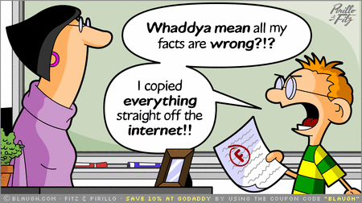
Warning! The Web
Instant access to a wealth of information and scholarship; but learn to distinguish between types of Internet content
Wikipedia and other sources of information
Scholarship: databases and search engines:
Google Scholar
Google Books
Boole Library
JSTOR
Project Muse

Slide 11
Internet Detective
Free Internet tutorial to learn to discern the good, the bad and the ugly for your online research:
https://www.llas.ac.uk/resources/mb/2595

Slide 12
Warning! Plagiarism

Slide 13
What is plagiarism?
Plagiarism is using other people’s ideas, concepts, arguments and words, without clearly acknowledging that they are not yours
You may (and should!) reference sources, but you must always give clear and full credit to the authors

Slide 14
What is plagiarism?
Using another person’s ideas, information, or expressions without acknowledging that person’s work (intellectual theft)
Passing off another person’s ideas, information, or expressions as your own to get a better grade (fraud)
Copying from another student (whether with their consent or not)
Allowing a student to copy your work (collusion)
Buying or otherwise acquiring a research paper and handing in part or all of it as your own
Presenting the same work for different modules

Slide 15
Examples: you have plagiarised if
You repeated or paraphrased someone’s wording without acknowledgment
You paraphrased someone’s argument or presented someone’s line of thought without acknowledgment
You took notes that did not distinguish summary and paraphrase from quotation and then you presented wording from the notes as if it were all your own
While browsing the Web, you copied and pasted text into your paper without quotation marks or without citing the source
You took some text and replaced some of the words with synonyms without giving credit to your source

Slide 16
You can avoid plagiarism by:
Making a list of the writers and viewpoints you discovered in your research and using this list to double-check the presentation of material in your paper
Keeping the following three categories distinct in your notes:
your ideas,
your summaries of others’ material, and
exact wording you copy
Keeping record of the sources of all material you borrow—exact wording, paraphrases, ideas, arguments, and facts; keep a working bibliography

Slide 17
You can avoid plagiarism by: CREDITING YOUR SOURCES WHEN YOU QUOTE, PARAPHRASE OR SUMMARISE
Quotations must be identical to the original, using a narrow segment of the source. They must match the source document word for word and must be attributed to the original author.
Paraphrasing involves putting a passage from source material into your own words. A paraphrase must also be attributed to the original source. Paraphrased material is usually shorter than the original passage, taking a somewhat broader segment of the source and condensing it slightly.
Summarising involves putting the main idea(s) into your own words, including only the main point(s). Once again, it is necessary to attribute summarised ideas to the original source. Summaries are significantly shorter than the original and take a broad overview of the source material.

Slide 18
You can avoid plagiarism by:
Do not “cut and paste”!
Develop your original argument; engage with your sources, and integrate them within your argument (giving credit!)
Use a citation system

Slide 19
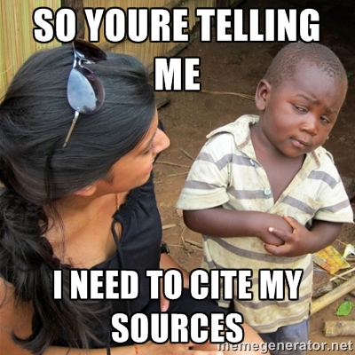
Why use a citation system?
Using a citation system provides a consistent format for writing papers
Allows your readers to locate your sources for further information
Gives clear credit to your sources of information and ideas
Removes the risk of plagiarism

Slide 20
MLA Handbook. 8th ed. Joseph Gibaldi. Modern Language Association, 2016.
COPIES ARE AVAILABLE FROM THE BOOLE LIBRARY, Q+3

Slide 21
MLA: the basics

Slide 22
MLA format follows the author-page method of in-text citation. This means that the author’s last name and the page number(s) from which the quotation or paraphrase is taken must appear in the text, and a complete reference should appear on your Works Cited page. The author’s name may appear either in the sentence itself or in parentheses following the quotation or paraphrase, but the page number(s) should always appear in the parentheses, not in the text of your sentence. For example:
Wordsworth stated that Romantic poetry was marked by a “spontaneous overflow of powerful feelings” (263).
Romantic poetry is characterized by the “spontaneous overflow of powerful feelings” (Wordsworth 263).
Wordsworth extensively explored the role of emotion in the creative process (263).
Both citations in the examples above, (263) and (Wordsworth 263), tell readers that the information in the sentence can be located on page 263 of a work by an author named Wordsworth. If readers want more information about this source, they can turn to the Works Cited page, where, under the name of Wordsworth, they would find the following information:
Wordsworth, William. Lyrical Ballads. Oxford UP, 1967.

Slide 23
Type of sources
Each type of source requires a different approach, depending on type of author (one author, two authors, one editor, several editors, anonymous author, corporate author, etc.) and type of publication (book, edited collection, article in scholarly journal, online article; film, song, art work, etc.).

Slide 24
Works Cited
This list contains all the works that you will cite in your text. The list simplifies documentation by permitting you to make only brief references to these works in the text.
For example, when you have the following entry in your list of works cited:
Harbord, Janet. The Evolution of Film: Rethinking Film Studies. Polity, 2007.
a citation such as: (Harbord 32–35) fully identifies your source to readers (provided that you cite no other work by an author with the same last name).

Slide 25
Style and formatting
MLA also provides a set of style guidelines – including on:
Capitalisation
Use of italics
Use of quotation marks
How to format titles of books, films, articles
How to present block quotes
Etc.

Slide 26
Turnitin
Turnitin generates reports that highlight sections of texts that also exists in other sources stored on the Internet and in its database
It can be used as a tool to detect plagiarism
If the highlighted passages are quotes accompanied by a reference, they will not be considered by the lecturer as instances of plagiarism
Lecturers detect plagiarism in other ways too – drawing on their experience and knowledge of sources

Slide 27
What are the consequences?
Plagiarism may result in a lesser mark or, if extensive, even in a fail
You will be invited to attend a meeting with the Plagiarism Officer and your Lecturer, and will be given an opportunity to explain
A penalty will be assigned
Should you not accept the penalty, a report will be filed with the UCC Student Records and Examinations Officer, and the matter will be dealt with by the Registrar and Discipline Committee
Penalties go from a mark of zero in the module to permanent exclusion from the university
Familiarise yourself with the UCC PLAGIARISM POLICY

Slide 28
RESOURCES

Slide 29
BA ASSESSMENT GUIDELINES AND PROCEDURE BOOKLET
Find it in the Student area of the Film and Screen Media website

Slide 30
MLA online:
An excellent free online guide to MLA style is the Purdue OWL (Purdue University Writing Lab), which is available here: https://owl.english.purdue.edu/owl/resource/747/01/

Slide 31
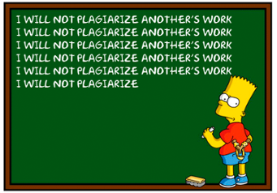
UCC RED online plagiarism resources
RECOGNISING PLAGIARISM EXERCISE

Slide 32
UCC Plagiarism Policy
https://www.ucc.ie/en/exams/procedures-regulations/

Slide 33
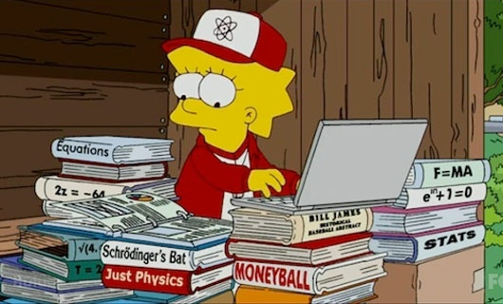
In doubt?
Check with your Lecturer/Teaching & Learning Officer (me!) when you are uncertain about your use of sources

