Slide 1
College of Arts, Celtic Studies and Social Sciences IRC Postgraduate Scholarships 2024
Thursday 12th September 2024, ORB G27a (CACSSS Seminar Room)
 | Welcome and opening remarks Dr James Kapalo, CACSSS Vice Head for Research and Innovation
 | Introduction IRC GoI schemes 2025: Deadlines and CACSSS reviews and UCC supports. Dr Allen White, CACSSS Research Manager
 | Developing research questions, aims & objectives & research methodologies: social sciences perspectives Dr Caitriona Ni Laoire, School of Applied Social Studies
 | Developing research questions, aims and objectives & research methodologies: humanities perspectives Dr Silvia Ross, School of Languages Literatures and Cultures
 | Developing research questions, aims & objectives & research methodologies: interdisciplinary perspectives Dr Oisin Wall, School of History
 | IRC Govt of Ireland Scholar award holders Giulia Benuzzi, IRC Scholar, School of Languages, Literatures and Cultures Dr Dyuti Chakravarty, IRC Fellow, School of Society, Politics and Ethics
3:30 | Q & A

Slide 2

College of Arts, Celtic Studies and Social Sciences
College Research Manager:
Allen.white@ucc.ie
College Research Support Officers:
M.Scanlon@ucc.ie
Siobhanobrien@ucc.ie

Slide 3
Postgraduate Scholarships
Strategic funding partners awards 2024
Strategic Partner | Theme/topic | More info
Environmental Protection Agency | Climate change - evidence and needs | App 1
 | Green & circular economies
 | Healthy environments
 | Restoring natural environments
Dept of Children, Equality, Disability, Integration & Youth | Children who live/have lived with socio-economic disadvantage | App 2
 | Children who experience/have experienced disadvantage due to living with disabilities/ additional needs
 | Children from migrant populations, Travellers, or Roma who experience/or have experienced disadvantage
 | Relevant socio-historical research.
Met Eireann (max 5 awards) | Multiple | App 3
Department of Foreign Affairs Andrew Green scholarship | Women, peace and security Post-conflict resolution | App 4

Slide 4
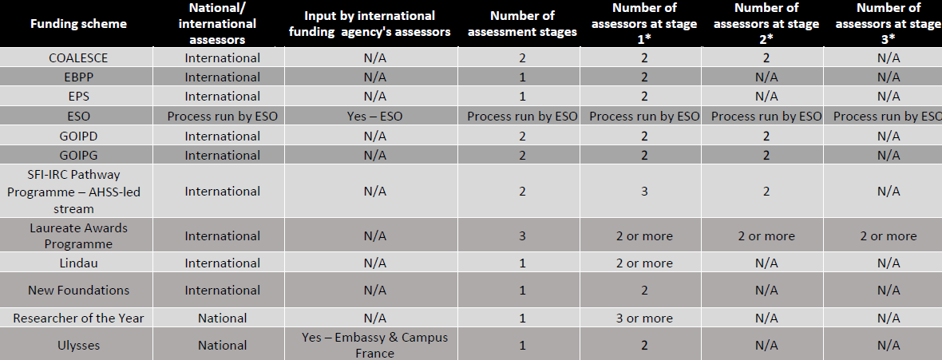

Slide 5
Evaluation criteria
Evaluation Criteria & Detail | Evaluation Marks
 | PG | PD
1 APPLICANT | 40% | 30%
2. PROJECT | 40% | 35%
3. Training and Career Development Aspects of proposal | 10% | 25%
4. ENVIRONMENT: Suitability of the host organisation(s): | 10% | 10%
Postgraduate Evaluation Criteria & Detail | Evaluation Marks
1. PROJECT: Quality of the research project including (40%): Clarity and coherence of the proposed research project. Quality and appropriateness of approach, including research methodology, and consideration of ethical and sex/gender issues and the limitations of the approach to be adopted. Feasibility and credibility of the proposed research plan in the proposed time period. Originality and innovative nature Dissemination plans Direct alignment with Strategic Funding Partner themes as set out in Terms and Conditions, where appropriate Training and Career Development Aspects of proposal (10%): Clarity and quality of Training and Career Development Plan to acquire new knowledge and skills to achieve research and professional development aims*. Evidence of real thought as to why research is to be undertaken and the impact of the proposed award on the applicants’ career path. | 50% (0-50)
2. APPLICANT: Capability of the applicant including: Track record and research potential of the applicant. Personal Statement. Referees’ reports. Match between applicant profile and research project. | 30% (0-30)
3. ENVIRONMENT: Suitability of the host organisation(s): Suitability and ability of Academic Supervisor(s), Employment Mentor to provide adequate supervision. Quality of infrastructure and facilities provided by Host Organisation(s). Match between applicant, Academic Supervisor(s), Employment Mentor and Host Organisation(s). | 20% (0-20)
Notes:
Applicant: 40%
Track record and research potential of the applicant
Personal statement
Referees’ reports
Match between the applicant profile and the research project
Quality of the research PROJECT including (40%):
Clarity and coherence of the proposed research project.
Quality and appropriateness of approach, including research methodology, and consideration of ethical and sex/gender issues and the limitations of the approach to be adopted.
Feasibility and credibility of the proposed research plan in the proposed time period.
Originality and innovative nature
Dissemination plans
Direct alignment with Strategic Funding Partner themes as set out in Terms and Conditions, where appropriate
Training and Career Development Aspects of proposal (10%):
Clarity and quality of Training and Career Development Plan to acquire new knowledge and skills to achieve research and professional development aims
Particular attention will be paid to skills relevant to employment outside the traditional academic sector
Evidence of real thought as to why research is to be undertaken and the impact of the proposed award on the applicants’ career path.
ENVIRONMENT: Suitability of the host organisation(s):
Suitability and ability of Academic Supervisor(s), Employment Mentor to provide adequate supervision.
Quality of infrastructure and facilities provided by Host Organisation(s).
Match between applicant, Academic Supervisor(s) and Host Organisation(s).

Slide 6
College of Arts, Celtic Studies and Social Sciences
Undergraduate Qualifications
Master’s Degree (if applicable)
Other Education
Research Achievements
Work Experience
Personal Statement
Career Training and Development Plan
Progress of research to date
Modifications to re-submitted applications
Primary Area
Key words
Lay abstract
Details of your proposed research
Research design and methodologies
Research schedule
Description of any specialist knowledge/data/access to specialist equipment/facilities
Dissemination and knowledge exchange
Higher Education Institution.
Ethical Statement
Sex/Gender Dimension Statement
Data management
Help Pack
+ recorded podcasts
CACSSS Research Support review
CACSSS staff review

Slide 7
Key dates & supports
Applications docs, guides, forms, FAQs on IRC website: www.research.ie
See UCC Research Sharepoint sites: here and here
PG and PD applicants must notify UCC Research of their intent to submit via email by 2pm Tuesday 24th September
  Emails must be addressed to ircgoiapplications@ucc. and
  MUST put in the email subject line: IRCGOIPostgrad/doc followed by name, School, College and topic
A Help-pack covering all parts of the IRC GoI 2024 application is available to all applicants who contact UCC research (above). Contact ircgoiapplications@ucc.ie for password.
Draft Application Reviews
  CACSSS applicants can upload a draft (pdf or Word doc) application here by 4 pm Thursday 26th September 2024. Your application will be returned by email with feedback from at least 2 members of staff in CACSSS before the IRC closing date of 10th October 2024.
IRC Deadline for applications 10th October @ 4 pm

