Slide 1
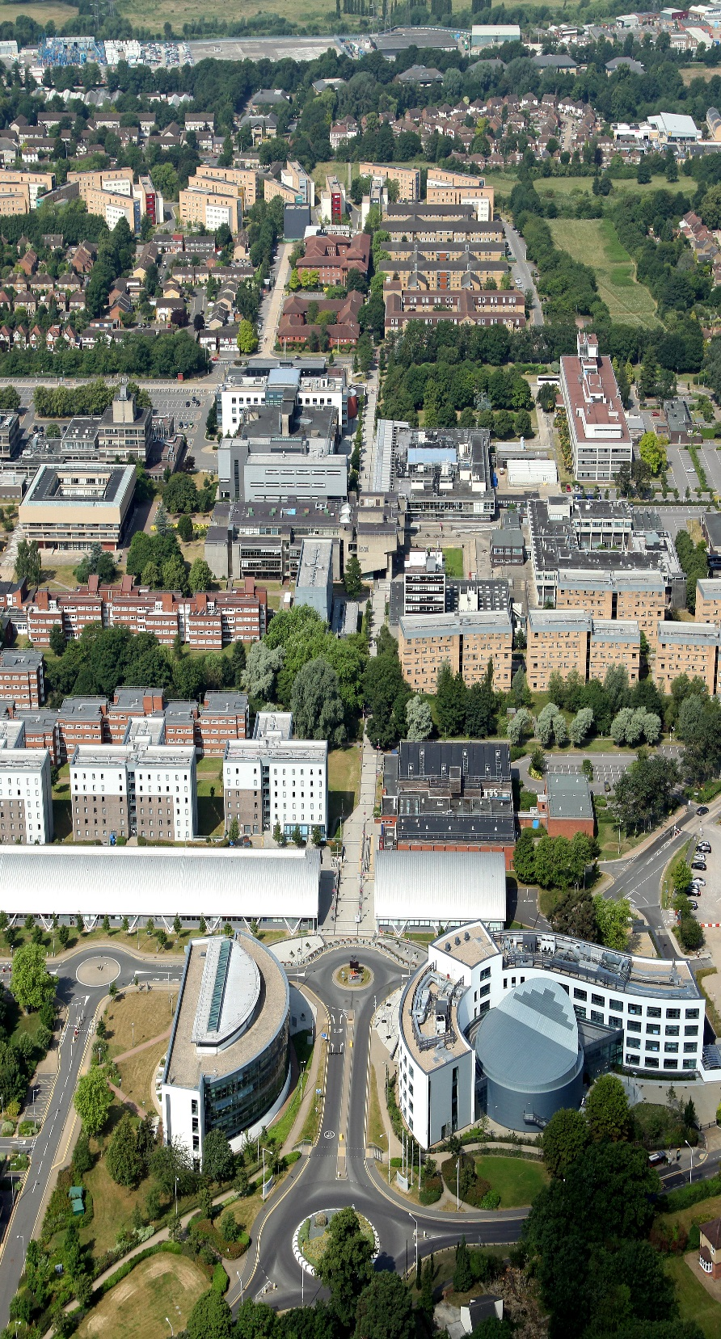
Athena SWAN Initiatives in the UK: Critical Reflections
Maria Tsouroufli PhD
Professor of Education
University of Brunel
Maria.Tsouroufli@brunel.ac.uk

Slide 2
Objectives
To critically reflect on Athena SWAN Initiatives in the UK since the inception of the awards
To consider the challenges and opportunities for gender and race equality and their intersections within neo-liberal contexts of Higher Education
To consider ways forward

Slide 3
Athena SWAN 2005 and post-2015
Athena Swan was formally launched in the UK in 2005 at the Institute of Physics with the support of ECU and UK Research Councils. The first awards were conferred in 2006.
The requirements and prerequisites for Bronze, Silver and Gold awards as well as the principles of Athena SWAN have been adapted to address the under-representation of women in senior roles in arts, humanities, social sciences, business and law (AHSSBL); to address the gender pay gap; the intersections of gender with other factors and the challenges that transsexual staff and students face in higher education. Athena SWAN charter now covers women in academic roles in all disciplines, professional and support staff.

Slide 4
Athena SWAN post 2015
At Bronze and Silver level institutions are expected to consider the role of the intersection of gender with ethnicity for academic, professional and support staff. At Gold level, the institution should demonstrate that they have taken an intersectional approach to analysing data and devising possible solutions to identified challenges.
The language of Athena Swan charter and the revised Athena Swan principles have received limited if any attention by researchers and self-assessment teams across UK Universities. For example, no systematic research has looked at how self-assessment teams perceive and define ‘gender bias’ , ‘ inclusive culture’ , or how they might operationalize these terms and intersectionality in gender action plans and the collection and analysis of Athena SWAN submission data (Tsouroufli, 2018: 42)

Slide 5
Athena SWAN Successes in the UK
April 2017 saw 143 applications, with 4 Gold awards, 22 Silver Awards and 59 Bronze awards being conferred. The overall success rate was 59%.
Although many of the younger Universities (post-1992) have joined the scheme and have received departmental and institutional awards, most of the silver and all gold awards had been received by Russell group Universities which include some of the best Universities in the world (King’s College, Oxford) (Tsouroufli, 2018a)
Most good practice examples of financial investment in Athena Swan by Universities come from affluent institutions (ECU Awards Booklet, 2017). For example, the allocations of £100K central funds by Ulster University to support the Athena Swan initiatives and a £5,000 training budget per person by the School of Economics University of East Anglia as part of keeping in touch process or on return to work as part of the process of supporting return to work.

Slide 6
Athena SWAN: Who gets involved?
Until recently, over-representation of full-time female academics, usually from lower academic grades in Athena Swan self-assessment teams at departmental and institutional levels and also under-representation of students and non-academic staff other than HR professionals. The ethnic mix and gender equality expertise and feminist commitment of those involved in review panels also require consideration and attention (Tsouroufli, 2018a).

Slide 7
Athena SWAN: Gender Parity or Gender Equality
Interpretations of gender equality as gender parity might lead departments to focus on men, for example through encouraging men into primary school teaching or nursing. Such initiatives might happen at the expense of analysing discriminatory practices and sexist cultures that disadvantage women even in those fields that are highly feminised where men are often over-represented within senior positions (Tsouroufli, 2018a).
Interpretation of gender equality as gender parity might also have negative implications for STEMM disciplines. For example if self-assessment team achieve gender party within heavily male dominated departments, this means that a disproportionate number of female staff will be expected to work on the team (Pearce, 2017).

Slide 8
Athena SWAN: Reproducing gender inequalities in HE?
In their qualitative study Caffrey et al. (2016) found that gender inequity was reproduced in the programme’s enactment as female staff was undertaking a disproportionate amount of Athena SWAN work with potentially negative impacts on individual women’s career progression.
Despite the successes of Imperial College with Athena SWAN, it was felt by staff that: ‘Athena Swan has merely scratched the surface of issues or had just provided a veneer which concealed continuing inequalities and that events such as Athena SWAN lecture were a little bit more than a box ticking exercise’’ (Imperial College Report by Changing University Cultures, 2016, http://chucl.cm )
Notes:
The project for which the report was produced was commissioned in 2015 and was the first of its kind in the UK HE sector, prompted by serious concerns about sexism in sport following the College’s 2015 Varsity rugby tournament.

Slide 9
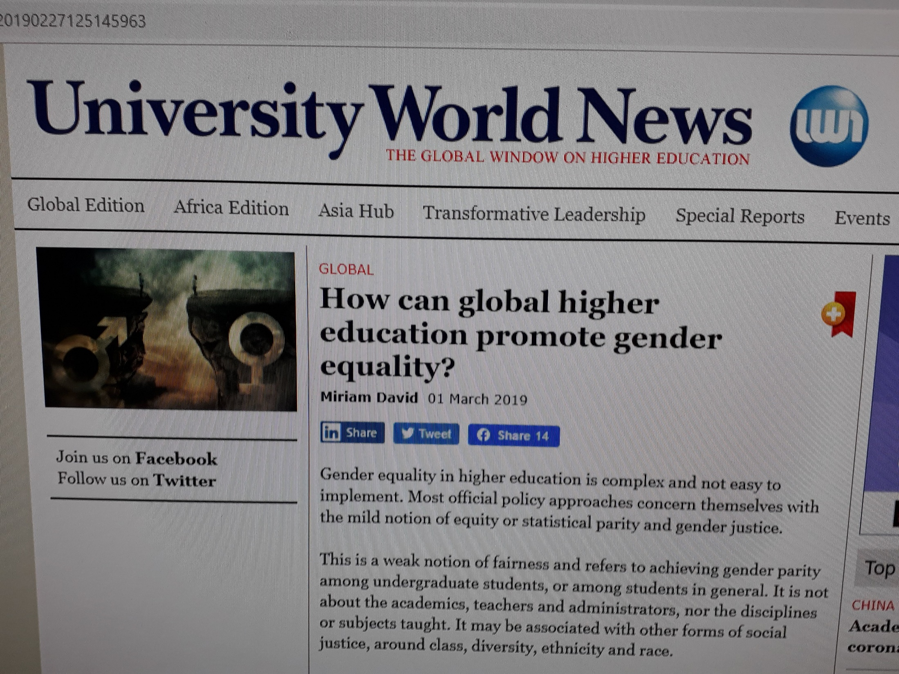
Notes:
https://www.universityworldnews.com/post.php?story=20190227125145963

Slide 10
Doing gender
Involving practices that are culturally available to ‘do gender’ (West and Zimmerman, 1987) and the literal practising of gender that is constituted through interaction.
Intentionality and agency involved in the practising of gender (Martin, 2006)
More is needed to understand the shape, ﬂuidity and dynamism of gender in practice (Martin, 2001), particularly gender as practised at the group level (Martin, 1997; Messner, 2000, 2002; Quinn, 2002; Thorne, 1993).

Slide 11
Changing Universities, Changing Gender Relations
Gendered culture and gender regime
‘the patterning of gender relations in that institution, and especially the continuing pattern, which provides the structural context of particular relationships and individual practices’ (Connell, 2005, p.6)
Gendered knowledges, curricula and pedagogies (Morley et al, 2006; Tsouroufli, 2016)
Gendered divisions of labour
Gender-based violence (e.g. laddish culture, sexual harassment)
Notes:
Connell: 4 dimensions of gender regime: “The overall pattern of gender relations within an organization may be called its gender regime.” (Connell 2006, 839.)
● Gender division of labour
— the way in which production and consumption are arranged along gender lines, including the gendering of occupations and the division between paid work and domestic labor
● Gender relations of power — the way in which control, authority, and force are exercised along gender lines, including organizational hierarchy, legal power, and collective and individual violence
● Emotion and human relations
— the way in which attachment and antagonism among people and groups are organized along gender lines, including feelings of solidarity, prejudice and disdain, and sexual attraction and repulsion
● Gender culture and symbolism
— the way in which gender identities are defi ned in culture, the language and symbols of gender diff erence, and the prevailing beliefs and attitudes about gender
Feminist scholarship has been concerned with the relationship between gender and pedagogy in higher education (Burke 2015) and has demonstrated that ‘pedagogies are bound up with historical and masculinised ways of being and doing within higher education’ (Burke 2013, 109). Feminist research has also fundamentally questioned the foundations of Western rationality which underpins hegemonic notions of pedagogic and academic and (Walkerdine, Lucey, and Melody 2001; Leathwood and Hey 2009; Tsouroufli and Ozbilgin 2012).

Slide 12
Gender bias in HE
There is a huge body of literature on gender and academia that shows evidence of biases against women.
Academic excellence is not a universal and gender neutral concept but imbued with gender inequalities (Van den Brink and Benschop, 2011).
Women’s work is often less valued, they are asked discriminatory questions in interviews, they tend to work more part-time but their CV is not evaluated proportionally, and they are often not considered as excellent as men even if they equal or surpass them in numbers of countable merits.

Slide 13
Gender based violence in HE
Research by Jackson and Sundaram (2018:1) suggests that lad culture is particularly associated with groups of men in social contexts and involves excessive alcohol consumption, sexism, homophobia, sexual harassment and violence. They also argue that perceptions about the prevalence of lad culture are influenced by how it is conceptualised and to whom it is visible.
The Hidden Marks study (NUS, 2010) reported two thirds of 2000 female students having experienced some form of verbal or non-verbal harassment in and around their institution.
Philipps and Young’s qualitative study (2013) found that experiences of misogyny were prevalent for female university students who participated in the project.

Slide 14
Gender and Race Inequalities in HE
Overall in 2009/10, 53.8 of all staff were women. However, a higher proportion of staff in professorial roles were male (80.9%) than female (19.1%) (ECU, 2011)
The mean salary of female staff was £31,116 compared with £39,021 for male staff, an overall mean pay gap of 20.3% (ECU, 2011).
76.1% of UK national staff in professorial roles and 67.4% of non-UK national staff in professorial roles were white males (ECU, 2011)

Slide 15
Persisting Gender and Race Inequalities
67.5% of professors were white men, and 22.9% white women (ECU, 2018)
7.5% of professors were BME men, compared to just 2.1% BME women (ECU, 2018).
BME/white identity also differed between UK and non-UK professors. 6.5% of UK professors were BME men, 1.9% were BME women. In contrast, 11.1% of non-UK professors were BME men, 2.9% were BME women (ECU, 2018).
The median and mean gender pay gaps were present among both BME (2.9% and 4.7%, respectively) and white staff (8.4% and 9.8%, respectively) (ECU, 2018)

Slide 16
International staff vital for UK’s future STEM success
Notes:
https://www.universitiesuk.ac.uk/news/Pages/International-staff-vital-for-UK%E2%80%99s-future-STEM-success.aspx

Slide 17
BME staff experiences in Further and Higher Education
An overwhelming majority of survey respondents reported that they had faced barriers to promotion, with nine out of ten (90%) across further and higher education reporting that this had often or sometimes been the case for them (UCU, 2016).
In related questions, half (50%) of the respondents across both sectors did not agree they had been fully informed of the process of applying for promotion. That figure was marginally higher in further education (52%) than in higher education (47%). Three-fifths (59%) across both sectors reported that senior colleagues and managers had not supported them in seeking to progress their career. Just over half of respondents (52%) across both sectors did not see a positive future for their career with their current employer (UCU, 2016)
Another stark result to emerge from this survey was that seven out of ten respondents (71%) in post-16 education said they were ‘often’ or ‘sometimes’ subject to bullying and harassment from managers. The percentage was slightly larger in higher education (72%) than in further education (68%) (UCU, 2016)

Slide 18
Black and minority ethnic academics
Notes:
https://theconversation.com/black-and-minority-ethnic-academics-less-likely-to-hold-top-jobs-at-uk-universities-125253

Slide 19
BME female Professors in HE
The largest proportion of BME female professors was among Asian academics (3.2% compared with 0.6% of black academics and 1.8%, 1.4% and 1.5% of academics from Chinese, mixed and other ethnic backgrounds, respectively). This was true for both UK and non-UK nationals (ECU, 2018)

Slide 20
Female Black Professors
There are just 25 Black British female Professors in UK universities – the smallest group of Professors in terms of both race and gender (Rollock, 2019) the first study of its kind in the UK commissioned by UCU.
Among the findings were experiences of culture of explicit and passive bullying along with racial stereotyping and racial micro-aggressions; lack of transparency and fairness in promotion and progression; and exclusion by white females academics despite their commitment to feminism.

Slide 21
Black academic staff in HE
Notes:
https://www.ucu.org.uk/article/10360/Black-academic-staff-face-double-whammy-in-promotion-and-pay-stakes

Slide 22
Retention and Degree class between ethnic groups
There are significant variations in the outcomes of higher education between BME and white students. Retention rates are lower for all ethnic groups (apart from students of Chinese and Indian ethnicity) compared with their white peers from 2008 to 2015.
Furthermore students from a black Caribbean background have the highest non-continuation rates of all ethnic groups, demonstrating that issues for these students continue beyond entry to higher education.
https://www.officeforstudents.org.uk/data-and-analysis/differences-in-student-outcomes/ethnicity/

Slide 23
Retention and Degree class between ethnic groups
Regardless of entry qualifications, the proportion of BME students achieving a first or 2:1 was lower than their white peers for 2015-16 . For the majority of entry qualifications the largest differentials exist between black and white graduates.
https://www.officeforstudents.org.uk/data-and-analysis/differences-in-student-outcomes/ethnicity/

Slide 24
Who benefits from Athena SWAN?
The only independent evaluation of Athena SWAN commissioned by ECU (Munir et al. 2014) has shown that academic/research staff were more satisfied with their career development and performance in the Silver award departments than staff in non award departments.
Also this evaluation has shown that in all departments holding awards academic/research staff rated their Universities higher for the promotion of equality and diversity (Tsouroufli, 2018a:50)
Limited impact of the charter on postgraduate students and no impact on undergraduate students ( Munir et al. 2014).

Slide 25
Who benefits from Athena SWAN?
Research by Barnard (2107) conducted with Universities holding gold awards found that Athena Swan Charter rarely has impact on middle and senior management.
Gregory-Smith (2015) analyzed data about clinical academic employment from UK medical schools and concluded that early adopters of Athena SWAN did not increase female participation by more than other schools that signed up later. His findings suggest that tying up Athena SWAN silver award status to research funding has not yet has a significant impact on women’s career in clinical medicine (Tsouroufli, 2018a, p.50).
Research by Bhopal and Henderson (2019) has shown that gender equality has become a standard item on meeting agenda and appointment panels.

Slide 26
Gender Equality in HE: a neo-liberal project?
Miriam David (2015:10) argues that patriarchy or hegemonic masculinity in HE is strongly felt and experienced despite women’s and feminist involvements.
Gender equality a popular discourse and innocuous practice embraced by governments, European commission and UNESCO but how is it being interpreted across educational and national contexts?
Tzanakou and Pearce (2019:1191) argue that gender equality programmes in universities and colleges may operate as a form of ‘moderate feminism’ They also argue that equality programmes such as Athena SWAN are often poorly design to address complex issues such as intersectional identities.

Slide 27
Race Equality Programmes in HE: Another neo-liberal project?
Bhopal argues ‘that as long as white privilege is not threatened white groups are supportive of diversity and inclusive programmes such as affirmative action. Consequently they can sell themselves as diverse as long as their white privilege remains intact’ (2018:103)

Slide 28
White privilege
Peggy Macintosh argues that ‘white privilege is like an invisible weightless knapsack of special provisions, maps passports, visas, clothes and tools’ (1988:3)
'There are different shades of whiteness: acceptable and unacceptable/legitimate and illegitimate forms of whiteness - and some groups represent an unacceptable form of whiteness' (Bhopal, 2018:46).

Slide 29
Gender Equality, neo-liberalism and the corporate University
Despite the popular discourse of a “female future” (Leathwood, 2005: 387), the corporatisation of higher education has not led reduced gender, racial and class inequalities in the academic profession (Blackmore, 2002; Ozbilgin, 2009).
Current economist and neoliberal discourses treat women and men similarly in demanding particular kinds of work and a particular orientation of work without acknowledging the gendered implications of these practices (Currie et al., 2000; Tsouroufli, 2012:2)
Emphasis on research performativity, the REF, and recently impact case studies have had negative implications for women’s careers (Bagihole, 1993; Yarrow and Davis, 2018)

Slide 30
Neo-liberalism posing new challenges for women in HE
The neo-liberal and meritocratic logic that drives higher education turns attention on the individual and not on the social structures, discourses and cultures that are implicated in the reproduction of inequalities (Ozbilgin 2009; Morley, 2011).
It has posed new challenges for women through the operation of masculinist discourses of success and academic conduct, which sustain power relations and reproduce gendered divisions of labour, ideologies and structures within gendered organisations (Acker, 2006).
The emergence of individualism has also had implications for gender and higher education pedagogies which have become linked to the interests of students–consumers and the interests of Universities to compete for the best students in a competitive higher education market (Burke, 2015; Tsouroufli, 2016:46).

Slide 31
Gender Equality and neo-liberalism in the UK
Although some authors argue that market liberalisation has contributed to women’s empowerment because of higher participation rates, evidence suggests that while neo-liberal policies in Britain have given rise to what critics call a ‘feminization’ labour, they have also been accompanied by a deterioration of working conditions-casualization, flexibilisation and low wages. The pay and prospects gap was found to be relatively high in Britain compared to many other OECD countries (Dalingwater, 2018:9).

Slide 32
Athena SWAN: Inclusivity and Intersectionality
Intersectionality means recognising that people’s identities and social positions are shaped by multiple factors, which create unique experiences and perspectives. A person is not, for example, a woman on one hand and disabled on the other; rather they are the combination of these at the same time, i.e. a disabled woman (ECU, 2018).

Slide 33
Intersectionality in the post-2015 Athena Swan period
Interest in intersectionality research has increased and some very good initiatives have been led by Universities. Bristol Dental School has made a strong commitment to promote ethnic diversity including conducting qualitative research with BAME students.
Leeds Beckett University, which joined the Athena SWAN in 2014, added intersectional objectives in its outreach activities including the Larkia summer programme for girls from South Asian backgrounds (ECU Awards Booklet, 2017)
Interestingly in the pre-2015 submission Universities with distinguished migrant academics did not make any attempts to highlight the intersections of gender, motherhood and migration and/or ethnic minority status in the careers of female scientists (Tsouroufli, 2018a).

Slide 34
Intersectionality
Intersectionality is rooted in the premise that gendered experiences and identities are temporally and spatially contingent. Intersectionality treats systems of power and oppression along axes of gender, race etc. as interweaving in such a manner that their effects can only be examined by considering all dimensions and without prioritising any one form of power or oppression over another (Flintoff, 2008; Tatli and Ozbilgin, 2012)
An emic perspective to intersectionality (Tatli and Ozbligin, 2012) identifies and explores intersections emergent in the field and situated in a specific time and place.
Patriarchy and sexism considered alongside racist politics (Crenshaw, 1989).
Drawing on what Collins (2000) calls the ‘matrix of domination’ and Yuval-Davis’s (2006) notion of social divisions as intermeshing.
Notes:
It was introduced to address criticisms levelled at universalist notions of the social construct of ‘woman’ and ‘man’, embedded in feminist theory and research. Crenshaw K. Mapping the margins: intersectionality, identity politics and violence against women of colour. In: Crenshaw K, Gotanda N,Peller G, Thomas K, eds. Critical 10 Race Theory. The Key Writings that Formed the Movement. New York, NY:New Press 1995

Slide 35
Operationalizing Intersectionality
Intersections are not cumulative
Intersections are locally embedded
Intersections and identities are not fixed
Intersectional inequalities require a change of:
. People
. Structures / systems / institutions
Cultures / values

Slide 36
Intersecting inequalities and privileges for Greek academics/mothers
In my study, motherhood and academic work emerged as dynamic concepts, and a network of practices both constrained and enabled by gendered, heteronormative, and classed family and work cultures.
Attention to the lived experiences, agency and intentionality of women, time and context contributes to understanding of complex processes of challenging and reproducing patriarchal structures and gendered discourses (Tsouroufli, 2018b)

Slide 37
Intersectionality in the implementation of gender equality charter marks in schools
The intersectionality of gender with culture, ethnicity and religion emerged in one of the three schools in teachers’ discourses of ethnic deficit associated with perceived lack of ability, freedom, and choice in ethnic minority girls’ lives and inappropriate expressions of sexuality (Tsouroufli, 2020)
The intersectionality of gender with sexual norms emerged in essentialist views about female academic and professional competence and normative expectations of sexual conduct, sustaining a culture of gender disrespect and a gender regime in which SRGBV was the penalty of transgressions of gender and sexual norms and the means to reiterate male privilege in two schools (Tsouroufli, 2020)

Slide 38
Concluding remarks
Lack of consensus on understandings of gender equality across and within HE institutions
Simplistic approach to intersectionality and organisational change
Lack of awareness of the fact that Athena SWAN initiatives are embedded within a web of entrenched gender , race, and other inequalities reflecting the wider HE and socio-political context
Discrepancies in University resources

Slide 39
Questions
How can governments support Athena SWAN initiatives at policy level and financially?
What might be the challenges and obstacles in the implementation of Athena SWAN initiatives in Ireland?

Slide 40
Questions
What evaluations of Athena SWAN initiatives might be appropriate and necessary?
What research should we conduct that will inform future Athena SWAN initiatives?
What collaborations/synergies might be useful for designing effective Athena SWAN initiatives?

Slide 41
Questions
What type of gender equality do we want other than quantitative change?
How might we operationalize intersectionality in ways that allow us to go beyond gender and racial parity?

Slide 42
Selective References
Bhopal, K. (2018) White Privilege: the myth of a post-racial society. Bristol: Policy Press.
Bhopal, K. and Henderson, H. (2019). Competing inequalities: gender versus race in higher education institutions in the UK, Education Review, DOI:10.1080/00131911.2019.1642305
Tsouroufli, M. (2018a) ‘An examination of the Athena SWAN initiative: critical reflections’ In Gail Crimmins (Eds.) Strategies for resisting sexism in the academy: Higher Education, Gender and Neoliberalism London: Palgrave Gender and Education Series
Tsouroufli, M. (2018b). Gender and classed performances of good mother and academic professional in Greek academia, European Journal of Women’s Studies, published first online 24th September 2018, https://doi.org/10.1177/1350506818802454
Tsouroufli, M. (2018). Gender, Pedagogical identities and academic professionalism in Greek Medical Schools, Gender and Education, 30(1): 45-78. Published first on line 7th December 2016 http://www.tandfonline.com/doi/full/10.1080/09540253.2016.1262008
Tsouroufli, M. (2012). Breaking in and breaking out a Medical School: Feminist Academic Interrupted’, Special Issue on ‘Being a Feminist Academic, Equality, Diversity and Inclusion Journal, 13(5): 467-483.
Tzanakou, C. and pearce, R. (2019). Moderate feminism within or against the neoliberal university? The example of Athena Swan, Gender, Work and Organisation, 26:1191-1211
Yancey Martin P. (2006). Practising Gender at Work: Further Thoughts on Reﬂexivity, Gender, Work and Organization. 13(3): 254-273.

