Slide 1

Ann-Marie Burdett - Am.Burdett@ucc.ie Payrollqueries@ucc.ie

Slide 2
What we will cover today.
Accessing myAccount with Revenue
    My Documents
    Employment Summary Detail
    Useful Sections of myAccount
How to Access your Payslips in ESS with a UCC email address
Your Questions?

Slide 3
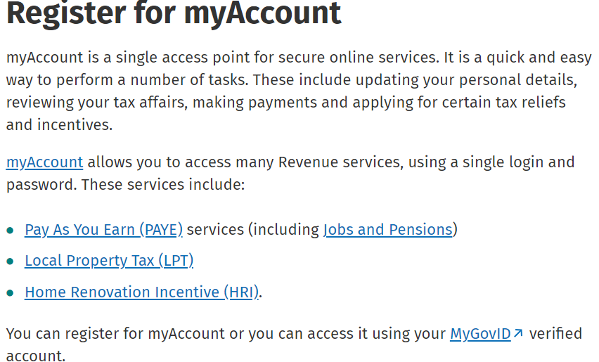
Register for myAccount

Slide 4

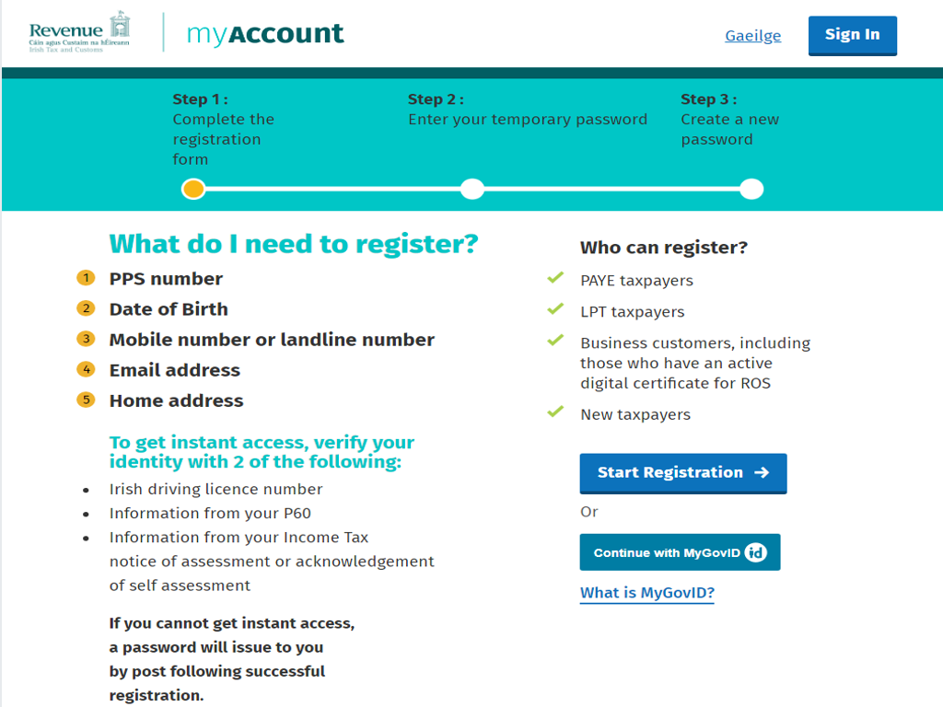



Registering for myAccount with Revenue is quick and easy

Slide 5
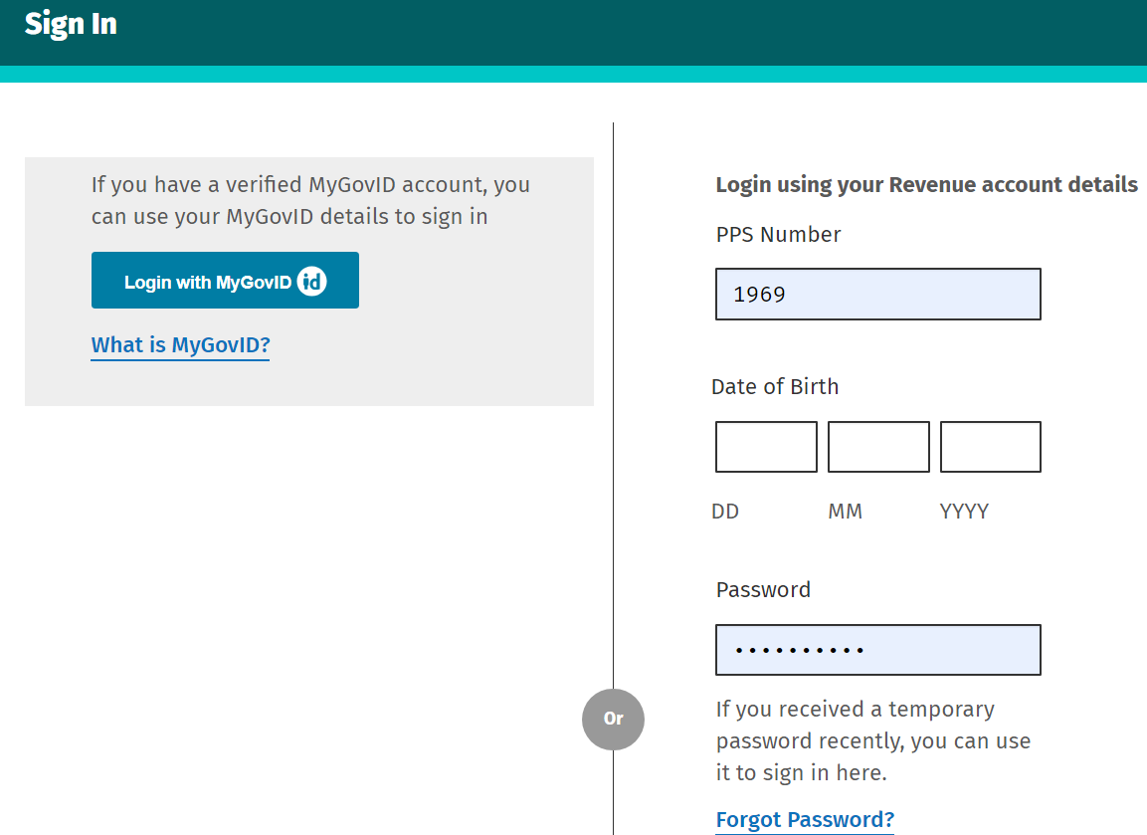
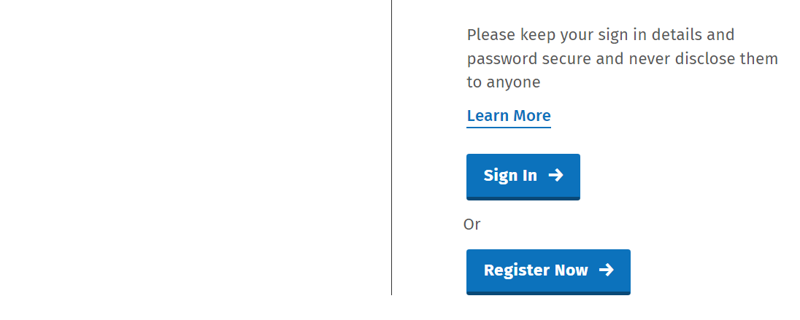
Logging in to myAccount with Revenue

Slide 6
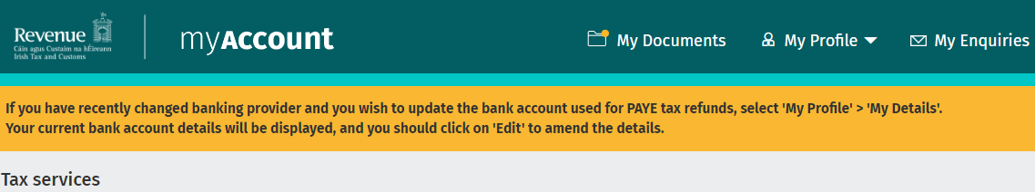
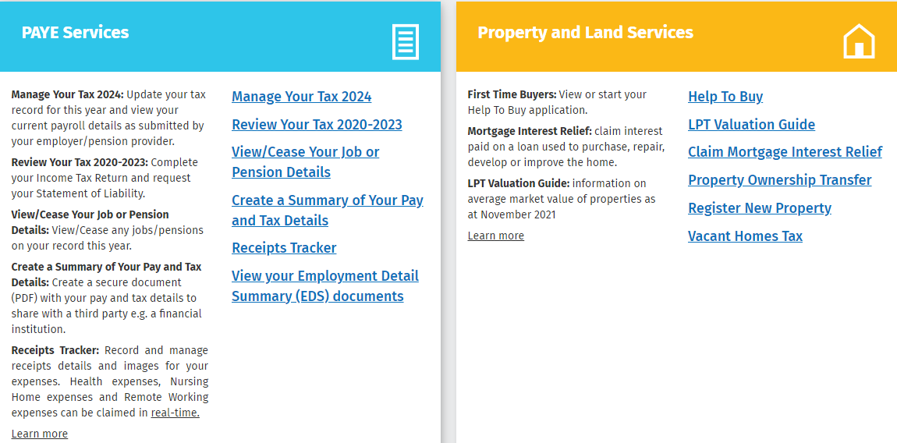

Slide 7
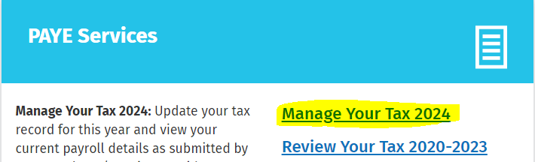
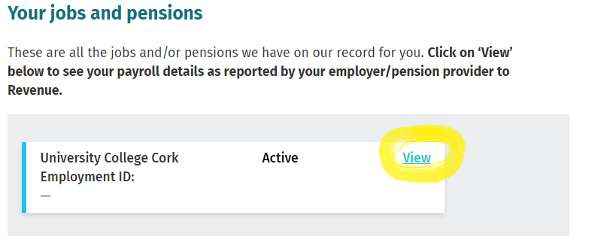
View Your Payments
Go to Manage Your Tax 2024 and then under Your jobs and pensions click “View”.

Slide 8
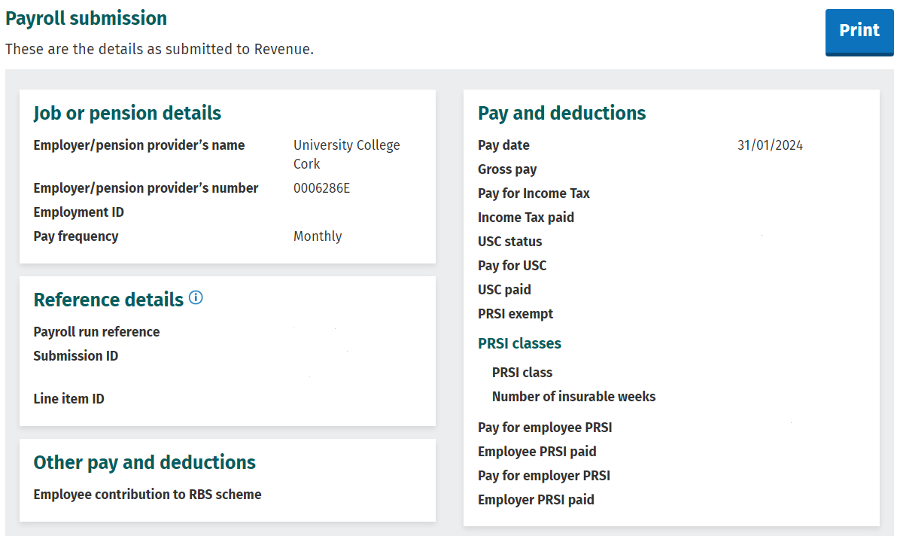
Under Payroll Details click View to see or print Your Payments on one page

Slide 9

My Tax Credit Certificate and Employment Details Summary
Revenue will issue you with a Tax Credit Certificate which can be viewed in the “My Documents” section on myAccount.
Tax credits reduce the amount of tax you pay and your tax cut off point will determine the rate of tax deducted – please contact Revenue for any issues through myAccount or call 01 738 3636 from 9:30 to 1:30 Mon - Fri.
An employee's Employment Details Summary contains a summary of pay, income tax, USC, PRSI & LPT per employment as reported by their employer(s).
You can view your own information on your myAccount on the revenue website Welcome to Revenue.ie.

Slide 10
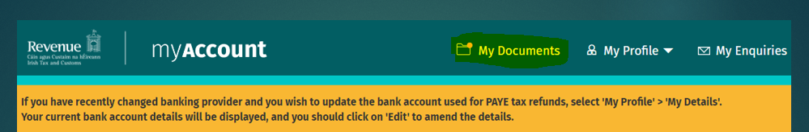
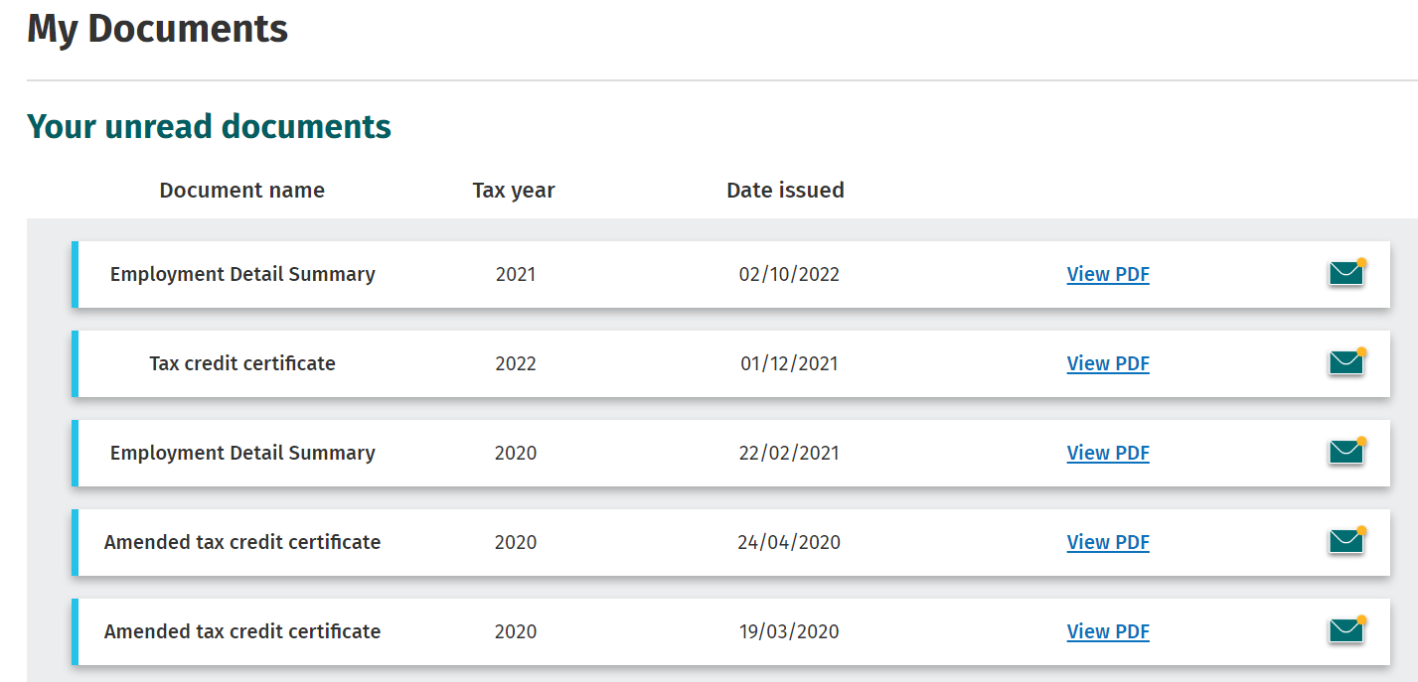
View “My Documents”

Slide 11
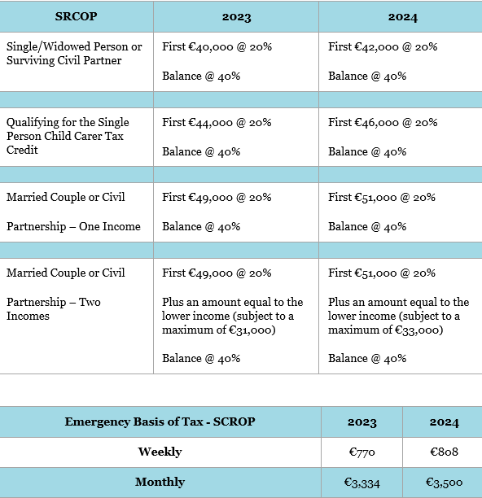
How is my Tax Calculated?
Your Income Tax is calculated by:
applying the standard rate of 20% to the income in your monthly tax cut off point
applying the higher rate of 40% to any income above your monthly tax cut off point
adding the two amounts above together
deducting the amount of your monthly tax credits from this total.

Slide 12
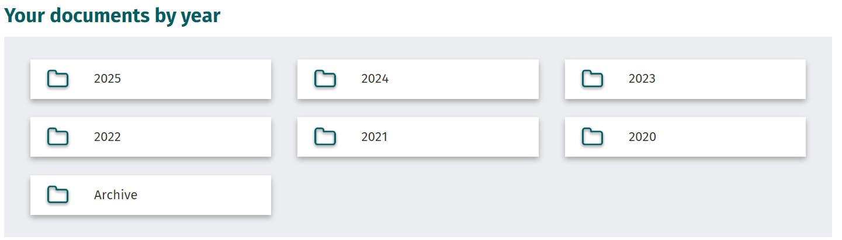
My Documents – All Past Years

Slide 13
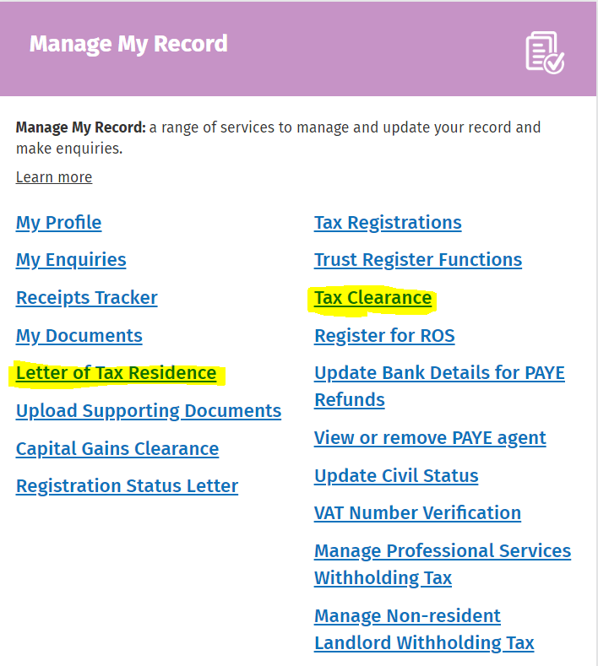
Manage My Record
Letter of Tax Residence
Tax Clearance

Slide 14
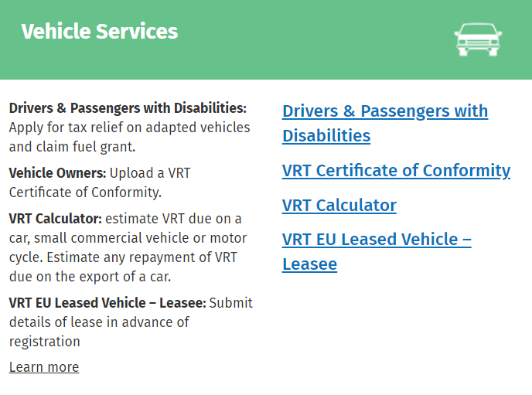
Other useful Sections of myAccount

Slide 15

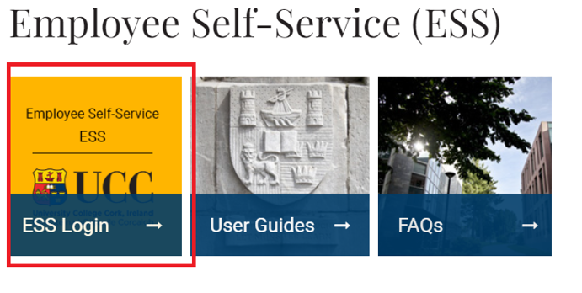
Accessing your payslips online = Logging into ESS
You will be asked for your UCC email address and password, and you will be prompted to verify your identify by selecting the text option which will send a Verification code to your mobile phone.

Slide 16
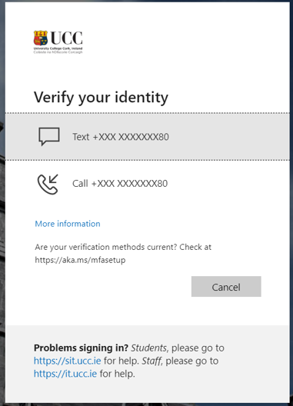
Logging into ESS
Enter the 6-digit code that is sent to you phone and you will find yourself in ESS

Slide 17
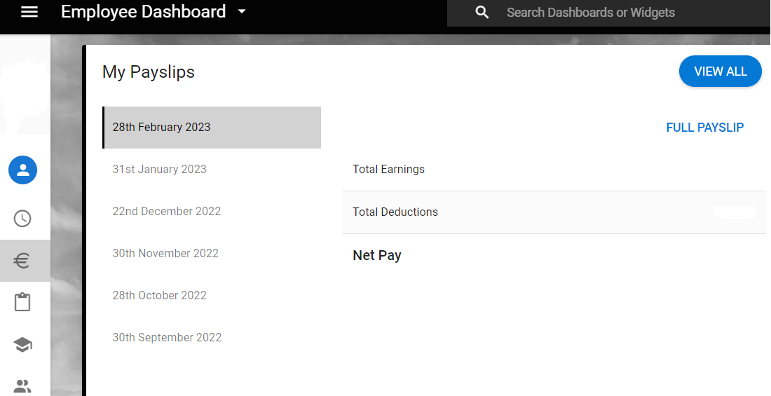
To view your Payslip log into ESS
Click on € Payment and you will be able to view and download all of your payslips – your last 4 payslips are shown but all are available to you here by clicking “View All”.

Slide 18
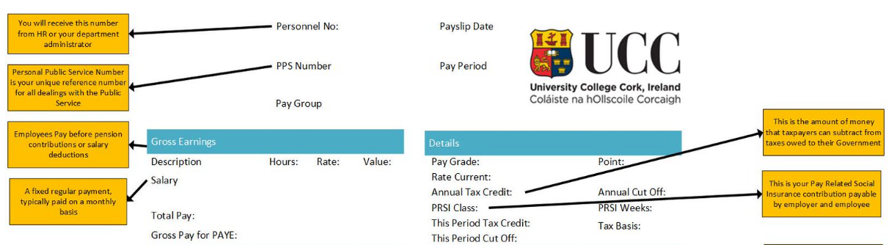
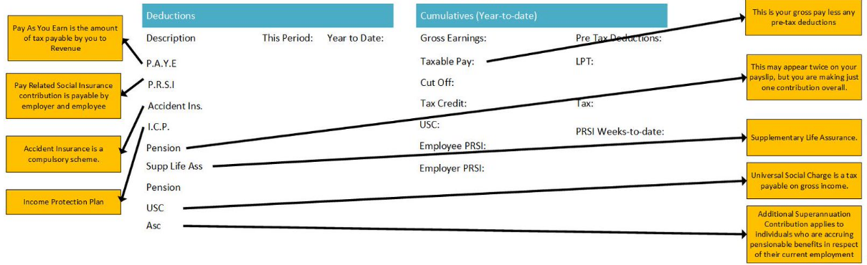
Your Payslip Explained

Slide 19
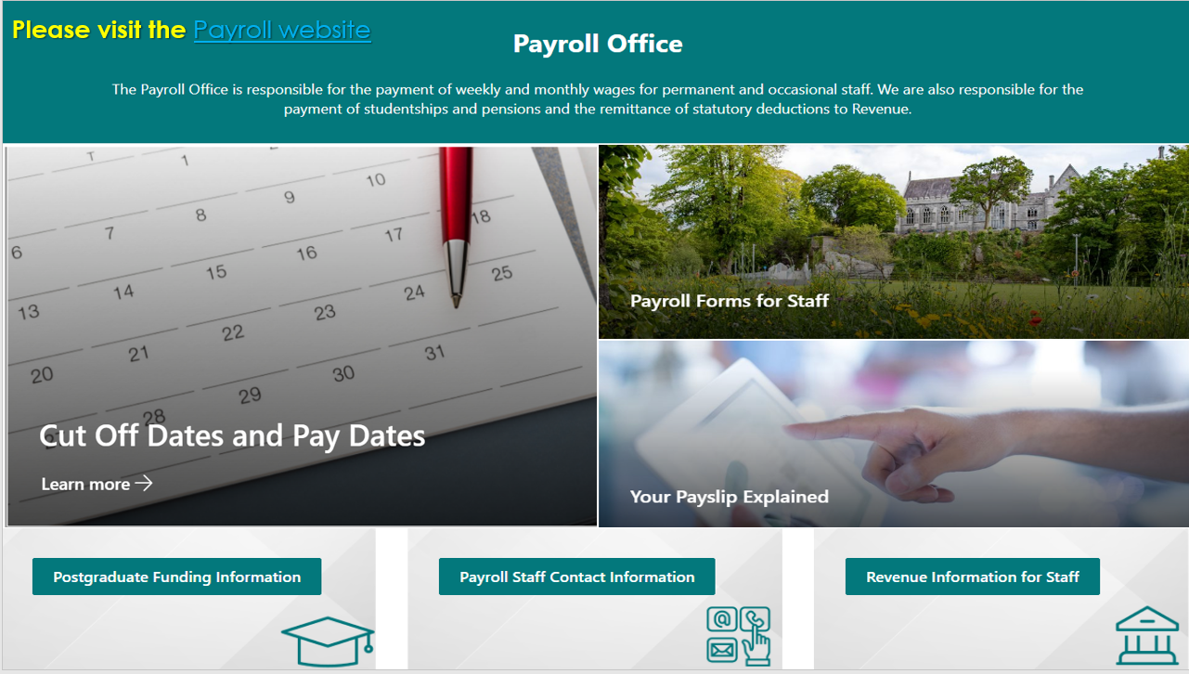

Slide 20
Questions for the Payroll Office?
Thanks for your time.

