Slide 1

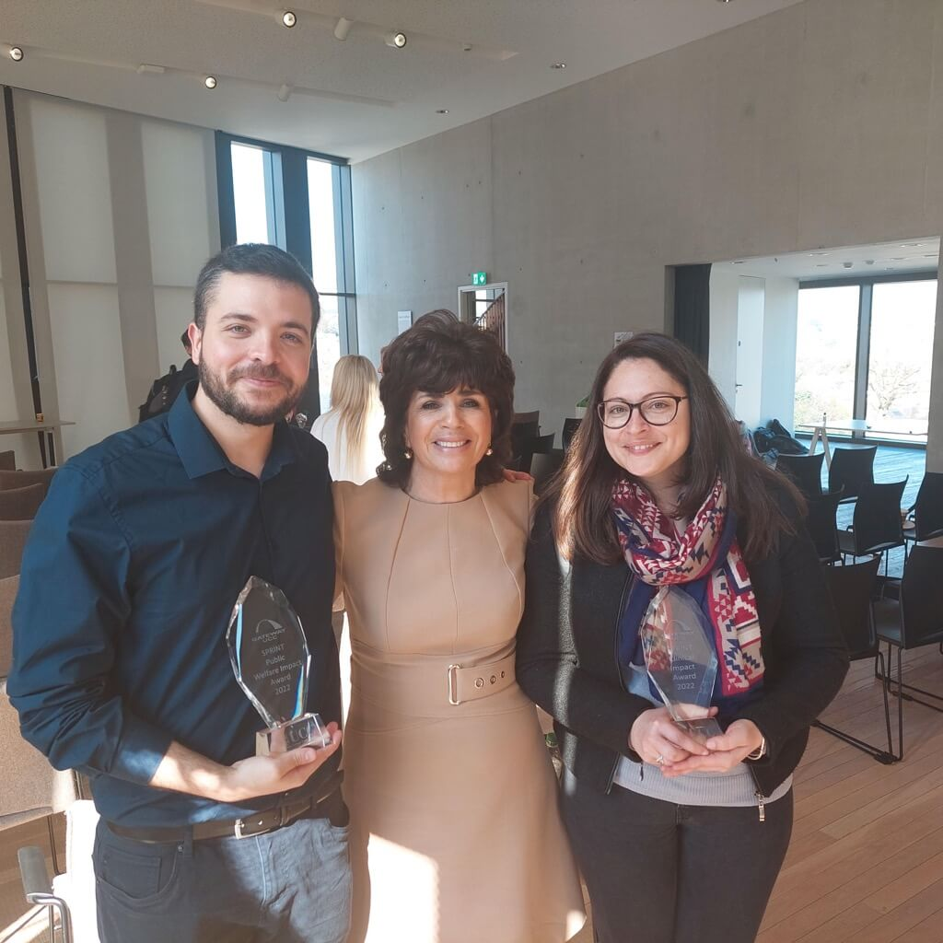

Researcher Guide to Commercialisation and Business Start Up
  Myriam Cronin, Head
  of Gateway UCC
  6 October 2023
  myriam.cronin@ucc.ie

Slide 2
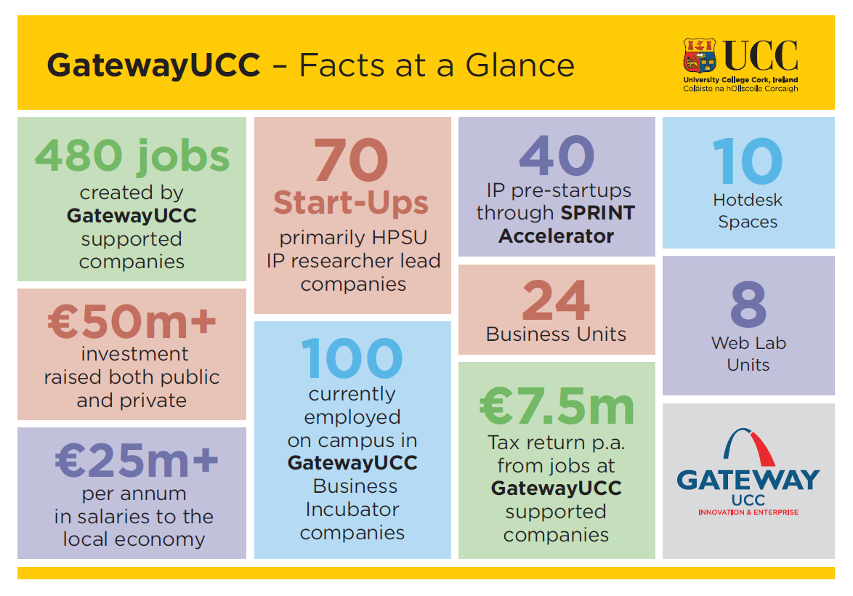

Slide 3
Current Position & Impact
Current Position
  Assisted just under 100 company start-ups including on the Sprint Accelerator Startup over 8 yrs
  Total of 550 jobs and growing
  100 people currently working in Gateway UCC Campus Companies in UCC
Impact
  40 LEO and EI High Potential Start Up (HPSU) companies
  60 pipeline new ventures via SPRINT Accelerator
  - 550 jobs created since 2010
  €25m per annum salaries into the local economy
  €50m investment raised public and private

Slide 4
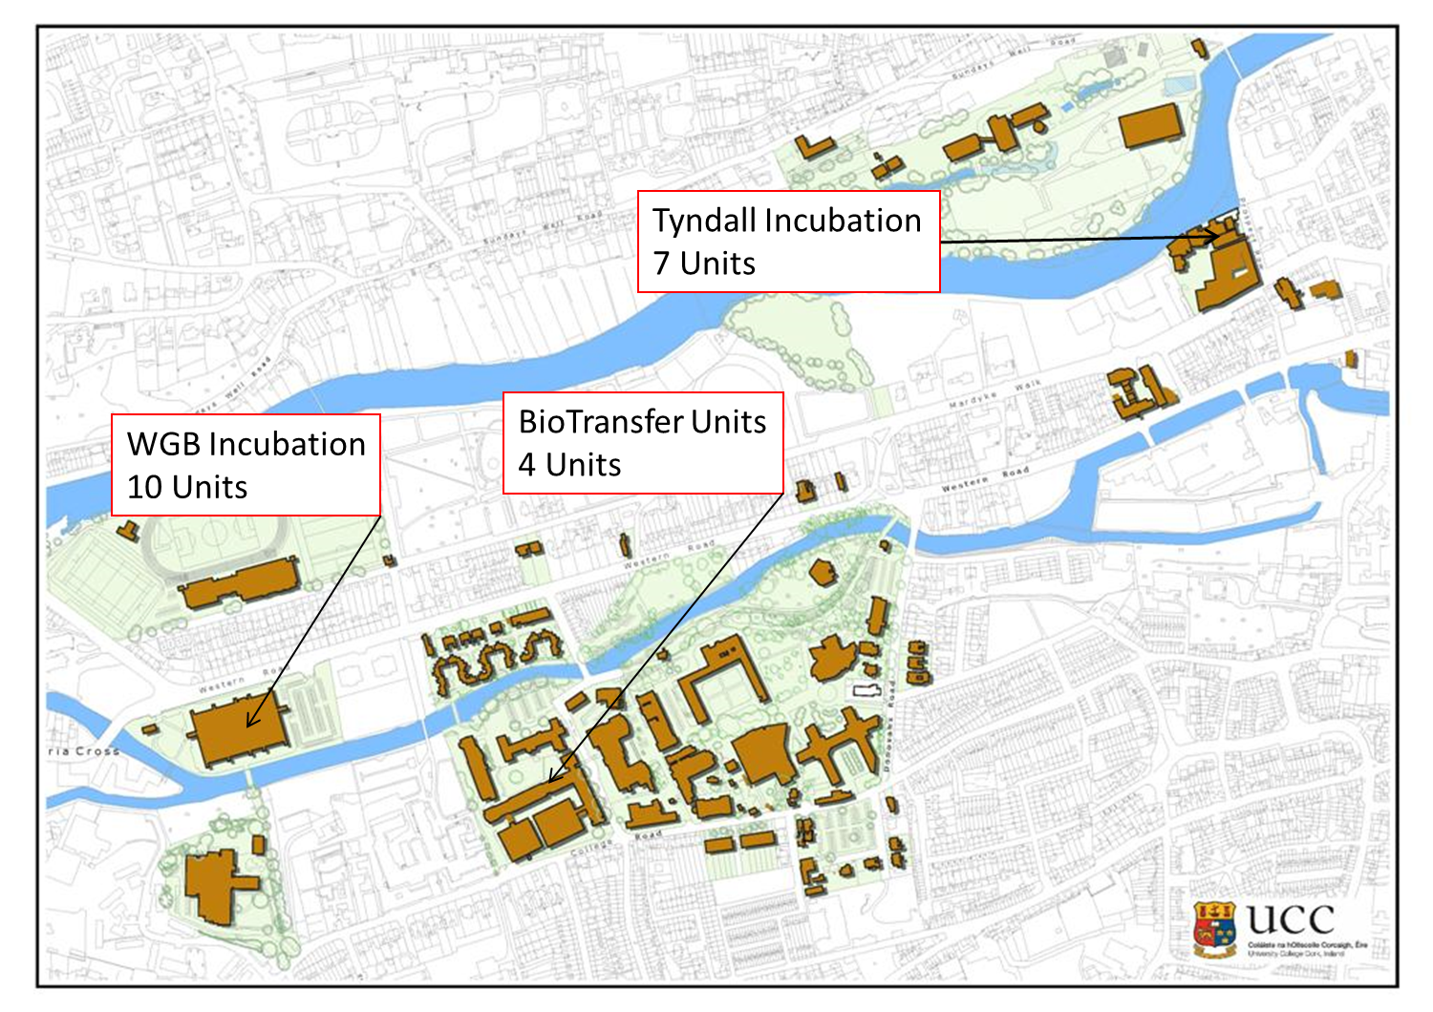
Gateway UCC Incubation Locations
1,300 sq metres, 24 Business Units
3 Locations , 8 Wet Laboratory units + write up offices, 10 Hot Desks

Slide 5


























Gateway UCC sample spinout activity

Slide 6
GatewayUCC SPRINT Accelerator Programme
Launched Feb 2016 by Julie Sinnamon, CEO Enterprise Ireland.
Providing a backdrop for a University Wide Exposition of its entrepreneurship support initiatives.
Researchers with Early Stage Start Up Ideas
Working with Seasoned and Successful Business Mentors
SPRINT a GatewayUCC developed programme
Business Development Coaching
Scaling and International Growth under the guidance of the GATEWAY Manager

Slide 7
GatewayUCC SPRINT Accelerator Programme
Identifies pre and early-stage companies and researchers working on cutting edge technologies and platforms,
Gives the tools and assistance needed prior to spin out for the development of their business.
Navigates the business landscape and introductions to the networks/funding and connections that can help them succeed.
This typically happens 6 months to 2 years prior to the spin out taking place. SPRINT is first comprehensive business programme for RESEARCHER in the University.

Slide 8
SPRINT to date
8TH YEAR
90 Researchers/ through the programme. From Tyndall, APC Microbiome, Infant, MaREI, IPIC, INSIGHT.
Three Phases, first Phase 6 modules – Digital Badge
Serial Entrepreneurs and Business Practitioners presenting.
Sponsored by Enterprise Ireland, Cork City LEO and Cork City Council.

Slide 9

Map out stages
Map out Stages for Pipeline Generation and SPRINT Development Pathway

Slide 10
Proposed revamp:
3 Phase Spin-out Development Pathway
1.Kick off Bootcamp Concept Ideation
2.Proof of Concept
Customer Validation
3 .Investor Readiness Demo Day
6 modules
16 modules Weeks
4 days over a month

Slide 11
PHASE 1: KICK OFF BOOTCAMP
CONCEPT IDEA STAGE
Participant Learning Outcomes:
Knowledge of IP
Understand UCC supports
Feasibility fund application
Purpose (UCC Innovation):
Lead Generation
Inform researchers of UCC supports and policies
Link to Case Manager
Format:
6 modules;
6 weeks
Lead Generation TARGET PHD/POST DOC/PI
IP capture and Live Case Studies
EI Feasibility Template
Market Evaluation
Customer Discovery
Value Proposition
Business Model Outline

Slide 12
Problem/Solution/Market Analysis/IP CAPTURE EXERCISE
Concept Idea Lead Generation
Leading to Decision
Licence or Spin out
Concept Idea Lead
Generation
Leading to
Broadbase Comms Fund application for Consideration with EI
Concept Idea Lead Generation
Leading to Feasibility Fund application market scoping
Decision to Comms Fund application

Slide 13
Phase 2 – Proof of Concept/Customer Validation (Comms Fund Underway)
Purpose (UCC Innovation):
Lead Generation/Customer Validation
Format:
20 modules;
3/4 month period
Entry requirements:
Comms feasibility funding/Comms Fund
UCC Outcomes:
Spin out pipeline prospects
Participant Learning Outcomes:
Developing entrepreneurial skills Product market validation & Commercial lead engagement
Elevator Pitch
Slide Pitch Deck
Early Investor engagement
Funding Options and Investment
Sales Strategy / Market Validation
Term Sheets and Equity and Dilution
Comms Fund in place /
Commercial Lead engagement
Business Plan Development

Slide 14
Phase 3: Investor Ready Bootcamp
Purpose (UCC Innovation):
Get spin-out companies investor ready
Format:
4 modules; 4 days
1 day/weekly
1 x pa
Entry requirements:
Will complete Comm Fund in next 3-6 months
Ready to incorporate spin-out
UCC Outcomes:
Spin-out formation
Potential investment
Participant Learning Outcomes:
Spin out business start up
On-boarding investment
Defining Team structure
Investor Meetings/ Feedback
Networking
Pitch Perfecting
Intensive Bootcamp
Refine Slide pitch deck
Coaching and Mentoring
Business plan/ Investor Readiness
Demo Day
Elevator Pitch

Slide 15
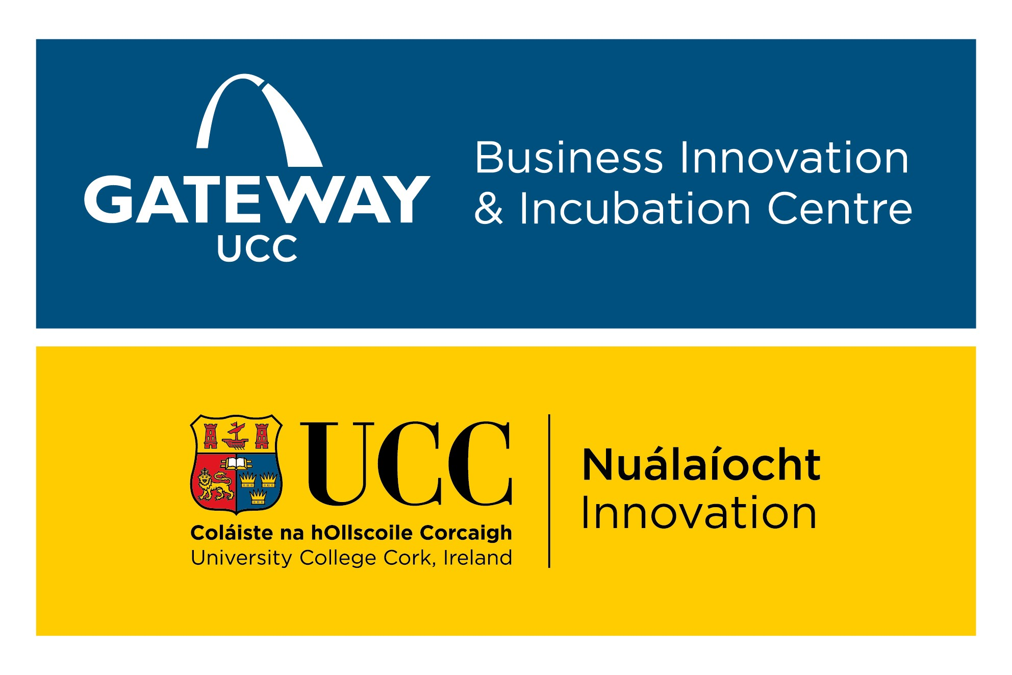
SPRINT content
Professional advice Learning from entrepreneurs
General Start-up advice Case Studies Peer discussion
Enhance your Network Raising finance
Company structure Lead generation
Customer discovery Market Segment identification
Business plan Mentoring/Coaching
Design Thinking Business Model Canvas
Presentation Skills Conducting Customer Interviews IP Management

Slide 16
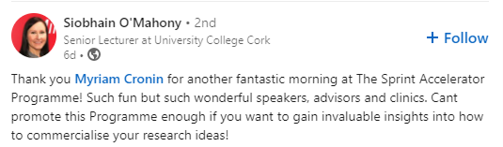
SPRINT – Testimonials
“GatewayUCC’s SPRINT Accelerator Programme gave me the opportunity to build a solid foundation of the essentials needed to progress my research towards commercialisation. The seminars are led by industry experts and experienced entrepreneurs who offer a wealth of support and provide great opportunities to build a strong business network,” Dr Mark O’Sullivan, NeuroBell.
LinkedIn post
“This was the most relevant course I have ever taken. I can’t pick our a single session that I didn’t benefit from,” Dr Brenda Long, ERI
“Fantastic and highly recommended,”
Dr Xing Dai, IPIC, Tyndall National Institute
For further information, please contact myriam.cronin@ucc.ie

Slide 17


Commercialisation Feasibility Fund
Assess the commercial viability of your research
  This fund provides researchers with the opportunity to validate the commercial opportunity for your technology with a grant of €15,000 to procure an expert independent industry consultant
Commercialisation Fund
Move your technology up the TRL scale
This fund provides researchers with a dedicated Commercialisation Specialist to guide and support applicants during the application and project. Proposals range from ~€80,000 to €350,000.

Slide 18

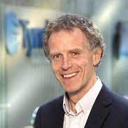
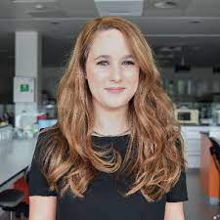
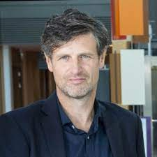
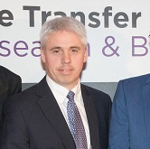
Commercialisation Case Managers (TTO)
Anthony Morrissey | Emer O’ Shea | Kevin Dalton | David Corkery
PIC/Photonics Mathematics Computer Science CUBS | APC Microbiology Psychiatry | Infant Pharmacy Medicine | Tyndall Wireless Systems Tyndall MCCI Tyndall SPSS
a.morrissey@ucc.ie | emeroshea@ucc.ie | k.Dalton@ucc.ie | d.corkery@ucc.ie

Slide 19
New Commercial Champions
New leads and earlier engagement – partnering to accelerate the spin out
VC / business Partners Programme
Cork BIC / National BIC network
Alumni Event opportunities
Headhunting / middle management in corporates
Tagline on all correspondence - Newsletters
IRRUS Angel Network
Boole Angel Network

Slide 20

UCC Consulting
Introduction to UCC’s managed consultancy unit

Slide 21
Our Process
Step 1
Project Brief
Risk assessment
Step 2
Draft Contract
SOW - Price and Ts & Cs
Step 3
Project Delivery
Step 4
Project Close
HOS/HOC Approvals
Issue to client for counter signature
Resources
  Project milestones
  Time/budget management
  Billing
  Delivery
  Invoicing
  Internal distributions
  Consultancy declaration on IRIS
  Impact report (where applicable)

Slide 22

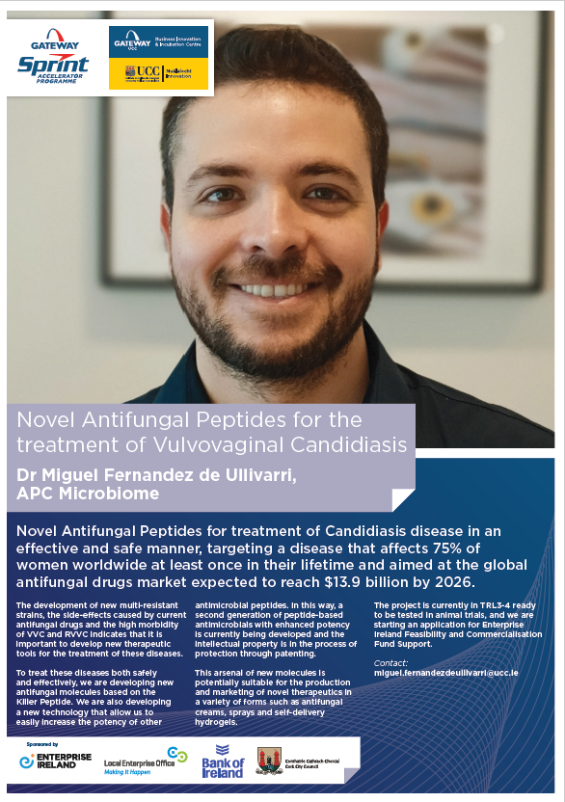

Introducing….

