Slide 1
Writing Grant Proposals 16 June 2023
Niamh Mundow EU Research Officer Niamh.mundow@ucc.ie
euresearch@ucc.ie

Slide 2

When you apply for funding for your research, UCC’s involvement becomes part of the terms and conditions of it being granted.
Your funder grants the funding to UCC and not directly to you.
Your research applications and contracts need a legal signatory – VP Research & Innovation.

Slide 3
1 to 1 consultations
Application and endorsement
Budget
Proposal
Letters of commitment
Safety reviews
Contracts
Research Acount

Slide 4

Do not select funders based on upcoming deadlines at the last minute – you could end up being penalised for not having understood the amount of time you should be putting in for a competitive proposal
When looking at funders you need to consider not just where you are now, but where you are going, so you have time to develop your profile and meet the eligibility criteria in future calls.
Potential to lead ---- leadership ---- established leader

Slide 5
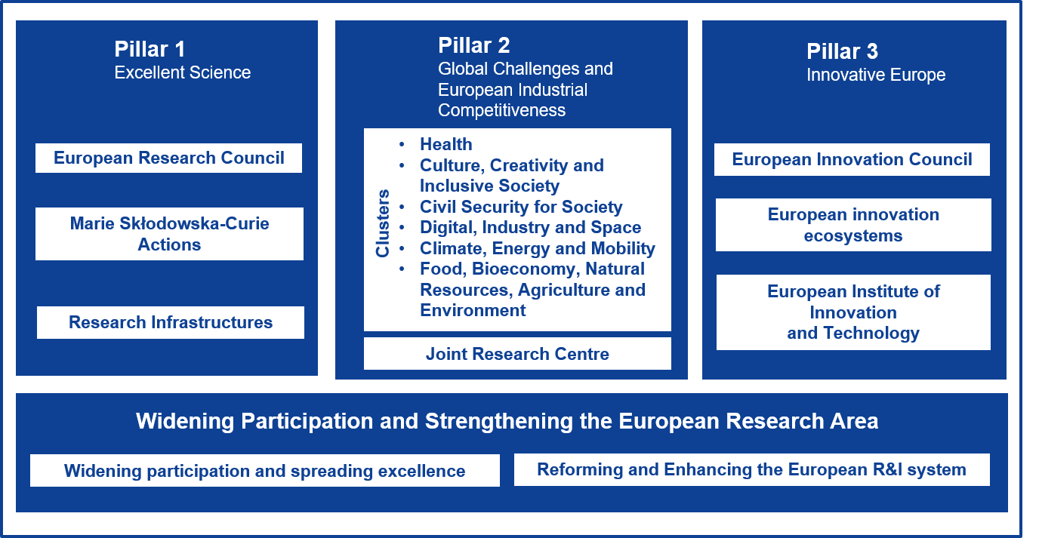
Horizon Europe
Top down or bottom up?

Slide 6


Post doctoral fellowships are often advertised locally in UCC. Speak to academics in your Department about any projects recently funded or in the pipeline.
https://www.ucc.ie/en/hr/vacancies/research/

Slide 7
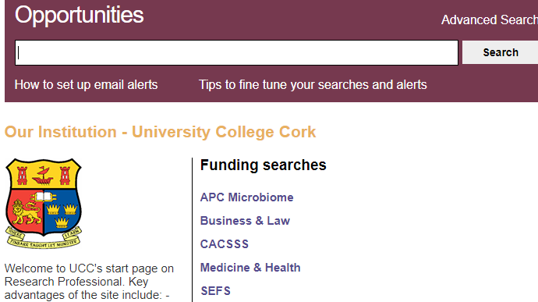

https://www.researchprofessional.com/0/rr/home

Slide 8


Consortium applications
MSCA Doctoral Networks / Co-Fund, European Innovation Council, Widening / ERA, Pillar 2 Global Challenge, Missions
Work programmes
Involvement in developing work programmes
Enterprise Ireland funding – 12.500
Application
Reviews
Policy research
Partner searches
Information sessions
Workshops
If you are writing the proposal…
Individual applications
Enterprise Ireland support
Workshops
Reviews - in line with consultant sessions
Mock interviews
Application / portal
euresearch@ucc.ie

Slide 9
Enterprise Ireland support for Horizon Europe
€16,000
€12,500
€3000
ERC
Staff Costs
Travel
Professional
4 month deadline
​
Coordinator
Staff costs €8000
Travel €2000
Professional €4000
10 week deadline
12 MSCA
COST = €3000
Travel
3 days per trip
Multiple trips allowed
EU brokerage events
HE Consortium meetings
Meet potential partners​

Slide 10
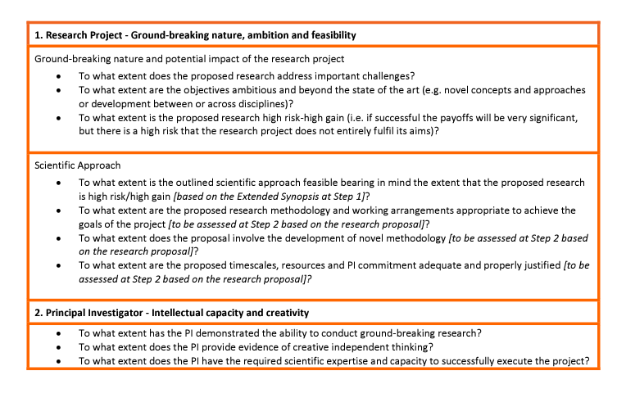
Eligibility checks
Track record and CV
Know which panel you addressing and the profiles of the evaluators
2 proposals – B1 and B2 submitted together

Slide 11

General feedback on ERC Evaluation Summary Reports
Positive
The PI has an excellent record of achievement
This project aims to fill an important gap in research
Negative
The very broad scope of the project, as well as the lack of sufficient detail for some of the approaches are an area of concern
A credible contingency plan is not provided. It seems like the applicant is putting all his eggs in one basket
The projects groundbreaking potential is uncertain due to the lack of genuine novelty and excessively narrow focus
No indication of number of subjects used for this study
Some of the existing literature is overlooked
Evidence of research leadership would strengthen the proposal
Not sufficiently novel

Slide 12
MSCA Post Doctoral fellowships
Evaluation Criteria
Impact Weighting – 30%
Measures to enhance career perspectives and employability of researcher and contribution to skills development
Suitability and quality of the measures to maximise expected outcomes and impact as set out in the dissemination and exploitation plan, including communication activities
The magnitude and importance of the projects contribution to the expected and scientific, societal and economic impacts
Quality and efficiency of implementation –20%
3.1 Quality and efficiency of the work plan, assessment or risks and appropriateness of the effot assigned to work packages (nb gantt chart)
3.2 Quality and capacity of host institutions and participating organisations including hosting arrangements
Excellence Weighting: 50%
Quality of objectives
Methodology – including interdisciplinary approaches, gender, diversity, quality of open science, engagement of civil society
Quality of the supervision, training and two way transfer of knowledge between the researcher and the host
Researchers existing experience in relation to the proposed project

Slide 13

1 Show you have read the guidelines and understand the evaluation criteria. This should drive the structure.
2 Use and respect the templates – including CV. If listing publications, make it clear what your contribution is that demonstrates your feasibility for this project.
3 Ask your research question from the beginning. Customise. Be careful with copy and paste. Make it easy to scan.
4 Make diagrams easy to follow – check with family or friends
5 Identify risks and contingencies / gains that make the risk worth it
6 Be clear as to the aim of each objective and work package. Outline and develop. No random surprises mid text
7. If they don’t want incremental, make it very clear why its not. If it’s a novel idea then gather preliminary data to demonstrate feasibility.
Tips

Slide 14

Build your profile
Publish
Contribute in conferences
Ongoing projects
Become an evaluator

Slide 15

https://www.ucc.ie/en/research/support

