Slide 1
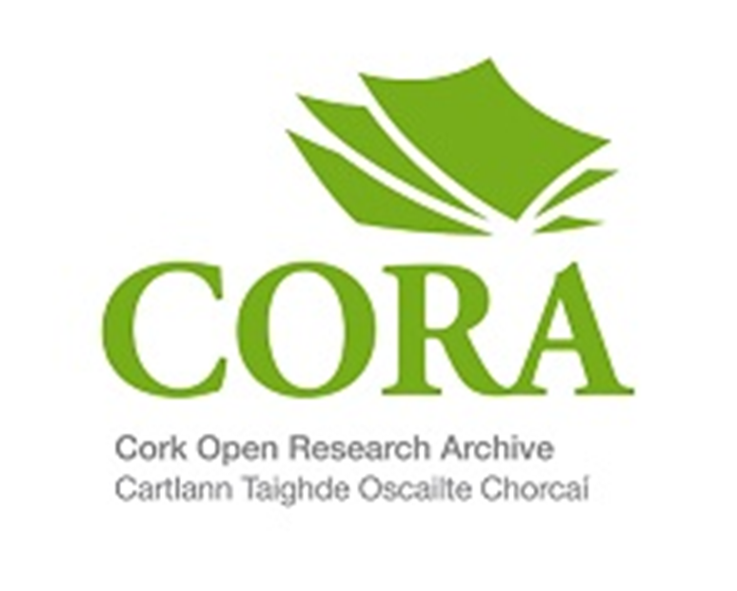
OPEN RESEARCH UCC HR Researcher Training
Friday 21.04.23
1100 – 1200 – via Teams
Donna Ó Doibhlin
https://libguides.ucc.ie/openaccess
donna.odoibhlin@ucc.ie / cora@ucc.ie

Slide 2
Research lifecycle – What’s in a name?
ORCID, short for Open Researcher and Contributor ID, gives researchers and authors a single unique digital ID which works across the research landscape
Eliminates name ambiguity
Improves discoverability
Connects your work – one profile for all your work
Stays with you throughout your career - institution and publisher agnostic
Facilitates system integration
https://orcid.org/0000-0001-6033-0480

Slide 3
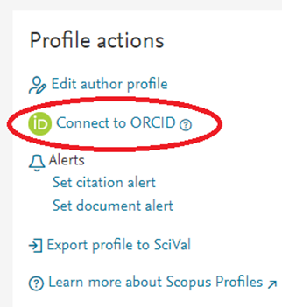
Research lifecycle
ORCID eliminates name ambiguity!
https://www-scopus-com.ucc.idm.oclc.org/authid/detail.uri?authorId=6602488702

Slide 4
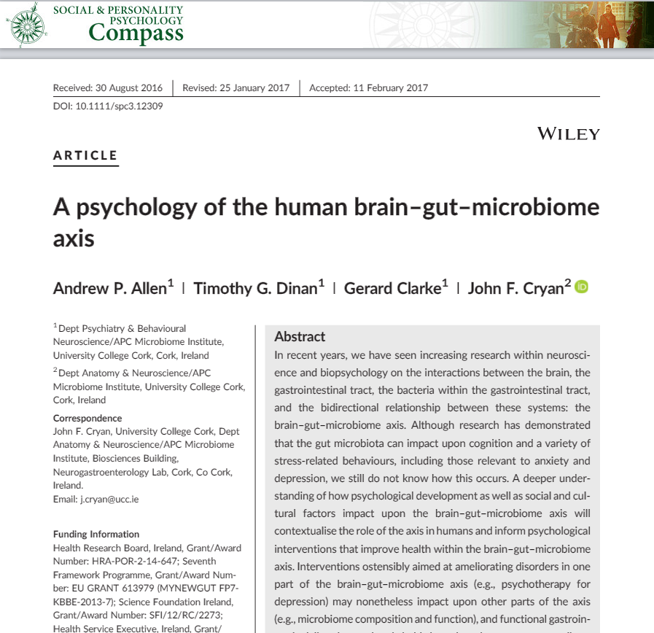
Research lifecycle - Publishers using ORCID

Slide 5
Promote your articles - Make yourself visible online:
Distribute your profile:
IRIS
ORCID Self-register and can set up for auto updates.
Publons Self-register by claiming Web of Science ResearcherID
Scopus Author Profile. Automatically populated but can request corrections
Google Scholar Self-register and can set up for auto updates
Research Gate, Academia.edu, Loop
Promoting via social media, Twitter, personal websites, LinkedIn etc.

Slide 6
“Open science is an approach based on open cooperative work and systematic sharing of knowledge and tools as early and widely as possible in the process.
It has the potential to increase the quality and efficiency of research and accelerate the advancement of knowledge and innovation by sharing results, making them more reusable and improving their reproducibility.
It entails the involvement of all relevant knowledge actors”
Open Science/Research
Open Data
Open Methodology
Open Access Publications
Citizen Science
Open Evaluation
Horizon Europe Programme Guide
Notes:
There is no single definition of ‘Open Science’ or ‘Open Research’ , but Open Access publishing is at it’s centre.
Open science encompasses unhindered access to scientific articles, access to data from public research, and collaborative research enabled by ICT tools and incentives.
Broadening access to scientific publications and data is at the heart of open science, so that research outputs are in the hands of as many as possible, and potential benefits are spread as widely as possible and this is what we are trying to encourage by our OA policies and supports.

Slide 7
What is open access?
Open access is a set of principles and practices through which research outputs are distributed online, free of cost or other access barriers.
Through licensing via an open license (usually a Creative Commons license), freely available outputs can also be legally shared and reused.
Therefore, open access is more than just free access.
Notes:
Making scholarly research outputs freely available on the web, with no (or limited) licence restrictions on reuse

Slide 8
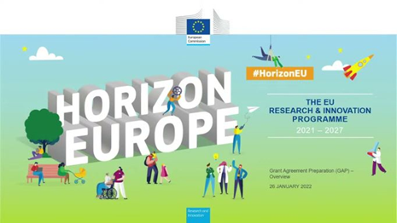
Policy shift
Note: Open Access is increasingly the norm nationally and internationally. Also, for funded research, Open Access may be a requirement of the funding agency
Notes:
Several policy papers have been published recently by scientific government bodies in Ireland and Europe with the aim of making research, especially that which stems from public funding, freely available to anyone with access to the internet. European bodies and research organisations have signed several agreements to demand that published research findings and papers transition from behind paywalls, to open access online..
Many funding bodies have signed up to Plan-S which is tightly focused on transition of OA for publications, and of with SFI is a signatory, as are the IRC and HRB.
With HORIZON EUROPES ADOPTION OF PLAN S – THIS HAS CHANGED HOW RESEARCH MUST BE CONDUCTED AND SHARED
SFI / IRC / WELCOME ARE ALL signatories

Slide 9
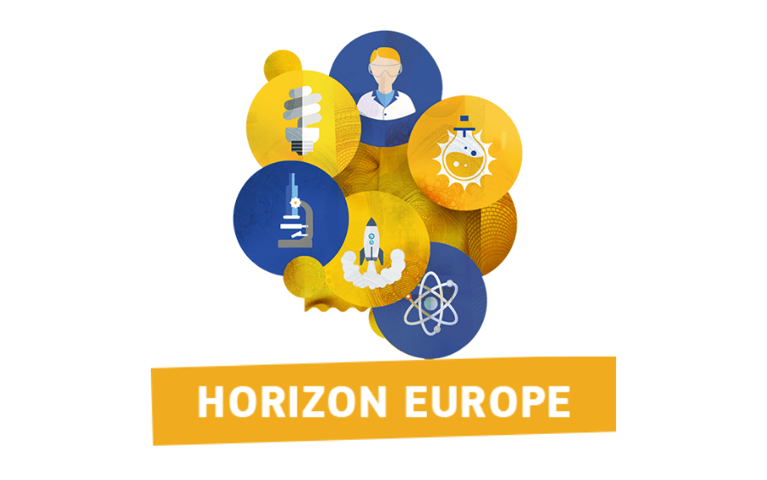
Plan S: What’s different?
Immediate access/Zero embargo
Rights Retention by author/institution required & content licensed under CC-BY
‘Hybrid OA’ not eligible for funding (except through TA/TJ)
Full OA Journal/Platform
Transformative Agreement/Journal (until 2024)
Repository with zero embargo
(Rights Retention)
Notes:
Immediate access/Zero embargo
Rights Retention by author/institution required & content licensed under CC-BY
‘Hybrid OA’ not eligible for funding (except through TA/TJ)
Plan S
Plan S, an initiative of cOALition S, was launched in September 2018 with the goal of achieving full and immediate open access to publications. COAlition S comprises a group of research funders that has committed to implementing Plan S, and aims to accelerate the transition to a scholarly publishing system characterised by immediate and free online access to scholarly publications.

Slide 10
Funder's open access policies
NORF * - https://norf.ie/national-action-plan/
The National Action Plan is structured according to three themes: Establishing a culture of open research; achieving 100% open access to research publications; and enabling FAIR research data and other outputs.
The National Action Plan has been endorsed by over 50 national and international stakeholder organisations
Coalition S - Plan S
“With effect from 2021, all scholarly publications on the results from research funded by public or private grants provided by national, regional and international research councils and funding bodies, must be published in Open Access Journals, on Open Access Platforms, or made immediately available through Open Access Repositories without embargo”
Horizon Europe
All peer-reviewed scientific publications arising from Horizon Europe funding have to be made available in open access. This implies that publications are to be made freely available online, immediately upon publication and with no restrictions on use, by depositing them on a repository. You should be aware that you are required to retain sufficient intellectual property rights (IPR) to comply with these open access obligations.
Notes:
Many funding bodies have signed up to Plan-S which is tightly focused on transition of OA for publications, and of with SFI is a signatory, as are the IRC and HRB.
With HORIZON EUROPES ADOPTION OF PLAN S – THIS HAS CHANGED HOW RESEARCH MUST BE CONDUCTED AND SHARED - SFI / IRC / WELCOME ARE ALL signatories

Slide 11
Funder's open access policies
European Research Council Open Access Policy
The ERC supports the principle of open access to the published output of research as a fundamental part of its mission &
Require that an electronic copy of any research article, monograph or other research publication that is supported in whole, or in part, by ERC funding be deposited in a suitable repository immediately upon publication, and that open access be provided to that copy under the terms of the applicable Model Grant Agreement used for ERC actions;
Strongly encourage ERC funded researchers to use domain-specific or discipline-specific repositories for their publications
IRC Open Access Policy
All researchers must lodge their publications and other research outputs, resulting in whole or in part from Council-funded research, in an open access repository and should make such publications publicly discoverable, openly accessible and re-usable as soon as is possible.
Repositories should release the metadata immediately upon deposit. Open Access to the full text paper should be made immediately upon deposit or once access restrictions, as required by certain publishers, have expired.
Wellcome Trust Open Access Policy
Published outputs that arise from our funding must be open and accessible to everyone. This open access policy applies to all original, peer-reviewed research publications that have been supported, in whole or in part, by Wellcome.
Notes:
Many funding bodies have signed up to Plan-S which is tightly focused on transition of OA for publications, and of with SFI is a signatory, as are the IRC and HRB.
With HORIZON EUROPES ADOPTION OF PLAN S – THIS HAS CHANGED HOW RESEARCH MUST BE CONDUCTED AND SHARED - SFI / IRC / WELCOME ARE ALL signatories

Slide 12
Funder's open access policies
SFI Open Access Policy
SFI now requires all peer-reviewed articles and conference proceedings submitted for publication after 1st January 2021 to be made openly accessible immediately from the date of publication. This requirement also applies to other funding agencies that have endorsed cOAlition S / Plan S e.g. Wellcome Trust. Coalition S
Environmental Protection Agency (EPA) Open Access Policy
All projects funded by the EPA Research Programme are required to ensure open access to all peer-reviewed publications resulting from EPA funding. This must be done by depositing your peer reviewed manuscript in an open access repository as agreed with the EPA. You are also encouraged to publish in reputable open access journals. Please note however, the communications budget may only be used for Gold Open Access in exceptional circumstances, subject to prior approval by the EPA. Expenditure on Gold Open Access that has not had the prior approval of the EPA will be deemed ineligible.
European Commission – Horizon Europe / Horizon 2020
All peer-reviewed scientific publications arising from Horizon Europe funding must be made available in open access. This implies that publications are to be made freely available online, immediately upon publication and with no restrictions on use, by depositing them on a repository. See here for more info.

Slide 13
Publish your research
Where to publish?
IrEL list of Journals with APC agreements see:
https://libguides.ucc.ie/OAagreements/home
Supervisor guidance
Your own familiarity with your field, your own reference list
Use database to search for your topics and review results – eg Scopus
Consider preprints archives: https://www.biorxiv.org/
Open library of Humanities
DOAJ http://www.doaj.org

Slide 14
Selecting a Journal
Look for OA journals
http://www.doaj.org
What are the requirements for authors?
Indexing of the journal
Web of Science Master List
Scopus Sources
Medline / PubMed
Journal Citation Performance
Journal Citation Reports
Scopus Sources
Scimago
Analyse Search Results from databases
Web of Science
Scopus (See the example in the next few slides)

Slide 15
Analyse search results for your topic in the databases Eg. Scopus

Slide 16
https://coara.eu/
‘Publish or perish’ and metrics have led us into a blind alley. Let’s start recognizing the full breadth of value created by researchers.
Marc Schiltz, President of Science Europe
Coalition for Advancing Research Assessment
- Our vision is that the assessment of research, researchers and research organisations recognises the diverse outputs, practices and activities that maximise the quality and impact of research. This requires basing assessment primarily on qualitative judgement, for which peer review is central, supported by responsible use of quantitative indicators.
Notes:
The Agreement on Reforming Research Assessment sets a shared direction for changes in assessment practices for research, researchers and research performing organisations, with the overarching goal to maximise the quality and impact of research.
The Agreement includes the principles, commitments and timeframe for reforms and lays out the principles for a Coalition of organisations willing to work together in implementing the changes.
‘Publish or perish’ and metrics have led us into a blind alley. Let’s start recognizing the full breadth of value created by researchers. (Marc Schiltz , President of Science Europe)
The interim secretariat of the Coalition for Advancing Research Assessment (CoARA) is provided by Science Europe, the European University Association (EUA) and the European Commission.
https://coara.eu/

Slide 17
Preparing your article. . things to consider:
Journal publishing guidelines – eg. BMC, Journal of Genetic Resources
Special issues of journals
The audience you want to reach
Peer review
Check journal websites for author guidelines
Apply . . edit . . resubmit . . .

Slide 18
Questionable Publishers & Journals
Think - Check - Submit Website
Notes:
Look out for questionable publishers who may email you offering to publish your article – this is possible predatory publishers and they should be avoided – see https://libguides.ucc.ie/OAatucc/predatorypublishing for more info

Slide 19
So, when you have your paper ready to publish – you have choices . . and obligations
Where?
Will it meet my funder requirements?
What type of CC licence should I apply?
Notes:
All

Slide 20
Funder mandates - https://v2.sherpa.ac.uk/juliet/
Does journal offer funder compliant publishing route? - https://journalcheckertool.org/ or https://v2.sherpa.ac.uk/romeo/
Is there an IReL publishing deal that would cover an APC? - https://irel.ie/open-access/ or https://libguides.ucc.ie/OAatucc/publishyourresearch
Is green open access enough, or do I need to pay for gold open access? Check the Plan S Journal Checker Tool
Do I need to apply a rights retention licence/which one? https://creativecommons.org/about/cclicenses/
Pre-submission:
Things to consider/
check out

Slide 21
Routes to open access for UCC researchers:
Green OA:
Self-archiving a postprint (AAM) in UCC’s Open Access Repository – CORA - in addition to traditional publication in subscription access journal authors deposit a draft copy of their articles (postprint) in an institutional repository e.g. CORA. This may involve a temporary embargo on accessing the full text of article.
Gold OA:​
Articles are made openly accessible by the publisher, often for a fee, known as an article processing charge (APC) which covers publication costs​ (between €100 - €4k per paper)
Diamond/Platinum OA:​
Articles are made openly accessible by the publisher, but no fee is charged to the author. Instead, publication costs are covered by institutions, funders, societies etc. For example: HRB Open Research​, The Boolean, Scenario, The Open Library of Humanities journal, etc.
Notes:
So, to ensure our funded researchers are compliant with their OA obligations we have to give them options - Green / Gold / Diamond
Green OA- A postprint (AAM) is a digital draft of a research journal article after it has been peer reviewed and accepted for publication, but before it has been typeset and formatted by the journal. Publishers may demand an embargo is applied on releasing the full text for a period of time. Self-archiving a postprint (AAM) in UCC’s Open Access Repository – CORA - in addition to traditional publication in subscription access journal authors deposit a draft copy of their articles (postprint) in an institutional repository e.g. CORA. This may involve a temporary embargo on accessing the full text of article.
Gold OA: -Articles are made openly accessible by the publisher, often for a fee, known as an article processing charge (APC) which covers publication costs​ (between €100 - €4k per paper)

Slide 22
Green open access: Repository Based Open Access
Submitting your paper/book chapter to CORA (UCC’s Open Access Repository) fulfils the requirements of UCC’s Open Access to Publications Policy (2016).
Articles may be published in a subscription/toll-access journals but authors deposit their post print/author's accepted-manuscript in an open access repository, such as CORA .
The CORA Team ensures that sharing the article complies with the publisher’s copyright policy - in some cases an embargo may apply.
Papers are accessible once archived in a repository & following lifting of any embargoes
No author charges for archiving
Author / Institution / Funder driven

Slide 23
Contact us: cora@ucc.ie
How we can help:
Open Access: CORA is University College Cork's online, open access institutional repository, giving free open access to UCC’s research publications, inc. journal articles, book chapters, conference papers, theses.
UCC Theses: CORA is the central repository for electronic copies of UCC postgraduate research theses.
CORA supports Green Open Access publishing. This Green route involves no costs to researchers and enables you to deposit the final manuscript version of your papers in the CORA repository, where they will be archived and published open access.
CORA offers advice on current Open Access Agreements: These allow corresponding authors to publish gold open access on publication, at no extra APC cost, with participating publishers (quotas apply).
Resources:
CORA: https://libguides.ucc.ie/OAatucc/cora
Theses: https://libguides.ucc.ie/theses
Open Access Agreements: https://libguides.ucc.ie/OAagreements/home

Slide 24
What about ‘Embargoes’?
A publication embargo is a temporary delay to full text availability in the institutional repository. The associated metadata is fully visible and discoverable, with links to the published article.
The length of these embargoes varies, with an average of 12 months. However, some publishers have no embargo at all on their self-archiving policy and allow accepted manuscripts to be made available at the time of article acceptance or at publication.
You can find out if your journal applies an embargo using the Sherpa Romeo tool: https://v2.sherpa.ac.uk/romeo/
The CORA team check publication embargoes as part of their processing workflow. Publication embargoes will be applied by the team.

Slide 25
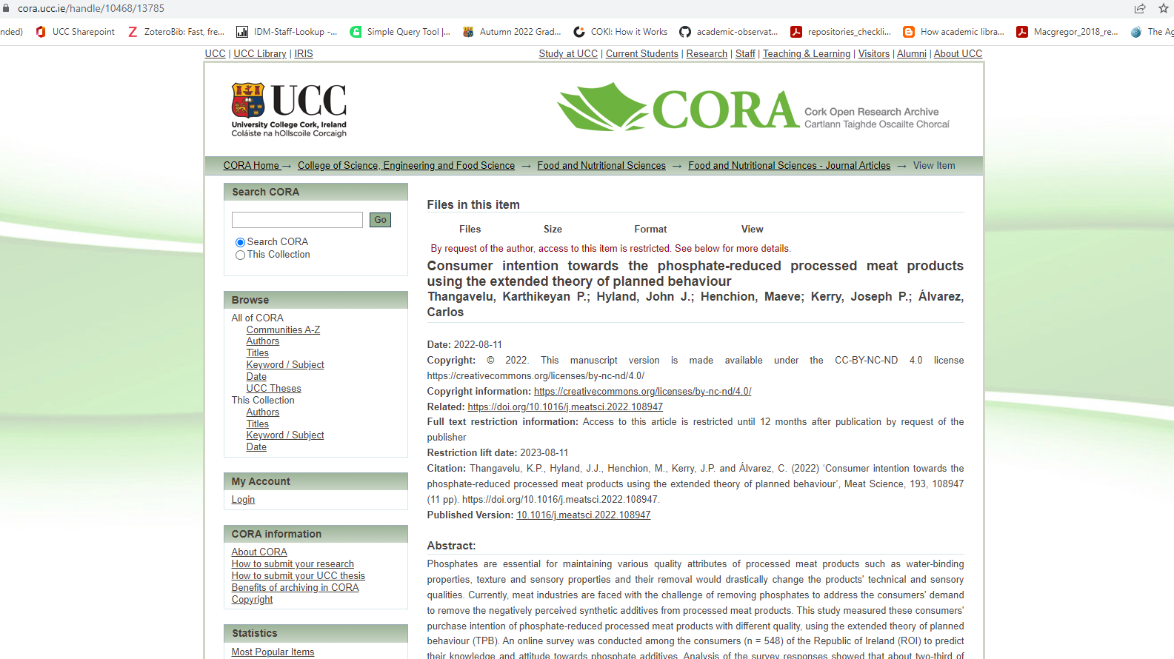
Example of embargoed fulltext
http://hdl.handle.net/10468/13785

Slide 26
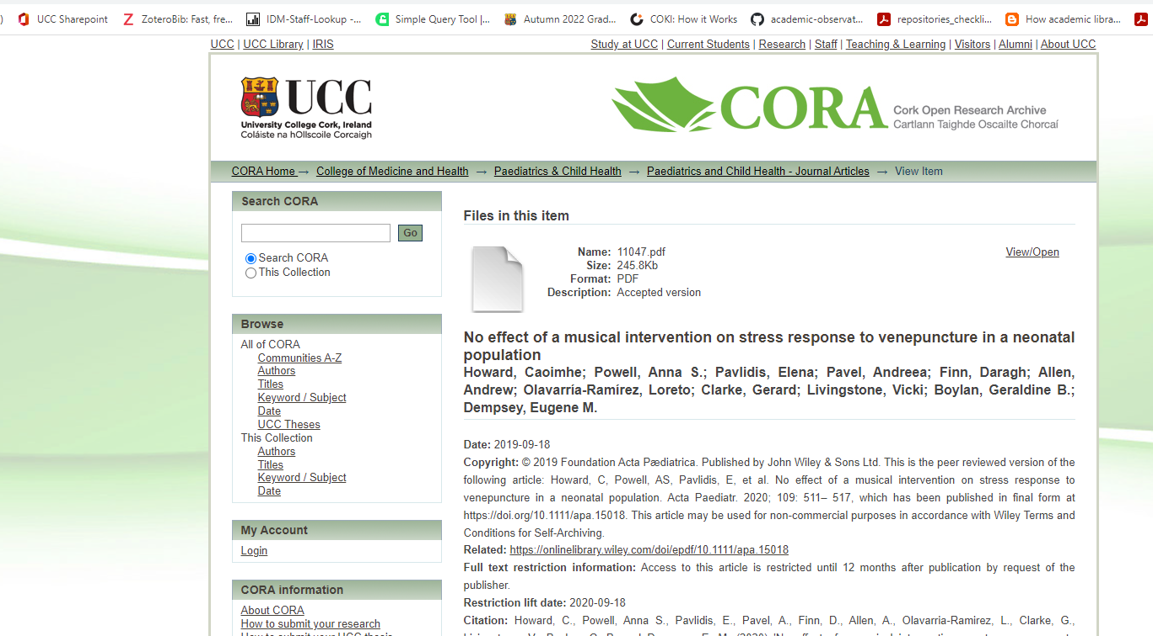
Embargo lifted. Fulltext AV available
http://hdl.handle.net/10468/9804

Slide 27
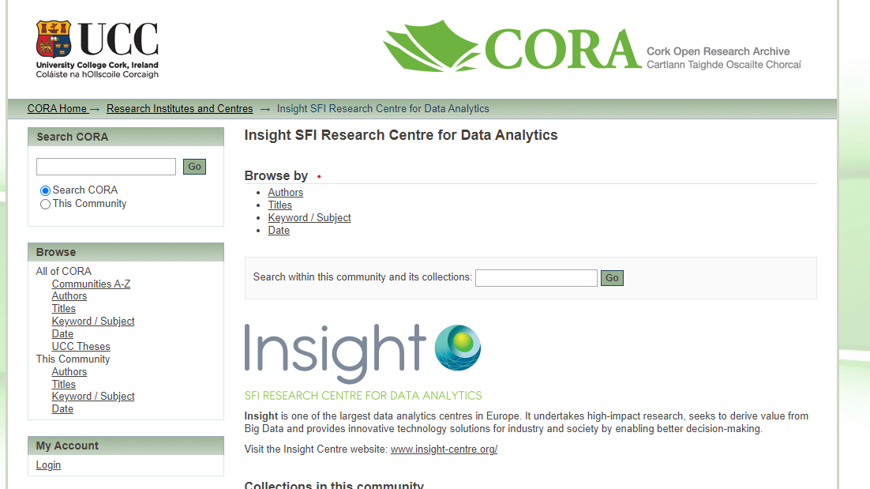

Slide 28
How to Add Materials to CORA
DIY: Do it yourself
Send your publications via e-mail cora@ucc.ie
Upload publications through your IRIS profile
PhD students submit their doctoral etheses through CORA

Slide 29
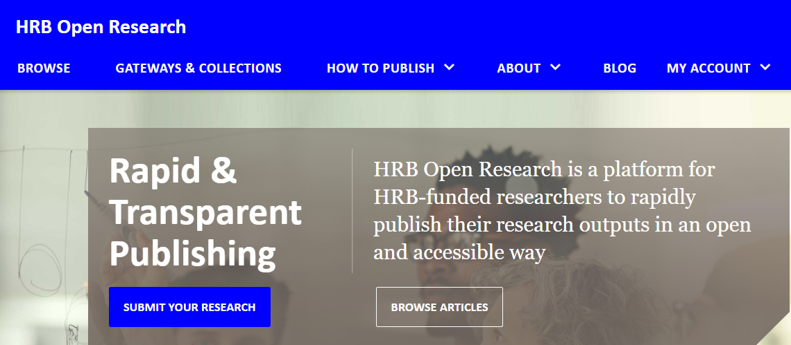
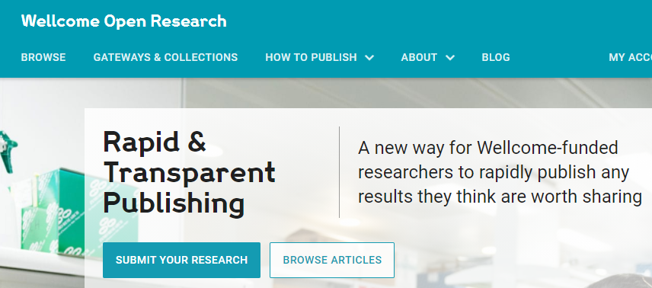
Funder Publishing Platforms

Slide 30
Publish your research - licence options:
Licence Options - Codes/Licence Name
CC Zero Public Domain CC BY Attribution CC BY-SA Attribution - Share Alike CC BY-NC Attribution - Non Commercial CC BY-NC-SA Attribution - Non Commercial - Share Alike CC BY-ND Attribution - No Derivatives CC BY-NC-ND Attribution - Non Commercial - No Derivatives

Slide 31
Gold Open Access
Accessible immediately at the point of publication
Author may have to pay article processing charges (APCs) once an article has been accepted for publication
Author retains copyright and readers are granted reuse rights
Publisher managed
Notes:
UCC as a member of the IrEL consortium have access to an annual allocation of pre-paid APCs – contact the CORA Team to ascertain if there is funding available to support publishing your papers open access immediately.
The CORA team oversee the APC process in UCC, encouraging researchers to avail of APCs where available

Slide 32
IReL Transformative Agreements –
funding Open Access publishing for UCC authors
UCC, via IReL have secured several 'Transformative Agreements' with publishers that typically allow corresponding authors from eligible institutions to publish their articles open access immediately on publication. These Article Publishing Charges (APCs) have been prepaid for a large number of articles with a wide range of publishers.
To confirm if your proposed journal is eligible for a funded APC please check the link below: https://libguides.ucc.ie/OAagreements or email libraryapcs@ucc.ie.
To avail of funded APCs UCC authors must meet the following criteria, when their article is accepted for publication:
You must be listed as the corresponding author.
You must include ‘University College Cork’ in your affiliation details.
You should use your UCC email address: @ucc.ie , @tyndall.ie.
See: https://libguides.ucc.ie/OAagreements
Notes:
To avail of funded APCs UCC authors must meet the following criteria, when their article is accepted for publication:
You must be listed as the corresponding author.
You must include ‘University College Cork’ in your affiliation details.
You should use your UCC email address: @ucc.ie
Funding is limited and a number of agreements are expired . . Till January 2023

Slide 33
2023 IReL Transformative agreements with publishers:
Association of Computer Machinery (ACM)
American Chemical Society (ACS)
American Institute of Physics (AIP)
American Psychological Association (APA)
Annual Reviews
BMJ Journals
Cambridge University Press
Company of Biologists
Electrochemical Society
Elsevier (Science Direct)
Emerald
IEEE
Institute of Physics (IOP)
Microbiology Society
Optica Publishing Group
Oxford University Press
PLOS Public Library of Science
Rockefeller University Press
Royal Irish Academy
The Royal Society
The Royal Society of Chemistry
Sage
Springer
Taylor & Francis
Wiley
Notes:
Irel has negotiated agreements with the following publishers – the CORA team oversee the APC process in UCC ensuring that researchers can avail of funded APCs
The funds have already run out in a few of the agreements.
A new tranche of APCs will be released in January 2023

Slide 35
For UCC authors
https://libguides.ucc.ie/OAagreements
On submission:
All UCC authors should ensure ‘University College Cork’ is included in affiliation details
All UCC corresponding authors should use UCC email address: @ucc.ie
Where applicable, accept publication under Transformative Agreement in submission workflow
SFI/Wellcome/PlanS-funded authors must include standard text on Rights Retention in the body of the submitted manuscript:
On acceptance:
UCC authors should continue to send the Author Accepted Manuscript (AAM) to CORA (via IRIS or cora@ucc.ie
Library staff will approve articles eligible under Transformative Agreements via publisher workflow systems
Library staff will process AAM and make it or the “version of record” (VoR) available on CORA

Slide 36
Diamond / Platinum Open Access
Immediate Open Access publication by the journal or book publisher without payment of a fee. Copyright may be retained by the author and permission barriers to share, or reuse are generally removed.
UCC Library Services support Diamond Open Access publishing though OJS – eg The Boolean and Scenario.
Other OA publishing options include: DOAJ Open Research Europe , Open Library of Humanities

Slide 37
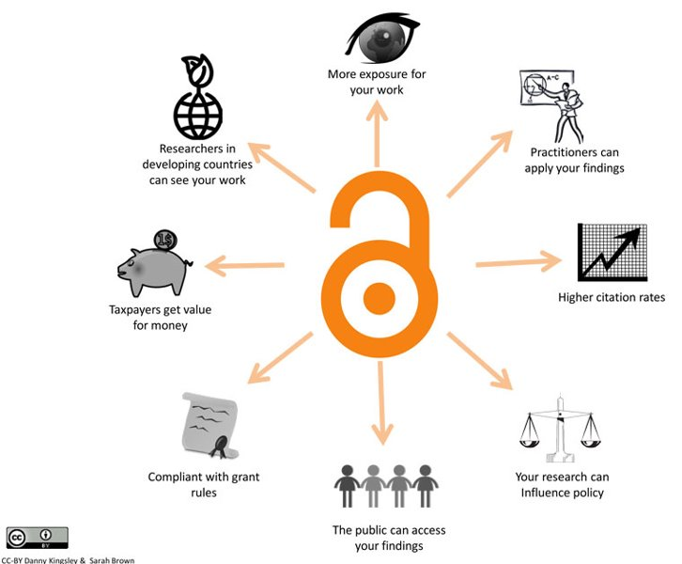
Benefits of Open Access Publishing
Notes:
Pease see the benefits of OA publishing

Slide 38
To publish your research contact:
The CORA Team: Cora@ucc.ie
(Gill, Liz, Siobhan & Donna)
OA Article Publishing Charge queries: libraryapcs@ucc.ie
The Scholarly Communications Librarian: donna.odoibhlin@ucc.ie
More info:
https://libguides.ucc.ie/OAatucc/home
http://libguides.ucc.ie/theses/etheses

Slide 39
Questions?
Thanks.
Donna

