Slide 1


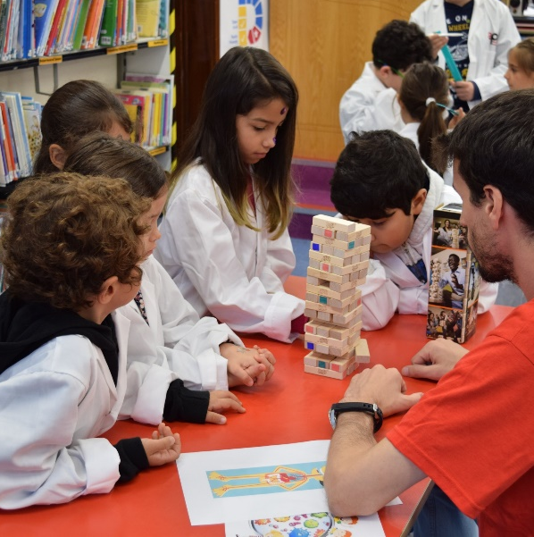


Civic and Community Engagement
Civic Engagement in the Curriculum

Slide 2
Quick Introduction
Dr Ruth Hally
Civic and Community Engaged Learning Officer
CIRTL, Teaching and Learning Office.

Slide 3


Slide 4
Quick Introduction
Your name, your research area, and
What’s your impression/understanding of civic and community engagement?

Slide 5
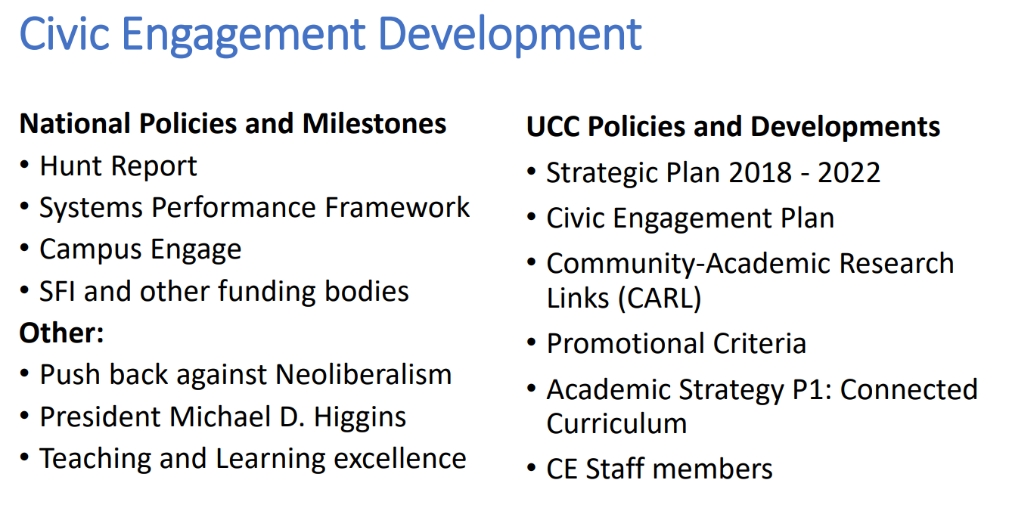

Slide 6
What and Why Civic Engagement in H.Ed?
The world is on fire…let’s work together
The 3rd mission (public money, public good)
To engage staff and students with critical issues
  Action the Sustainable Development Goals and Education for Sustainable Development

Slide 7

What is Community Engaged Learning?
Notes:
Play until 1.40
This is just one rationale as to WHY get involved in CE. You could look to many different sources to

Slide 8
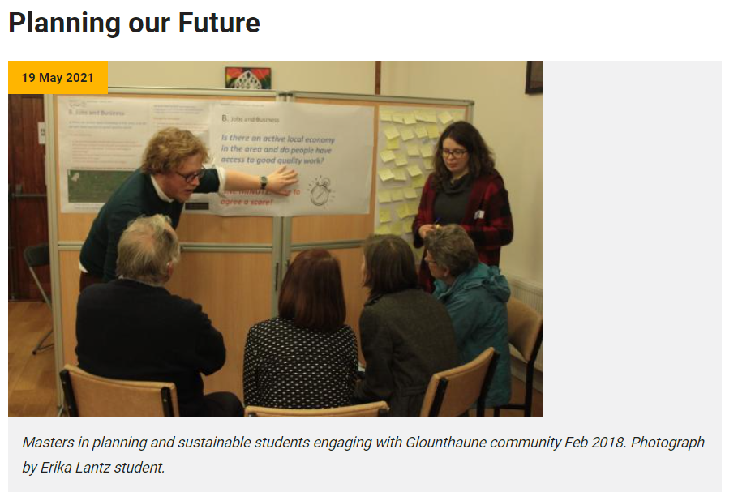

Examples of CEL

Slide 9

Examples of CEL

Slide 10
Thank you
ruth.hally@ucc.ie

