Slide 1

Welcome to UCC Innovation
UCC HR
Online sessions for Research Staff
Commercial Awareness and Knowledge Transfer

Slide 2
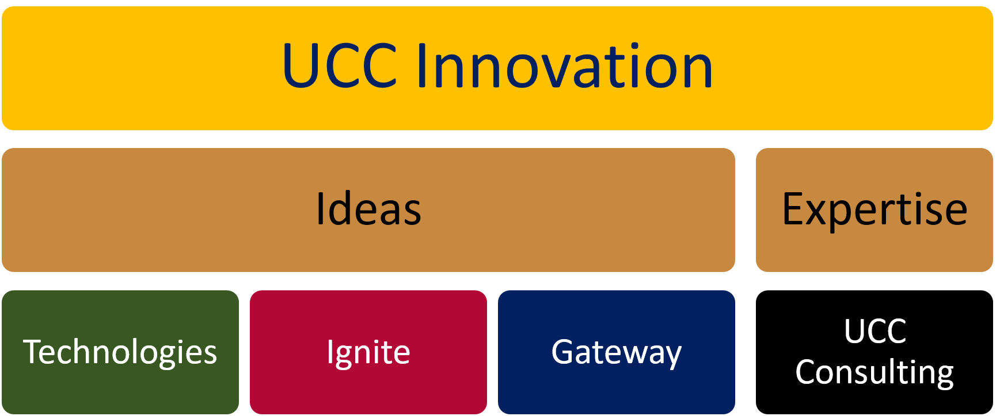
About Us
Getting UCC's ideas and expertise to the commercial arena to
  benefit society,
  impact on the economy
  provide a return to the university to further advance its research mission
National Leader in Licenses, Inventions
Active spinout establishment and development programme
Purpose for this presentation
  Introduce ourselves
  Explain why commercialisation is a part of your future
  Explain how it gets done in universities
Interview all internal customer groups | Identify service needs | Align approach
Identify IP opportunities | Develop commercialisation strategies | Execute contractual obligations

Slide 3
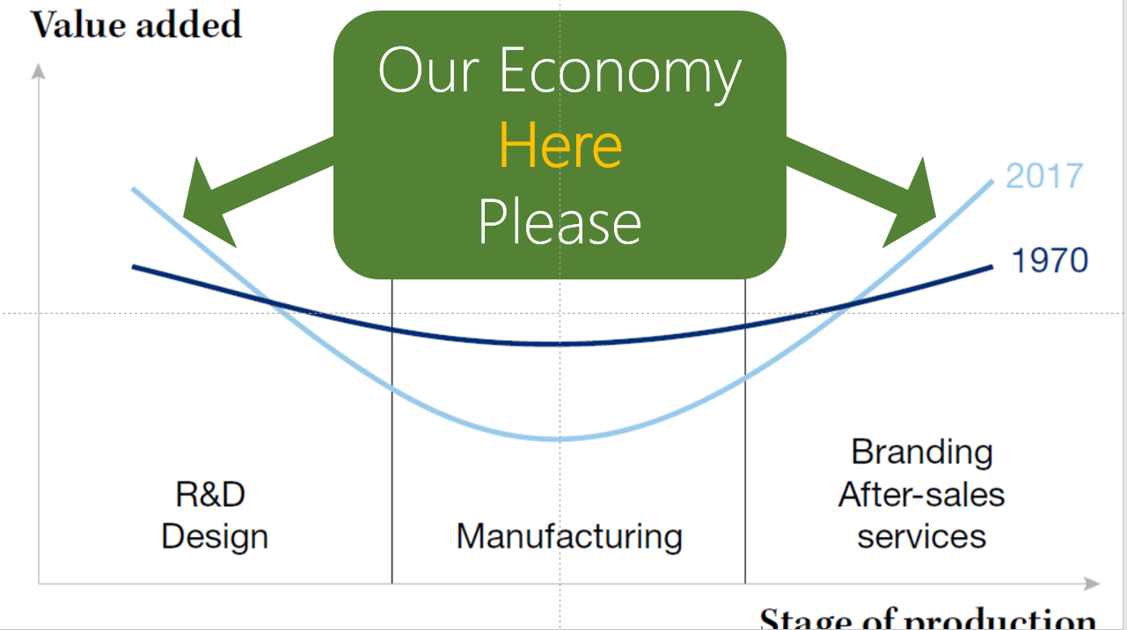
Our Economy
Here
Please

Slide 4
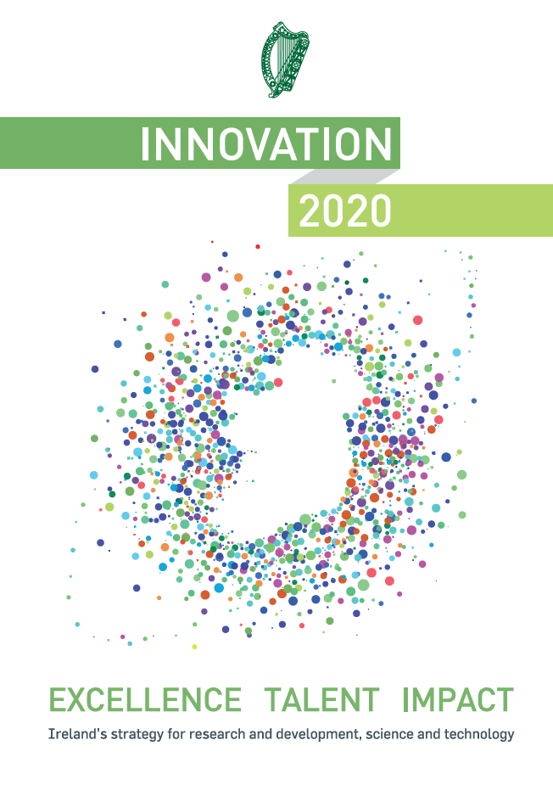
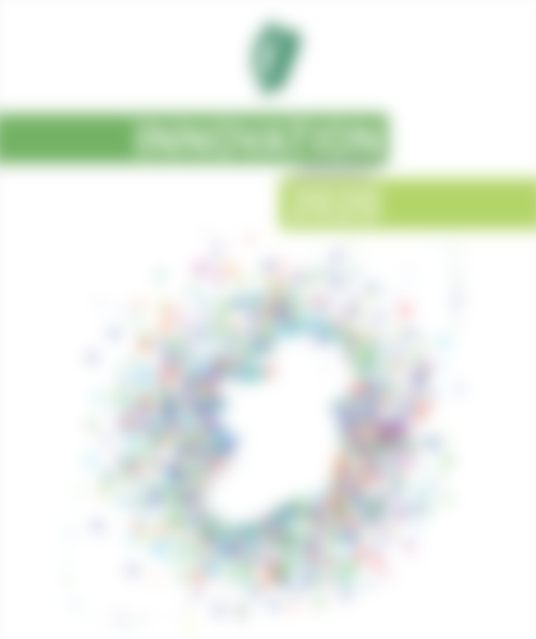
VISION
“ENHANCE IMPACT OF RESEARCH & INNOVATION FOR ENTERPRISE”

Slide 5
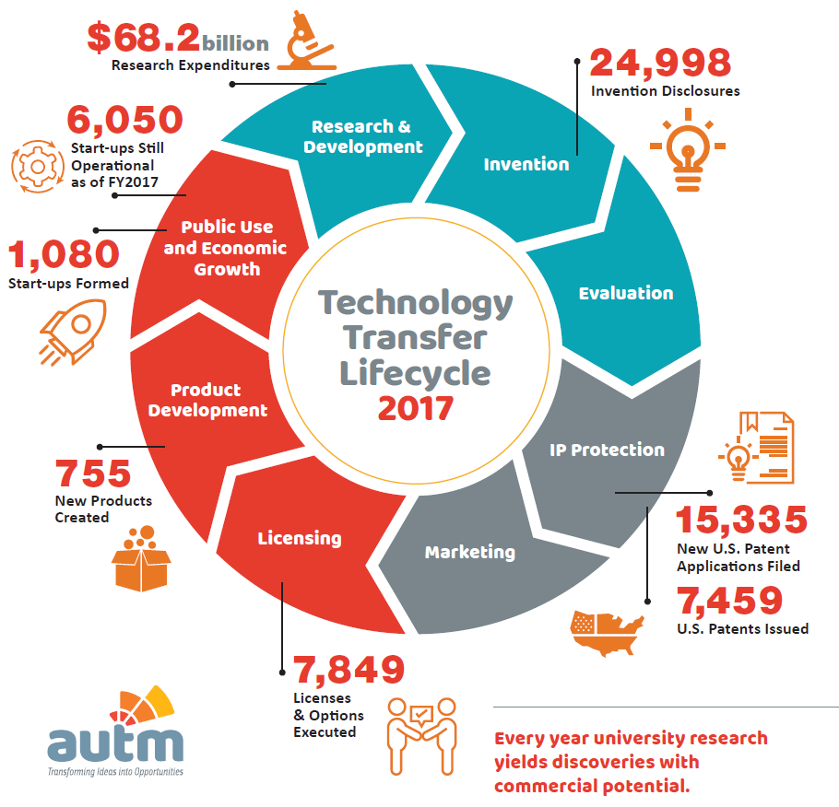

Invention Disclosure Form
What is the Innovative part?
Who came up with the innovative part?
Who paid for the work?
Who might want it?
IMPACT

Slide 6
Technology Commercialisation Process
Identify
Evaluate
Protect
Market
Deal
Relationship
Internal marketing
Researcher meeting
IDF Prep
IDF submission
Customer Readiness Level (CRL)
Technology Readiness Level (TRL)
Business Readiness Level BRL)
IPR Level (IPRL)
Team Readiness Level (TMRL)
Funding Readiness Level (FRL)
Priority
PCT
Nationalise
Write profile
Promote
Online
In print
Phone
Valuation
Term sheet
Template agreements
Sign off
Annual royalty report
Technology "forward due diligence"
Research collaboration
Royalty audit

Slide 7

UCC Technologies
Invention Disclosure Form
What is the Innovative part?
Who came up with the innovative part?
Who paid for the work?
Who might want it?
Identify

Slide 8
PATENT when
There is an Innovation
UCC owns the Innovation
The Innovation has potential
The innovation is patentable
Before Publication
WHEN
TO
PATENT
Vs
PUBLISH

Slide 9


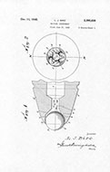
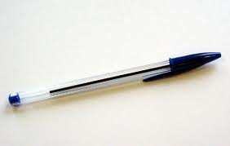

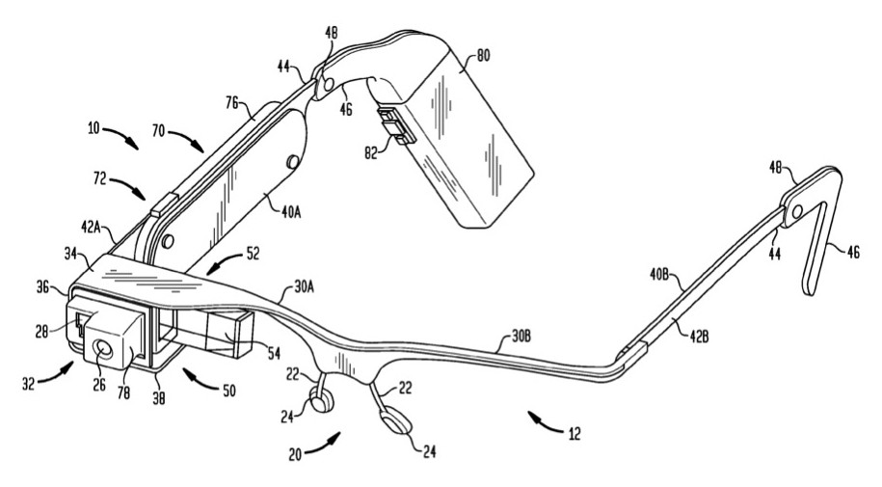
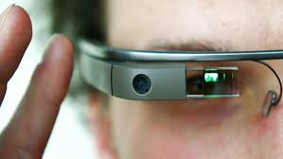

Slide 10
Forms of Protection
Patent
Copyright
Know-How
Open-source
PROTECT

Slide 11
Patent
Negative Right
Novelty
Utility
Non-Obviousness
PROTECT

Slide 12
Copyright
Arises
“Right to Copy” – NOT the idea
Not Registered
© UCC 2021
PROTECT

Slide 13
Outputs
License
Spin-Out Company
Research Collaboration
Consultancy
DEAL

Slide 14
Impacts
Jobs
Products
Partnership
Revenue
SUCCESSFUL
RELATIONSHIP

Slide 15
Impacts
Extended Network
Competitive Advantage
Income
BENEFITS

Slide 16
UCC owns the IP
Talk to UCC Innovation….early
Don’t publish….yet
Use Confidentiality Agreements
Leave a Forwarding Address
ACTIONS

Slide 17
Technologies UCC
uccinnovation@ucc.ie
+353-21-4205880
http://techtransfer.ucc.ie
Linkedin & Twitter
CONTACT US

