Slide 1




Mary Kate O’Regan
HR BUSINESS MANAGER
HR RESEARCH
@marykateucc
#HRS4R

Slide 2
Order of Speakers today
HR Research
Anthony Morrissey of UCC Innovation
Donna O’Doibhlin Research and Digital Services Boole Library
Dr David O’Connell UCC Research
Questions and Answers

Slide 3

Who we are
Mary O’Regan marykate.oregan@ucc.ie
Niamh Buckley Niamh.buckley@ucc.ie
Orla Sharpe Osharpe@ucc.ie
HR Research UCC
TEAM

Slide 4

What we do
Personal & Professional Development
Career Management Structure
Recruitment
Contract Management
Salary Administration
HR Research UCC

Slide 5

European Charter for Researchers: What is it?
Set of general principles and requirements which specify the:
Roles
Responsibilities
Entitlements
Of Researchers in the European Research Area

Slide 6

Who does it apply to?
It applies to Researchers, Employers and Funders
It also includes a code of conduct for the recruitment of researchers
Included in:
Horizon Europe grant agreements

Slide 7
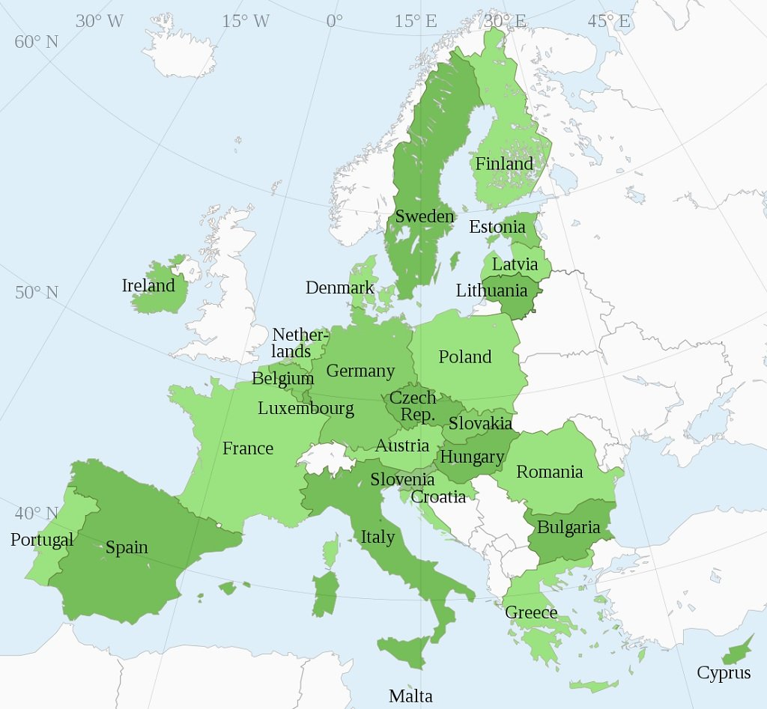

European Union and European Universities
Governance
Employment Law
Recruitment Processes
Terms and Conditions
Career Progression

Slide 8

HR Excellence in Research Award
4 Thematic Areas
Ethical and Professional Aspects
Recruitment (OTM-R)
Working Conditions & Social Security
Training and Development

Slide 9

Advantages of HR Excellence in Research
Adds value to funding applications ​
Demonstrates a commitment to good working conditions and career development for researchers​
It promotes this commitment to researchers who might be considering moving to your institution. ​

Slide 10

Real Examples: Advantages
1038
Research Staff
HR Excellence in Research
Post Doc Development Hub
Professional Skills for Research Leaders
CV assistance and
advice
The Odyssey
Program
New Policy and Guidelines
Remember
10 years ago UCC had none of these offerings

Slide 11


UCC Researcher career framework
Post Doc to Senior Post Doc
Research Fellow to Senior Research Fellow
Grant writing
Ethics in research
Communication skills
Presentation skills
Career planning
CV job applications & interview techniques
Working with PhD students
Funding applications
Leadership training
Grantsmanship
Managing a research team
Negotiation skills
Commercialisation and IP
Teaching and Learning
Progression occurs through open transparent and merit based recruitment

Slide 12
A few dates……
2013
HR Excellence in Research Award
2014
Post Doc Development Hub.
2015
Professional Skills for Research Leaders.
2016
Research Staff Surveys.
2018
Odyssey Pilot Programme launched
2021
2024
2024
2022
HR Excellence in Research Award Renewal for Second time!
Horizon Europe Project CARDEA
HR Excellence in Research Award Renewal application for Third time!
Pilot Advancing your research career for RSO’s

Slide 13



HEA Odyssey Programme
National Roll-Out
Mary Kate O'Regan
HR Business Manager Research
PI CARDEA Horizon Europe

Slide 14
Our hr research website
https://www.ucc.ie/en/hr/research/

Slide 15
Training Available to research staff in ucc
https://www.ucc.ie/en/hr/research/researchertraining/
https://www.ucc.ie/en/hr/wellbeingdevelopment/

Slide 16


Staff Ombudsman
The Ombudsman provides a confidential and impartial forum where staff can discuss matters which trouble them.
The Ombudsman can recommend possible courses of action to facilitate solutions and to arrange meetings with those within the University who are tasked with the management of the particular difficulty.
The Ombudsman will take no action without the full permission of the person who has consulted them.
The office phone is not normally attended, so the best way to contact them is by email which they check regularly - staffombudsman@ucc.ie
Tom Cotter t.cotter@ucc.ie Mary McNulty mmcnulty@ucc.ie Ger Fitzgerald g.fitzgerald@ucc.ie

Slide 17
Staff id cards
New Staff please email at staffidcards@ucc.ie

Slide 18

UCC’s Bystander Intervention Programme educates and empowers staff and students to recognise and respond to incidents of sexual harassment and violence and other forms of unacceptable behaviour in study, work and social environments.
Completing this training will impact positively on your own university experience by cultivating a shared responsibility and capacity to contribute to a safe and respectful staff and student experience.
Watch the Introductory video here
Register for the UCC Bystander Intervention Digital Badge and develop your ability to contribute to a safer campus experience
To register go to bystanderintervention.ucc.ie

Slide 19

IFUT - UCC Branch
Irish Federation of University Teachers
The trade union representing academic staff, researchers, and librarians within UCC
Open to all, regardless of contract status (full-time, part-time, temporary)
Affiliated to the Irish Congress of Trade Unions
UCC Branch Chair: Dr Edward Lahiff
Secretary: Dr Jacqui O’Riordan
Researcher Coordinator: Dr Brendan Palmer
Web: www.ifut.ie
Email: UCC@ifut.ie

Slide 20

SIPTU
https://www.siptu.ie/
SIPTU Rep UCC is Gary Hurley
G.hurley@ucc.ie

Slide 21
Research Staff Association
Link to UCC RSA web pages

Slide 22




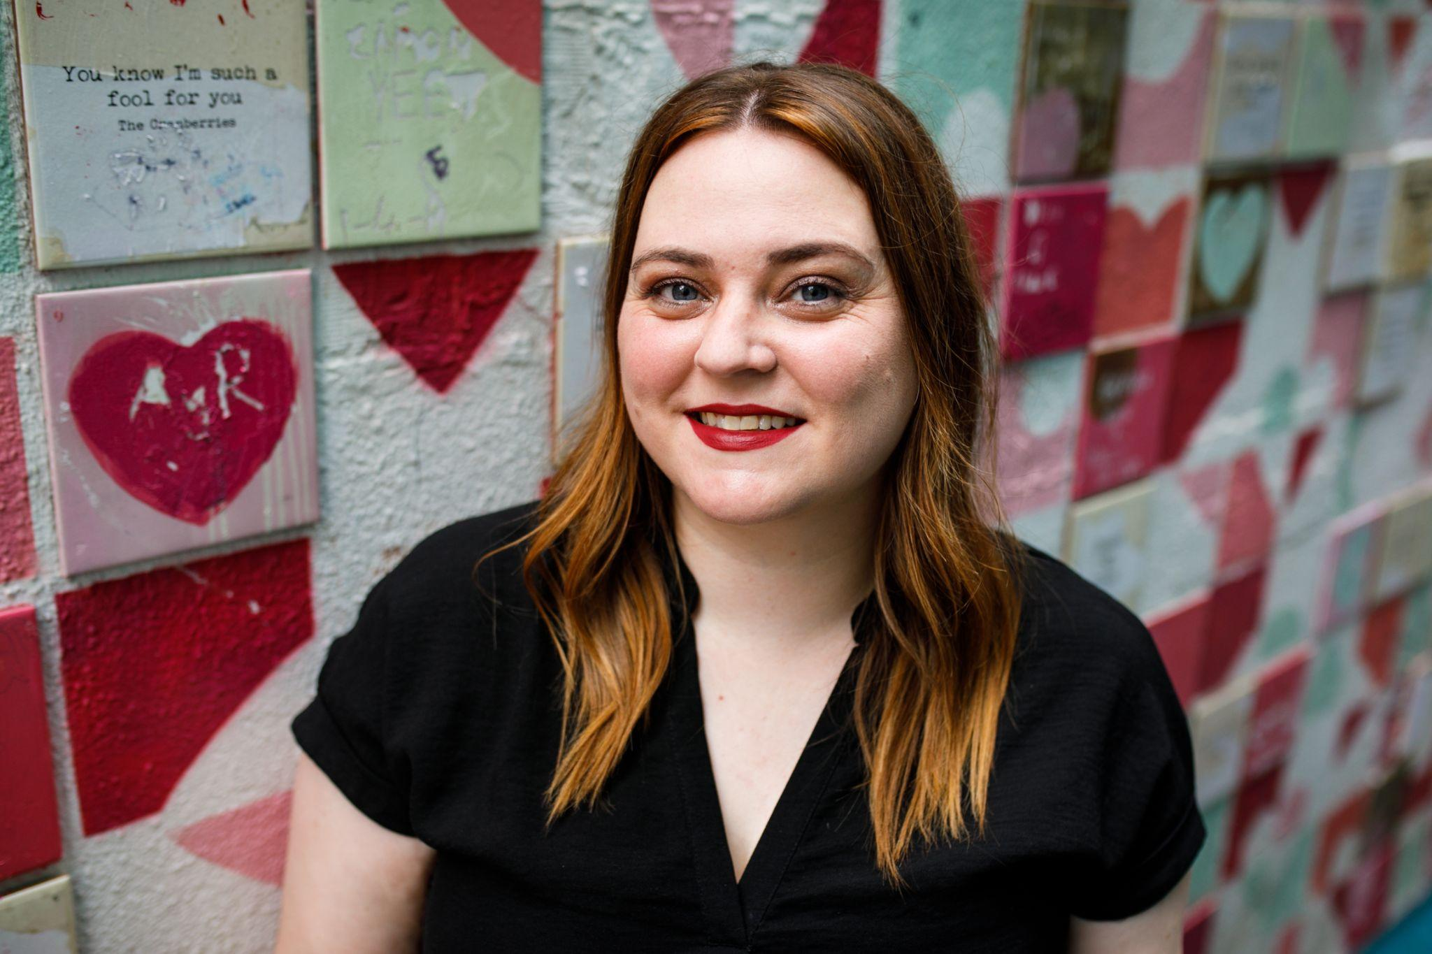
Dr Caroline West, Sexual Violence and Harassment Prevention and Response Manager
cwest@ucc.ie
Based in the South Gate Lodge
Information sessions on Sexual Violence policy will be held from March onwards
Collaborations most welcome for our Safe & Sound campaign

Slide 23

Thank you for your time

