Slide 1


Research Staff orientation
Mary o’regan
Human resources ucc

Slide 2


Slide 3
Who we are
Mary O’Regan marykate.oregan@ucc.ie
Laura McSweeney l.mcsweeney@ucc.ie
Niamh Buckley Niamh.buckley@ucc.ie
Kasia Wloch katarzyna.wloch@ucc.ie
Louisa O’Reilly louisaoreilly@ucc.ie
HR Research UCC

Slide 4

What we do
Personal & Professional Development
Career Management Structure
Recruitment
Contract Management
Salary Administration
HR Research UCC

Slide 5

Our hr research website
https://www.ucc.ie/en/hr/research/

Slide 6

Charter and code : What is it?
Set of general principles and requirements which specify the:
Roles
Responsibilities
Entitlements
Of Researchers in the European Research Area

Slide 7

Who does it apply to?
It applies to Researchers, Employers and Funders
It also includes a code of conduct for the recruitment of researchers
Included in:
Article 32 of the H2020 model grant agreement – and on Horizon Europe grant agreements

Slide 8
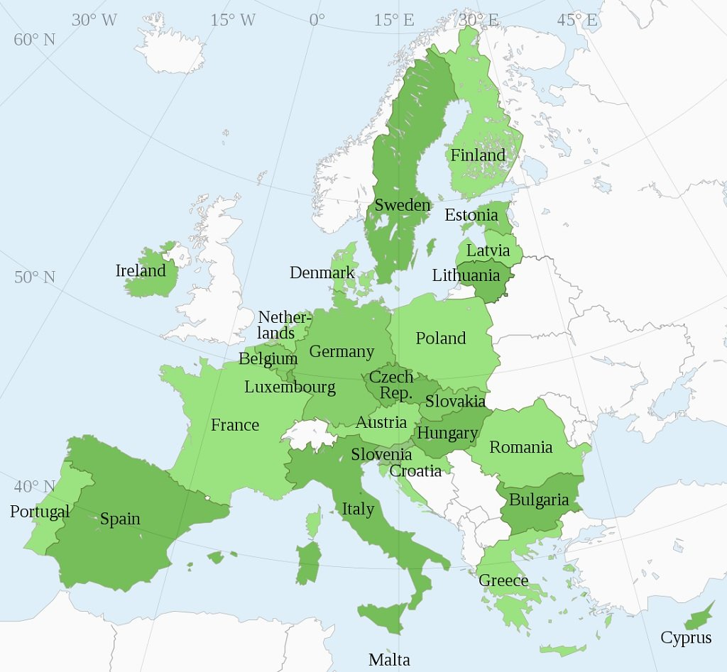

European Union and European Universities
Governance
Employment Law
Recruitment Processes
Terms and Conditions
Career Progression

Slide 9

HR Excellence in Research Award
4 Thematic Areas
Ethical and Professional Aspects
Recruitment (OTM-R)
Working Conditions & Social Security
Training and Development

Slide 10

Real Examples: Advantages
1004
Research Staff
HR Excellence in Research
Post Doc Development Hub
Professional Skills for Research Leaders
HR Researcher Conference
CV assistance and
advice
The Odyssey
Program
New Policy and Guidelines
Remember
Seven years ago UCC had none of these offerings

Slide 11

UCC Researcher career framework
Post Doc to Senior Post Doc
Research Fellow to Senior Research Fellow
Grant writing
Ethics in research
Communication skills
Presentation skills
Career planning
CV job applications & interview techniques
Working with PhD students
Funding applications
Leadership training
Grantsmanship
Managing a research team
Negotiation skills
Commercialisation and IP
Teaching and Learning
Progression occurs through open transparent and merit based recruitment

Slide 12
A few dates……
2013
HR Excellence in Research Award
2014
Post Doc Development Hub.
2015
Professional Skills for Research Leaders.
2016
Research Staff Surveys.
2018
Odyssey Programme launched
2021
HR Excellence in Research Award Renewal for Second time!

Slide 13


Staff Ombudsman
The Ombudsman provides a confidential and impartial forum where staff can discuss matters which trouble them.
The Ombudsman can recommend possible courses of action to facilitate solutions and to arrange meetings with those within the University who are tasked with the management of the particular difficulty.
The Ombudsman will take no action without the full permission of the person who has consulted them.
Bettie Higgs B.Higgs@ucc.ie Gavin Burnell g.burnell@ucc.ie Tom Cotter t.cotter@ucc.ie

Slide 14
Staff id cards
New Staff please email Valerie O'Brien at staffidcards@ucc.ie Val will then send you a link to a form to complete which will allow you to upload your photo. Val will save it and upload to CoreBadge and can then generate a new staff card. It will be posted out to your home address.

Slide 15

UCC’s Bystander Intervention Programme educates and empowers staff and students to recognise and respond to incidents of sexual harassment and violence and other forms of unacceptable behaviour in study, work and social environments.
Completing this training will impact positively on your own university experience by cultivating a shared responsibility and capacity to contribute to a safe and respectful staff and student experience.
Watch the Introductory video here
Register for the UCC Bystander Intervention Digital Badge and develop your ability to contribute to a safer campus experience
To register go to bystanderintervention.ucc.ie

Slide 16

IFUT - UCC Branch
Irish Federation of University Teachers
The trade union representing academic staff, researchers, and librarians within UCC
Open to all, regardless of contract status (full-time, part-time, temporary)
Affiliated to the Irish Congress of Trade Unions
UCC Branch Chair: Dr Edward Lahiff
Secretary: Dr Jacqui O’Riordan
Researcher Coordinator: Dr Brendan Palmer
Web: www.ifut.ie
Email: UCC@ifut.ie

Slide 17
Research Staff Association
Link to UCC RSA web pages

Slide 18
Any questions?
Up next
Niamh Mundow of the Research Support Services UCC
David Corkery Innovation UCC

