Slide 1
Leadership for Research Team Leaders
Dr Anne Gannon
Friday 11th November 2022

Slide 2
LEARNING OBJECTIVES
Reflect on the strengths and attributes of effective research leaders and the approaches and behaviours that each researcher demonstrates as a current or potential leader
Introduce researchers to definitions and ideas of leadership
Briefly explore the difference between leadership and management
Consider the advice which successful research leaders offer in achieving research success
Review the model of Action Centred Leadership (Adair, 1973)
Next steps – taking action to grow your leadership expertise

Slide 3
Reflection……………
From your own experience, what makes a researcher an effective research leader?
What are the approaches and behaviours that demonstrate strong and effective research leadership?
What are the approaches and behaviours that I myself currently practice in demonstrating research leadership in my role?
What approaches and behaviours would I like to develop further in becoming an effective research leader?

Slide 4
Definitions
A research team is a group of people working together in a committed way towards a common research goal (vitae.ac.uk)
Leadership is influencing others people to follow…
Effective leadership enables followers to succeed. It sets direction, builds a vision and adapts as circumstances require.
A good leader creates a vision of the future, works well with a team, enables their team’s success and demonstrates flexibility (Emerald Works, 2021)

Slide 5

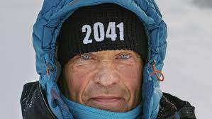
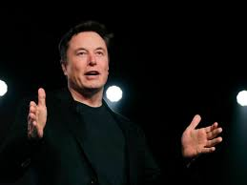
What is a leader?
Notes:
The word leader can evoke different images – political leaders pursuing passionate, personal causes as this week at Cop27– an explorer courageously leading others through intrepid terrain – Robert Swan has walked both poles and is an advocate for the protection of Antartica and renewable energy. A leader such as Elon Musk although controversial may be an executive or entrepreneur strategizing to enable the delivery of impactful visionary goals

Slide 6
What is the difference between leadership and management?
Leadership and Management are not the same thing. They are distinctive, yet complementary processes.
Leaders are forward-thinking and change-oriented while managers focus on consistency and efficiency in accomplishing tasks
Theories of leadership often emphasise mechanisms such as vision, inspiration, and relationships aimed at influencing people
Models of management focus on mechanisms such as planning, directing, and organising aimed at overseeing work
Notes:
Antes, A.L., Mart, A. and DuBois, J.M., 2016. Are leadership and management essential for good research? An interview study of genetic researchers. Journal of Empirical Research on Human Research Ethics, 11(5), pp.408-423.

Slide 7
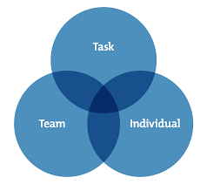
Action Centred Leadership (John Adair, 1973)
John Adair’s model looks at what an effective leader needs to do
rather than the characteristics they need to display.
An effective leader addresses the needs of the
TASK
TEAM
INDIVIDUAL

Slide 8
Identifying the role of the Research Leader
Action Centred Leadership (The 3 circles model) (John Adair, 1973) identifies the core actions you must take to lead your team effectively. These actions are grouped into three areas:
Task: the actions that you take to achieve a goal.
Team: your actions at the group level, to encourage effective teamwork and group cohesion.
Individual: actions that address each team member's unique needs.

Slide 9
What advice do current research leaders offer?
“Science must come from the heart.
Treat everyone with respect.
Listen.
Be authentic.
Ask for help.
Don’t be afraid to say you don’t know.
Communicate.
Put your mentees first.
Don’t give up.
Stay humble.
Be honest with yourself.
Give yourself time to think”
(Antes & DuBois, 2018)
Notes:
Antes, A.L. and DuBois, J.M., 2018. Cultivating the human dimension in research. Molecular cell, 72(2), pp.207-210.

Slide 10
Keys for Researcher Success
Integrity 19%
Balance 21%
Strategy 29%
Leadership 33%
Resilience 37%
Passion 42%
Relationships 54%
52 well-respected principal investigators were interviewed to uncover for their top advice for early-career researchers.
Most research participants offered several pieces of advice, which were organised into a number of themes

Slide 11
Demonstrating the 7 keys to success in research
Cultivate relationships and draw strength from others. Build a rich network of great colleagues and be willing to learn from others.
Do research you are passionate about and find joy in your work.
Be resilient in response to criticism and failure. Learn from failures and do not take criticism personally. Believe in what you are doing.
Be an engaged, respectful team leader. Be deliberate about building your team, interact with your team members regularly, and take time to listen.

Slide 12
Demonstrating the 7 keys to success in research
Stay focused, make strategic decisions with your goals in mind and advocate for yourself
Adopt a balanced approach – have interests outside work and give yourself time to think.
Demonstrate integrity by committing to the required hard work, be honest with yourself and remember that cutting corners never pays

Slide 13
How to grow your leadership expertise
Participate in a leadership development programme – as these require professionals to do something they often fail to do: stop and reflect (Porter, 2017 as cited by Antes & DuBois, 2018).
Work with a coach or a mentor. Seek advice, support and feedback from others
Build relationships and grow your network
Take on more responsibility and seek opportunities to work with others
Develop greater self awareness and practice reflective learning regularly
Notes:
Antes, A.L. and DuBois, J.M., 2018. Cultivating the human dimension in research. Molecular cell, 72(2), pp.207-210.

Slide 14
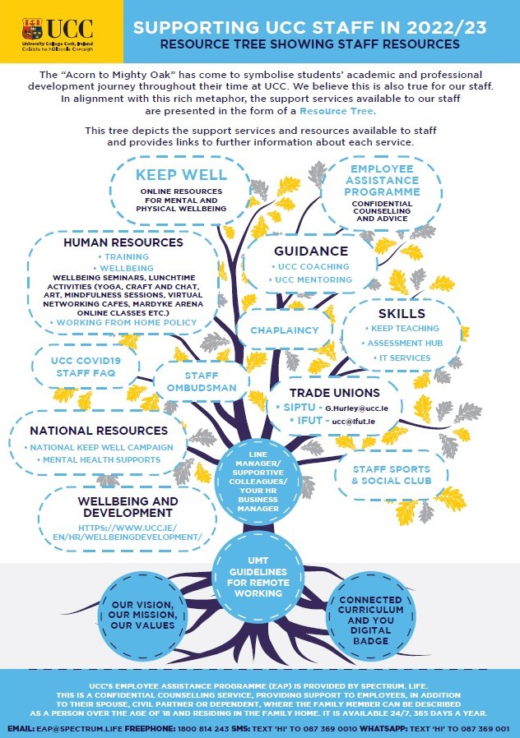
Resource Tree Showing Staff Resources

Slide 15
Your Action Plan
What action are you now going to take to become a more effective research leader?

Slide 16
Follow us on our social networks
Staff Wellbeing & Development
@UCCWellDev
@uccstaffwell_dev

